Slide 1
DIGITAL PORTFOLIO

Slide 2
DIGITAL PORTFOLIO
STUDENT NAME : ASHWIN RAJ P
REGISTER NUMBER AND NMID : 2422K156O AND asbru4q2422k156O
DEPARTMENT : BSC.COMPUTER SCIENCE
COLLEGE : KSG COLLEGE OF ARTS AND SCIENCE
UNIVERSITY : BARATHIYAR UNIVERSITY

Slide 3
STUDENT PORTFOLIO
USING FRONT END DEVELOPMENT

Slide 4
AGENDA
1.Problem Statement
Project Overview
End Users
Tools and Technologies
Portfolio design and Layout
Features and Functionality
Results and Screenshots
Conclusion
Github Link

Slide 5
PROBLEM STATEMENT
“Create a visually appealing and user-friendly digital portfolio that effectively showcases my skills, experience, and accomplishments as a (web developer/designer/etc.], while also demonstrating my ability to design and develop a professional online presence.”

Slide 6
PROJECT OVERVIEW
Brief Summary: This project is a personal portfolio website designed to showcase my skils, experience, and achievements in a clear and concise manner. The website & built using modem web development technologies and is fully responsive, ensuring a seamless user experience across various devices Portfolio Contents: The portfalo includes the following sections About Me. A brief introduction to who I am, my background, and my professional experience. D-Projects: A showcase of my notable projects, including descriptions, screenshots, and links to live demos or GitHub repositories Skalis A list of my technical skis, including programming languages, frameworks, and fools. Contact: A contact form or email address where visitors can reach out to me for Inquiries or collaboration opportunities. D-Main Idea: The primary objective of this project is to demonstrate my expertise and showcase my personal achievements, skills, and projects in a visually appealing and easy-to-navigate format. The website is designed to be a central hub for my online presence, providing a professional and modern representation of my work.

Slide 7
WHO ARE THE END USERS ?
Potential Employers: Hiring managers or recruiters looking for candidates with specific skills and experience. Clients: Potential clients or customers interested in your services or products. Industry Peers: Other professionals in your field who may be interested in your work or potential collaboration opportunities. Mentors or Advisors: Experienced professionals who can provide guidance or feedback on your work.

Slide 8
TOOLS AND TECHNIQUES
Front-end development tramewons: Such as React, Angular, which provide a structure and set of tools for building the interface CSS pre-processors: tie Sass or less, which allow for more efficient and modular CSS writing. Responsive design: Techniques such as media queries and flexible grids to ensure a seamless user experience devices Version contest: Tools lle Gif, which help track changes and collatiorate with others. Design tools: Such as Figment, Sketch, or Adobe XD, which are used to create wireltrames, prototypes, and high-fidelity designs. 4. Content management systems: Uke WordPress or Headless CMS, which can be used to manage and update content on the wetisite 7. Deployment platforms: Such as Notify, Verse, or GitHub Pages, which provide a simple and efficient way to deploy and host the website Some popular techniques include
1.Mobile-fint development: Designing and building the website for mobile devices first, then adapting it for larger screens
2. Progressive enhancement: Building the website to work for basic functionally, then adding enhancements for more advanced features.
3. Accessibility: Ensuring the website is usable by people with dhabilities, following guidelines such as the Web Content Accessibility Guidelines WCAG
4. Performance optimization, lechniques such as code spilling, lazy loading, and image compression to improve the website’s loading speed

Slide 9
PORTFOLIO DESIGN AND LAYOUT
Grid-based layout: A grid-based layout is a great way to showcase multiple projects in a clean and organized manner Masonry layout. A masonry layout is similar to a grid-based layout, but the projects are arranged in a mare organic and slaagered way Hero section: A hero section is a prominent section on the homepage that showcases a featured project or a call-to-action Project showcase. A dedicated section that showcases your projects, with images, descriptions, and links to more Intormation. Case studies: In-depth examinations of specific project, including the challenges, solutions, and results. Minimalist design: A minimalist design focuses on simplicity and clean typography, allowing the projects to take center stage Storytelling: Using narative techniques to tell the story behind your projects and your design process. Interactive elements: Incorporating interactive elements, such as animations, scrolling effects, or hower effects, to enhance the experience

Slide 10
FEATURES AND FUNCTIONALITY
1. Home/Welcome Page: A brief introduction to your portfolio, highlighting your skills and expertise. 2. About Me: A section that provides more information about your background, experience, and interests. 3. Projects: A showcase of your notable projects, including descriptions, screenshots, and links to live demos or GitHub repositories. 4. Skills: A list of your technical skills, including programming languages, frameworks, and tools. 5. Contact: A contact form or email address where visitors can reach out to you. Functionality: 1. Interactive Elements: Animations, transitions, or other interactive elements that enhance the user experience. 2. Search Functionality: A search bar that allows visitors to find specific projects or content. 3. Contact Form: A form that allows visitors to send you messages or inquiries. 4. Downloadable Resume/CV: A link to download your resume or CV. 5. Analytics: Integration with analytics tools to track visitor behavior and engagement.

Slide 11
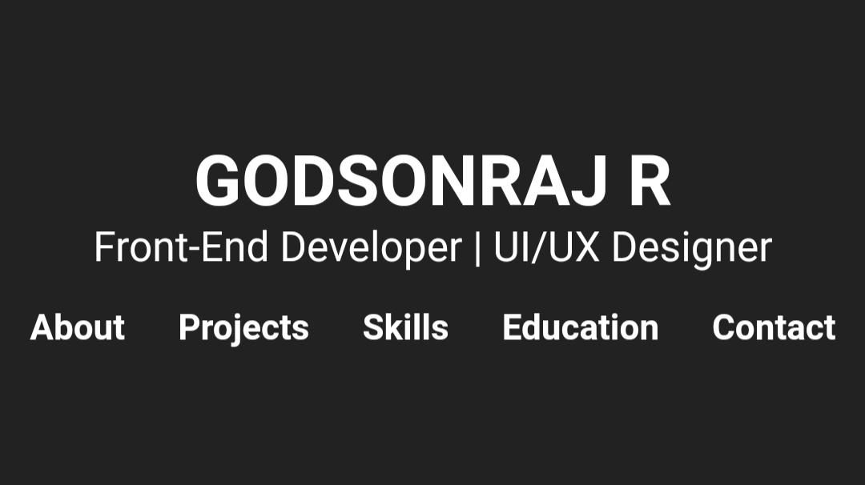
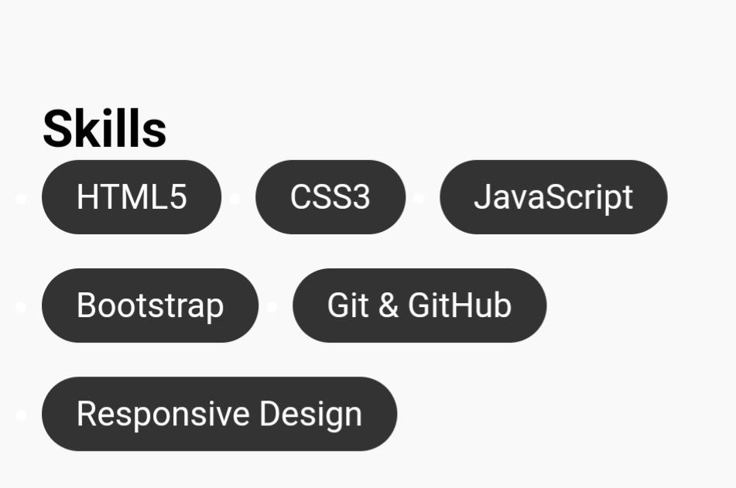
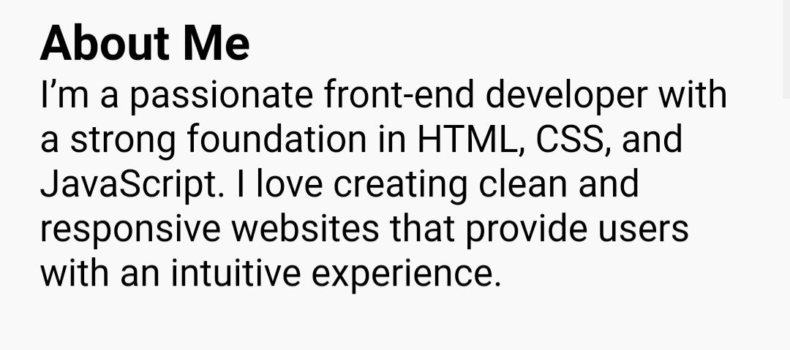
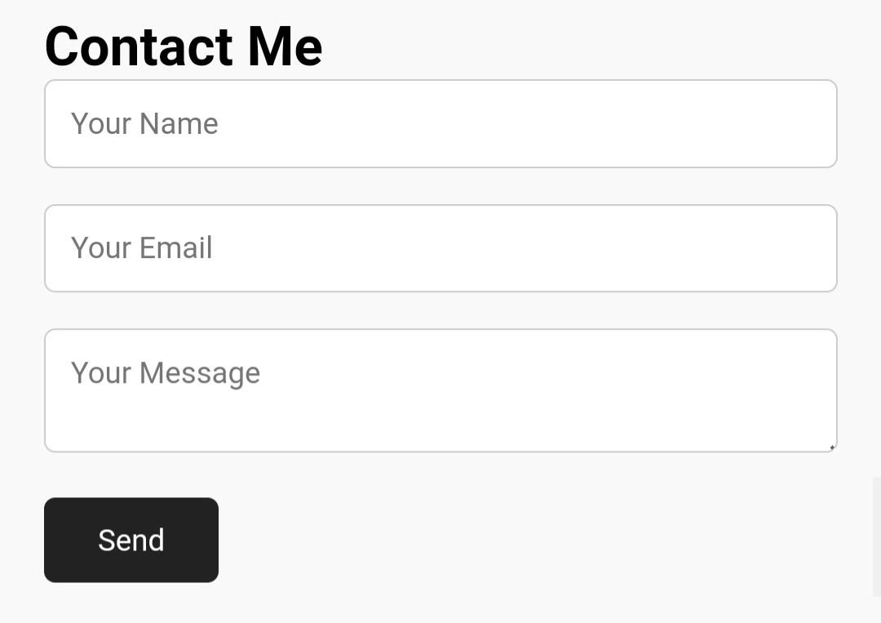
RESULT AND SCREEN SHOT

Slide 12
CONCLUSION
Thank you for visiting my presentation
my digital portfolio showcases my skills and experience. I’ve demonstrated my ability to design and develop a professional online presence. My expertise in [specific areas] is highlighted through various projects. I’m excited to collaborate with like-minded individuals and organizations. I’m committed to continuous growth and evolution. Thank you for exploring my portfolio. I welcome feedback and opportunities for collaboration.”

