Slide 1


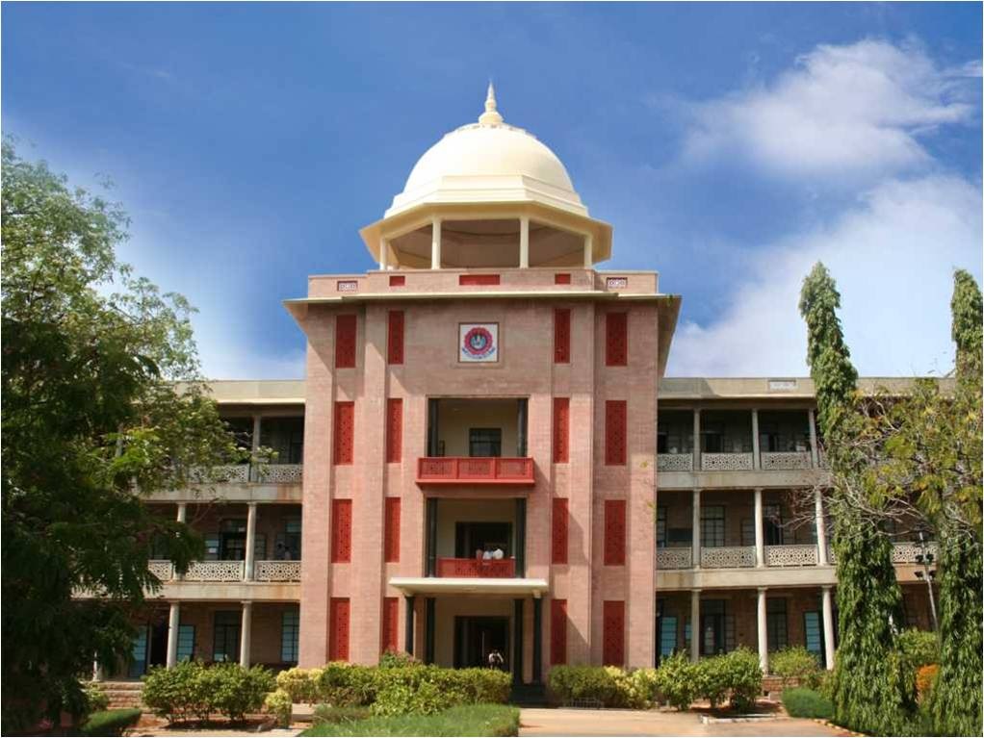
CIRCULAR MANAGEMENT AND CLASSIFICATION SYSTEM
An Automated System to Collect, Read, Sort, and Track College Circulars
THIAGARAJAR COLLEGE OF ENGINEERING, MADURAI-15
(A Govt. Aided Autonomous Institution affiliated to Anna University)
- where quality and ethics matter
Team Members:
1. Aswin C (2503917762221001)
2. Thirunavukarasu S (2503917762221009)
Type of Project: Institutional Web Application
10/15/2026
Department of Computer Applications, TCE Madurai
1

Slide 2
Industry Area and Project Scope
Industry Area:
Higher Education & College Administration
Thiagarajar College of Engineering, Madurai
Project Scope (What it does in simple terms):
* Collect all official notices and circulars from the college mailbox automatically.
* Read words inside attachments, including scanned photos and PDF documents.
* Sort circulars into simple groups such as Exams, Fees, Holidays, and Placements.
* Find last dates and deadlines to warn students before time runs out.
* Provide one clean website so students and teachers can search and read any circular in seconds.
10/15/2026
Department of Computer Applications, TCE Madurai
2

Slide 3
Problem Statement
The Problem in Everyday College Life:
* Too Many Emails: Colleges send dozens of emails every week. Important notices get lost easily.
* Hidden Text: Most circulars are attached as PDF files or photos of paper notices that cannot be searched.
* Missed Deadlines: Students often miss the last date to pay exam fees or apply for scholarships.
* Hard to Find: Searching an old notice through weeks of email takes too much time.
Who Will Use This System:
* Students: Open one simple website to see all exam notices, fee alerts, and placement news.
* Teachers and HODs: Check department circulars quickly without digging through email inboxes.
* College Office: Share announcements with confidence that students will see them on time.

Slide 4
Project Objectives
1. Automatic Email Reading: Connect to the college mailbox (Gmail) and fetch new circular emails automatically without manual work.
2. Smart Text Extraction (OCR): Read printed and scanned text from PDF files, Word documents, and image files accurately.
3. Automatic Topic Classification: Sort each notice into simple categories like Examination, Academic, Fees, Holidays, and Placements.
4. Urgent Deadline Detection: Detect last dates and deadlines (like 'valid until' or 'last date to pay') and alert users before time expires.
5. Clean and Fast Web Hub: Build an easy-to-use website with fast search, filters, dark mode, and mobile support for everyone.
10/15/2026

Slide 5
Tools and Technologies Used
Area / Component | Technology Used & What It Does
Frontend (Web UI) | React 18 & Tailwind CSS: Builds clean, responsive web pages that open fast on laptops and phones.
Backend (Server) | Node.js & Express: A fast REST API server that manages logins, processes emails, and serves data.
Database (Storage) | MongoDB & Mongoose: Reliably stores circular details, categories, extracted text, and user accounts.
Text Reading (OCR) | Tesseract OCR & PDF-Parse: Reads text from photos, scanned images, and PDF documents automatically.
10/15/2026
5

Slide 6
System Modules Explained Simply
Module 1 - Mailbox Reader: Connects securely to Gmail via Google OAuth or IMAP, checks for new circular emails, and downloads attachments in the background.
Module 2 - Smart OCR Reader: Extracts written text from PDF documents, Word files, and photos so that every notice can be searched and read on screen.
Module 3 - Automatic Classifier: Scans the words and assigns the circular to one of 7 categories (Exams, Academic, Fees, Holidays, Placements, Events, Admin).
Module 4 - Deadline & Expiry Tracker: Looks for dates and words like 'last date', 'valid until', or 'due date', calculates days left, and shows red warning badges.
Module 5 - Circular Hub Web Portal: An interactive dashboard with instant search, category filters, urgent 'Ending Today' list, dark mode, and original file downloads.
10/15/2026
6

Slide 7
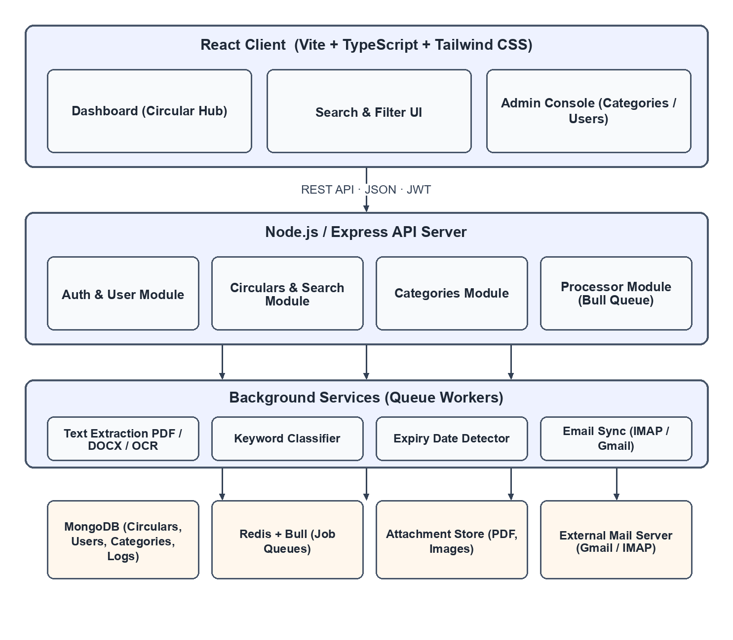
Proposed System Architecture
How Data Flows (In 3 Simple Steps):
1. INPUT
Emails arrive from teachers or college offices with attached PDF files, Word docs, or photos of paper notices.
2. PROCESSING
Our server reads text using OCR, matches keywords to choose the category, and detects any due date or deadline.
3. OUTPUT
Circulars appear on the web dashboard instantly with search, filters, urgent badges, and download buttons.
10/15/2026

Slide 8
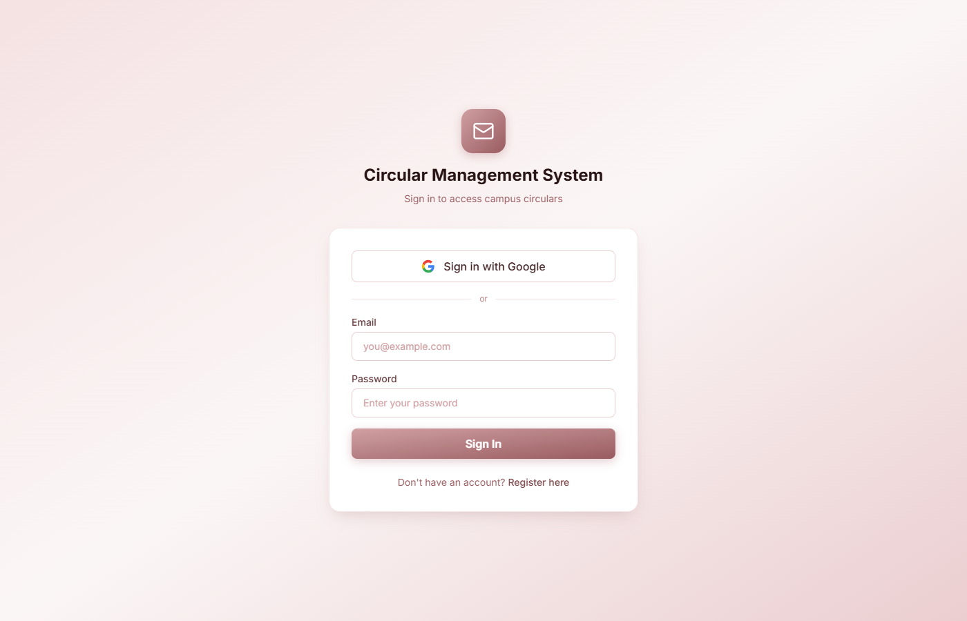
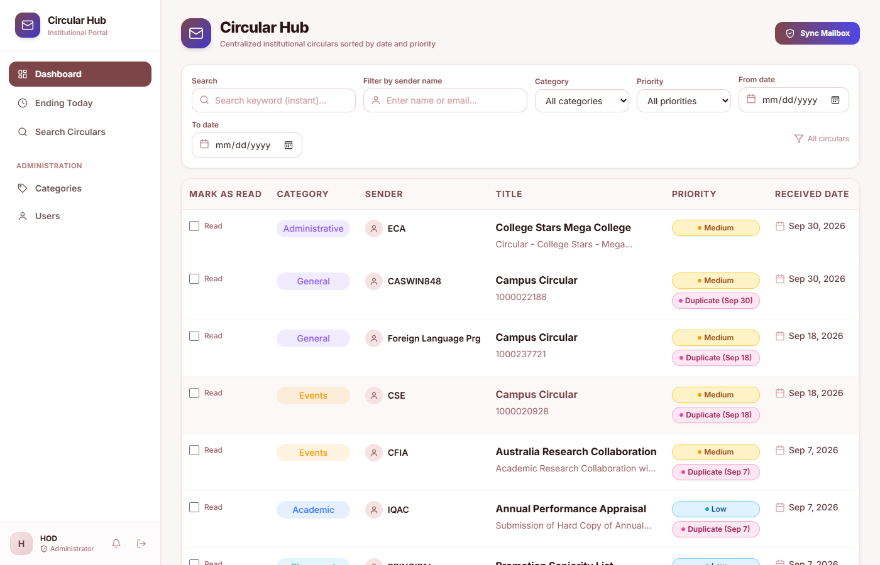
Live System - Login & Circular Hub
Left: Secure Login Screen - Sign in with one click using Google or campus student credentials.
Right: Circular Hub Dashboard - Centralized view showing all notices sorted by date, category badge, and priority tag.
10/15/2026
Department of Computer Applications, TCE Madurai
8

Slide 9
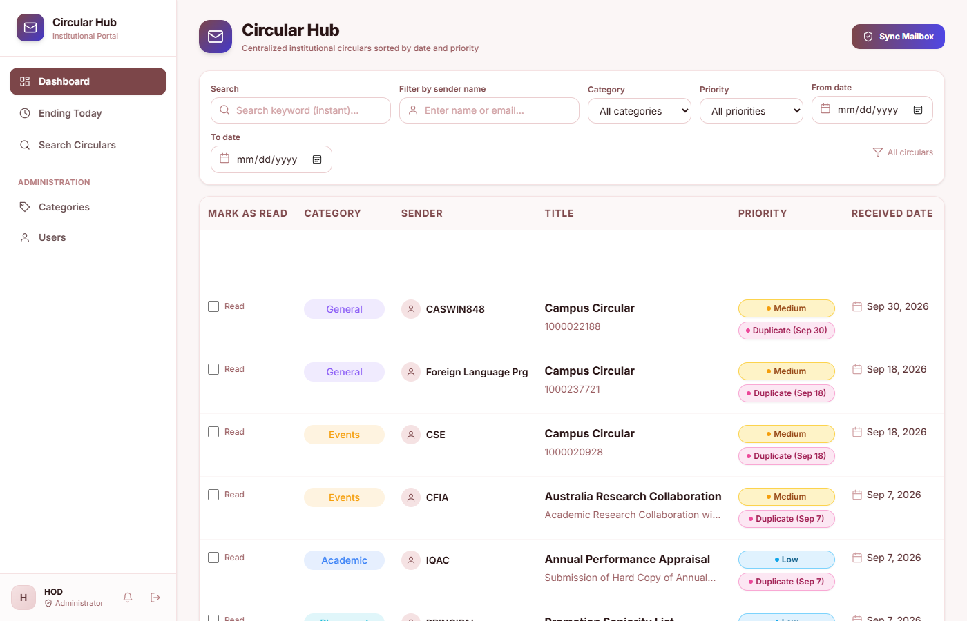
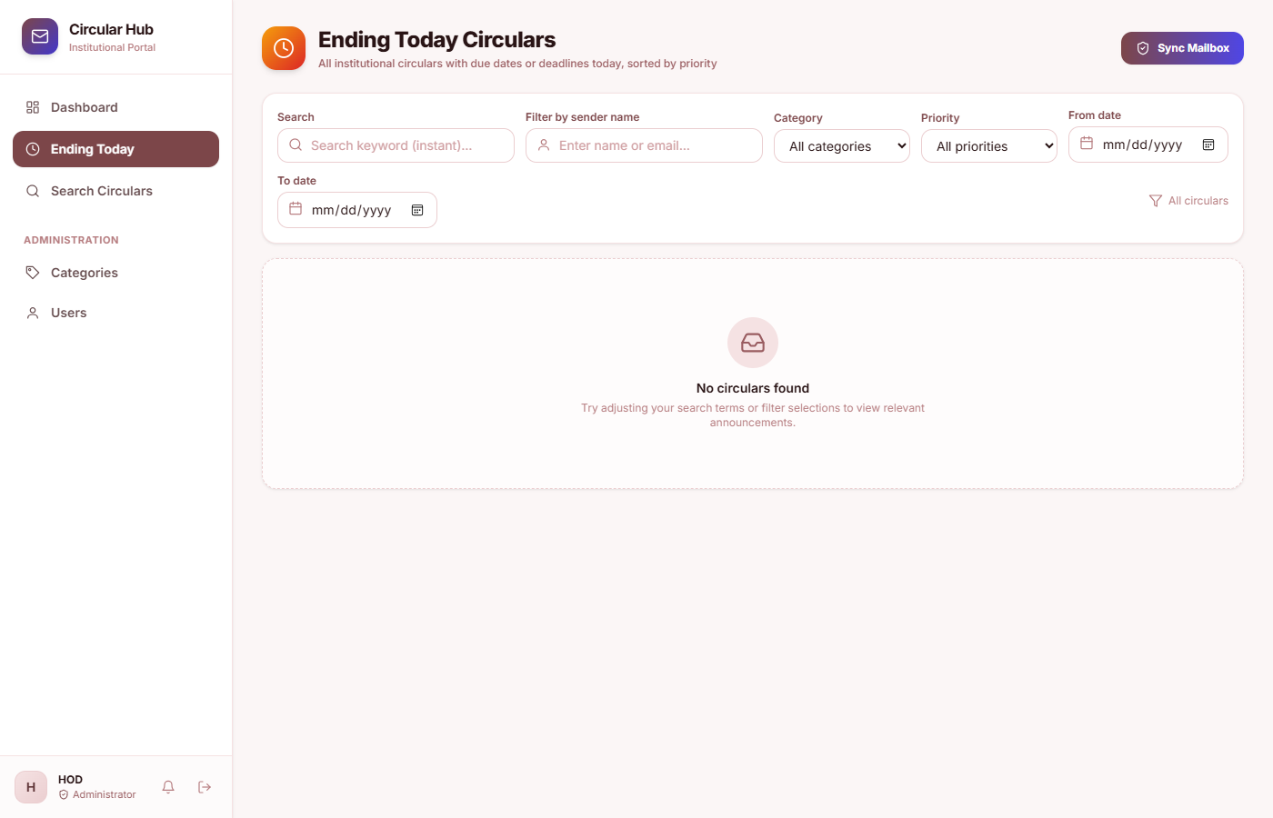
Live System - Notice View & Deadlines
Left: Full Notice View - Clicking any circular shows complete extracted text, sender info, and allows attachment download.
Right: Urgent 'Ending Today' View - Instantly filters notices with deadlines today so students never miss fee or registration dates.
10/15/2026
Department of Computer Applications, TCE Madurai
9

Slide 10
Results and System Performance
What The Results Show:
* High Classification Accuracy (83.1% F1): The system sorts circulars into categories with 80-83% accuracy without making up categories.
* Department Recognition (80%): Correctly identifies the issuing department (Exam Office, Placement Cell, Dean, etc.).
* Perfect Recall (1.0): Finds every real entity and deadline in the text so critical dates are never overlooked.
* Lightning Fast (< 0.2s): Search and filter results return in less than half a second.
* Predictable & Safe: Rule-based matching always gives the exact same result for the same notice with zero hallucination.
10/15/2026
Department of Computer Applications, TCE Madurai
10

Slide 11
Why This System Helps Our College
1. No More Missed Deadlines: Students get clear red alerts before fee payments, hall ticket collections, or scholarship deadlines expire.
2. Reads Photos and Scans: Even if a notice is posted as a cell phone photo of a paper circular, our OCR reads the text easily.
3. Stops Email Overload: Students and faculty can check one clean, organized website instead of wading through hundreds of emails.
4. Fast Search in Seconds: Find any past circular by typing just one word (e.g., 'timetable', 'tcs', 'fee', 'sports').
5. Role-Based Security: Separate logins for Students and HOD/Admin ensure college communications remain authentic and safe.
521 / 521
Backend API Tests Passed (Pytest)
238 / 238
Frontend UI Tests Passed (Vitest)
10/15/2026
Department of Computer Applications, TCE Madurai
11

Slide 12
Conclusion and Future Plans
Conclusion:
* We built and tested a complete, working Circular Management System for Thiagarajar College of Engineering.
* Manual searching through crowded email inboxes is replaced by automatic email syncing, OCR, and smart sorting.
* Students stay informed with deadline alerts, avoiding late fee fines and missed academic opportunities.
* The system is fast, secure, fully responsive on mobile phones, and verified with 750+ passing tests.
Future Plans:
* Mobile Push & WhatsApp Alerts: Send urgent deadline reminders directly to student phones.
* Bilingual Support: Automatically read and translate Tamil and English circulars.
* Voice Search: Allow students to search notices by speaking naturally into their phone.
10/15/2026
Department of Computer Applications, TCE Madurai
12

Slide 13
References
1. Smith, R. (2007). An Overview of the Tesseract OCR Engine. Ninth International Conference on Document Analysis and Recognition (ICDAR).
2. Manning, C. D., Raghavan, P., & Schutze, H. (2008). Introduction to Information Retrieval. Cambridge University Press.
3. Banko, M., et al. (2007). Open Information Extraction from the Web. International Joint Conference on Artificial Intelligence (IJCAI).
4. Chodorow, K. (2013). MongoDB: The Definitive Guide. O'Reilly Media.
5. Banks, A., & Porcello, E. (2020). Learning React: Modern Patterns for Developing React Applications. O'Reilly Media.
6. Thiagarajar College of Engineering (2026). Institutional Academic Regulations and Communication Guidelines.
10/15/2026
Department of Computer Applications, TCE Madurai
13

