Slide 1


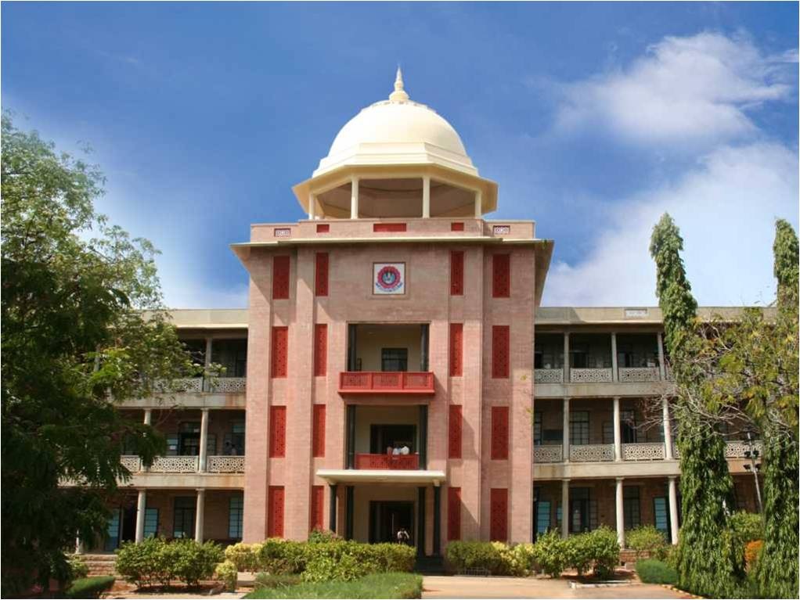
INTELLIGENT LINKEDIN POST CLASSIFICATION AND AUTOMATED REPORTING SYSTEM
Using Natural Language Processing and Dynamic Schema Induction
THIAGARAJAR COLLEGE OF ENGINEERING, MADURAI-15
(A Govt. Aided Autonomous Institution affiliated to Anna University)
- where quality and ethics matter
Team Members:
1.Kabileshwaran J(2503917762221002 )
2.Shalini B V (2503917762222027)
Type of the project: Institutional Project
10/14/2026
Department of Computer Science and Business Systems
1

Slide 2
Industry area identified
Industry area:
Thiagarajar College of Engineering
Scope:
Collect and verify college achievements (research, patents, MoUs, placements, events) from web pages and LinkedIn posts, and turn them into structured reports for audits.
10/14/2026
Department of Computer Science and Business Systems
2

Slide 3
Problem Statement
The need: Educational institutions generate vast amounts of valuable achievement and event data on social platforms like LinkedIn. However, this data remains unstructured and scattered in text format. Manually extracting, categorizing, and structuring this information for institutional audits (NAAC, NIRF) and departmental reporting is labor-intensive, error-prone, and inefficient.This project automates the extraction, NLP-based classification, and dynamic tabular report generation of institutional journeys from unstructured LinkedIn and historical data.
Who will use it:
Deans and IQAC coordinators: accreditation figures and audit checks.
Department heads and faculty in-charges: track milestones, funding and industry tie-ups.
Administrators and auditors: ask questions in plain English and download Excel or PDF reports.

Slide 4
Objectives
1.Automated Data Ingestion & Preprocessing:
Develop an automated pipeline to extract institutional data from historical records and live LinkedIn feeds, eliminating duplicates, handling missing values, and standardising records across academic years.
2.NLP-Driven Classification & Information Extraction:
Employ NLP and AI models to classify each post into appropriate institutional categories, departments, and primary stakeholders (Faculty, Student, Institution), while extracting key metrics such as patent numbers, funding agencies, sanctioned amounts, and event dates.
3.Dynamic Schema Induction & Governance:
Automatically induce tabular report structures based on field occurrence thresholds of 15% offering AI-assisted recommendations and an admin approval workflow with version-controlled schema freezing.
4.Interactive Dashboard & Automated Reporting:
Deliver an interactive React web portal featuring multi-level drill-down analytics, search capabilities, and synchronized Excel and PDF export facilities for audit readiness (e.g., NAAC / NIRF).

Slide 5
Tools and Technologies used
Area | Technologies used (and what for)
Backend and storage | Python 3.12 (runtime), Flask & Flask-CORS (RESTful API), SQLite3 in WAL mode (high-speed concurrent storage, parameterised SQL, and version-controlled schema store), Pandas (reading & standardising historical Excel files)
NLP and AI | spaCy (en_core_web_sm) & Regex (entity extraction for dates, persons, organizers, and venues), RapidFuzz (token-level fuzzy matching for cross-source deduplication), LLM / Generative AI — Groq & Gemini (deep category classification and dynamic schema layout recommendations)
Frontend | React 19 & Vite 8 (single page dashboard), React Router v7 (navigation & drill-down flow), Recharts (analytics charts), Vanilla CSS (clean, responsive UI design)
Data, Export and Testing | Apify LinkedIn Actor (scheduled post collection), OpenPyXL (formatted Excel report generation), ReportLab (audit-ready PDF export), Pytest & Vitest (backend & frontend automated testing)

Slide 6
Module description
Module 1 - Data ingestion and de-duplication: reads the historical workbooks and weekly Apify LinkedIn posts, checks mandatory fields, parses date ranges and removes near-duplicate records with RapidFuzz.
Module 2 - NLP classification and extraction: assigns each activity to one of 19 categories, 17 departments and 3 stakeholders, and extracts research milestones (patents, funded projects, publications), grant agencies, sanctioned amounts and inventors.
Module 3 - Dynamic schema induction and governance: measures how often each field is actually filled (coverage of at least 0.15) for every Category, Journey Type and Milestone, suggests 'Balanced', 'Focused' and 'Comprehensive' layouts, and lets the admin reorder or remove columns before freezing a versioned schema.
Module 4 - Journey portal and reports: a React dashboard with period, category and stakeholder drill-downs, natural language queries converted to safe parameterised SQL, and Excel and PDF export for accreditation.

Slide 7
Proposed Block Diagram
INPUT
5 historical Excel workbooks (2023-24 to 2026-27)
Public TCE web pages (robots.txt compliant)
Apify LinkedIn live post feed
Reference seeds: 17 departments, 19 categories, 3 stakeholders
PROCESSING
1. Normalisation and de-duplication (RapidFuzz)
2. NLP classification (rules + Gemini)
3. Attribute extraction (patents, grants, dates, venues)
4. Schema induction (coverage 0.15 + layout options)
5. Admin review and schema freeze
OUTPUT
React dashboard with drill-downs
Natural language query search
Induced schema views
Synchronised Excel reports
Accreditation PDF (NIRF / NAAC / NBA)

Slide 8
Conclusion and Future Work
Conclusion
Built and tested an end-to-end NLP and dynamic schema induction system for Thiagarajar College of Engineering.
Manual data entry is replaced by automatic extraction and standardisation of records from 5 years of workbooks and the LinkedIn feed.
The rigid-table problem is solved: columns adapt to each category (for example Patents vs Grants) without changing the database tables.
Checked with 521 backend and 238 frontend automated tests, all passing.
Future Work
Real-time webhooks from Apify / LinkedIn so new milestones are indexed immediately.
Support for Tamil-English mixed announcements.
Direct submission of the exports to the NAAC, NBA and NIRF portals.
10/14/2026
Department of Computer Science and Business Systems
8

Slide 9
Results and inferences (1)
What the graph shows
The rule-based classifier scored a macro-F1 of 0.7347, far above Logistic Regression (0.29) and SVC (0.25).
Naive Bayes scored 0, because it had zero recall on this sparse data.
Academic activity text is short and has few examples per class, so statistical models struggle.
Rules give the same output every time, so no made-up categories appear.
10/14/2026
Department of Computer Science and Business Systems
9

Slide 10
Results and inferences (2)
What the graph shows
Micro-F1 (0.8312) is higher than macro-F1 (0.7347): common categories are classified well, rarer ones are harder.
Department (14 classes) and stakeholder (8 classes) identification are both 80% accurate.
Entity extraction has recall 1.0 and precision 0.667 (F1 0.80): it finds every real entity but also picks up a few extra ones.
10/14/2026
Department of Computer Science and Business Systems
10

Slide 11
Results and inferences (3)
Rules first, no hallucination: keyword rules beat the ML models on sparse text and always give the same answer for the same input.
Schema per Category, Journey Type and Milestone: Research shows Inventors and Patents, Placement shows Package and Recruiters, and the SQL tables never change.
Coverage of at least 0.15: keeps mostly empty columns out of the tables, so reports stay readable.
Human-in-the-loop governance: admins can move columns up or down and remove them; every saved version is kept for audit.
521 / 521
backend tests passed (Pytest)
238 / 238
frontend tests passed (Vitest)
10/14/2026
Department of Computer Science and Business Systems
11

Slide 12
References
Manning, C. D., Raghavan, P., & Schutze, H. (2008). Introduction to Information Retrieval. Cambridge University Press.
Devlin, J., Chang, M. W., Lee, K., & Toutanova, K. (2019). BERT: Pre-training of Deep Bidirectional Transformers for Language Understanding. Proceedings of NAACL-HLT, 4171-4186.
National Institutional Ranking Framework (NIRF), Ministry of Education, Govt. of India (2024). Data Validation Guidelines and Parameters for Higher Education Institutions.
National Assessment and Accreditation Council (NAAC) (2023). Institutional Accreditation Manual for Autonomous Colleges and Data Verification Guidelines.
Honnibal, M., & Montani, I. (2017). spaCy 2: Natural language understanding with Bloom embeddings, convolutional neural networks and incremental parsing.
Bizer, C., Heath, T., & Berners-Lee, T. (2011). Linked Data: The story so far. Semantic Services, Interoperability and Web Applications, 205-227.
Pedregosa, F., et al. (2011). Scikit-learn: Machine learning in Python. Journal of Machine Learning Research, 12, 2825-2830.
10/14/2026
Department of Computer Science and Business Systems
12

Slide 13
Publications( proposed/ submitted)
1. Journal paper (final preparation): "Dynamic Schema Induction and Multi-Source Attribute Mining for Institutional Journey Intelligence"
Target: IEEE Transactions on Learning Technologies (Scopus Q1). Focus: coverage-gated attribute induction and schema governance over semi-structured academic activity feeds.
2. Conference paper (targeted): "Automated Academic Activity Classification and Grounded Regulatory Reporting Using Hybrid NLP Architectures"
Target: IEEE ICALT 2027 (IEEE CS Press). Focus: rule-based baselines compared with LLM prompt classification for zero-fabrication compliance.
3. Patent / copyright disclosure: "A Dynamic Schema Overlay System and Method for Automated Institutional Journey Analytics"
Status: drafted for review by the Institutional IPR Cell (TCE-IPR-2026-CSBS).
Authors: Shalini B. V., Department of Computer Science and Business Systems, TCE Madurai.
10/14/2026
Department of Computer Science and Business Systems
13

