Slide 1
ITC 6000 Sec 03 Database Management Systems Final Project Presentation 2021 Winter B INSTAGRAM
Aswin

Slide 2
Overview
Project Overview
User Personna’s
Business Rules
ER Diagram
Architecture
Major SQL examples
Metrics
Security & Privacy Compliance
Next steps / Future Ideas

Slide 3


Project Overview
Instagram, Inc. provides mobile phone-based photography sharing services. It allows its users to take photos, add effects, and share content online and over various social networks.
It was founded by Stanford graduates Kevin Systrom and Mike Krieger and is now owned by Facebook.
As of September 2017, Instagram had 800 million registered users.
The name Instagram is a combination of “instant camera” and “telegram”.
Link to the website: Instagram.com

Slide 4
I have chosen Instagram app as the project topic because everyone uploads and shares images with their friends and family and follows each other.
Instagram is one of the most popular social network applications worldwide.
As of January 2021, India and the United States were the two countries with the most Instagram users with 140 million users.
Past research has found that photos with peoples face receive more likes and comments.
Ongoing research continues to find how media content on the platform affects user engagement.

Slide 5
Personnas
Instagram Users
- Signup and log in using the credentials which you gave during sign up.
- Add your name, and description and choose the type of account that is required.
- Search the profile you wanted by using their username.
- Instagram users can continue using it even without uploading any media content.
Role of Instagram Analysts
- For example, the number of interactions on a post and follower count at the time when the post was created. This allows Instagram to generate revenue in terms of advertisement.
- Users who are active & Inactive. Once they find the list of users who are inactive, email is sent to log on to Instagram.

Slide 6
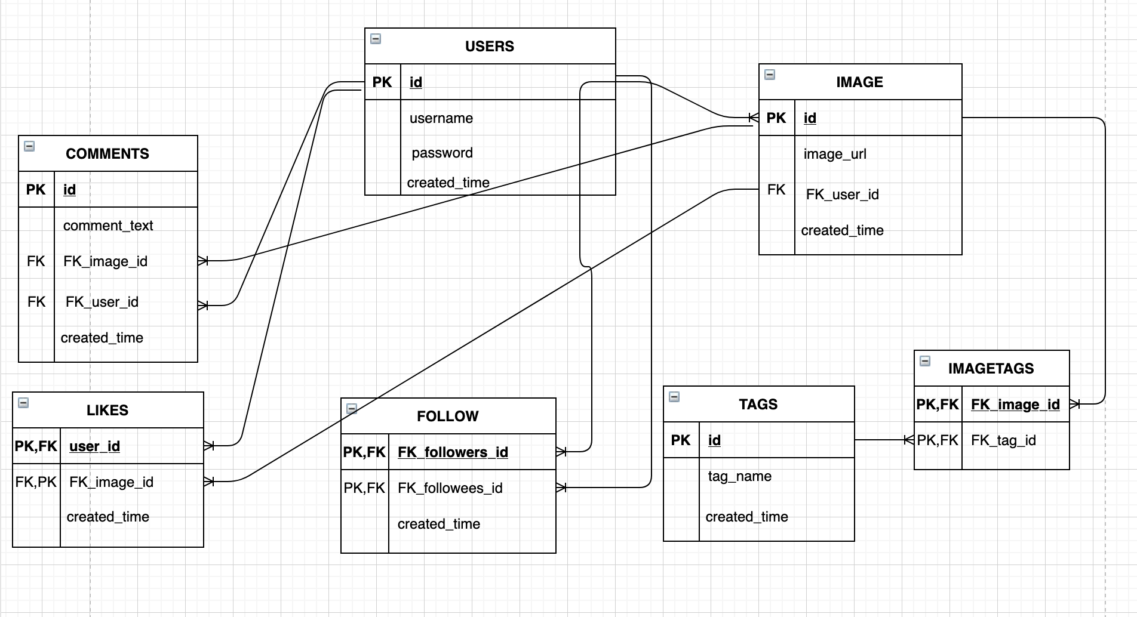
ER Diagram

Slide 7
Architecture
Instagram with 3 layer architecture
Presentation Layer: This is top-level in a three-tier architecture. It is commonly referred to as Graphical User Interface. In this case, for Instagram front-end mobile application and a website. This is where the users interact and input the data.
Business/ Service Layer: The input from the user is sent to this layer and the data is uploaded to the storage platform. The input data is stored in the database according to the business rules.
Data Layer: NoSQL Database Server.
Advantages of 3 tier Architecture
Security: Since there is no direct interaction between client & server we can restrict unauthorized access.
Integrity: As we have a Service layer between client and server side data corruption could be removed.

Slide 8
Business Rules & Facts About Instagram
Business Rules:
A USER can upload many IMAGES.
A USER LIKES many images.
Every USER should have a different USERNAME.
One USER can write many COMMENTS.
One IMAGE can have many LIKES and
One IMAGE can have many COMMENTS.
Facts About Instagram:
As of 2019 there are 1 billion monthly active users.
Within 1 month of launch Instagram gained 1 million users while twitter took 2 years to reach this milestone.
As of 2017, number of daily active Instagram Stories users (200 million) surpassed snapchat daily users (161 million).

Slide 9
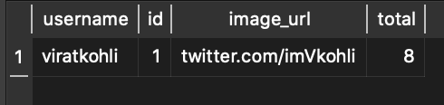
SQL Example 1
--SQL Query: To find the most liked photo with username, image ID, and image URL.
SELECT
username,
IMAGE.id,
IMAGE.image_url,
COUNT(*) AS total
FROM IMAGE
INNER JOIN LIKES
ON LIKES.FK_image_id = IMAGE.id
INNER JOIN USERS
ON IMAGE.FK_user_id = USERS.id
GROUP BY IMAGE.id
ORDER BY total DESC
LIMIT 1;
Output

Slide 10
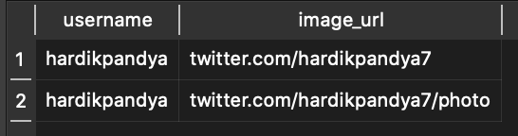
SQL Example 2
--SQL Query: To display all the image URL of a user with their username. In this case for username hardikpandya
SELECT username,image_url
FROM USERS
LEFT JOIN IMAGE
ON USERS.id = IMAGE.FK_user_id
WHERE username = 'hardikpandya'
Output

Slide 11
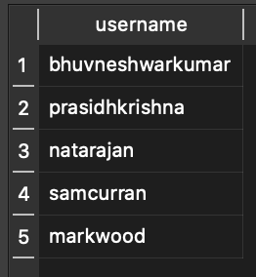
SQL Example 3
--SQL Query: To display all the users with no images
SELECT username
FROM USERS
LEFT JOIN IMAGE
ON USERS.id = IMAGE.FK_user_id
WHERE IMAGE.id IS NULL
ORDER BY USERS.id;
Output

Slide 12
Metrics
Metrics:
- Instagram metrics tells us about the engagement with the photos and the users who engage with it.
- User engagement with likes, Comments, Profile Clicks for advertisers.
- Follower Growth: Follower Growth after promoting with advertisement. This will show the follower count before and after the promotion of Instagram profile.
- Instagram users can add up to 30 hashtags on each post.
- When relevant hashtags are used, it helps to keep the engagement in check.

Slide 13
Privacy & Security Features
- Private Account.
- Remove a follower.
- Two- Factor Authentication.
- Download your data, a copy of your comments, posts, and messages.
- Delete posts, remove or archive your posts and it will be not shown in your profile.

Slide 14
Future Ideas & Lessons Learnt
Lessons Learnt:
Created complex queries to retrieve information from the database using JOINs.
Learnt about the architecture design of Instagram.
Learnt about the Metrics along with the security and privacy features of the application.
Future Ideas:
Add actual pictures in the server in the current database.
With the help of new domain and a server space make website that can do the functions of this database with a better database design.

