Slide 1
House Price Prediction
Project Overview
Build a robust model for accurate house price predictions.
Analyze feature importance.
Provide actionable insights for stakeholders.

Slide 2
House Price Prediction USING MACHINE LEARNING TECHNIQUES

Slide 3
Project Objectives
Develop a reliable machine learning model.
Understand the impact of housing features on price.
Assist buyers, sellers, and agents with insights.
Ensure scalability for future data.

Slide 4
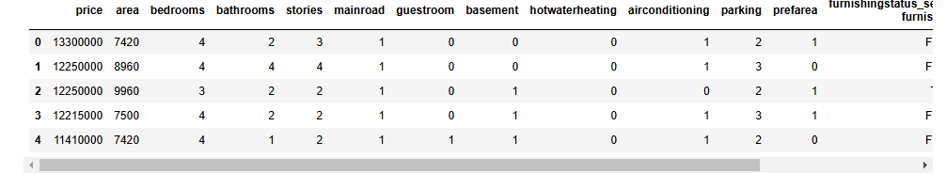
Data Overview
Dataset includes features such as:
Area (size in sq ft)
Bedrooms and Bathrooms
Stories (floors)
Amenities (e.g., air conditioning, parking)
Furnishing status
Target Variable: House Price

Slide 5
Data Preprocessing
Converted binary features (Yes/No) to numeric (1/0).
Created dummy variables for multi-class features.
Standardized numerical features using StandardScaler.
Split data into training (80%) and testing (20%) sets.

Slide 6
Model Development
Algorithm: Random Forest Regressor
Why Random Forest?
Handles numerical and categorical data.
Robust against overfitting.
Provides feature importance insights.
Hyperparameters:
n_estimators=100
random_state=42.

Slide 7
Feature Importance
Key Features Driving Predictions:
Area: 49.8%
Bathrooms: 18.2%
Stories: 10.5%
Air Conditioning: 8.7%
Insights:
Area is the most significant predictor of price.
Amenities play a notable role.

Slide 8
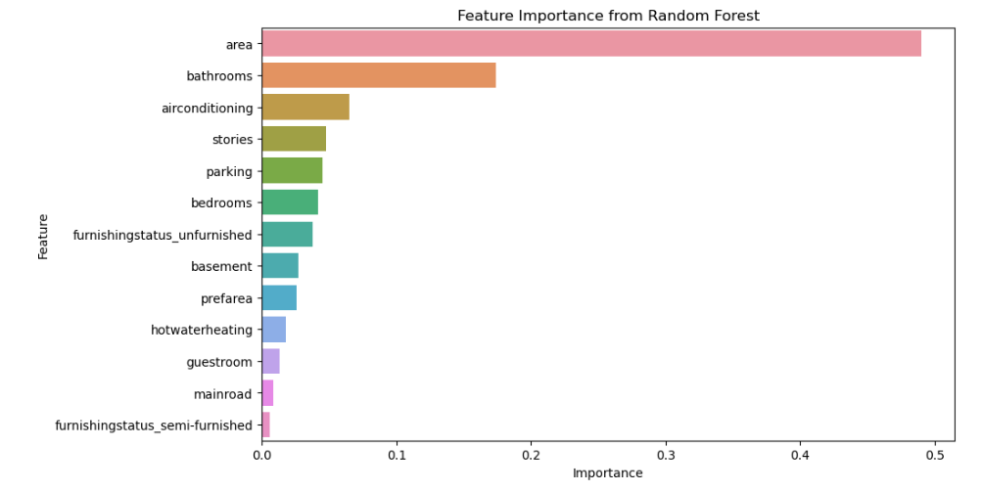

Slide 9
Residual Analysis
Residual Analysis Results:
Most residuals are close to zero.
Model performs well for most predictions.
Few outliers for very high-priced houses.
Conclusion:
Model shows minimal errors with high accuracy.

Slide 10
Key Insights and Recommendations
Insights:
Larger houses (area) command higher prices.
Bathrooms and additional floors significantly increase value.
Amenities like air conditioning influence prices.
Recommendations:
For Buyers: Focus on area and key amenities.
For Sellers: Highlight valuable features.
For Agencies: Use the model to guide pricing decisions.

Slide 11
Conclusion
Key Contributions:
Developed a reliable Random Forest model.
Identified area, bathrooms, and amenities as key drivers.
Provided actionable insights for buyers, sellers, and agencies.
Future Scope:
Incorporate location data.
Optimize hyperparameters.
Explore advanced models (e.g., XGBoost).

