Slide 1
Hibernate

Slide 2
Hibernate is an Object-Relational Mapping (ORM) solution for JAVA

Slide 3
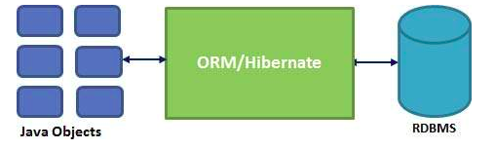
What is ORM?
Object-Relational Mapping (ORM) is a programming technique for converting data between relational databases and object oriented programming languages.

Slide 4
Why Object Relational Mapping (ORM)?
Mismatch between the object model and the relational database.
Databases are designed with Tables/Relations
Java objects are designed using OOPS.
We would want to store the data from objects into tables and vice-versa.
Earlier approaches involved writing SQL Queries : JDBC
How about mapping the objects directly to tables/relationships?

Slide 5
Object-Relational Mapping
Let’s business code access objects rather than DB tables.
Hides details of SQL queries from OO logic.
Entities based on business concepts rather than database structure.

Slide 6
Hibernate
Hibernate is one of the popular implementations of JPA.
Hibernate understands the mappings that we add between objects and tables
It ensures that data is stored/retrieved from the database based on the mapping.

Slide 7
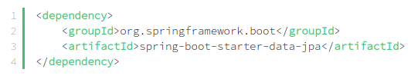
Spring Boot with Hibernate
Add spring-boot-starter-data-jpa as maven dependencies in pom.xml
This dependency includes JPA API, JPA Implementation, JDBC and other needed libraries.
Default JPA implementation is Hibernate

Slide 8
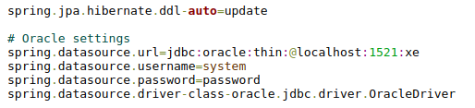
2. Add db connection details in application.properties

Slide 9
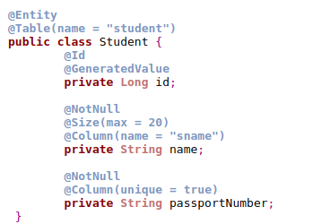
3. Creating the Entity
Entities are POJOs representing data that can be persisted to the database.
An entity represents a table stored in a database.
Every instance of an entity represents a row in the table.

Slide 10
@Entity - specifies to declare the class as entity or a table.
@Table - specifies to declare table name
@Id - specifies to use for identity (primary key of a table) of the class.
@GeneratedValue - specifies, how the identity attribute can be initialized such as Automatic, manual, or value taken from sequence table.
@Column - specify column or attribute for persistence property.
@Transient - specifies the property which in not persistent

Slide 11

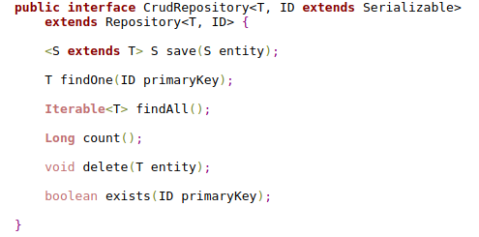
4. Create Repository class to Read Student information
@Repository annotation is used to indicate that the class provides the mechanism for storage, retrieval, search, update and delete operation on objects.

Slide 12
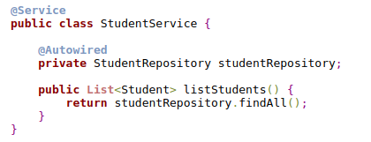
5. Service to call repository methods
.

Slide 13
JPA - Entity Relationships
@OneToOne Relation
@OneToMany Relation
@ManyToOne Relation
@ManyToMany Relation

Slide 14
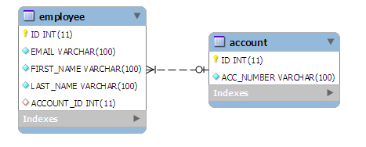
OneToOne Relation
It means each row of one entity is referred to one and only one row of another entity.

Slide 15
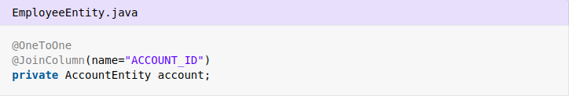

.
.
“mappedBy” attribute declares that it is dependent on owner entity for mapping

Slide 16
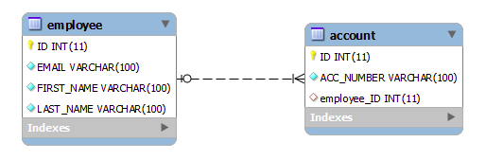
OneToMany Relation
Hibernate one to many mapping is made between two entities where first entity can have relation with multiple second entity instances but second can be associated with only one instance of first entity.

Slide 17
Employee Entity
.
Account Entity

Slide 18
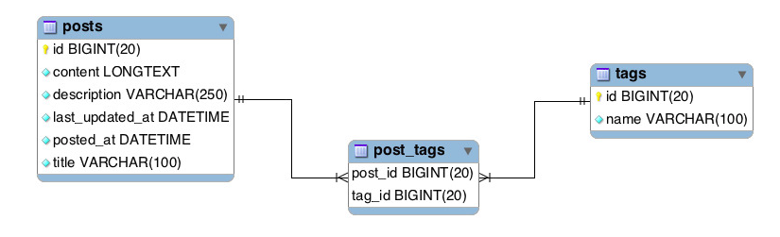
ManyToMany Relation
Many-To-Many relationship is where one or more rows from one entity are associated with more than one row in other entity.

Slide 19
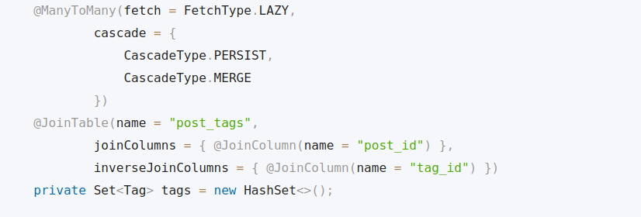
Post Entity
.

Slide 20
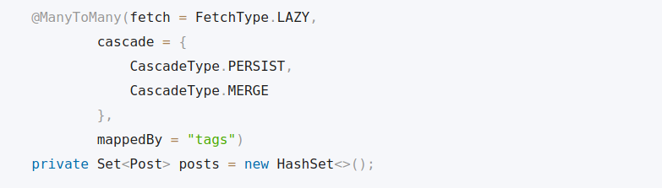
Tag Entity
.

