Slide 1
GOVERNMENT OF INDIA • MINISTRY OF STATISTICS & PROGRAMME IMPLEMENTATION (MoSPI)
National Skill Intelligence & Learning Platform
AI-Enabled Competency Benchmarking, Skill Gap Analysis & Mission Karmayogi Integration
SIH 2026 Solution Presentation • Official Statistical Cadres (ISS / SSS / DES / NSSTA) GitHub Repository: https://github.com/aswinbalaji780-afk/SIH_PRO.git • Live Prototype: http://127.0.0.1:8000

Slide 2
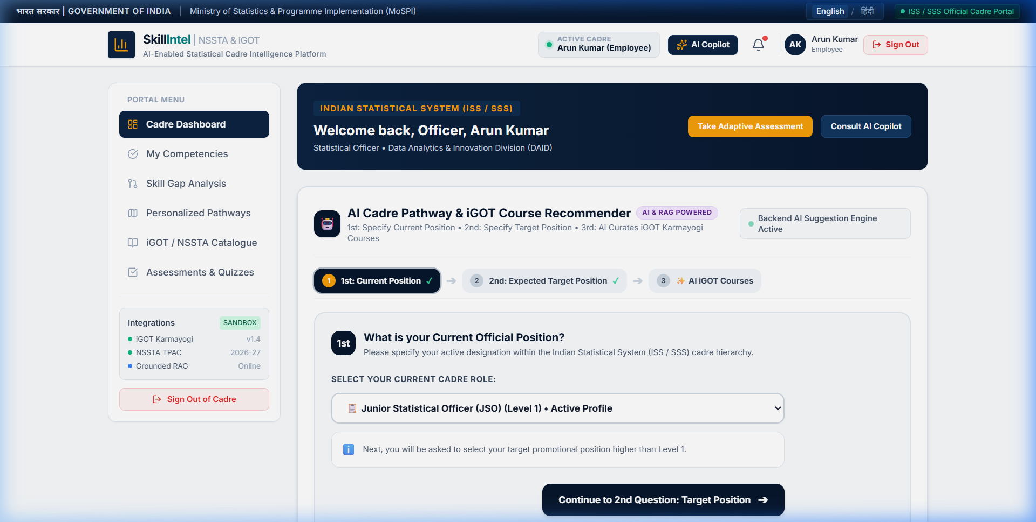
SLIDE 1 • SOLUTION ARCHITECTURE & INNOVATION
Proposed Solution: Closed-Loop Cadre Skill Intelligence
1. THE CORE PROBLEM IN OFFICIAL STATISTICAL CAPACITY
• Traditional LMS Shortcomings: Static course catalogues with zero role-competency benchmarking. Training is episodic, voluntary, and disconnected from promotional career ladders.
• Subjectivity & Skill Decay: Self-reported qualifications decay over time with no multi-source verifiable evidence ledger across official cadres (ISS, SSS, DES).
• Disjointed National Infrastructure: iGOT Karmayogi catalog courses are unlinked to localized NSSTA training guides and actual statistical production gaps (PLFS, CPI, GDP).
2. OUR INNOVATIVE CLOSED-LOOP SOLUTION
✔ Multi-Source Competency Engine: Evidence-weighted assessment (45% Quizzes, 30% Course Completion, 15% Experience, 10% Self-Evaluation) across 5 standardized competency levels.
✔ Automated Skill Gap Engine: Calculates Gap = Required Role Benchmark - Assessed Score. Prioritizes Critical (51+), High (31-50), Medium (16-30), and Low (6-15) deltas.
✔ Hybrid AI Recommender Engine: 5-variable objective optimization curates personalized iGOT & NSSTA learning paths with transparent human-readable explainability.
✔ RAG-Grounded Multi-Level MCQ Studio: Synthesizes Bloom's Taxonomy questions (Levels 1-3) grounded in official NSSTA guides with verifiable source citations.
KEY PLATFORM HIGHLIGHTS
★ Strict Role-Based Access: Learner, Trainer, Dept Admin, System Admin
★ Seamless Mission Karmayogi (iGOT) REST API Sync with telemetry
★ In-App iGOT Course Player & 4-Module Syllabus Viewer
★ Real-time countdown examination timers with auto-submit protection
Smart India Hackathon 2026 • MoSPI / NSSTA / iGOT Karmayogi • Slide 1 of 5 • https://github.com/aswinbalaji780-afk/SIH_PRO

Slide 3
SLIDE 2 • TECHNICAL DEPTH & EXECUTION CLARITY
Technical Stack & System Architecture Flow
TECHNOLOGY STACK WITH STRATEGIC JUSTIFICATIONS
▪ Frontend: Vanilla HTML5, Tailwind CSS, Lucide Icons, Vanilla JS
Why: Zero build bloat, sub-100ms first contentful paint, guaranteed compatibility across low-bandwidth NIC regional offices and intranet nodes without framework overhead.
▪ Backend: Python 3.11+ with FastAPI & ASGI Uvicorn
Why: Asynchronous high-throughput request processing, native Pydantic v2 data validation, and automated OpenAPI 3.0 (Swagger) documentation (/docs).
▪ Database & ORM: SQLite (Embedded) / PostgreSQL + SQLAlchemy
Why: ACID compliance, immutable historical audit ledgers, zero initial configuration overhead for offline testing, and direct deployability to NIC MeghRaj cloud.
▪ AI / RAG Pipeline: Grounded RAG + TF-IDF Vector Indexing + Gemini 1.5 Pro
Why: Prevents hallucination by strictly constraining questions to uploaded NSSTA manuals, indexing page/chapter source citations.
▪ Integrations: iGOT Karmayogi v1.4 REST API + NSSTA TPAC Gateway
Why: OAuth2 token lifecycle, real-time course syllabus ingestion, and enrollment telemetry tokens (e.g. IGOT-ENR-2026-XXXX).
END-TO-END SYSTEM OPERATIONAL FLOW
▶ Step 1: Officer Profiling & Role Binding
User logs in with Cadre Credentials (SSO). System binds verified role (JSO, SSO, AD) and fetches required competency benchmarks.
▶ Step 2: Multi-Source Competency Evaluation
Computes baseline score from Quizzes (45%), Course Records (30%), Experience (15%), and Self-Ratings (10%).
▶ Step 3: Automated Skill Gap Prioritization
Deltas calculated against target promotional role. Identified gaps prioritized: Critical > High > Medium > Low.
▶ Step 4: AI iGOT Course Synthesis
Hybrid engine recommends sequenced iGOT courses + NSSTA programs; explains 'Why this course was recommended'.
▶ Step 5: iGOT API Enrollment & Player
1-click dispatch to iGOT API; updates UI state to '✓ Enrolled on iGOT'; opens in-app Course Player & Syllabus.
▶ Step 6: RAG-Grounded Adaptive Assessment
Officer undertakes Bloom's Level 1-3 exam with live countdown timer; scores auto-update the Competency Ledger.
Smart India Hackathon 2026 • MoSPI / NSSTA / iGOT Karmayogi • Slide 2 of 5 • https://github.com/aswinbalaji780-afk/SIH_PRO

Slide 4
SLIDE 3 • EXECUTION REALISM & SUSTAINABILITY
Feasibility, Viability & Proactive Risk Mitigation
✔ Technical Feasibility
Ultra-lightweight architecture (<50MB RAM footprint). Runs seamlessly on low-tier government hardware or containerized via Docker & Docker Compose. Supports dual mode: live API gateway + offline mock sandbox for restricted networks.
✔ Financial Feasibility
100% open-source stack (FastAPI, SQLite, Vanilla CSS/JS) eliminates vendor licensing lock-in. Minimal LLM token costs achieved via pre-chunked TF-IDF semantic retrieval and localized RAG grounding.
✔ Operational Feasibility
Directly aligns with MoSPI's training mandate and NSSTA's TPAC calendar. Integrates cleanly with existing iGOT Karmayogi employee IDs without requiring parallel account management or data duplication.
✔ Market & Cadre Viability
Designed for nationwide adoption across ISS, SSS, and State DES departments (~12,500+ statistical personnel). Directly implements DoPT Mission Karmayogi capacity building objectives.
TRANSPARENT RISK ANALYSIS & MITIGATION STRATEGIES
⚠ Risk 1: AI Hallucination in Question Synthesis ➔ Mitigation: Strict RAG grounding on uploaded NSSTA manuals with exact page citations + Human-in-the-Loop Trainer Review Queue.
⚠ Risk 2: Intermittent Connectivity in Remote Field Offices ➔ Mitigation: Offline-first architecture, local storage caching of assessments, and asynchronous background sync upon reconnection.
⚠ Risk 3: Cadre Role Mismatch & Security Escalation ➔ Mitigation: Strict 4-role RBAC isolation; Learner, Trainer, Dept Admin, and System Admin views are segregated at router level.
Smart India Hackathon 2026 • MoSPI / NSSTA / iGOT Karmayogi • Slide 3 of 5 • https://github.com/aswinbalaji780-afk/SIH_PRO

Slide 5
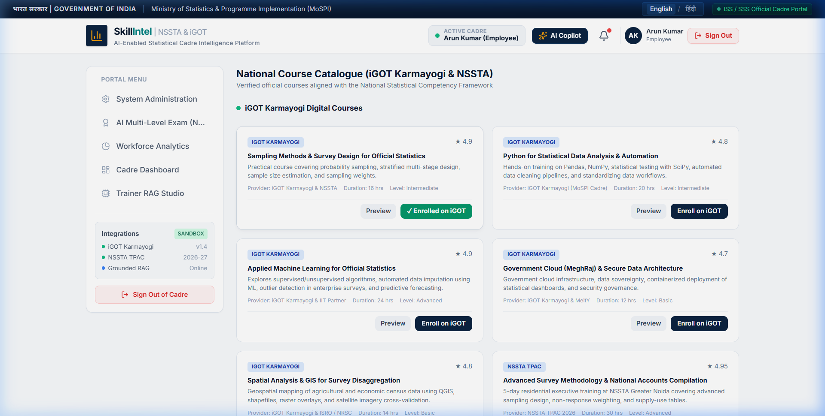
SLIDE 4 • QUANTIFIABLE PUBLIC VALUE
Real-World Impact, Cadre Benefits & Adoption Strategy
QUANTIFIABLE MULTI-DIMENSIONAL IMPACT
✔ Economic & Budgetary Impact: Eliminates ~40% of redundant/duplicate training hours across regional statistical divisions. Maximizes public capacity fund ROI by targeting proven skill gaps rather than generalized lectures.
✔ Data Quality & Governance Enhancement: Directly uplifts sampling precision, reduces non-sampling errors, and guarantees SNA 2008 / DQAF compliance across high-stakes national datasets (GDP, CPI, PLFS, Agricultural Census).
✔ Democratized Career Progression: Establishes a transparent, meritocratic skill roadmap for Junior Statistical Officers (JSOs) aspiring to SSO, Assistant Director, and Director cadres with verified competency audit trails.
✔ Adoption Barrier Mitigation: Eliminates cognitive burden via 1-click SSO, gamified competency progression (+8.2% monthly), and transparent 'Why this course was recommended' explanations.
STRATEGIC VALUE DELIVERED TO MoSPI & NSSTA
★ Single Pane of Glass: Executive workforce analytics across 12,480+ cadre strength.
★ Real-Time Competency Ledger: Tamper-evident progression history.
★ Bilingual Governance: Full English & Hindi UI for pan-India cadre inclusivity.
★ Direct Mission Karmayogi Alignment: Operationalizes National Capacity Building.
Smart India Hackathon 2026 • MoSPI / NSSTA / iGOT Karmayogi • Slide 4 of 5 • https://github.com/aswinbalaji780-afk/SIH_PRO

Slide 6
SLIDE 5 • GROUNDWORK & SCIENTIFIC CREDIBILITY
Methodological Foundations, Citations & Competitive Benchmarks
ACADEMIC PAPERS & METHODOLOGICAL STANDARDS
📚 Hansen, M. H., & Hurwitz, W. N. (1943)
On the Theory of Sampling from Finite Populations. Annals of Mathematical Statistics. Foundational to our Sampling & Survey Design competency benchmark.
📚 Horvitz, D. G., & Thompson, D. J. (1952)
A generalization of sampling without replacement from a finite universe. JASA. Powers our survey weighting and variance estimation Bloom L2 questions.
📚 Rao, J. N. K., & Molina, I. (2015)
Small Area Estimation. John Wiley & Sons. Governs our Fay-Herriot EBLUP auxiliary administrative data integration benchmarks.
📚 Bloom, B. S. (1956) & Anderson et al. (2001)
A Taxonomy for Learning, Teaching, and Assessing. Underpins our 3-tiered cognitive exam synthesis (Recall, Applied, Strategic).
📚 United Nations Statistical Commission (UNSD)
Fundamental Principles of Official Statistics & National Accounts System (SNA 2008). Informs our official statistical ethics and national accounts benchmarks.
BENCHMARKING AGAINST EXISTING PLATFORMS
⚖ Baseline iGOT Karmayogi
Catalog repository only; lacks official statistical gap calculation, dynamic promotion benchmarking, and automated RAG test synthesis.
⚖ Diksha (MoE)
K-12 student and school teacher focus; lacks civil service cadre hierarchy, multi-source evidence ledgers, and statistical methodology engines.
⚖ Commercial LMS (Coursera / edX)
Generic corporate skills; zero alignment with Government of India official statistical service rules (ISS/SSS/DES) and prohibitive recurring SaaS costs.
⚖ Our National Skill Intelligence Platform
100% purpose-built for India's Official Statistical System: Closed-loop intelligence, automated gap scoring, multi-level cognitive exam engine, and sovereign zero-cost architecture.
Smart India Hackathon 2026 • MoSPI / NSSTA / iGOT Karmayogi • Slide 5 of 5 • https://github.com/aswinbalaji780-afk/SIH_PRO

