Slide 1

“Watching earth bloom,one pixel at a time”
Bloom Watch

Slide 2

Project Overview
Employs machine learning for accurate flower species and bloom stage classification
Supports farmers with crop flowering and harvest planning insights
Aids conservationists in habitat monitoring and invasive species detection
Engages citizen scientists to improve models and provides actionable ecological insights
BloomWatch is an intelligent, satellite-driven visualization tool that monitors and analyzes global plant blooming events using NASA Earth observation datasets (like MODIS and Landsat). It provides real-time insights into vegetation dynamics — tracking bloom timing, intensity, and patterns — across ecosystems ranging from agricultural lands to wild habitats

Slide 3
Problem Statement
Difficulty in detecting bloom patterns across diverse landscapes and seasons
Limited integration of NASA Earth observation data for localized analysis.
Lack of actionable insights for farmers, researchers, and conservationists.
Understanding and monitoring plant blooming events is essential for agriculture, ecology, and climate research. However, existing systems lack real-time, scalable, and visually intuitive tools to track these changes using satellite data.

Slide 4
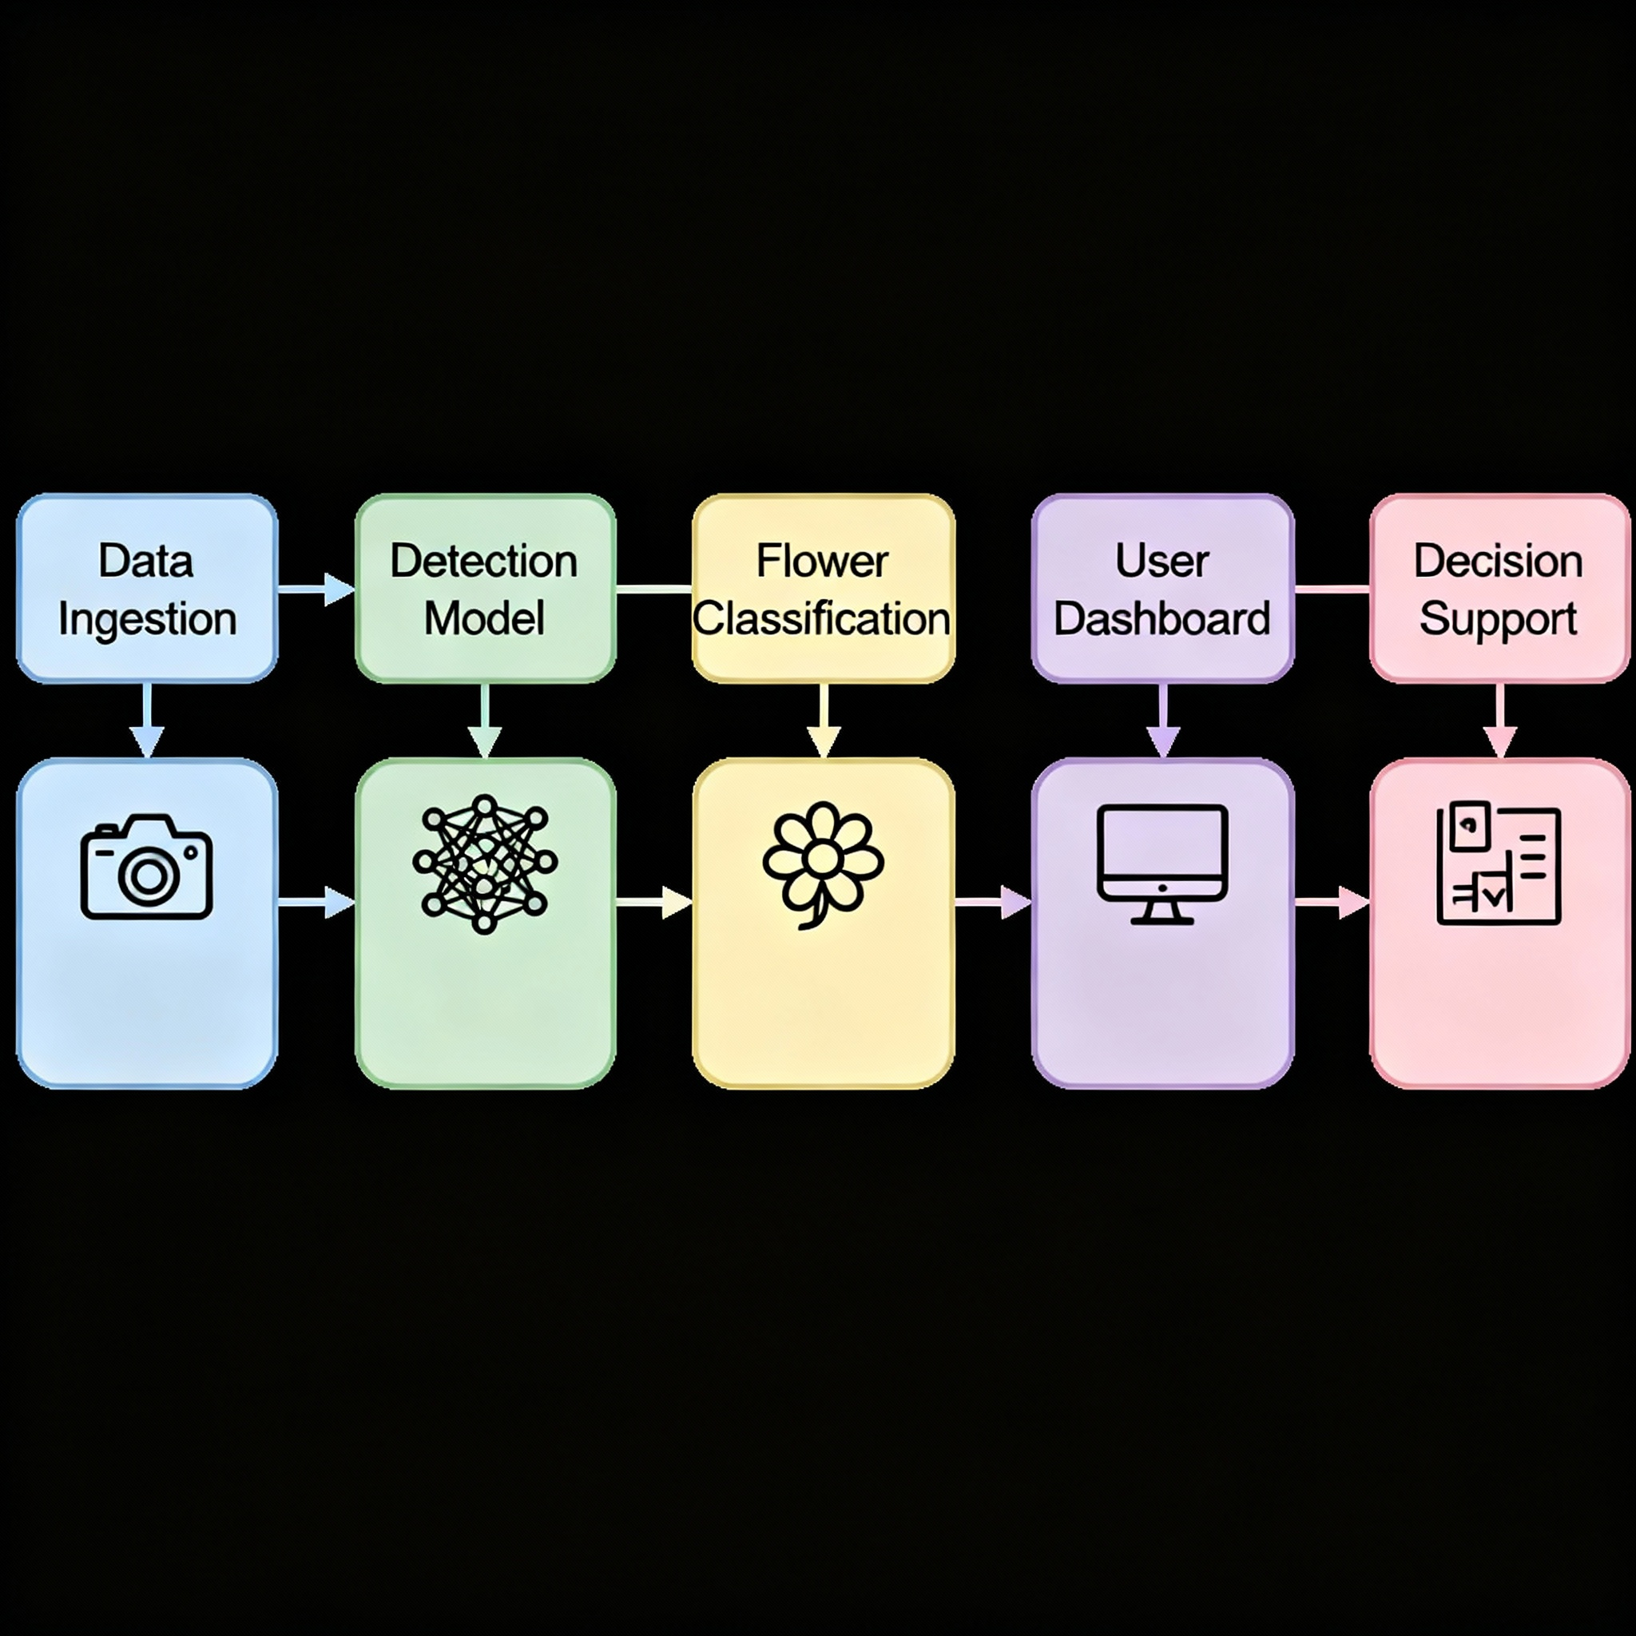
System Design
Flowchart
Modular Architecture: Independent agents, easy scaling
Concurrent Processing: Parallel execution, fast response
Resilient Design: Auto-fallbacks, error handling
API Integration: Multiple APIs, unified data flow
Data Pipeline: Real-time processing to visualization

Slide 5
Technical Details
Orchestrator: Main coordinator & API h andler, manages agent workflow
Explain-Bot: GPT4 botanical expert, generates regional bloom insights
Search-Bot: Web crawler for phenology & agricultural data
Predict-Bot: Climate & bloom probability forecaster + GeoJSON
System: 2-5s response, parallel processing, smart fallbacks
AI Agents - CrewAI
Image Classification Model
Flower species classifier: Developed a YOLO-based model trained on a manually labeled dataset to classify flower species
Heuristic Based Model
Flower Blooming Probability Predictor: Built a model architecture using mock-NDVI data to predict regional blooming probabilities and visual graphs.
AI - chatbot
Integrated a RAG based chatbot for assistance

Slide 6
Results & Impact
Impacts
Agricultural management: crop bloom and disease control predictions.
Ecological studies: invasive species detection, biodiversity monitoring, phenology assessments.
Conservation planning: prioritizing vulnerable regions for protection.
Environmental forecasting: predicting super blooms and seasonal vegetation cycles.
Public engagement: supporting community science in monitoring local blooms
Results
Accurate detection and mapping of bloom events .
Model accuracy (up to 80%) in distinguishing flowers from leaves and background.
Successful classification of flowering stages and species using machine learning.
Visualization of bloom timing, duration, and spatial extent in interactive maps

Slide 7
Thank you
Team ARRIVALISTS
Paul Johnston,
Aswin Binoy
Muhammed Sinan D

