Slide 1
Hatch 2027
Building skills that work for you
Notes:
PRIVATE — PRESENTER ONLY
Welcome. Say: Today we will use existing tools, then teach a skill to do a task we understand. Students: keep one repeated task from your own work in mind.
Teacher guide: https://github.com/aswinckr/Hatch/blob/main/Workshop/instructor/TEACHER-GUIDE.md

Slide 2
Skills I use
Sunlight
Research, design QA, and recurring analysis
Notes:
PRIVATE — PRESENTER ONLY
Show one genuine Sunlight example you can safely demonstrate. Explain the repeated job it does. Keep the full private skill inventory out of the handout. Students: name a repeated decision in their own work.
Teacher guide: https://github.com/aswinckr/Hatch/blob/main/Workshop/instructor/TEACHER-GUIDE.md

Slide 3
Skills I use
Research and learning
Creative work
Custom workflows
Notes:
PRIVATE — PRESENTER ONLY
Say: A skill can support research, creative work, or an everyday workflow. Give one example, then ask students for one. Do not turn this into a tour of every tool.
Teacher guide: https://github.com/aswinckr/Hatch/blob/main/Workshop/instructor/TEACHER-GUIDE.md

Slide 4
If you had to hire an intern to help you with your job, what would their role be?
Notes:
PRIVATE — PRESENTER ONLY
Ask the intern question. Give everyone one minute to write privately, then have pairs share. Revisit their answers at the end of the day.
Teacher guide: https://github.com/aswinckr/Hatch/blob/main/Workshop/instructor/TEACHER-GUIDE.md

Slide 5
About me — TODO
Notes:
PRIVATE — PRESENTER ONLY
TODO FOR ASWIN: personal introduction. Add only the story and facts you want to share. No biography has been invented.
Teacher guide: https://github.com/aswinckr/Hatch/blob/main/Workshop/instructor/TEACHER-GUIDE.md

Slide 6
My projects — TODO
Notes:
PRIVATE — PRESENTER ONLY
TODO FOR ASWIN: project examples. Add images and one sentence about the work you personally did.
Teacher guide: https://github.com/aswinckr/Hatch/blob/main/Workshop/instructor/TEACHER-GUIDE.md

Slide 7
Agenda
Try the tools
Build a skill through three versions
Choose your next workflow
Notes:
PRIVATE — PRESENTER ONLY
Explain the full-day rhythm: a tool warmup, then a 165-minute skills exercise. Three versions total, with a ten-minute break after version 2. Personal introduction and lunch timing remain yours to set.
Teacher guide: https://github.com/aswinckr/Hatch/blob/main/Workshop/instructor/TEACHER-GUIDE.md

Slide 8
Tech Check
A laptop, browser, and coding agent
Access to the workshop files
A shared reference and model
Notes:
PRIVATE — PRESENTER ONLY
Before teaching, confirm account access, browser capture, and the shared model. The QA exercise is a web app and needs no Xcode or AI Gateway balance. Keep a Python static server or the teacher-hosted app available. Do not quote a subscription price without checking it. Students: open the files and confirm they can see the reference.
Teacher guide: https://github.com/aswinckr/Hatch/blob/main/Workshop/instructor/TEACHER-GUIDE.md

Slide 9
Intro to Codex & Claude Code
Notes:
PRIVATE — PRESENTER ONLY
Show your chosen coding agent. Point out the working folder, prompt area, and browser preview. Use the same host for the demo and acknowledge that other hosts expose different controls.
Teacher guide: https://github.com/aswinckr/Hatch/blob/main/Workshop/instructor/TEACHER-GUIDE.md

Slide 10
A working folder and a fresh task
Your agent works with the files you give it
Preview changes in the browser
Start a fresh task when testing a skill
Notes:
PRIVATE — PRESENTER ONLY
Show the difference between an authoring task and a fresh audit task. Editing happens in authoring. The audit sees only one frozen skill and approved inputs. Explain that a fresh conversation alone does not restrict file access.
Teacher guide: https://github.com/aswinckr/Hatch/blob/main/Workshop/instructor/TEACHER-GUIDE.md

Slide 11
Tools of AI
Beginner Friendly
Notes:
PRIVATE — PRESENTER ONLY
Transition: we will try the tools through a small warmup. Keep this separate from the QA exercise so the audit target stays stable.
Teacher guide: https://github.com/aswinckr/Hatch/blob/main/Workshop/instructor/TEACHER-GUIDE.md

Slide 12
Workshop files
github.com/aswinckr/Hatch
Notes:
PRIVATE — PRESENTER ONLY
Open github.com/aswinckr/Hatch and the Workshop folder. Start with participants/WARMUP.md for the earlier tool exercises. The design QA handout is participants/START-HERE.md. The repository is private at preparation time, so arrange attendee read access before the event.
Teacher guide: https://github.com/aswinckr/Hatch/blob/main/Workshop/instructor/TEACHER-GUIDE.md

Slide 13
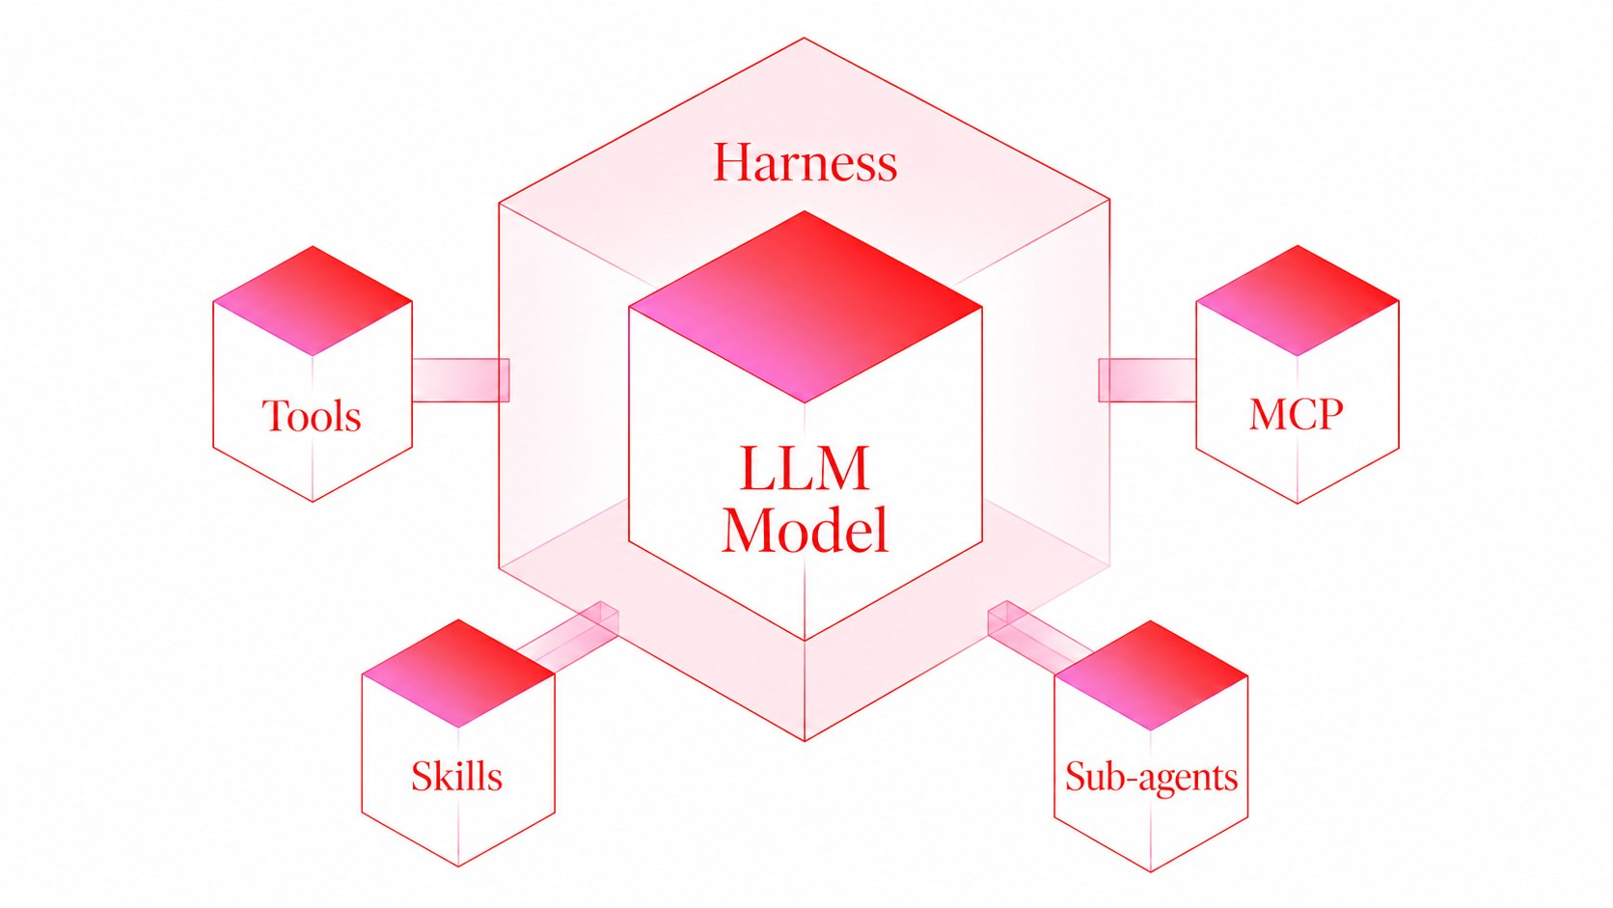
A Harness enables AI models to take action
Notes:
PRIVATE — PRESENTER ONLY
Explain with the existing illustration: the surrounding app gives the model tools and a place to work. Ask students to identify one action they have seen the agent take.
Teacher guide: https://github.com/aswinckr/Hatch/blob/main/Workshop/instructor/TEACHER-GUIDE.md

Slide 14
Skills are reusable instruction files your agent can read when a task matches
CONCEPT #1
Notes:
PRIVATE — PRESENTER ONLY
Explain that a skill gives reusable instructions. Show where the instruction file lives. A skill description helps the host choose it. Source: https://learn.chatgpt.com/docs/build-skills
Teacher guide: https://github.com/aswinckr/Hatch/blob/main/Workshop/instructor/TEACHER-GUIDE.md

Slide 15
Skills Demo
Finding a skill
Installing a skill
Running a skill
Notes:
PRIVATE — PRESENTER ONLY
Teacher: use the available skill interface to find and run Impeccable. Students: follow the first exercise in participants/WARMUP.md. Save a before screenshot and one design decision.
Teacher guide: https://github.com/aswinckr/Hatch/blob/main/Workshop/instructor/TEACHER-GUIDE.md

Slide 16
Your Turn:
Install impeccable skill and redesign the starter site
Notes:
PRIVATE — PRESENTER ONLY
Keep this slide projected during the warmup. Students use the prompt in participants/WARMUP.md to improve a copy of the starter. Ask pairs to explain one visible change and its tradeoff.
Teacher guide: https://github.com/aswinckr/Hatch/blob/main/Workshop/instructor/TEACHER-GUIDE.md

Slide 17
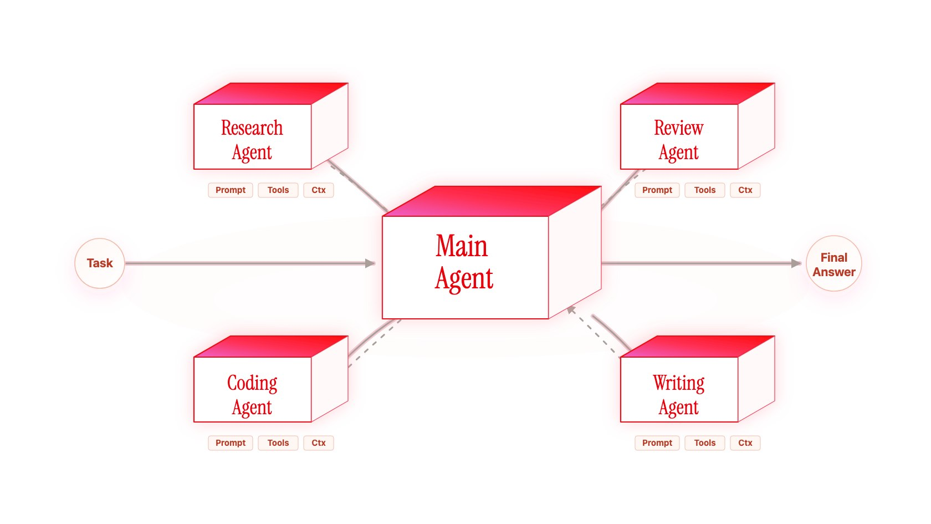
Subagents can handle a focused task separately
CONCEPT #2
Notes:
PRIVATE — PRESENTER ONLY
Explain separate focused work and its limits. A separate agent can still share files and tools. It is not automatically isolated from answers. Demonstrate only when the host supports it.
Teacher guide: https://github.com/aswinckr/Hatch/blob/main/Workshop/instructor/TEACHER-GUIDE.md

Slide 18
Subagents Demo
Creating a subagent
Calling a subagent
Notes:
PRIVATE — PRESENTER ONLY
Create a focused persona reviewer using the WARMUP prompt. Give it the target audience and rendered page. Ask for observations tied to evidence. Label its perspective as simulated, not user research.
Teacher guide: https://github.com/aswinckr/Hatch/blob/main/Workshop/instructor/TEACHER-GUIDE.md

Slide 19
Your turn
Review the page from a first-time visitor’s perspective
Notes:
PRIVATE — PRESENTER ONLY
Students: run the persona review, compare one observation with the page, and decide whether it is supported. Use a fresh task as a fallback if subagents are unavailable.
Teacher guide: https://github.com/aswinckr/Hatch/blob/main/Workshop/instructor/TEACHER-GUIDE.md

Slide 20
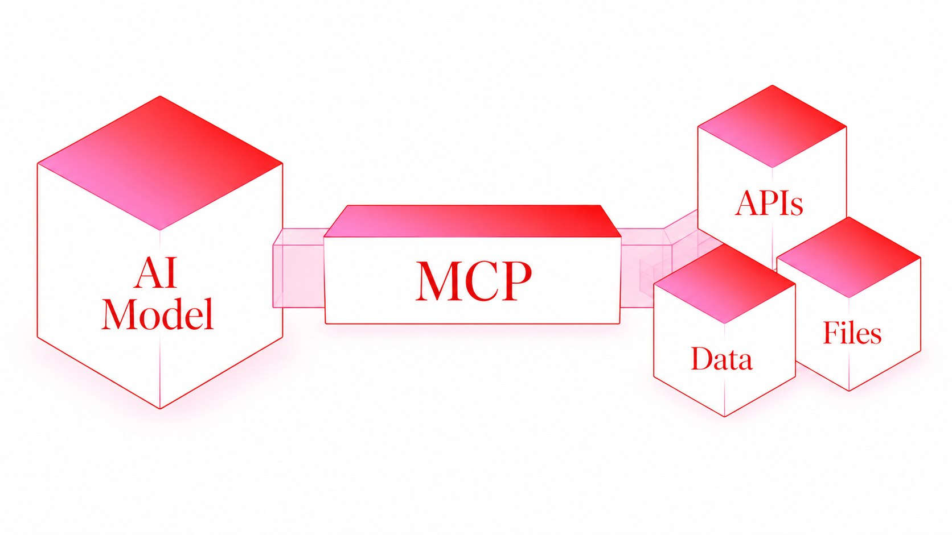
MCP connects your agent to external tools
CONCEPT #3
Notes:
PRIVATE — PRESENTER ONLY
Use the Figma example to show what a connection exposes. Tool access depends on the account, permissions, and quota. Keep screenshots ready so a rate limit does not stop the workshop.
Teacher guide: https://github.com/aswinckr/Hatch/blob/main/Workshop/instructor/TEACHER-GUIDE.md

Slide 21
MCP Demo
Installing an MCP
Running an MCP
Notes:
PRIVATE — PRESENTER ONLY
Teacher: demonstrate an available Figma read or write in an exercise copy. A failed or unavailable action should be reported honestly. Students use the matching WARMUP instructions.
Teacher guide: https://github.com/aswinckr/Hatch/blob/main/Workshop/instructor/TEACHER-GUIDE.md

Slide 22
Your Turn:
Push your impeccable design to figma using MCP
Notes:
PRIVATE — PRESENTER ONLY
Students: create an editable copy of their warmup page in an exercise Figma file if available. If write access is unavailable, retrieve or inspect the reference screenshot and discuss the difference between read and write capabilities.
Teacher guide: https://github.com/aswinckr/Hatch/blob/main/Workshop/instructor/TEACHER-GUIDE.md

Slide 23
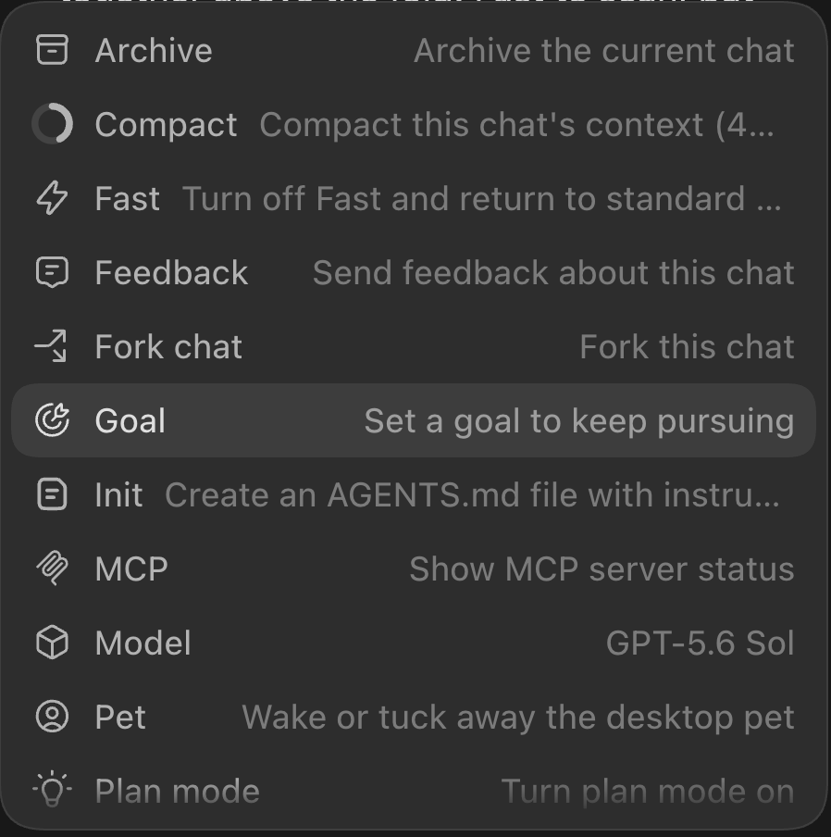
Commands are ‘/’ triggered workflows
CONCEPT #4
Notes:
PRIVATE — PRESENTER ONLY
Show one command available in the host you are using. Explain that invocation syntax is host-specific. Do not assume every command exists in every coding app.
Teacher guide: https://github.com/aswinckr/Hatch/blob/main/Workshop/instructor/TEACHER-GUIDE.md

Slide 24
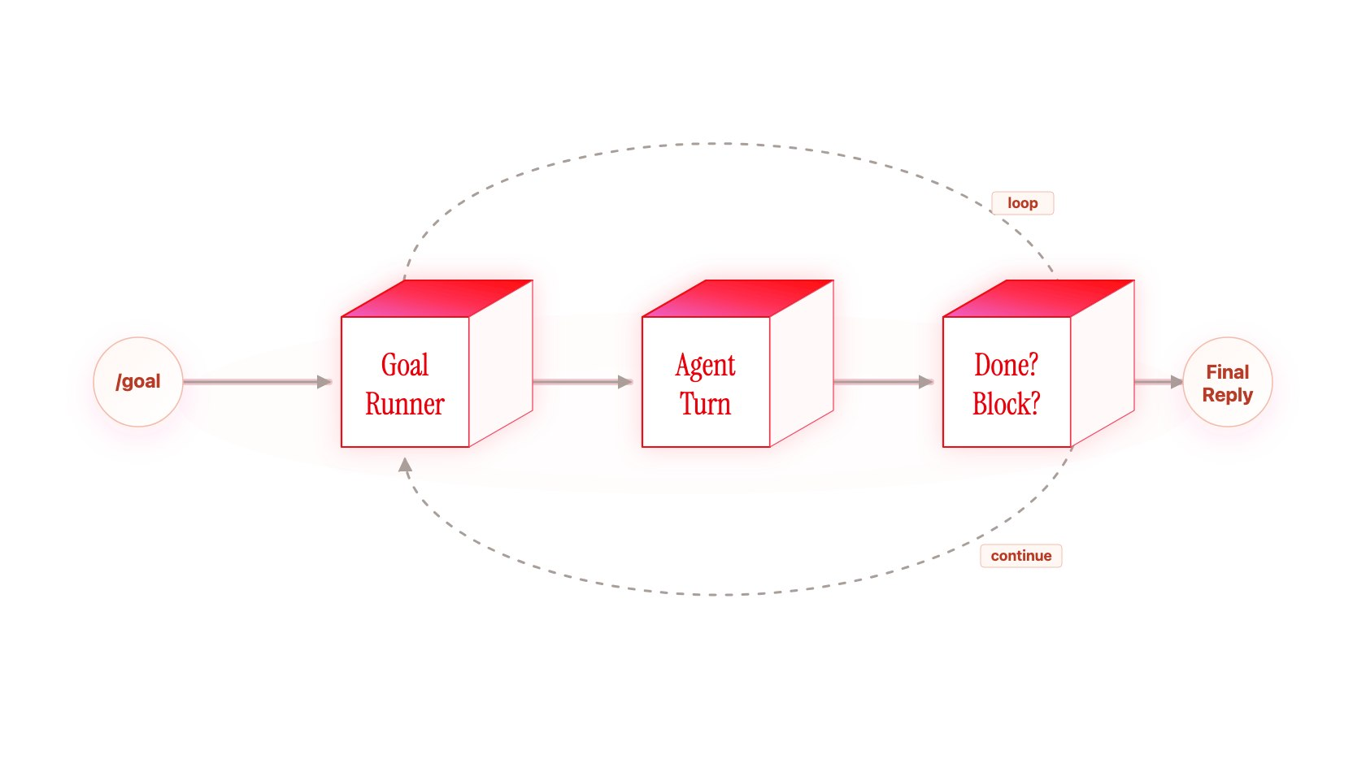
/goal
Notes:
PRIVATE — PRESENTER ONLY
Use the goal example as a bounded improvement loop. Students should be able to tell when an action has been checked. If no goal feature is available, follow the same bounded sequence manually.
Teacher guide: https://github.com/aswinckr/Hatch/blob/main/Workshop/instructor/TEACHER-GUIDE.md

Slide 25
Make the main action easy to find, then verify that it works
Make the page look more premium.
Good Goal
Bad Goal
Notes:
PRIVATE — PRESENTER ONLY
Compare the two requests. Ask: what could we observe to decide whether the second request is done? A model score alone is not proof that real users can complete a task.
Teacher guide: https://github.com/aswinckr/Hatch/blob/main/Workshop/instructor/TEACHER-GUIDE.md

Slide 26
Goal Demo
Writing a test case & setting up a /goal
Notes:
PRIVATE — PRESENTER ONLY
Teacher: choose one main action and define a concrete check. Use the WARMUP goal prompt. Stop after two passes and report what remains.
Teacher guide: https://github.com/aswinckr/Hatch/blob/main/Workshop/instructor/TEACHER-GUIDE.md

Slide 27
Your turn
Improve one action, then check it again
Notes:
PRIVATE — PRESENTER ONLY
Students improve one action in their warmup copy and check it again. Save evidence of the before and after behavior. Do not alter the QA target.
Teacher guide: https://github.com/aswinckr/Hatch/blob/main/Workshop/instructor/TEACHER-GUIDE.md

Slide 28
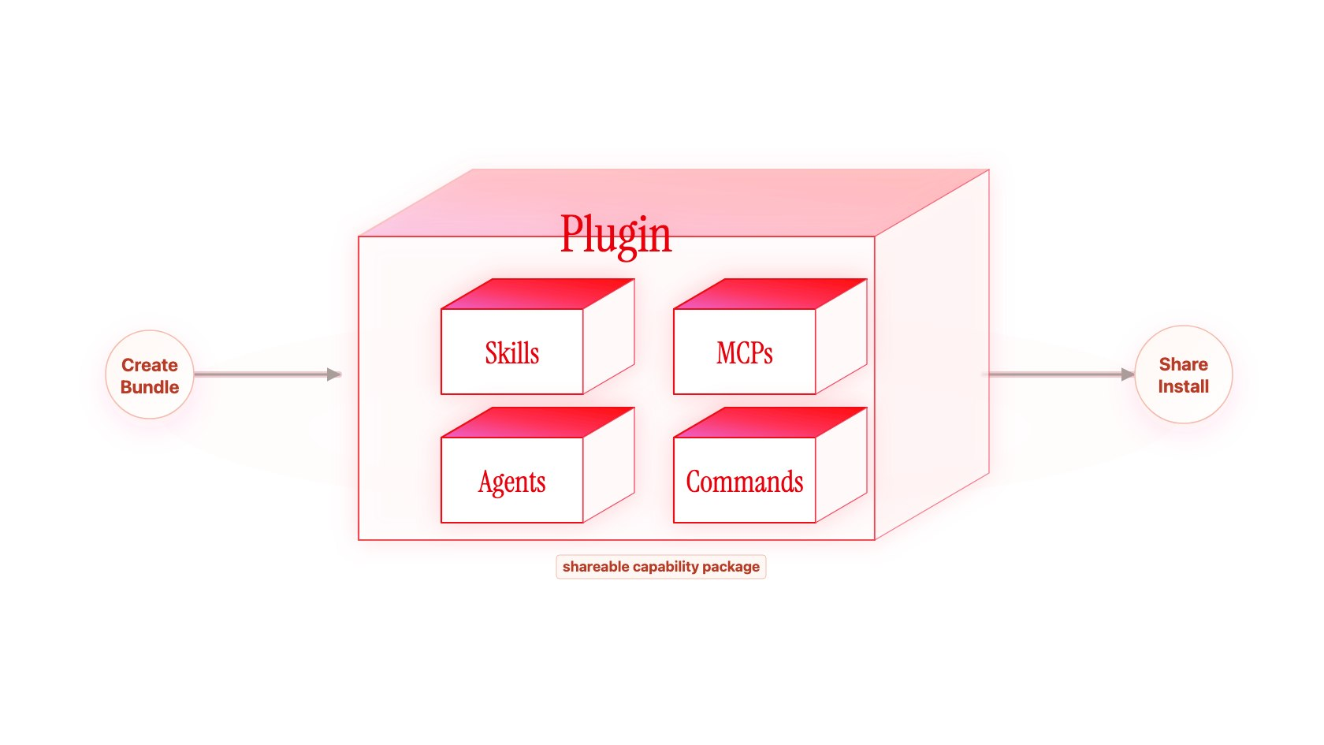
Plugins package skills and tool connections
CONCEPT #5
Notes:
PRIVATE — PRESENTER ONLY
Use the illustration to explain a reusable bundle. Actual plugin contents depend on the host. Point to the skill and tool parts students have already used.
Teacher guide: https://github.com/aswinckr/Hatch/blob/main/Workshop/instructor/TEACHER-GUIDE.md

Slide 29
Plugin Demo
Installing from plugin marketplace
Calling a skill from a plugin
Notes:
PRIVATE — PRESENTER ONLY
Demonstrate an installed plugin and one useful skill within it. If unavailable, use an already installed brainstorming skill and name the fallback.
Teacher guide: https://github.com/aswinckr/Hatch/blob/main/Workshop/instructor/TEACHER-GUIDE.md

Slide 30
Your turn
Give one animation a useful job
Notes:
PRIVATE — PRESENTER ONLY
Students use the WARMUP motion prompt. Ask what the animation communicates and how the page works with reduced motion. Keep the change small.
Teacher guide: https://github.com/aswinckr/Hatch/blob/main/Workshop/instructor/TEACHER-GUIDE.md

Slide 31
Introduction To Skills
Notes:
PRIVATE — PRESENTER ONLY
Begin the 165-minute skills section. The setup, recap, and framing slides are brief. Avoid repeating the entire earlier tool introduction.
Teacher guide: https://github.com/aswinckr/Hatch/blob/main/Workshop/instructor/TEACHER-GUIDE.md

Slide 32
We just did a few things…
You used a skill to change a page
You reviewed the result
Now you will teach your own process
Notes:
PRIVATE — PRESENTER ONLY
Ask students to recall one choice they made while using the earlier tools. Say: now we will put that kind of judgment into instructions.
Teacher guide: https://github.com/aswinckr/Hatch/blob/main/Workshop/instructor/TEACHER-GUIDE.md

Slide 33
Which task would you teach a skill?
Notes:
PRIVATE — PRESENTER ONLY
Give students a short moment to name a task. This replaces the earlier duplicate skill-creation demo; the actual one-shot comes in version 1.
Teacher guide: https://github.com/aswinckr/Hatch/blob/main/Workshop/instructor/TEACHER-GUIDE.md

Slide 34
Productizing yourself
Notes:
PRIVATE — PRESENTER ONLY
Say: What part of your judgment can you make reusable? Keep the emphasis on making a useful workflow, not replacing all design judgment.
Teacher guide: https://github.com/aswinckr/Hatch/blob/main/Workshop/instructor/TEACHER-GUIDE.md

Slide 35

Notes:
PRIVATE — PRESENTER ONLY
Use the existing illustration to describe doing a repeated task manually. Ask which steps you normally perform without explaining them.
Teacher guide: https://github.com/aswinckr/Hatch/blob/main/Workshop/instructor/TEACHER-GUIDE.md

Slide 36
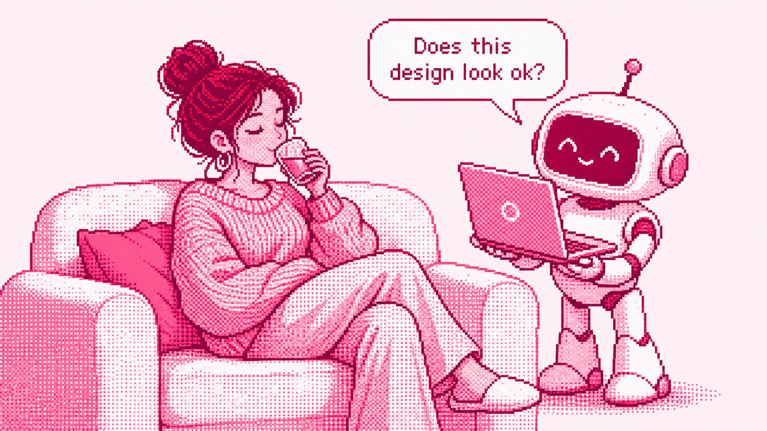
Notes:
PRIVATE — PRESENTER ONLY
Use the second illustration to describe reviewing work an assistant has prepared. Ask what evidence you would want before trusting it.
Teacher guide: https://github.com/aswinckr/Hatch/blob/main/Workshop/instructor/TEACHER-GUIDE.md

Slide 37
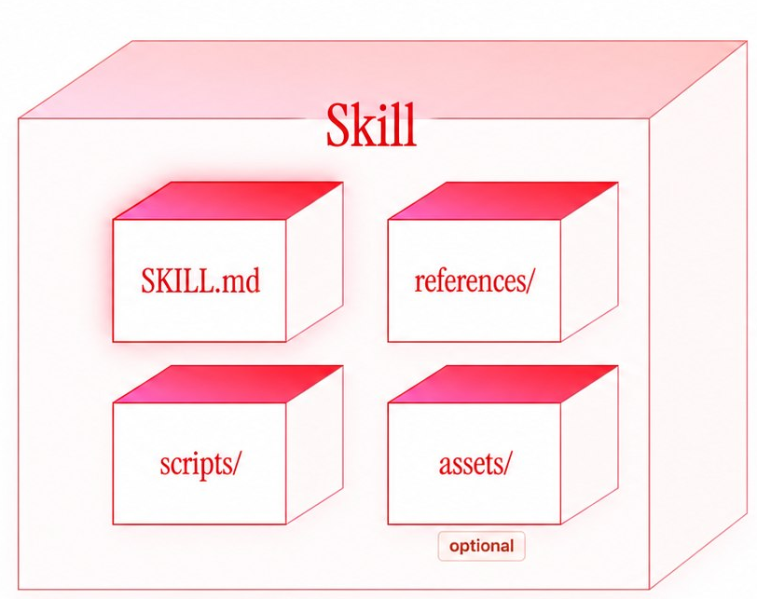
Anatomy of a Skill File
instructions / workflow
deeper docs, examples, API notes
templates, images, starter files
repeatable automations
Notes:
PRIVATE — PRESENTER ONLY
Point to SKILL.md, optional references, scripts, and assets. Keep this brief now; students will reorganize their own file in version 3. A small skill does not need every folder. Source: https://learn.chatgpt.com/docs/build-skills
Teacher guide: https://github.com/aswinckr/Hatch/blob/main/Workshop/instructor/TEACHER-GUIDE.md

Slide 38
A real skill file
The instructions behind the behavior
Notes:
PRIVATE — PRESENTER ONLY
Open a short already familiar skill file from the warmup. Show its purpose and instructions. Do not reveal the completed version 3 QA skill before students make their first attempt.
Teacher guide: https://github.com/aswinckr/Hatch/blob/main/Workshop/instructor/TEACHER-GUIDE.md

Slide 39
Let’s build a design QA skill
Notes:
PRIVATE — PRESENTER ONLY
Show the Figma reference and participant app. Confirm width, state, main-run scope, and reserved transfer section. Students record the common inputs on WORKSHEET.md.
Teacher guide: https://github.com/aswinckr/Hatch/blob/main/Workshop/instructor/TEACHER-GUIDE.md

Slide 40
The design QA exercise
Compare a rendered screen with its reference
Show the differences you can verify
Improve the instructions across three versions
Notes:
PRIVATE — PRESENTER ONLY
State the shared evidence rules from the teacher guide. We compare what is rendered, do not read app source, and do not fix the target. A supported finding is more useful than a long unsupported list.
Teacher guide: https://github.com/aswinckr/Hatch/blob/main/Workshop/instructor/TEACHER-GUIDE.md

Slide 41
Let’s one-shot this
Create, run, and review version 1
Notes:
PRIVATE — PRESENTER ONLY
## 1. Let's one-shot this
**Slide:** “Let's one-shot this.” **Time:** 8-minute demo, then 17-minute student activity and 10-minute review.
**What you are teaching:** A working first attempt gives you something concrete to improve.
**Teacher actions**
- Show the reference and app, then ask: “What would you want someone to check before this ships?” Take two answers.
- In the authoring task, select the available skill creator and paste the creation prompt below.
- Answer any necessary setup question with the shared inputs. Do not dictate a checklist or output format yet.
- Open the resulting skill and read a few lines aloud. Save it as version 1 before changing anything.
- Open a fresh audit task, provide only version 1 and the shared inputs, and paste the run prompt.
- While it runs, ask students to manually compare one small area. Review one actual finding when it finishes.
**Creation prompt**
```text
Create an instruction-only skill called design-qa-v1 that compares a rendered
web app with a Figma screenshot reference and reports design differences as a standalone HTML file showing current and expected
behavior with screenshot evidence. Choose your own layout.
Follow the exercise rules already provided. Save the skill in my authoring
workspace. Do not run the audit or change the app yet.
```
**Run prompt — reuse for every version, changing only the skill version**
```text
Use design-qa-v1 and the exercise rules to compare this app with the reference.
App URL: [paste the supplied URL]
Reference: [attach the supplied images or paste the Figma frame link]
Viewport: 428 × 900 CSS pixels, browser zoom 100%.
State: initial discovery screen, search empty, no dialog open, no saved changes.
Scope: discovery page except Highly-rated newcomers, reserved for transfer.
Audit time budget: 8 minutes. Report what you verified before the budget ends.
Do not change the skill or the app. State any evidence or coverage limitation.
```
**Students do — 17 minutes**
- Spend 3 minutes creating and saving their first skill.
- Spend up to 8 minutes running it in a fresh task.
- Spend 6 minutes saving the raw report and checking one claim against the two images.
- Write one sentence: “I want the next version to be better at ___.”
**Check before moving on:** Every student has a skill file and a saved report or clearly labeled partial run. Ask: “Can your partner locate the difference without you explaining it?” Do not grade by finding count.
**If it goes well:** Use that result. Ask what makes it useful and whether the behavior is repeatable. **If it stalls:** Use a genuine saved run and keep the student's own attempt for comparison.
Teacher guide: https://github.com/aswinckr/Hatch/blob/main/Workshop/instructor/TEACHER-GUIDE.md

Slide 42
Version 2: teach your process
Notes:
PRIVATE — PRESENTER ONLY
Transition to version 2. Students preserve version 1, then copy it to a new working folder. Predict one behavior that a better explanation could change.
Teacher guide: https://github.com/aswinckr/Hatch/blob/main/Workshop/instructor/TEACHER-GUIDE.md

Slide 43
Advise your intern
Explain the checks you normally leave unsaid
Notes:
PRIVATE — PRESENTER ONLY
## 2. Advise your intern
**Slide:** “Advise your intern.” **Time:** 8 minutes. Students apply it during the 24-minute version 2 activity.
**What you are teaching:** Explain the judgment you normally leave implicit.
**Teacher actions**
- Copy version 1 into a version 2 working folder. Keep version 1 unchanged.
- Click into the authoring task. Start voice input if available, or type the same explanation.
- Speak naturally for about a minute. Describe what to check and how to decide; do not recite the planted answers.
- Read the transcript once and correct words that change the meaning.
- Submit the explanation with the revision prompt. Open the revised file and point to two concrete new instructions.
- Ask students: “Which part of this explanation came from your experience as a designer?”
**Say or dictate**
> Imagine you're helping me check this design. Start by making sure we are looking at the same screen at the same width. I normally work from the top down. Within a section, I check the heading, the spacing around it, and then the cards. I compare the outer shape before looking at the image crop and the text. I look at the price and its relationship to the delivery information. If a pattern repeats, I check the other visible examples too. Tell me where the difference is and show the evidence. If you can't tell from the image, say that.
**Revision prompt**
```text
Use my explanation below to improve design-qa-v2, copied from version 1.
Turn my practical judgment into clear checking steps. Keep the shared evidence
rules. Do not add facts about this particular app as reusable instructions.
Save the revision and show me the meaningful changes. Do not run an audit yet.
My explanation:
[paste the corrected voice transcript or typed explanation]
```
**Students do**
- In their own words, dictate or type the checks they would give a junior designer.
- Include one decision rule, such as how they distinguish a repeated pattern from an isolated difference.
- Read the generated instructions and remove anything they did not mean.
**Checkpoint:** The new text names observable checks rather than repeating “be thorough.” **If voice fails:** Type rough bullets. The technique is explaining judgment, not using a particular dictation product.
Teacher guide: https://github.com/aswinckr/Hatch/blob/main/Workshop/instructor/TEACHER-GUIDE.md

Slide 44
Watch me work
Demonstrate one comparison, then extract the method
Notes:
PRIVATE — PRESENTER ONLY
## 3. Watch me work
**Slide:** “Watch me work.” **Time:** 10 minutes. Students repeat a smaller version during practice.
**What you are teaching:** Demonstrating one real comparison reveals the sequence and decisions that a verbal request can miss.
**Teacher actions**
- Bring the first “You visited before” card into view in Figma and the app. Match the card and surrounding heading, not just a similarly colored image.
- Capture one image of each at comparable scale, retaining enough surrounding content to locate the card. Label them `reference-card` and `app-card`.
- Tell the agent it is observing a demonstration, using the first prompt below. Attach both images. Do not assume it sees your cursor or screen automatically.
- Point to the outside edge. Say what you are comparing: corner shape and shadow. Record the observation as match, difference, or uncertain.
- Point to the image and its boundary. Compare crop and the transition into the card body.
- Point to the card title, then its supporting information. Compare hierarchy, alignment, and spacing.
- Point to the small product images. Compare their orientation and separation. Describe only what the two images support.
- Write one finding yourself using the observation template below. If you cannot verify a difference, model an “uncertain” entry instead.
- Send your observations and the extraction prompt. Check the extracted process before accepting it into version 2.
**Before demonstrating**
```text
I am going to demonstrate how I compare one component. Use the two attached
images and the observations I send. Do not audit the rest of the screen or
edit the skill yet. Keep track of my sequence of checks and the decisions I make.
```
**Narration pattern — say this while pointing**
> First I'm making sure this is the same card. Now I'm checking the outer shape. Here is what I see in the reference, and here is what I see in the app. Next I check the image boundary. Then I check the title and the smaller information. I haven't tested this control, so I can't claim that it behaves incorrectly. I can describe the visible difference.
**Your manual observation**
```text
Location: [section and component]
Reference: [what I can actually see]
App: [what I can actually see]
Result: match / difference / uncertain
Evidence: reference-card and app-card, [specific region]
Suggested correction, if justified: [plain visual instruction]
```
**After demonstrating**
```text
Extract a reusable checking procedure from my demonstration. Separate my
sequence of checks from the observations about this one card. Show me the
procedure first. Do not turn this card's contents or observed defects into
expected findings for other screens.
```
After reviewing it, send:
```text
Add the reviewed procedure to design-qa-v2. Merge it with the existing checks
instead of appending a second copy. Keep the one-card findings out of the
skill. Do not run the full audit yet.
```
**Students do**
- Choose one component and make their own matching captures.
- Manually compare it, narrating or typing at least three checks and one observation.
- Give those images and observations to the authoring agent and ask it to extract the method.
- Correct the method before merging it into version 2.
**Checkpoint:** A partner can follow the procedure on a different card. A list saying “this card has the wrong shadow” is an answer, not a procedure.
**If captures fail:** Use the supplied reference and app screenshots. The student still performs the comparison and supplies observations. No screen recording or live observation feature is required.
Teacher guide: https://github.com/aswinckr/Hatch/blob/main/Workshop/instructor/TEACHER-GUIDE.md

Slide 45
List ’em first
Review the checklist before running version 2
Notes:
PRIVATE — PRESENTER ONLY
## 4. List 'em first
**Slide:** “List 'em first.” **Time:** 5 minutes, followed by the version 2 activity.
**What you are teaching:** Review coverage before spending time executing a workflow.
**Teacher actions**
- Ask the authoring agent for a proposed checklist using the prompt below.
- Read one row aloud. Ask: “How would we know this was checked?”
- Replace vague items such as “check UX” with observable checks.
- Remove duplicate rows. Keep room to mark an item not applicable or unverified.
- Save the checklist requirement into version 2. Explain that execution now follows the reviewed checklist.
**Prompt**
```text
Using design-qa-v2, propose the checklist you would use before auditing.
For each item, name the region or component, the property being compared,
and the evidence needed. Do not report differences yet.
Keep the checklist usable during a short audit and avoid duplicate checks.
```
After reviewing:
```text
Add this checklist-first step to design-qa-v2. During a run, record whether
each check matched, differed, was not applicable, or could not be verified.
Require a standalone HTML report with Current behavior on the left and
Expected behavior on the right, each with matching screenshot evidence.
Keep the evidence rules. Save the skill without auditing the app yet.
```
**Students do — version 2 practice, 24 minutes total**
- 4 min: Explain their checks and revise the copied skill.
- 6 min: Demonstrate one component and extract the method.
- 4 min: Review the checklist and save version 2.
- 8 min: Run version 2 in a fresh audit task with the same shared inputs.
- 2 min: Save report.html and select one finding for pair review.
**Pair review — 8 minutes:** One person locates a finding in the screenshots while the other explains which instruction helped. Swap roles. Discuss one missed or uncertain area. Save both versions; do not replace the baseline report.
Teacher guide: https://github.com/aswinckr/Hatch/blob/main/Workshop/instructor/TEACHER-GUIDE.md

Slide 46
Version 3: make it reusable
Notes:
PRIVATE — PRESENTER ONLY
Take the ten-minute break before this block. Return with version 2 saved. Copy it into version 3. We will improve a rule, choose a trigger, organize detail, and test a simplification.
Teacher guide: https://github.com/aswinckr/Hatch/blob/main/Workshop/instructor/TEACHER-GUIDE.md

Slide 47
Anti-patterns
Show a mistake and teach the replacement behavior
Notes:
PRIVATE — PRESENTER ONLY
## 5. Anti-patterns
**Slide:** “Anti-patterns.” **Time:** 7 minutes.
**What you are teaching:** Turn a specific failure into a narrow rule with a useful replacement behavior.
**Teacher actions**
- Copy version 2 into a version 3 working folder.
- Choose one real weak finding from the reports. If none is suitable, label the examples below as hypothetical.
- Ask students what evidence the finding would need.
- Write “avoid this” and “do this instead” together.
- Add only rules that address an observed problem or a concrete evidence limitation.
**Hypothetical examples**
| Avoid | Do instead |
| --- | --- |
| “The radius is exactly 8 px wrong” from an uncalibrated screenshot | Describe the visible corner-shape difference and label any estimate |
| “Users cannot find the cart” after looking at one image | Describe the visible affordance; test the interaction or label the usability impact as a hypothesis |
| Ten separate findings for the same repeated card treatment | Group the repeated treatment and list the visible instances checked |
| “This section is missing” when it was below the viewport | Scroll or mark the section unverified |
**Prompt**
```text
Improve design-qa-v3 using this failure example:
[paste one finding and explain why its evidence or wording is insufficient]
Propose one narrow rule that prevents this mistake and a positive instruction
for what to do instead. Explain where it fits in the workflow. After I review
it, merge it into the skill without duplicating existing rules.
```
**Students do:** Choose one weakness in their own report, propose a replacement behavior, and add it to version 3 during practice. **Checkpoint:** The rule describes how to work, not which answers to output.
Teacher guide: https://github.com/aswinckr/Hatch/blob/main/Workshop/instructor/TEACHER-GUIDE.md

Slide 48
When should this skill run?
Choose an explicit request or a matching task
Notes:
PRIVATE — PRESENTER ONLY
## 6. User-invoked or model-invoked
**Slide:** “When should this skill run?” **Time:** 4 minutes.
**What you are teaching:** Choose the trigger deliberately. This is different from choosing a model.
**Teacher actions**
- Show an explicit request: “Use design-qa-v3 to compare these screenshots.” Select or mention the installed skill using the current app's skill control.
- Show a natural request without naming it: “Compare this rendered screen with its Figma reference.” Explain that a matching description can support automatic selection.
- Show an unrelated request: “Rewrite this meeting invitation.” Ask whether design QA belongs there.
- Let students choose the intended trigger for their future use case. Keep explicit invocation for the timed workshop audits so you know which version is running.
**Prompt**
```text
Review the trigger description for design-qa-v3. It should apply to comparing
a rendered interface with a supplied design reference, not general app
implementation or unrelated writing. Propose a concise description and three
example requests: a direct invocation, a natural matching request, and an
unrelated request. Do not run the audit.
```
**Optional Codex configuration demo:** If choosing explicit-only behavior, edit the skill's `agents/openai.yaml` to include `policy: { allow_implicit_invocation: false }`. Explicit invocation still works. Keep this a deliberate exercise choice, not a default applied to everyone's skill. Other hosts may use different controls. [Official OpenAI skill documentation](https://learn.chatgpt.com/docs/build-skills).
**Students do:** Write one sentence explaining when they want their skill to run. Use the three example requests as a routing check. **Checkpoint:** They can distinguish a trigger from the skill's checking procedure.
Teacher guide: https://github.com/aswinckr/Hatch/blob/main/Workshop/instructor/TEACHER-GUIDE.md

Slide 49
The main steps and the references
Keep the workflow clear and link detail where it is needed
Notes:
PRIVATE — PRESENTER ONLY
## 7. Structure the skill
**Slide:** “The main steps and the references.” **Time:** 4 minutes.
**What you are teaching:** Put essential instructions where the agent starts and conditional detail where it is needed.
**Teacher actions**
- Open the version 3 folder and show the main skill beside its reference folder.
- Keep purpose, evidence boundary, and workflow in the main file.
- Move the detailed visual checklist to a reference. Keep an explicit instruction saying when to read it.
- Put interaction checks in a separate reference that is read only when interaction testing is in scope.
- Open the supplied Figma discrepancy frame and the bundled HTML example. Point to the dark issue header, Current on the left, Expected on the right, and paired screenshot panels.
- Show how the HTML layout belongs in an asset, while the rules for evidence and reporting stay in the skill. The final output is a standalone report.html, with embedded images and no network dependency.
**Prompt**
```text
Organize design-qa-v3. Keep its purpose, input requirements, evidence rules,
and short workflow in SKILL.md. Move the detailed visual checklist and any
interaction-only instructions into focused references. Link each reference
at the step where it is needed. Preserve behavior and remove duplication.
Use the supplied discrepancy-template.html and HTML report specification
for the output: a dark issue header, current and expected columns, and paired
embedded screenshot evidence. Save a standalone report.html that opens offline.
Do not add scripts unless the workflow actually needs them.
```
**Students do:** Move one substantial piece of supporting detail and verify that the main skill tells the agent when to read it. **Checkpoint:** Ask “How will the agent know this file exists?”
Teacher guide: https://github.com/aswinckr/Hatch/blob/main/Workshop/instructor/TEACHER-GUIDE.md

Slide 50
Steer and prune
Keep the instructions that change the behavior
Notes:
PRIVATE — PRESENTER ONLY
## 8. Steer and prune
**Slide:** “Steer and prune.” **Time:** 10-minute demo, then version 3 practice.
**What you are teaching:** Test whether instructions change behavior before keeping or deleting them.
**Teacher actions**
- Select a vague line such as “be very thorough” and a duplicated paragraph from the working skill, if present.
- Replace vague steering with an observable instruction, such as “compare each visible repeated card and group shared differences.”
- Ask the agent to propose a deletion, but keep a copy of the current file.
- Run a small comparison twice in separate tasks, once before and once after the proposed deletion, using the same screenshot pair and model.
- Compare the actual outputs. Restore the line if the needed behavior disappears. Treat one pair of runs as a useful check, not proof of equivalence.
- If the skill is already concise, remove nothing. Have the student explain why each passage belongs.
**Prompt**
```text
Review design-qa-v3 for repeated instructions, vague wording, and detail that
does not affect the workflow. Propose up to three simplifications. For each,
explain the behavior that must stay the same and a small test that could
detect a regression. Do not apply the changes yet.
```
After choosing one:
```text
Apply only the selected simplification and preserve a before copy outside
the active skill folder. Show the difference. Keep the evidence rules and
reference links intact. I will compare the before and after behavior in
separate audit tasks.
```
**Students do — version 3 practice, 25 minutes**
- 4 min: Add an anti-pattern rule and review the trigger.
- 4 min: Organize one reference and choose one simplification.
- 7 min: Compare before/after on a small screenshot pair and decide whether to keep the change.
- 8 min: Run the full version 3 audit with the same main-run inputs.
- 2 min: Save version 3 and its report, including unfinished areas.
**Checkpoint:** A shorter file is useful only if it preserves needed behavior. Do not delete the input or evidence rules to win a word-count contest.
Teacher guide: https://github.com/aswinckr/Hatch/blob/main/Workshop/instructor/TEACHER-GUIDE.md

Slide 51
What will you teach your skill next?
Notes:
PRIVATE — PRESENTER ONLY
## 9. Transfer and close
**Slide:** “What will you teach your skill next?” **Time:** 10 minutes.
**Teacher actions**
- Give pairs the reserved “Highly-rated newcomers” section and its matching reference.
- Run a short check with version 3, or manually apply its procedure if tool time is exhausted. Clearly distinguish those two outcomes.
- Ask each pair to identify one supported finding or a justified match, and one uncertainty.
- Ask: “What would you teach this skill next?” Then: “Which task from your own work could you teach this way?”
- Point to the GitHub reference versions and instructions for later use.
**Transfer prompt**
```text
Use design-qa-v3 on only the supplied Highly-rated newcomers section and its
matching reference. Use the same evidence rules. Do not read earlier reports.
Spend up to three minutes, then report verified findings and limitations.
```
**Students do:** Save a short reflection: one useful instruction change, one remaining limitation, and one real task to try after the workshop. Sharing a finding is optional; explaining a decision is enough.

