Slide 1
Hatch 2027
Building skills that work for you

Slide 2
Skills I use
Sunlight
Research, design QA, and recurring analysis

Slide 3
Skills I use
Research and learning
Creative work
Custom workflows

Slide 4
If you had to hire an intern to help you with your job, what would their role be?

Slide 5
About me — TODO

Slide 6
My projects — TODO

Slide 7
Agenda
Try the tools
Build a skill through three versions
Choose your next workflow

Slide 8
Tech Check
A laptop, browser, and coding agent
Access to the workshop files
A shared reference and model

Slide 9
Intro to Codex & Claude Code

Slide 10
A working folder and a fresh task
Your agent works with the files you give it
Preview changes in the browser
Start a fresh task when testing a skill

Slide 11
Tools of AI
Beginner Friendly

Slide 12
Workshop files
github.com/aswinckr/Hatch

Slide 13
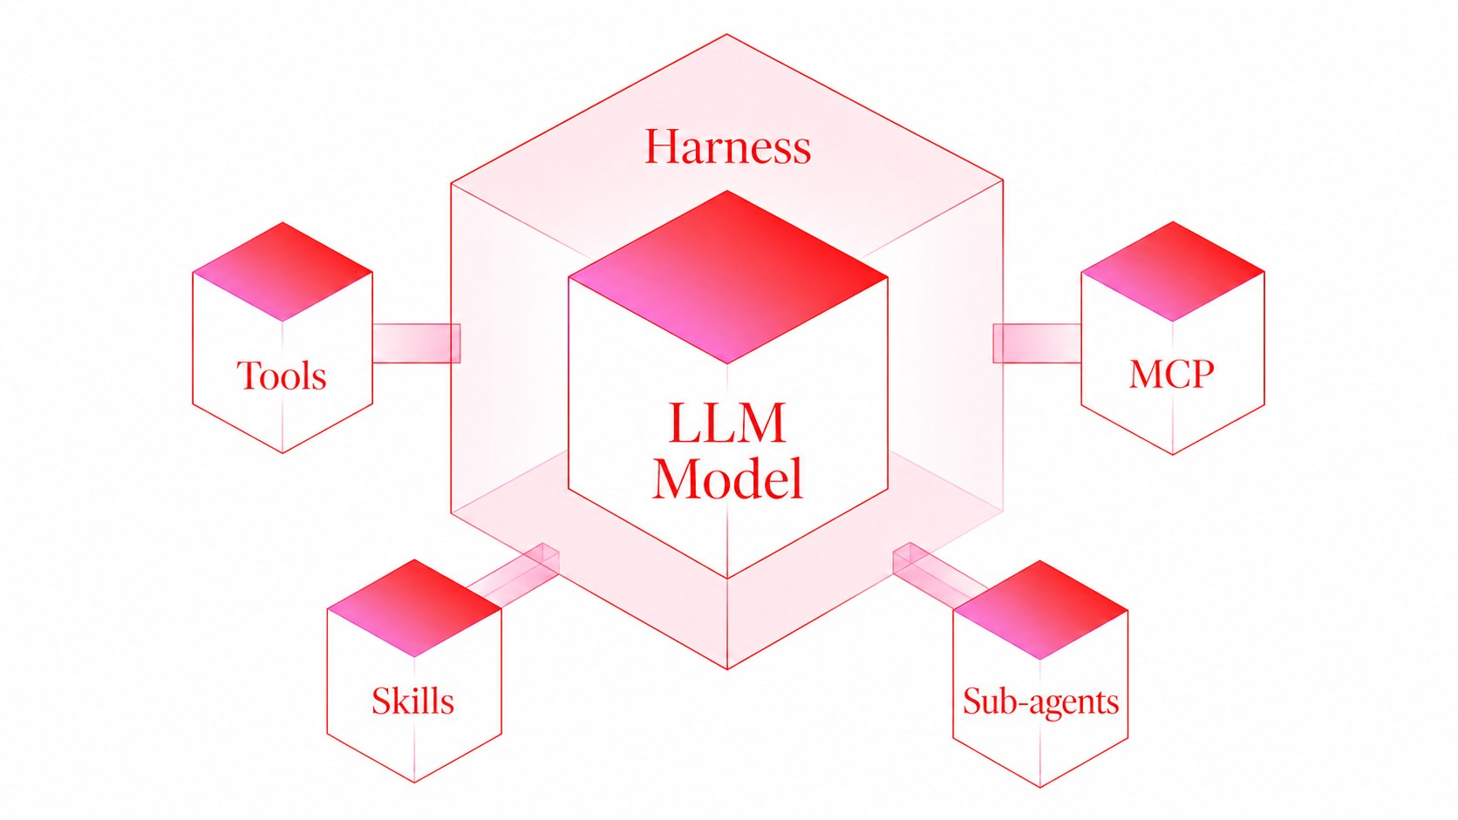
A Harness enables AI models to take action

Slide 14
Skills are reusable instruction files your agent can read when a task matches
CONCEPT #1

Slide 15
Skills Demo
Finding a skill
Installing a skill
Running a skill

Slide 16
Your Turn:
Install impeccable skill and redesign the starter site

Slide 17
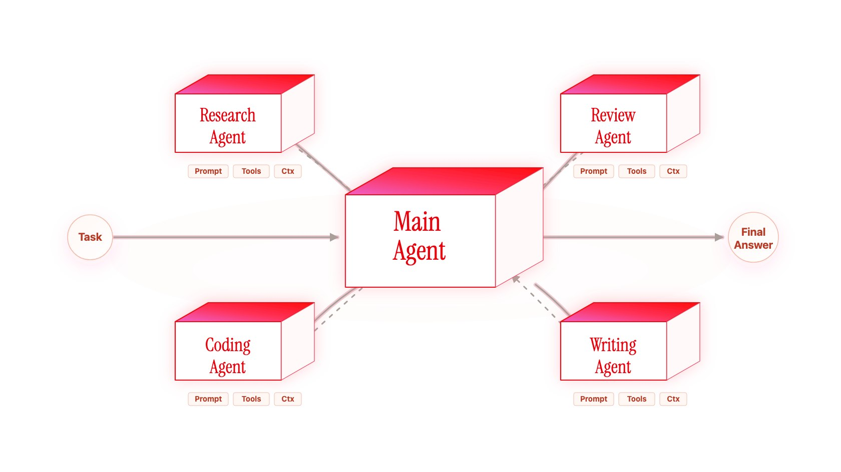
Subagents can handle a focused task separately
CONCEPT #2

Slide 18
Subagents Demo
Creating a subagent
Calling a subagent

Slide 19
Your turn
Review the page from a first-time visitor’s perspective

Slide 20
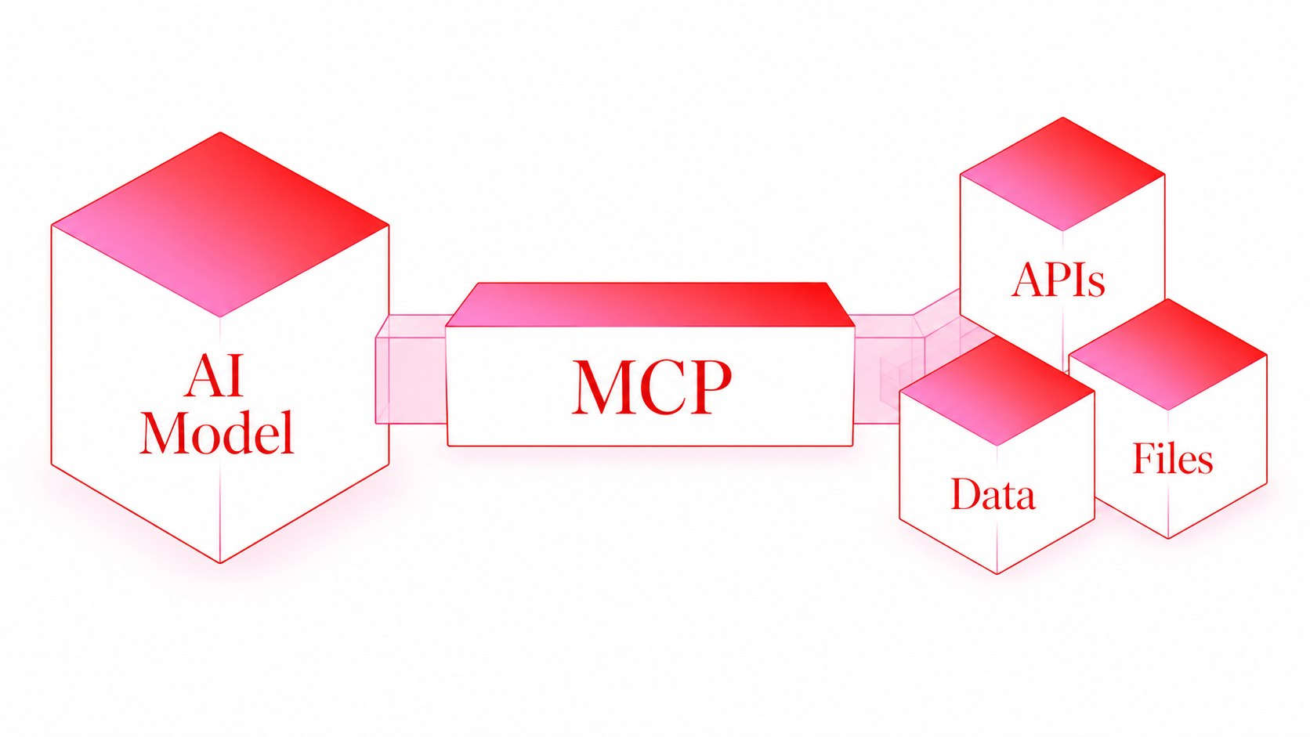
MCP connects your agent to external tools
CONCEPT #3

Slide 21
MCP Demo
Installing an MCP
Running an MCP

Slide 22
Your Turn:
Push your impeccable design to figma using MCP

Slide 23
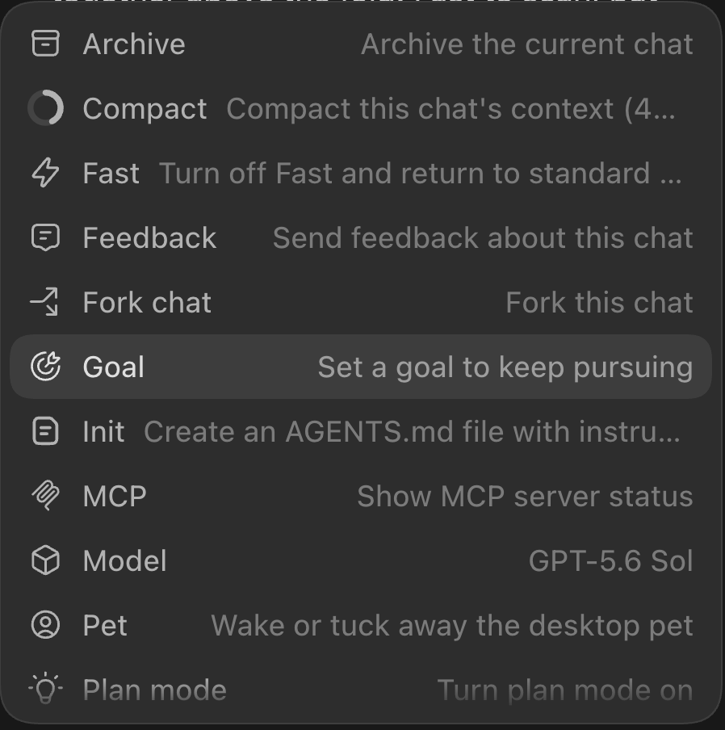
Commands are ‘/’ triggered workflows
CONCEPT #4

Slide 24
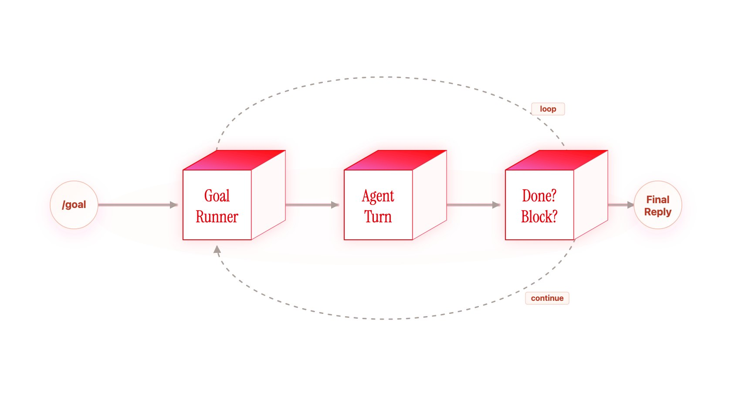
/goal

Slide 25
Make the main action easy to find, then verify that it works
Make the page look more premium.
Good Goal
Bad Goal

Slide 26
Goal Demo
Writing a test case & setting up a /goal

Slide 27
Your turn
Improve one action, then check it again

Slide 28
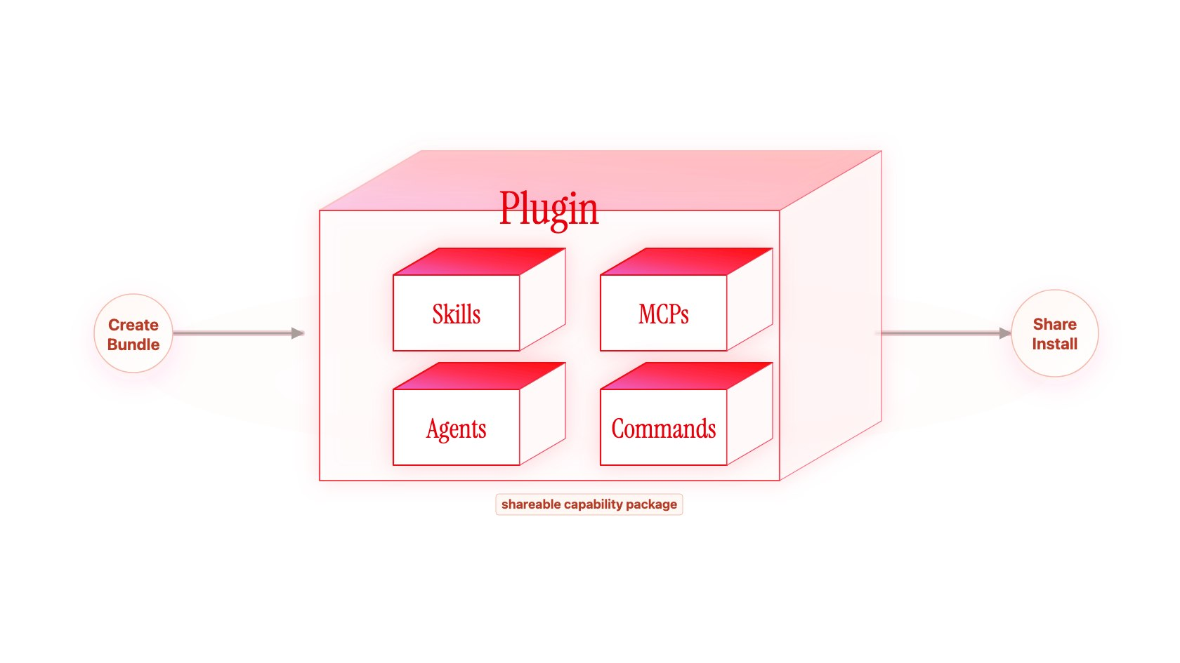
Plugins package skills and tool connections
CONCEPT #5

Slide 29
Plugin Demo
Installing from plugin marketplace
Calling a skill from a plugin

Slide 30
Your turn
Give one animation a useful job

Slide 31
Introduction To Skills

Slide 32
We just did a few things…
You used a skill to change a page
You reviewed the result
Now you will teach your own process

Slide 33
Which task would you teach a skill?

Slide 34
Productizing yourself

Slide 35


Slide 36


Slide 37
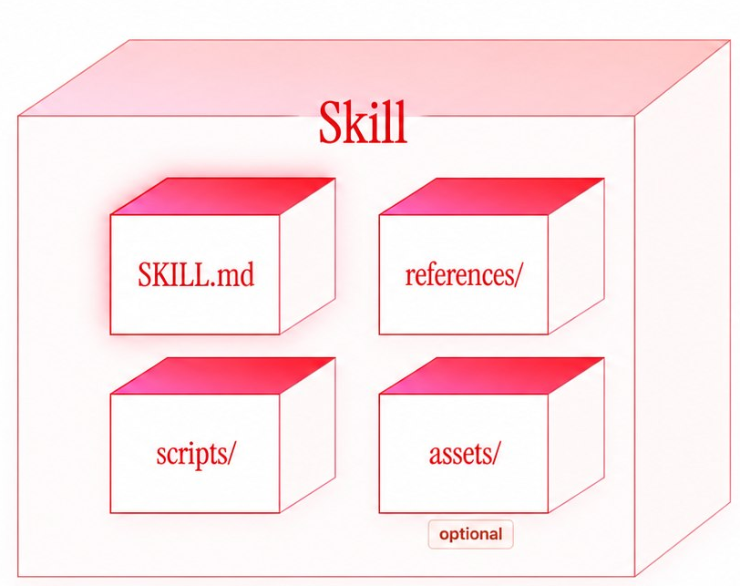
Anatomy of a Skill File
instructions / workflow
deeper docs, examples, API notes
templates, images, starter files
repeatable automations

Slide 38
A real skill file
The instructions behind the behavior

Slide 39
Let’s build a design QA skill

Slide 40
The design QA exercise
Compare a rendered screen with its reference
Show the differences you can verify
Improve the instructions across three versions

Slide 41
Let’s one-shot this
Create, run, and review version 1

Slide 42
Version 2: teach your process

Slide 43
Advise your intern
Explain the checks you normally leave unsaid

Slide 44
Watch me work
Demonstrate one comparison, then extract the method

Slide 45
List ’em first
Review the checklist before running version 2

Slide 46
Version 3: make it reusable

Slide 47
Anti-patterns
Show a mistake and teach the replacement behavior

Slide 48
When should this skill run?
Choose an explicit request or a matching task

Slide 49
The main steps and the references
Keep the workflow clear and link detail where it is needed

Slide 50
Steer and prune
Keep the instructions that change the behavior

Slide 51
What will you teach your skill next?

