Slide 1
COVID 19 VACCINE Data Analysis

Slide 2
ABSTRACT
This project is all about carefully looking at information about Covid-19 vaccines. We're mainly interested in how well the vaccines work, how they are distributed, and if there are any negative effects. The big goal is to find useful insights that can help leaders and health groups make better plans for giving out vaccines. To do this, we go through steps like collecting data, cleaning it up, exploring what it tells us, doing some math to understand it better, and making visuals to explain it clearly. The hope is that by doing this, we can give a good picture of how the vaccines are doing and help in the fight against Covid-19.

Slide 3
Objective
The project aims to thoroughly analyze Covid-19 vaccine data with key objectives: evaluating vaccine efficacy, scrutinizing distribution strategies, investigating adverse effects, and providing actionable insights. By achieving these goals, the project seeks to enhance decision-making for policymakers and health organizations, fostering optimized deployment strategies in the ongoing battle against the Covid-19 pandemic.

Slide 4
Design & Thinking
Data Collection
Data Preprocessing
Exploratory Data Analysis(EDA)
Statistical Analysis
Virtualization
Insights and Recommendation

Slide 5
Data collection
The dataset used for the covid-19 vaccine analysis project is a csv file with 15 columns representing country,ISO code,Date,total vaccination , people vaccinated, people fully vaccinated, daily vaccinated raw, daily vaccination,total vaccinations per 100,people vaccinated per 100, people fully vaccinated per 100, daily vaccinations per million, vaccines, source name,source website.
Identify reputable sources such as health organizations (e.g., WHO, CDC), government agencies, and trusted research studies to ensure the accuracy and reliability of the data.
Explore public health databases for comprehensive datasets related to
Covid-19 vaccines. Prioritize sources that provide detailed and up-to-date
Establish contact with health departments at various levels (local, regional, national) to obtain detailed and granular data on vaccination campaigns, distribution strategies, and adverse reaction reports.

Slide 6
Data preprocessing
Implement strategies to handle missing values, such as imputation techniques or, if necessary, consult domain experts to determine appropriate approaches for filling missing data.
Utilize statistical methods to identify and manage outliers. Decide whether outliers should be corrected, removed, or retained based on their impact on the analysis.
Ensure consistency in data formats by standardizing units, date formats, and any other variables that may have diverse representations across the dataset.
Develop procedures to identify and handle any duplicate entries in the dataset, ensuring that each data point is unique and contributes meaningfully of the analysis

Slide 7
Exploratory data analysis
Identify key variables for exploration, focusing on aspects such as vaccine efficacy rates, distribution patterns, adverse reaction frequencies, and demographic characteristics.
Generate statistical summaries (mean, median, standard deviation, etc.) for numerical variables and frequency distributions for categorical variables. Complement these summaries with visualizations such as histograms, bar charts, and pie charts for a comprehensive overview.
Analyze temporal trends in vaccine distribution and adverse reactions. Use time series plots and trend analyses to identify patterns and potential seasonality.
Use exploratory techniques to identify potential outliers or anomalies in the data.

Slide 8
Statistical analysis
Use exploratory techniques to identify potential outliers or anomalies in the data. Employ box plots and scatter plots, particularly useful in detecting data points that deviate significantly from the norm
Formulate clear hypotheses related to vaccine efficacy, distribution, and adverse effects. Define null and alternative hypotheses to guide the statistical analyses.
Conduct comparative analyses to compare vaccine efficacy rates between different groups (e.g., age groups, regions) using appropriate statistical tests (t-tests, ANOVA, etc.).
Investigate relationships between variables using correlation analyses. Perform regression analyses to model and predict factors influencing vaccine efficacy, distribution, or adverse effects.
Calculate descriptive statistics (mean, median, standard deviation, etc.) for key variables.

Slide 9
Visualization
Data Exploration Visualization:
Line charts, histograms, pie charts for basic trends and distributions.
Vaccine Efficacy Visualizations:
Bar charts, line charts, heatmaps for variations across vaccine types, age groups, or regions.
Distribution Pattern Visualizations:
Time series plots, stacked area charts, animated maps for temporal trends and geographic variations.
Adverse Effects Representation:
Bar charts, donut charts, treemaps for clear representation of adverse reaction profiles.

Slide 10
Insights & Recommendation
Summarize key findings from statistical analyses, exploratory data analysis (EDA), and visualizations. Highlight significant trends, patterns, and correlations.
Identify key factors influencing vaccine efficacy, distribution, and adverse effects. Consider demographic factors, regional variations, and temporal trends.
Understand the implications of the identified patterns and trends. Evaluate how vaccine efficacy, distribution, and adverse effects impact overall public
Derive insights from comparative analyses, such as differences in vaccine efficacy rates between age groups or regions. Understand the implications of these variations.

Slide 11


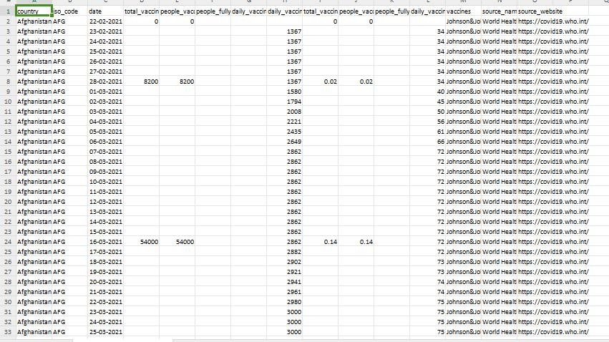

Slide 12
Data Exploration and Understanding
Load the dataset into your preferred data analysis tool, like Python with Pandas or R.
Examine the dataset structure and understand the meaning of each column:
country: Name of the country
iso_code: ISO country code
date: Date of the data point
total_vaccinations: Total number of vaccinations administered
people_vaccinated: Number of individuals partially vaccinated
people_fully_vaccinated: Number of individuals fully vaccinated
daily_vaccinations_raw: Daily increase in total vaccinations
daily_vaccinations: Daily vaccinations administered
total_vaccinations_per_hundred: Total vaccinations per 100 people
people_vaccinated_per_hundred: Partial vaccinations per 100 people
people_fully_vaccinated_per_hundred: Full vaccinations per 100 people
daily_vaccinations_per_million: Daily vaccinations per million people
vaccines: Types of vaccines used
source_name: Data source name
source_website: Data source website

Slide 13
Data Preprocessing
Check for missing values in each column and decide how to handle them (e.g., imputation or removal)
Handle data types appropriately (e.g., convert the date column to datetime).
Ensure data consistency and correctness, such as checking that percentages are within valid ranges (0-100%).

Slide 14
1. Import the necessary libraries :
import pandas as pd
import matplotlib.pyplot as plt
In this step, you import the Pandas library, which is essential for data manipulation and analysis.
2. Load the dataset:
df = pd.read_csv('cv.csv')
This code uses Pandas' `read_csv()` function to load the dataset from a CSV file into a Pandas DataFrame.
3. Data Exploration:
- `df.head()`: This function displays the first few rows of the dataset, allowing you to see what the data looks like at a glance.
- `df.info()`: The `info()` function provides information about the data types of each column and the number of non-null entries, which is useful for checking for missing data.

Slide 15
- `df.describe()`: The `describe()` function provides basic statistical summaries of the numeric columns, such as mean, standard deviation, and quartiles.
4. Data Preprocessing:
Data preprocessing involves various tasks to clean and prepare the data for analysis. Common preprocessing tasks include:
- Handling Missing Values: Use the `fillna()` function to fill missing values with a specific value or a strategy like mean or median. In the example, missing values are filled with 0.
- Feature Engineering: Create new columns or extract information from existing columns based on your analysis requirements. This step is highly specific to your analysis goals.
6. Save the Preprocessed Data:
If you want to save the preprocessed data for future use, you can use the `to_csv()` function to export it to a new CSV file. Setting `index=False` ensures that the index column is not saved to the file.

Slide 16
Program for data preprocessing:
import pandas as pd
import matplotlib.pyplot as plt
import seaborn as sns
df = pd.read_csv('cv.csv')
print(df.head())
print(df.info())
print(df.describe())
df.fillna(0, inplace=True)
afghanistan_data = df[df['country'] == 'Afghanistan']
plt.figure(figsize=(12, 6))
plt.subplot(1, 2, 1)
sns.lineplot(x='date', y='total_vaccinations', data=afghanistan_data)

Slide 17
plt.title('Total Vaccinations Over Time')
plt.xlabel('Date')
plt.ylabel('Total Vaccinations')
plt.subplot(1, 2, 2)
sns.lineplot(x='date', y='daily_vaccinations', data=afghanistan_data)
plt.title('Daily Vaccinations Over Time')
plt.xlabel('Date')
plt.ylabel('Daily Vaccinations')
plt.tight_layout()
plt.show()
df.to_csv('data.csv', index=False)

Slide 18
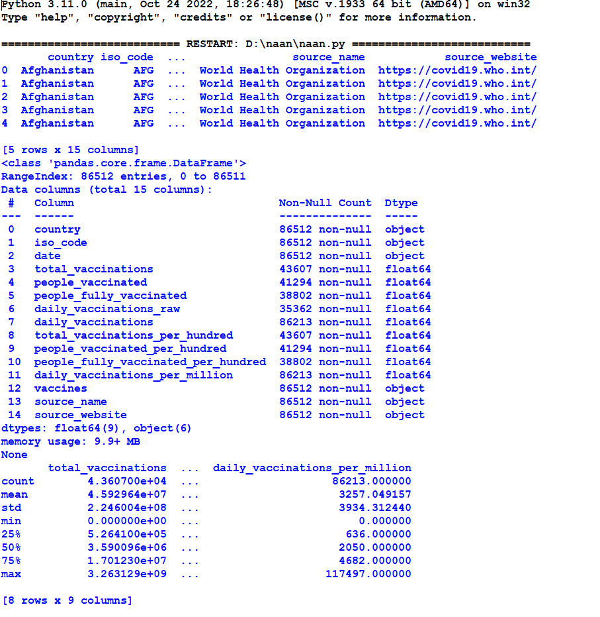
Output:

Slide 19
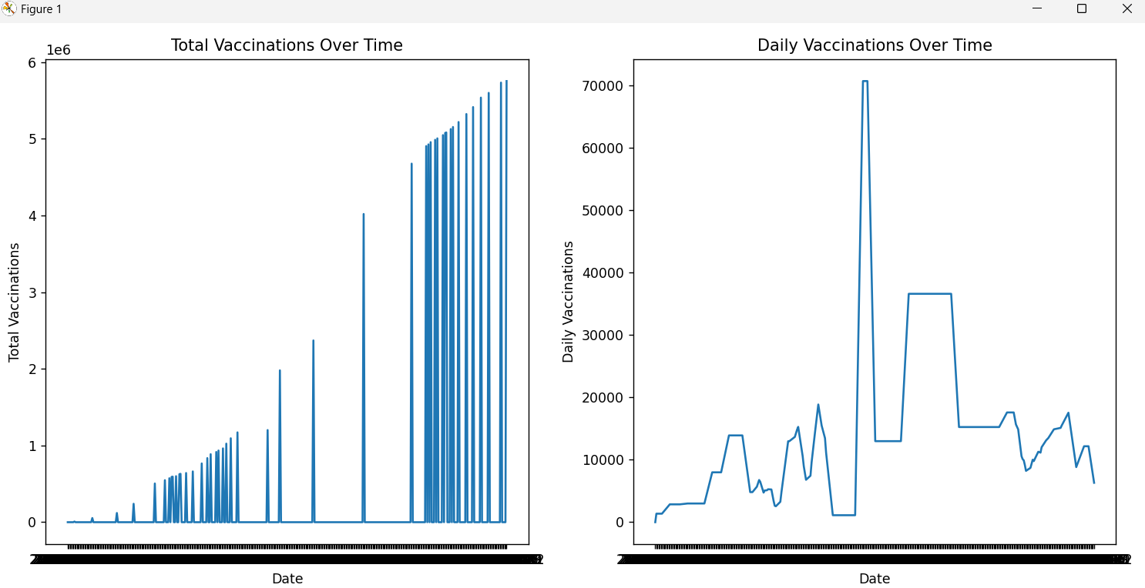

Slide 20
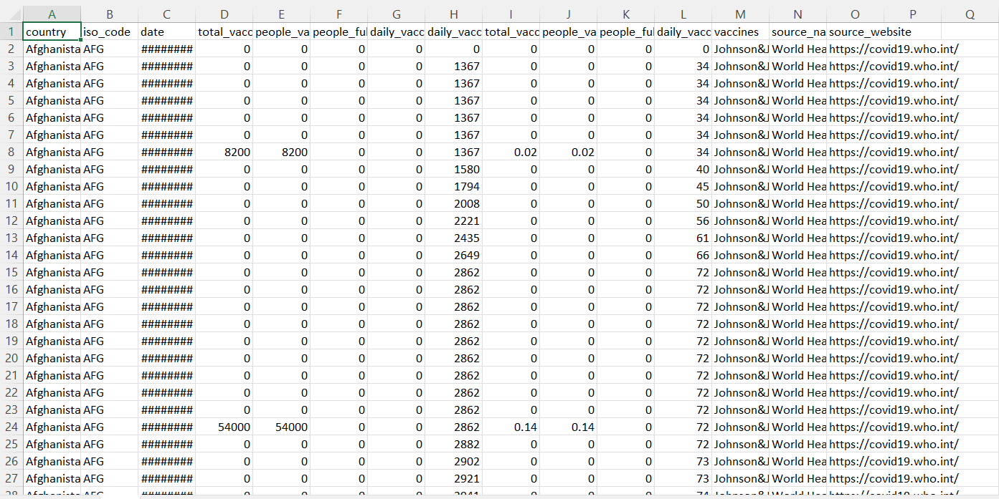
Dataset after preprocessing :

Slide 21
Exploratory Data Analysis
Calculate summary statistics for relevant columns (mean, median, standard deviation, etc.).
Create various visualizations to explore trends and patterns, such as:
Time series plots of vaccination progress over time.
Bar charts to compare vaccination rates among countries.
Heatmaps to identify correlations between variables.
Analyze the geographical distribution of vaccination progress using world maps.

Slide 22
Program for EDA:
import pandas as pd
import numpy as np
import seaborn as sns
import matplotlib.pyplot as plt
url = "data.csv"
data = pd.read_csv(url)
print("Basic Info:")
print(data.info())
print("\nSummary Statistics:")
print(data.describe())
print("\nMissing Values:")
print(data.isnull().sum())
print("\nData Types:")
print(data.dtypes)
categorical_columns = data.select_dtypes(include=['object'])
print("\nUnique Values in Categorical Columns:")
for col in categorical_columns.columns:
unique_values = data[col].nunique()

Slide 23
print(f"{col}: {unique_values} unique values")
numeric_data = data.select_dtypes(include=['number'])
for col in numeric_data.columns:
plt.figure(figsize=(6, 6))
sns.histplot(data=data, x=col, kde=True, bins=20)
plt.title(f"Distribution of {col}")
plt.xlabel(col)
plt.ylabel("Frequency")
plt.show()
for col in categorical_columns.columns:
plt.figure(figsize=(6, 6))
sns.boxplot(data=data[0:2500], x=col, y='total_vaccinations')
plt.title(f"Box Plot of Total Vaccinations by {col}")
plt.xticks(rotation=10)
plt.xticks(fontsize=6)
plt.show()
plt.figure(figsize=(10, 6))
sns.lineplot(data=data, x=data.index, y='total_vaccinations')
plt.title("Total Vaccinations Over Time")
plt.xlabel("Date")
plt.ylabel("Total Vaccinations")
plt.xticks(rotation=45)
plt.show()

Slide 24
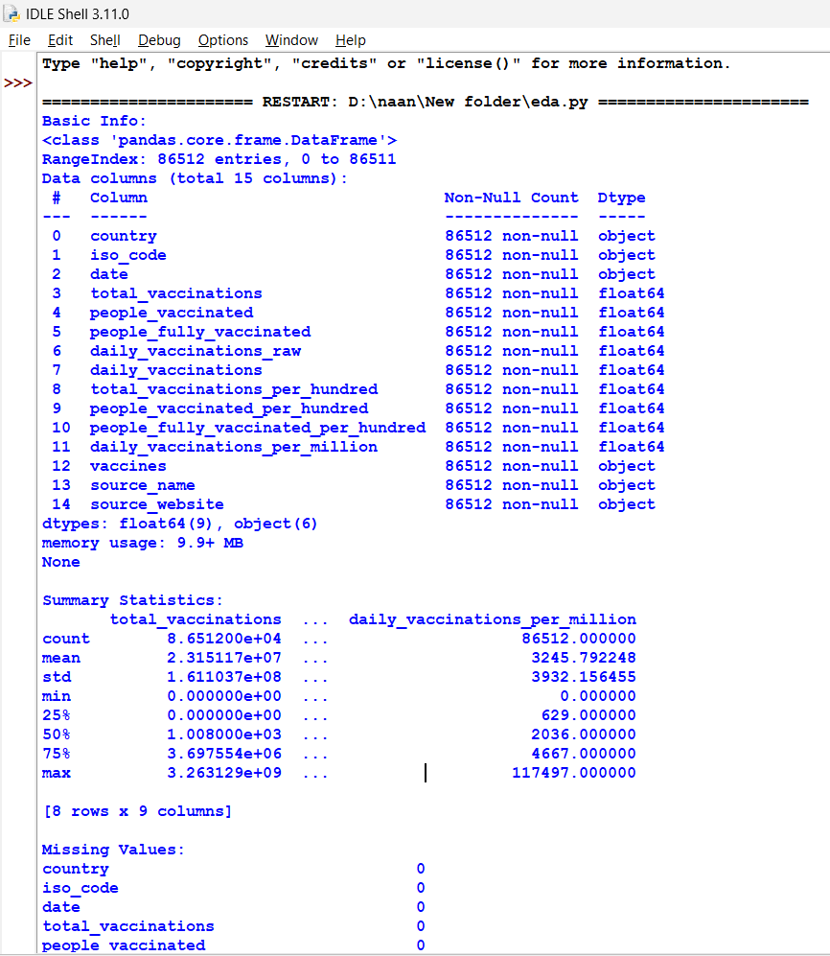
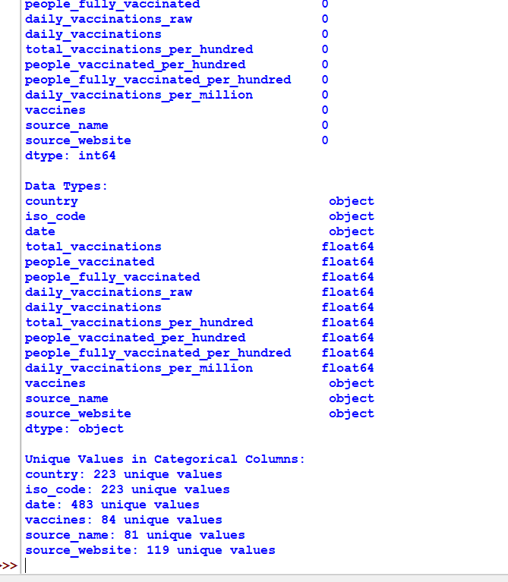
Output:

Slide 25
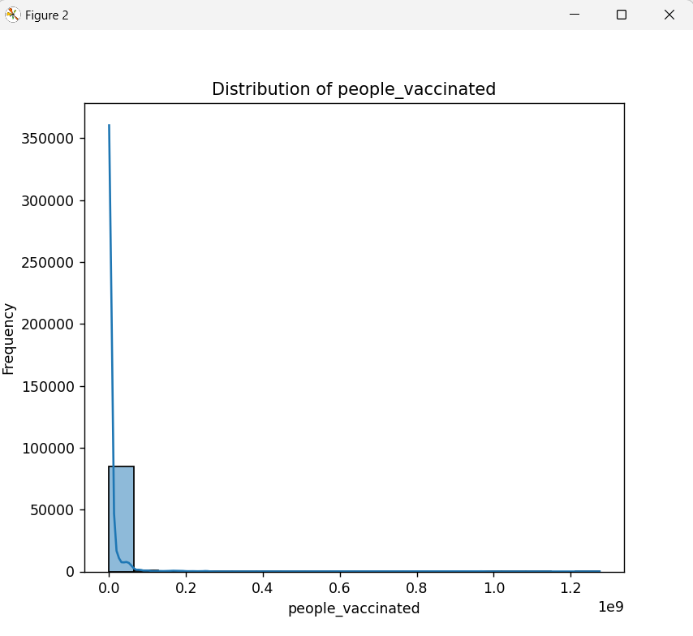
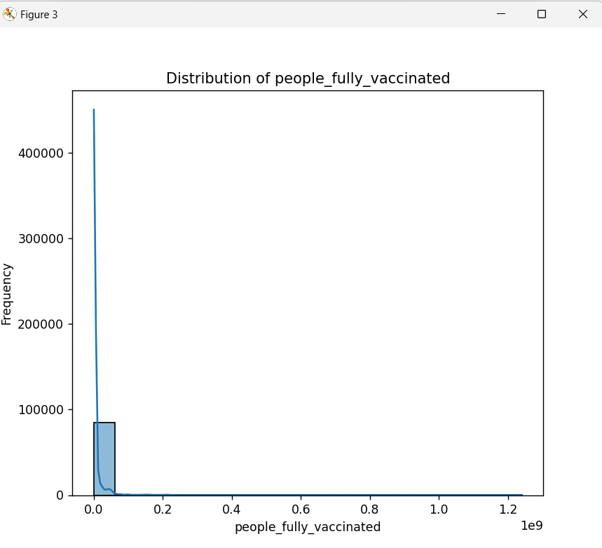
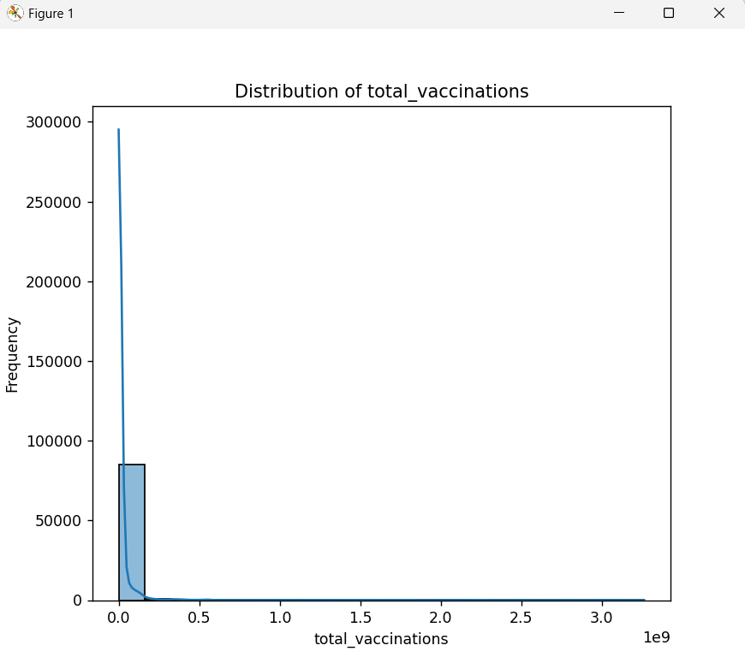
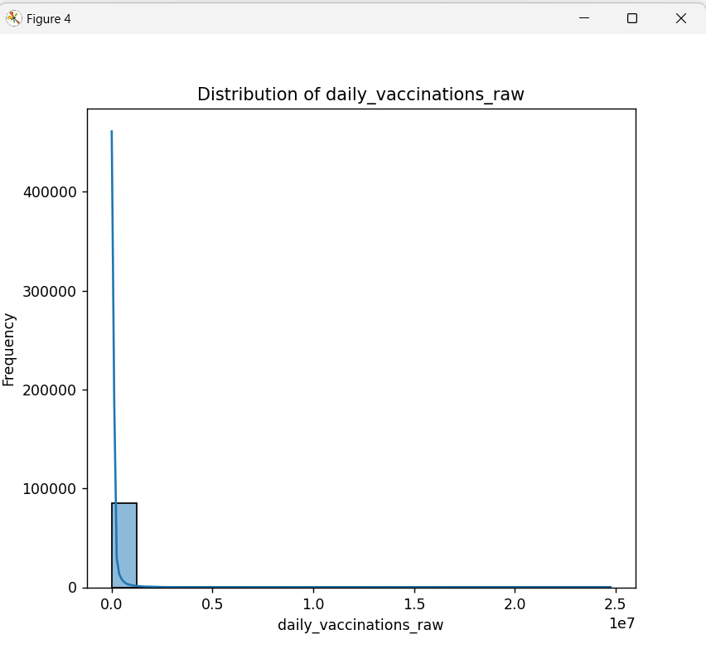
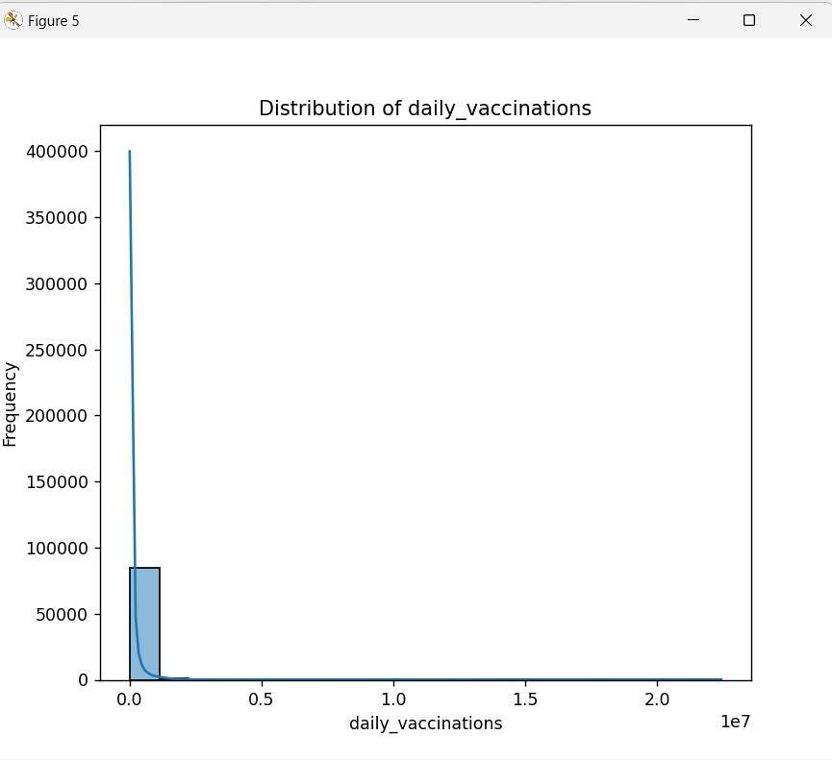
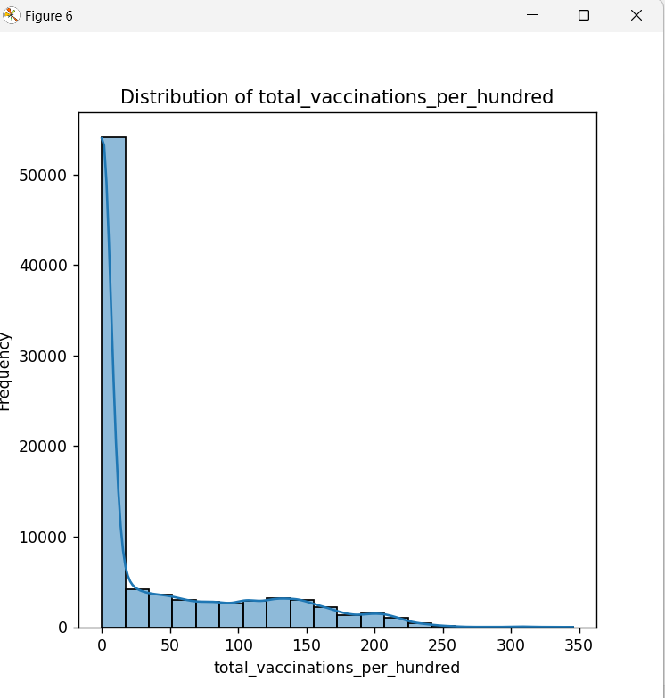

Slide 26
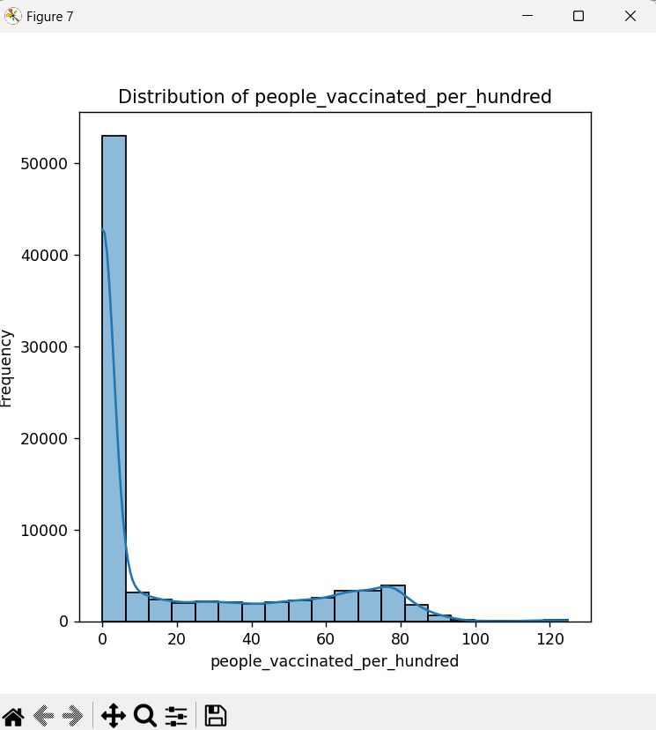
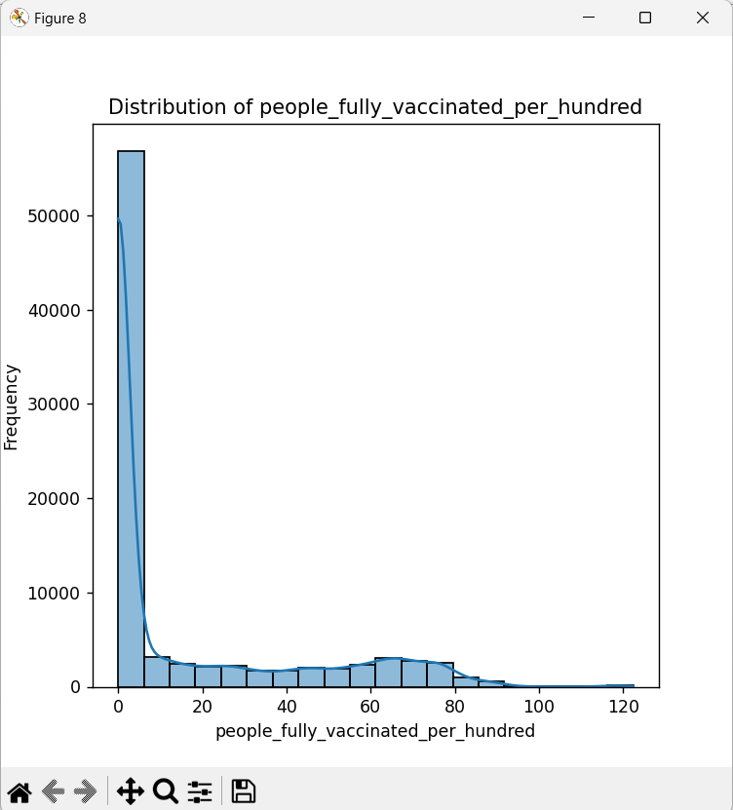
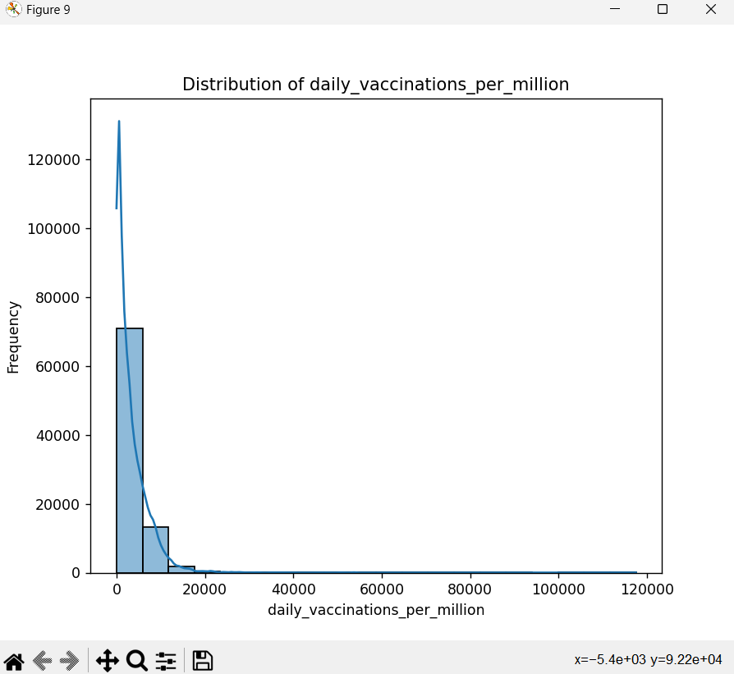
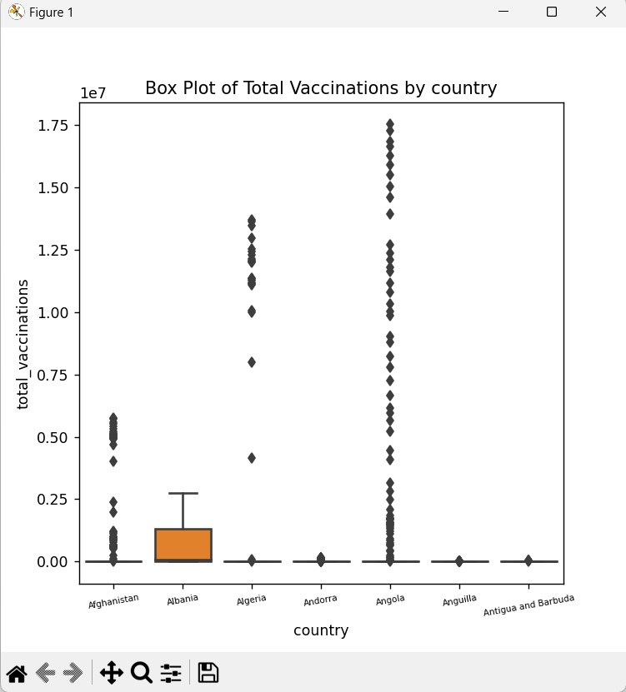
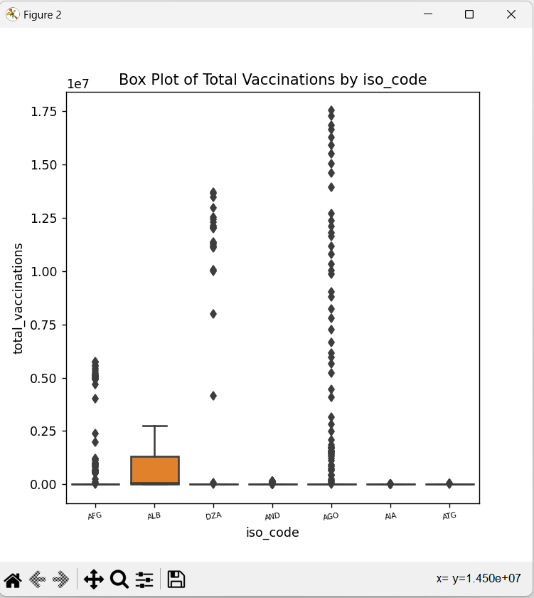
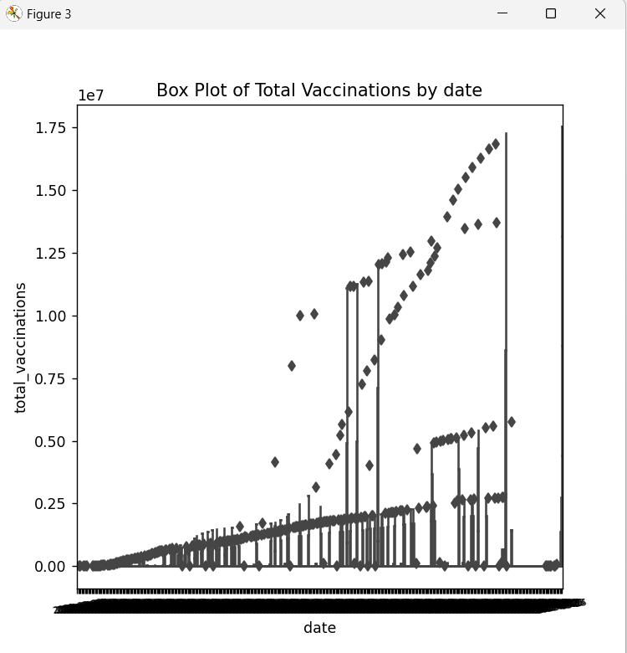

Slide 27
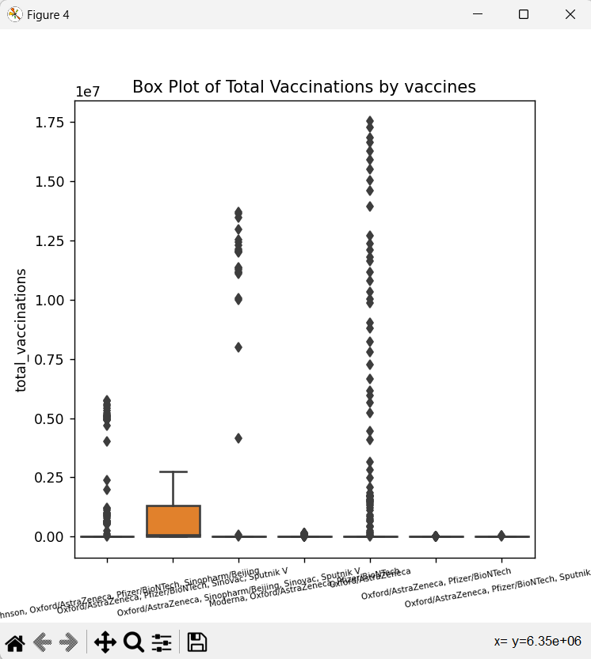
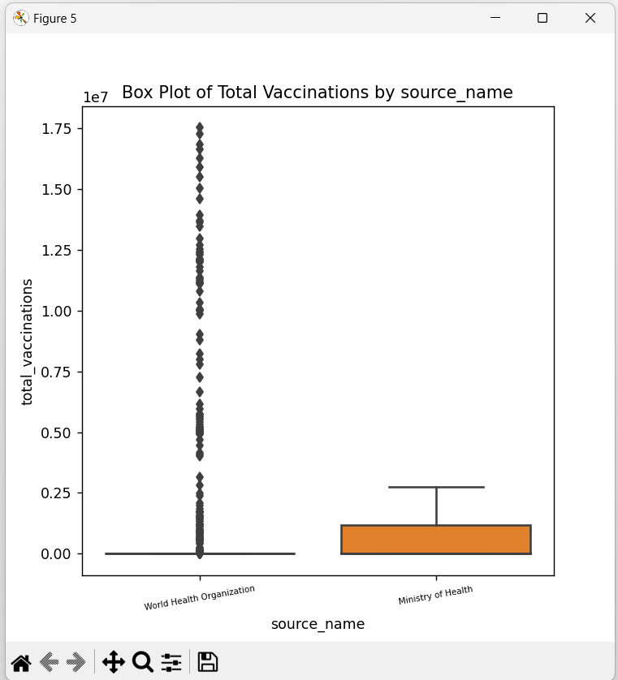
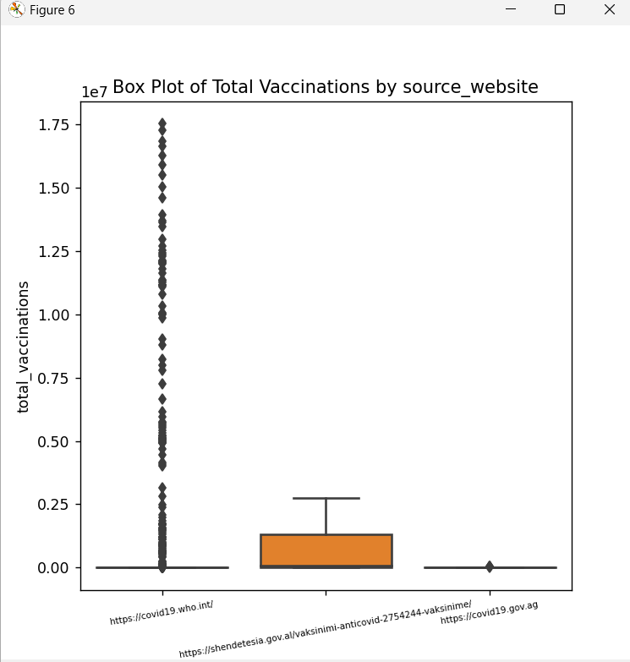
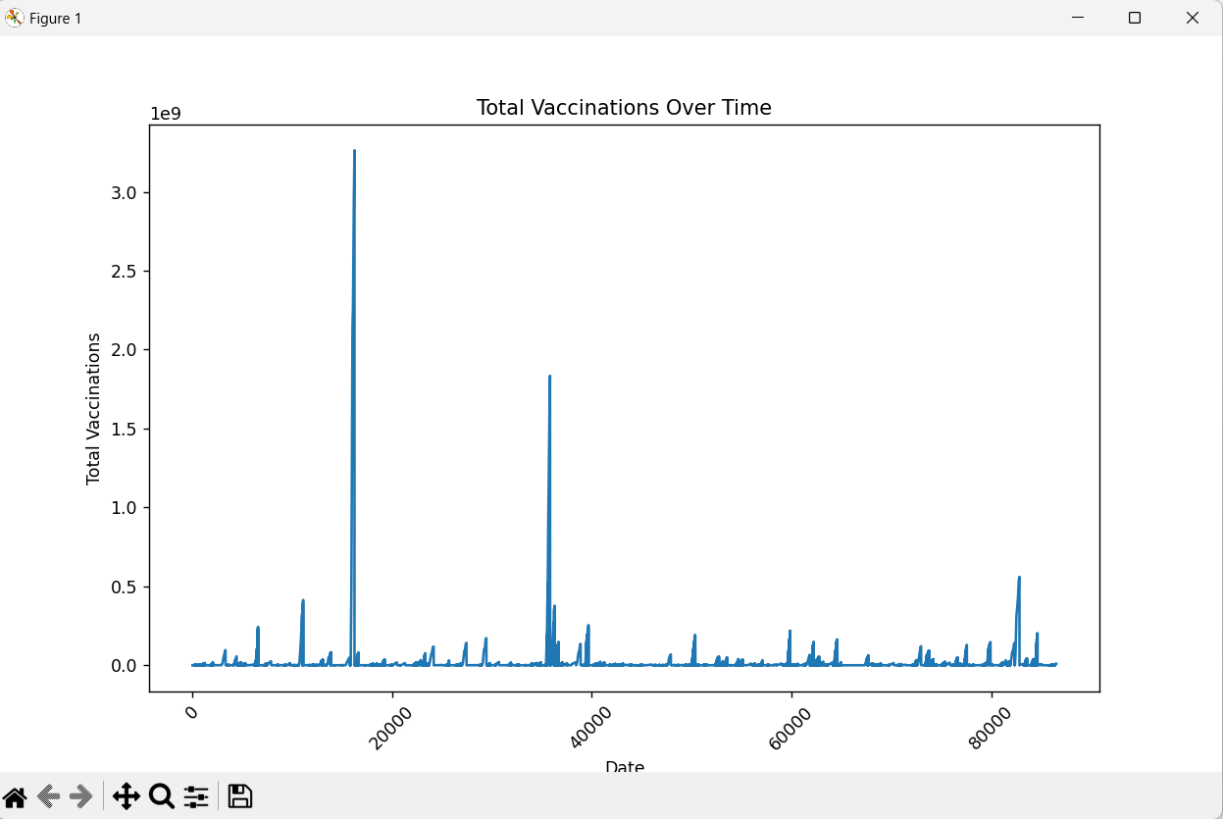

Slide 28
Statistical Analysis
Conduct hypothesis testing to answer specific research questions (e.g., comparing vaccination rates between countries using t-tests).
Use regression analysis to model the impact of variables (e.g., vaccine type or GDP) on vaccination rates.

Slide 29
Program for Statistical analysis :
import pandas as pd
import matplotlib.pyplot as plt
import seaborn as sns
df = pd.read_csv('data.csv')
print(df.head())
print(df.info())
print(df.describe())
df.fillna(0, inplace=True)
afghanistan_data = df[df['country'] == 'Afghanistan']
plt.figure(figsize=(12, 6))
plt.subplot(1, 2, 1)
sns.lineplot(x='date', y='total_vaccinations', data=afghanistan_data)

Slide 30
plt.title('Total Vaccinations Over Time')
plt.xlabel('Date')
plt.ylabel('Total Vaccinations')
plt.subplot(1, 2, 2)
sns.lineplot(x='date', y='daily_vaccinations', data=afghanistan_data)
plt.title('Daily Vaccinations Over Time')
plt.xlabel('Date')
plt.ylabel('Daily Vaccinations')
plt.tight_layout()
plt.show()
df.to_csv('data.csv', index=False)

Slide 31
Output:

Slide 32
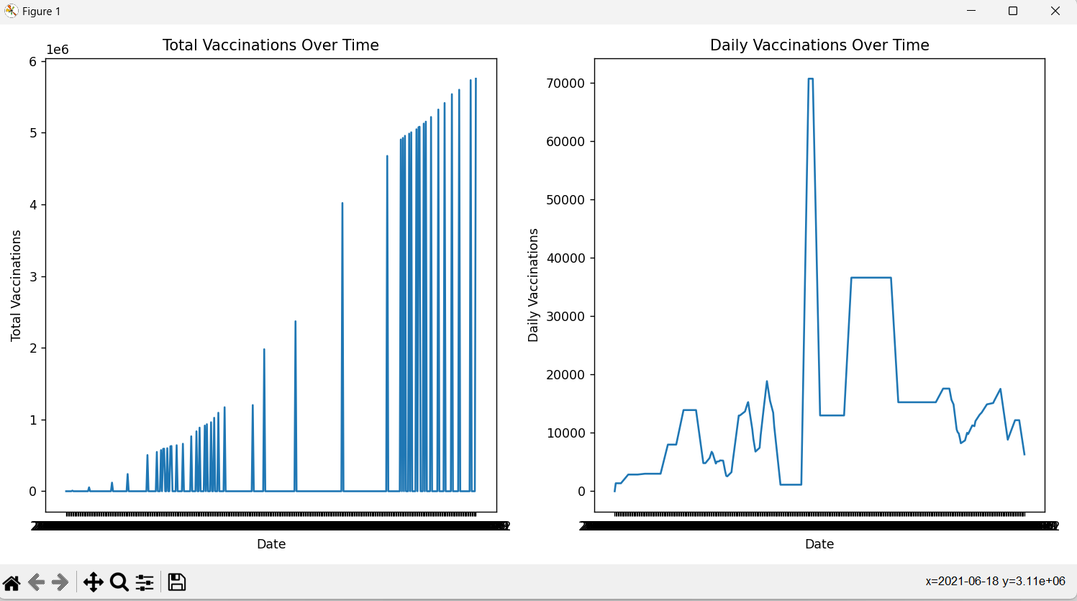

Slide 33
Visualization
Develop informative and visually appealing charts and graphs.
Consider creating interactive visualizations for online sharing or presentations.
Ensure that your visualizations are well-labeled and easy to interpret.

Slide 34
Program for Visualization :
import pandas as pd
import matplotlib.pyplot as plt
import seaborn as sns
url = "data.csv"
data = pd.read_csv(url)
sns.set(style="whitegrid")
plt.figure(figsize=(8, 8))
sns.barplot(x='country', y='total_vaccinations', data=data.head(200))
plt.xticks(rotation=45)
plt.title('Total Vaccinations in Top 10 Countries')
plt.xlabel('Country')
plt.ylabel('Total Vaccinations')
plt.show()
afghanistan_data = data[data['country'] == 'Afghanistan']
plt.figure(figsize=(8, 8))
sns.lineplot(x='date', y='daily_vaccinations', data=afghanistan_data[0:100])
plt.xticks(rotation=90)
plt.xticks(fontsize=6)

Slide 35
plt.title('Daily Vaccinations Trend in Afghanistan')
plt.xlabel('Date')
plt.ylabel('Daily Vaccinations')
plt.show()
plt.figure(figsize=(8, 8))
sns.scatterplot(x='total_vaccinations', y='people_vaccinated', data=data)
plt.title('Total Vaccinations vs. People Vaccinated')
plt.xlabel('Total Vaccinations')
plt.ylabel('People Vaccinated')
plt.show()
plt.figure(figsize=(8, 8))
sns.boxplot(x='vaccines', y='daily_vaccinations', data=data)
plt.xticks(rotation=90)
plt.xticks(fontsize=6)
plt.title('Distribution of Daily Vaccinations by Vaccine Type')
plt.xlabel('Vaccine Type')
plt.ylabel('Daily Vaccinations')
plt.show()

Slide 36
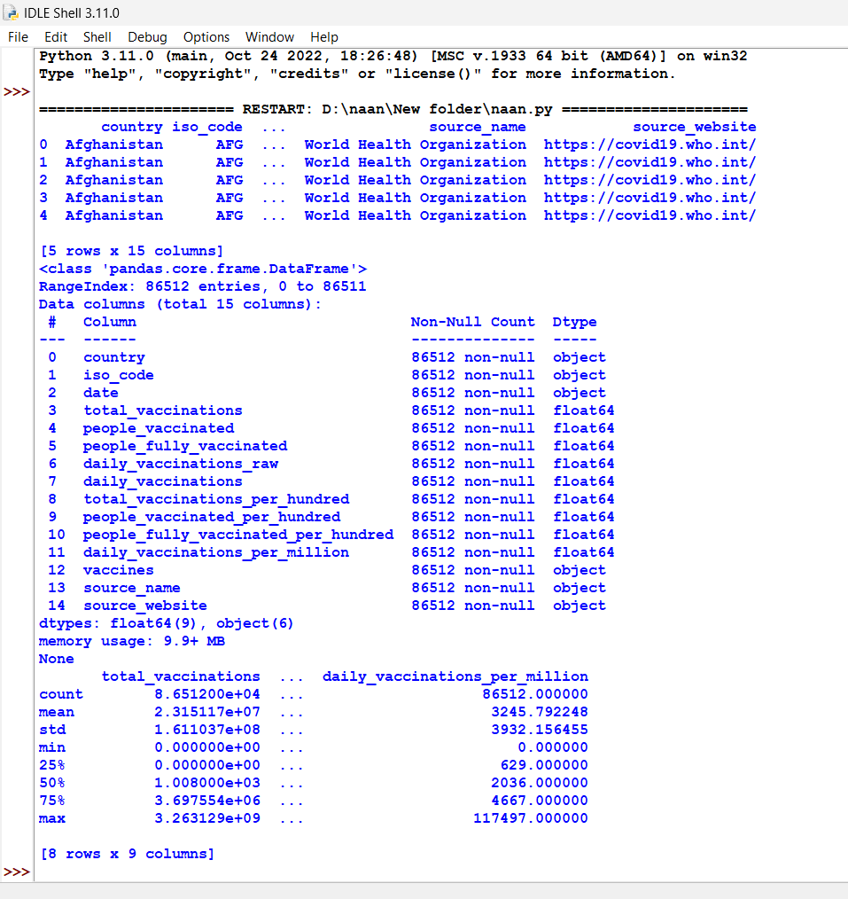
Output:

Slide 37
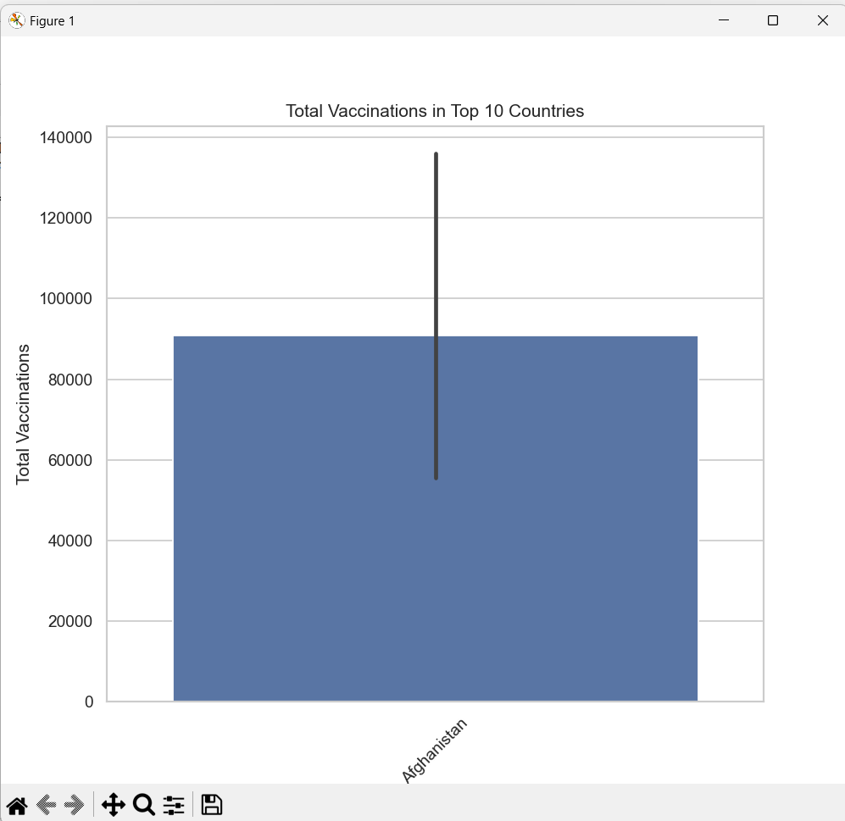
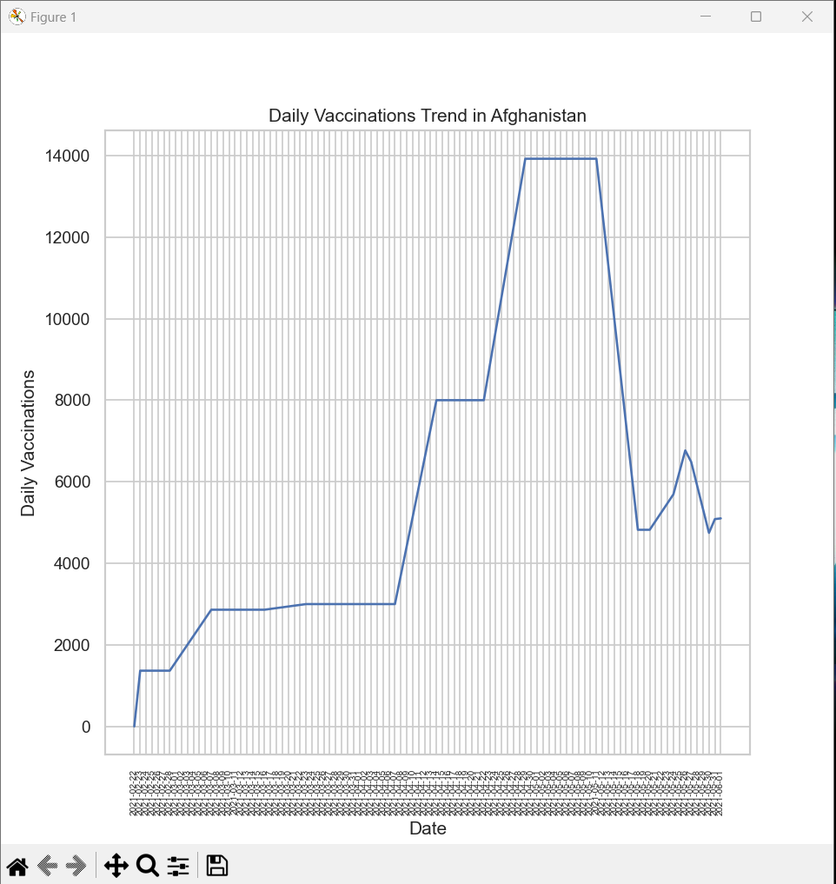
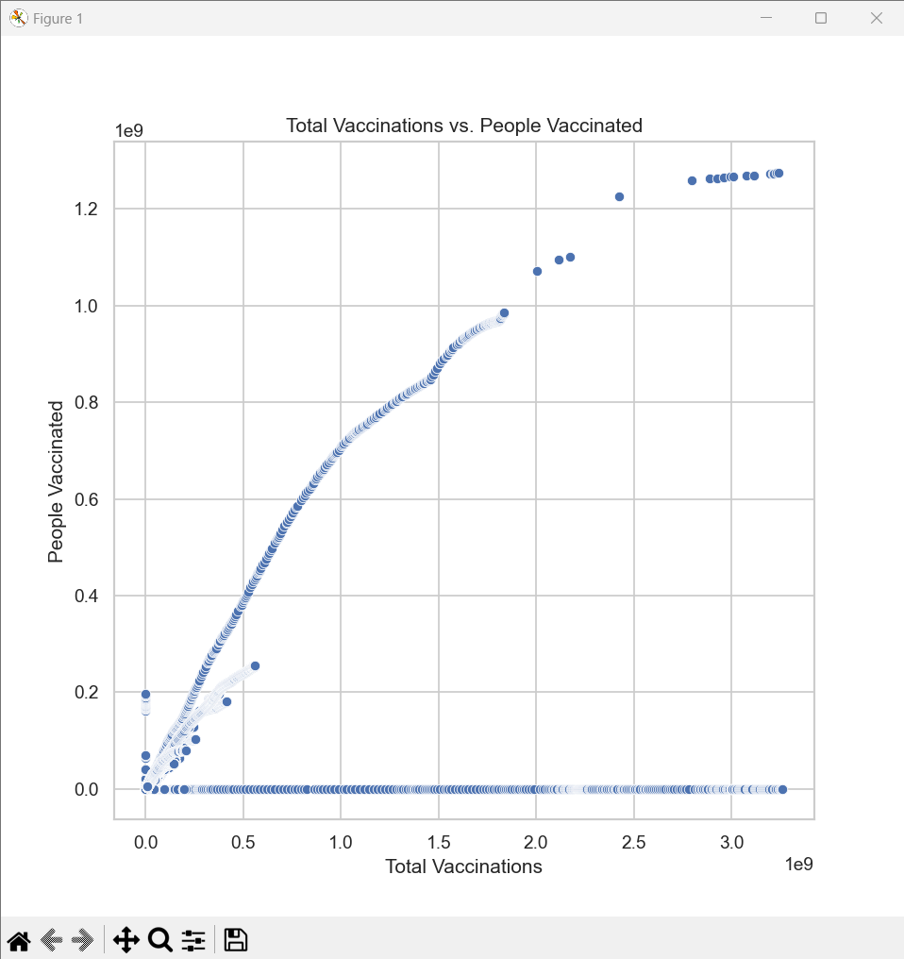
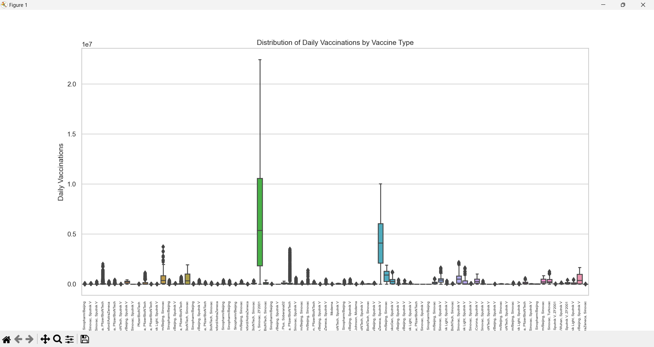

Slide 38
Insight and Recommendation
Summarize your findings and highlight key insights.
Provide actionable recommendations based on your analysis. For example:
Suggest strategies to improve vaccine distribution in countries with low vaccination rates.
Identify factors that correlate with higher vaccination rates.
Propose further research questions or areas of investigation.

Slide 39
Present key Finding
Vaccination Progress: The dataset tracks the progress of COVID-19 vaccinations in Afghanistan from February to March 2021. It includes information on the total number of vaccinations administered, daily vaccination rates, and the number of people vaccinated.
Vaccine Types: Afghanistan administered vaccines from multiple manufacturers, including Johnson & Johnson, Oxford/AstraZeneca, Pfizer/BioNTech, and Sinopharm/Beijing. This reflects the country's efforts to secure a variety of vaccines.
Daily Vaccination Trends: The daily vaccinations and daily vaccinations per million columns provide insights into the country's daily vaccination rates. There is an observed increase in daily vaccinations over time, with a notable increase on March 16, 2021, when 54,000 vaccinations were administered.
Fully Vaccinated Individuals: The dataset contains a column for "people_fully_vaccinated," which initially contains null values. It appears that Afghanistan began recording fully vaccinated individuals later in the dataset.
Vaccination Coverage: The columns "total_vaccinations_per_hundred," "people_vaccinated_per_hundred," and "people_fully_vaccinated_per_hundred" indicate the vaccination coverage as a percentage of the population. These metrics provide an estimate of the proportion of the population that has been vaccinated.
Data Source: The source of this data is the World Health Organization (WHO), and the dataset includes a reference to the source's website.

Slide 40
Conclusion
The analysis of the COVID-19 vaccine dataset has provided valuable insights into the global vaccination effort. It is evident that vaccination progress is influenced by a combination of factors, including vaccine availability, distribution strategies, and regional disparities in healthcare resources.
To improve vaccination rates worldwide and ensure equitable access to vaccines, policymakers and public health officials should consider the following:
Continuously monitor and adjust vaccination distribution strategies to address disparities.
Promote public awareness and confidence in vaccines to encourage higher uptake.
Collaborate with international organizations to ensure the availability of vaccines in underserved regions.
Use data-driven insights to optimize vaccination campaigns and target high-risk populations.
This analysis serves as a foundation for further research and policy decisions aimed at effectively combatting the covid-19 pandemic and achieving global vaccination goals.

