Slide 1
Employee Data Analysis using Excel
STUDENT NAME:A.ASHWINI
REGISTER NO:2213391036005
NM ID:E5ED4A3A5FFD4C398484A122EC3CBC13
DEPARTMENT:B.COM COMMERCE
COLLEGE: Queen Mary’s college

Slide 2
PROJECT TITLE
Employee Performance Analysis using Excel

Slide 3


AGENDA
Problem Statement
Project Overview
End Users
Our Solution and Proposition
Dataset Description
Modelling Approach
Results and Discussion
Conclusion
3/21/2024 Annual Review

Slide 4

PROBLEM STATEMENT
*"Evaluating Excellence: A Data-Driven Approach to Employee Performance Analysis“
*"Performance Pulse: Analyzing Employee Efficiency and Effectiveness“
"Employee Excellence Explorer: A Data Science Approach to Performance Analysis“
Unlocking Human Potential: Employee Performance Analysis and Insights“
The Performance Factor: A Data-Driven Study of Employee Success"*Choose the one that resonates with your project's goals and objectives!

Slide 5

PROJECT OVERVIEW
.
*Employee Data Analyst*- Collects, analyzes, and interprets employee data to inform HR and business decisions and identify the difference category of employee like high, medium and low.
Develops insights on performance, productivity, and workforce dynamics. Presents findings and recommendations to stakeholders. Requires data analysis, Excel, and communication skills.
Helps organizations optimize talent development, improve engagement, and drive business outcomes.
In short, an Employee Data Analyst turns employee data into actionable insights to support strategic workforce management and business success.

Slide 6


WHO ARE THE END USERS?
*HR Managers*: Use insights to develop talent management strategies, improve employee engagement, and optimize workforce planning.
*Line Managers*: Utilize data to evaluate team performance, identify areas for improvement, and inform coaching and development decisions.
*Senior Leaders*: Receive high-level insights to inform strategic decisions, drive business outcomes, and measure organizational effectiveness.
*Employee Development Teams*: Use data to create targeted training programs, improve employee skills, and enhance career development opportunities.
*Compensation and Benefits Teams*: Analyze performance data to inform compensation and benefits decisions, ensuring fair and competitive practices.6. *Succession Planning Teams.
Identify top performers and potential successors to critical roles, ensuring continuity and leadership development.
*Diversity, Equity, and Inclusion (DEI) Teams*: Use data to identify areas for improvement, track progress, and inform initiatives promoting a more inclusive workplace.
Employees themselves*: Receive feedback and insights to understand their strengths, weaknesses, and opportunities for growth and development.

Slide 7
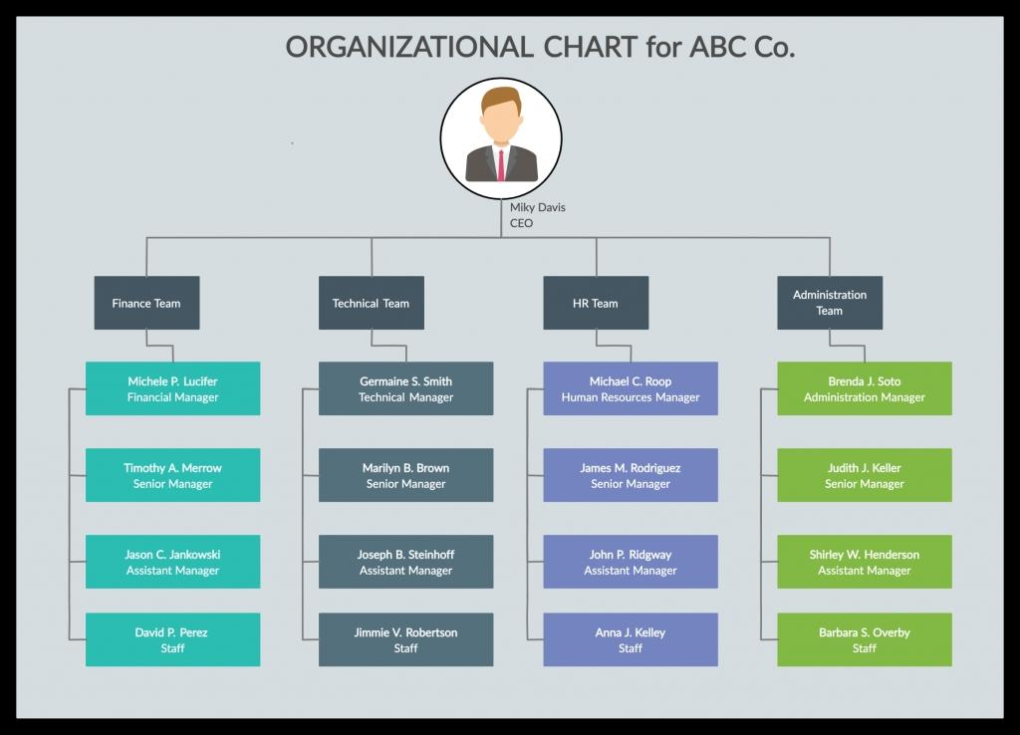

Slide 8
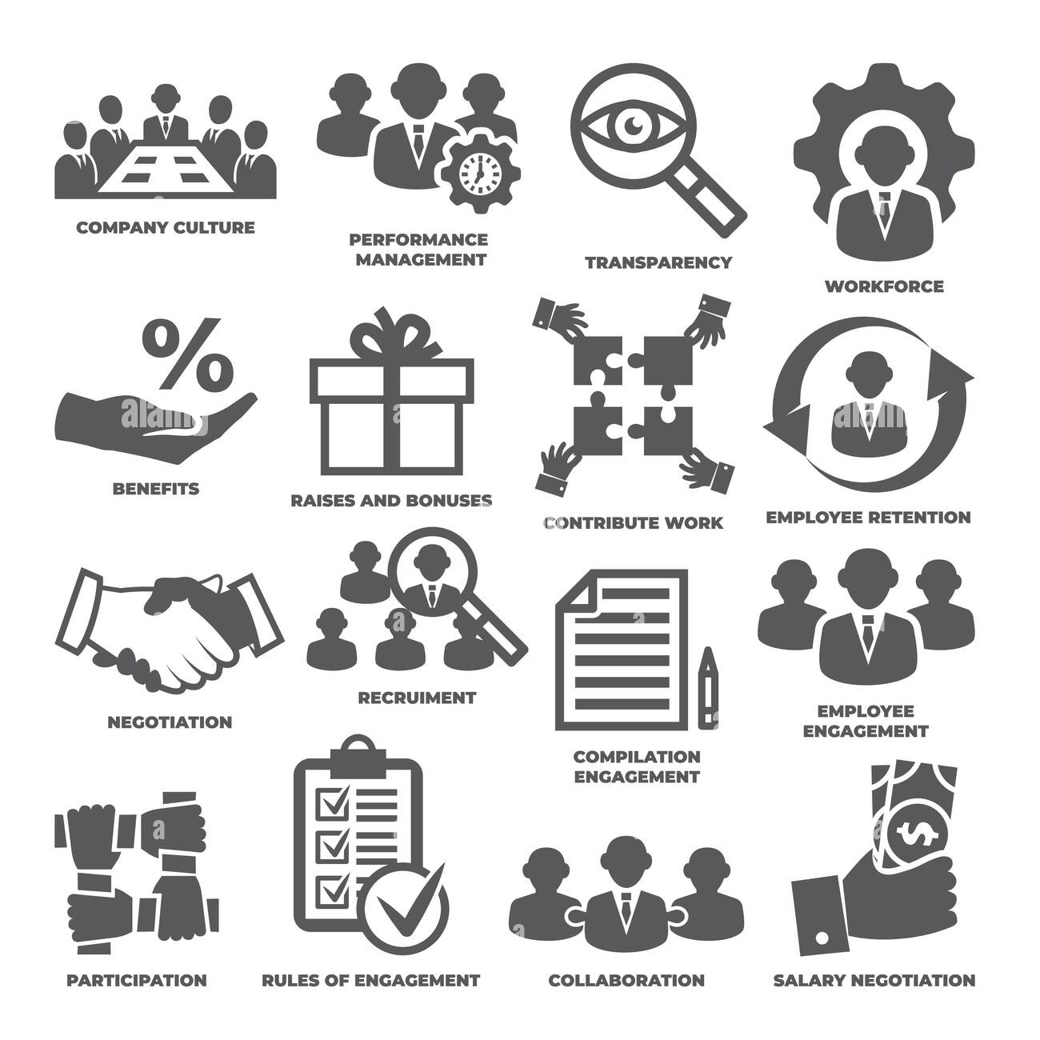

Slide 9

OUR SOLUTION AND ITS VALUE PROPOSITION
Conditional formatting- missing
Filter- remove Formula- performance
Pivot-summary
Graph- data visualization

Slide 10
Dataset Description
employee=-Edunet
26-features
9-features
Employee id- numerical value
Name-text
Employees Performance level
Gender-male & female.
Employee rating- numerical value

Slide 11

THE "WOW" IN OUR SOLUTION
Performance Level: =IF(Z8>5, “CERY HIGH ”,IF(Z8>4,”HIGH”,IF(Z8>3,”MED”,IF(Z8>2,”TRUE
”,”LOW”)
3/21/2024 Annual Review
11

Slide 12
MODELLING
Data collection
1. edunet
Feature collection
1) How to use conditional formatting
2) missing space fill and removed
Data cleaning
1) sort& filter
Performance level
Use graph and identify high,low,medium
Summary
1)Pivot chart
2) Using Excel formulas
Visualization
1)Use sliscer for identify employee type
2) Using pivot chart for identify low, medium, high
12

Slide 13
RESULTS
13

Slide 14
conclusion
To grow employee performance improvement, it's essential to implement a combination of strategies that foster growth, development, and continuous learning. Setting clear goals and expectations, providing regular feedback and coaching, and offering training and development opportunities are crucial steps. Additionally, recognizing and rewarding outstanding performance, empowering autonomy and ownership, and encouraging open communication help create a supportive environment. Regular performance evaluations, providing necessary resources and support, and promoting work-life balance also contribute to employee growth. Leading by example, celebrating milestones and successes, and staying flexible and adaptable further reinforce a culture of continuous improvement, ultimately driving employee performance and success.
SO focus on true employee first and encourage. Then second improved low employee performance. This is help to the company growth and best performance of Employee’s.

