Slide 1
Networking Basics
Presented by: Aswini

Slide 2
Agenda
Networking
OSI Model
TCP/IP
IP address
DNS
DHCP
Ports
Protocols

Slide 3
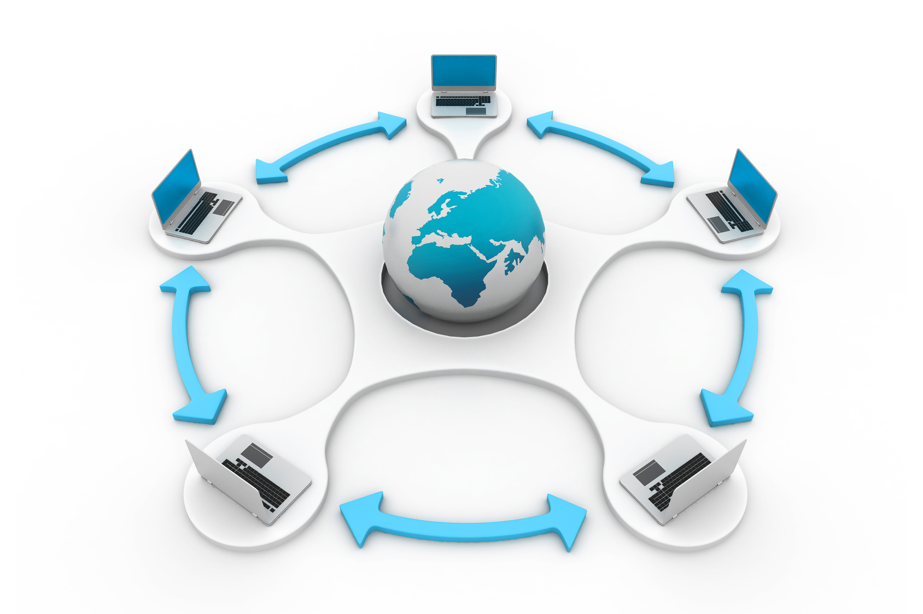
Networking
Networking is the process of connecting two or more computers or devices so they can share information, resources, and services.

Slide 4
Uses of Networking
Sharing Data: Easily transfer files, documents, and media between devices.
Communication: Send emails, chat, or make video calls.
Access to Internet: Connect to the web for browsing, online apps, and cloud storage.
Centralized Storage: Store data on a server so all users can access it securely.
Remote Access: Work on systems or access files from anywhere.
Data Backup and Security: Central backups and monitoring for better data safety.
Collaboration: Teams can work together in real-time on shared tools and platforms.

Slide 5
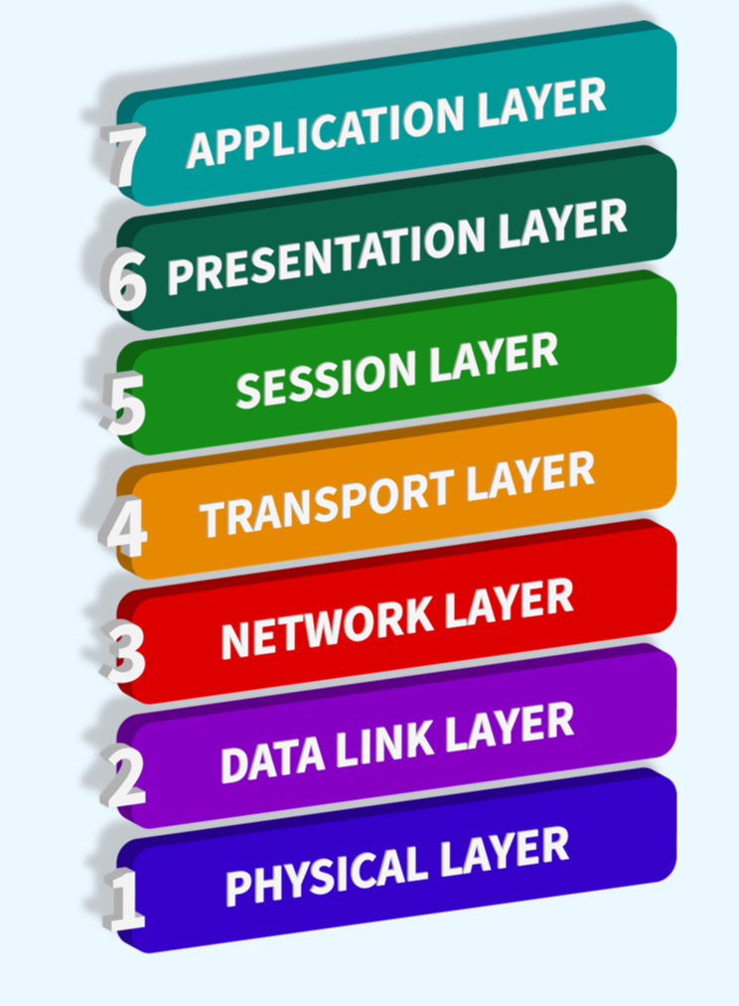
OSI Model
A theoretical model that shows how data moves from one device to another over a network in 7 layers.
7 Layers of OSI (Top to Bottom):
Application – What users see (browser)
Presentation – Data format (encryption, compression)
Session – Start/stop connections
Transport – Reliable delivery (TCP)
Network – Routing (IP)
Data Link – MAC addresses, switching
Physical – Cables, signals

Slide 6
2. TCP/IP Stack (Transmission Control Protocol/Internet Protocol)
A real-world model used on the internet. It has 4 layers and maps to the OSI model.
4 Layers of TCP/IP:
Application Layer – All user-related services (like HTTP, FTP)
Transport Layer – TCP/UDP for data delivery
Internet Layer – IP for addressing and routing
Network Access Layer – Deals with physical transmission

Slide 7
IP Addressing
An IP address is a unique number given to each device on a network. It helps Identify and locate the device.
Types of IP Addresses
1. Based on Usage
Private IP: Used within local networks (not accessible from internet) Example:192.168.1.5, 10.0.0.1
Public IP: Used on the Internet, globally unique
Example:49.205.200.18
🔹 Private IP – Given by router to devices at home or office 🔹 Public IP – Given by ISP (like Jio, Airtel), visible on internet

Slide 8
2. Based on Version
🔹 IPv4 – (Internet Protocol Version 4 )
It having 32 bit (2 power 32)
It has 4 numbers, separated by dots
2^32=4,294,967,296
Example : 192.168.0.1
🔹 IPv6 –(Internet Protocol version 6)
It having 128 bit (2^32)^4
Has 8 groups of hexadecimal, more address space
(2^32)^4 = 340,282,366,920,938,463,463,374,607,431,768,211,456
Example : 2001:0db8:85a3::8a2e:0370:7334

Slide 9
3. Based on Function
Static IP : Fixed IP, doesn't change
Example : Good for websites, CCTV, remote access
Dynamic IP: Changes each time you connect to the network
Example : Common for home users like Wi-Fi
IP Address Classification:
Priority bit : With the help of binary classification we get 0’s and 1’s.
Types Value Priority bit
Class A 0 -127 0
Class B 128 – 191 10
Class C 192- 223 110

Slide 10
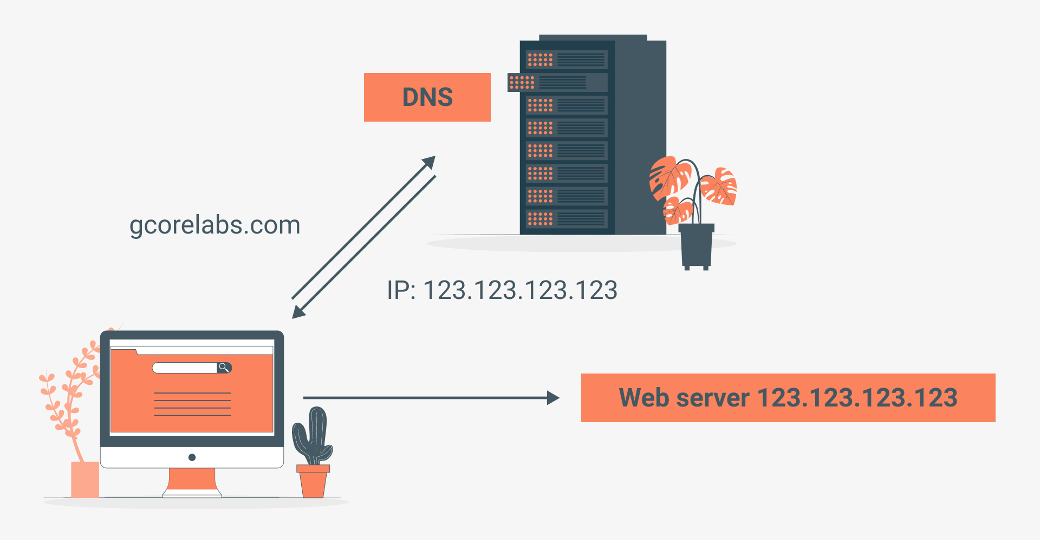
DNS (Domain Name System)
DNS translates domain names (like www.google.com) into IP addresses (like 142.250.195.4) so computers can understand and connect.
Humans remember names, not numbers. DNS helps us use easy names instead of hard IPs.

Slide 11
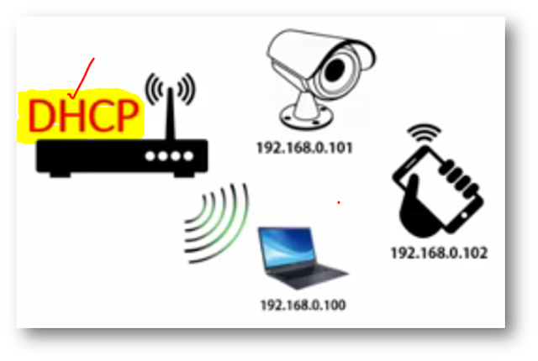
DHCP – Dynamic Host Configuration Protocol
DHCP automatically assigns IP addresses and other network settings to devices on a network.
So we don’t have to manually assign IPs to every phone, laptop, or printer. It saves time and avoids conflicts.

Slide 12
Protocols
A protocol is a set of rules that devices follow to communicate over a network.
Think of it as a language used between devices.
Protocol Use
HTTP Browsing websites (http://)
HTTPS Secure websites (https://)
FTP File transfer between computers
SMTP Sending emails
TCP/UDP Sending data reliably or fast

Slide 13
Ports
A port is like a door number on your device used to identify specific services or apps.
Each service runs on a specific port number.
Port No Protocol Use
80 HTTP Websites (not secure)
443 HTTPS Secure websites
22 SSH Remote login to servers
21 FTP File transfers
25 SMTP Sending emails
53 DNS Resolving domain names

Slide 14
Thank you

