Slide 1

FRUIT DISEASE DETECTION SYSTEM
ASWINI ANIL
ROLL NO:20
S3 MCA
REG NO: MLM24MCA-2021
DATE OF REVIEW:21/07/2025
GUIDE:
MS. GREESHMA P KURIAN
ASSISTANT PROFESSOR
DEPT. OF COMPUTER APPLICATIONS

Slide 2
INTRODUCTION
Fruits are important in our daily life, but they can easily get diseases. Finding these diseases early is important to save crops and reduce loss. Checking fruits manually sometimes may not be accurate. In this project, we use machine learning(CNN) to find fruit diseases from images. The system learns from healthy and infected fruit pictures and gives results quickly. This helps farmers take care of their crops in a better way.

Slide 3
ABSTRACT
Fruits are often affected by fungal and bacterial diseases.
Early detection helps reduce crop loss and improve yield.
This study uses Machine Learning for disease detection.
A CNN model gave 97.10% accuracy, better than traditional methods.
The system supports smart farming and reduces manual inspection costs.

Slide 4
Scope and Objectives
Scope
The system automatically detects and classifies fruit diseases using deep learning.
Users can upload fruit images and get instant predictions with prevention tips.
It ensures fast and accurate disease detection for multiple fruit types.
The system stores and displays users’ previous results for easy tracking.
Objectives
Detect fruit diseases using CNN
Allow users to upload images and view results
Provide prevention tips based on detected disease
Build a simple interface using Streamlit

Slide 5
FEASIBILITY STUDY
3. Operational Feasibility
Easy-to-use interface with simple login and image upload.
Farmers and non-technical users can operate it with minimal training.
Provides instant prediction with prevention tips.
4. Time Feasibility
Development completed within academic project timeline.
Faster predictions compared to manual checking.
1.Technical Feasibility
Tools and technologies (Python, Streamlit, TensorFlow/Keras) are readily available.
Dataset is easily accessible for training the model.
Hardware requirements are minimal (normal PC with GPU/CPU support).
2. Economic Feasibility
Open-source tools and libraries are used (no extra cost).
Cost-effective solution for farmers compared to manual expert consultation.

Slide 6
PROBLEM DEFINITION
To develop a desktop application using machine learning manual fruit disease detection is labor-intensive and error-prone, making it difficult to handle diverse diseases effectively.
Current methods lack scalability and accuracy, creating a need for automated machine learning solutions that can detect and classify fruit diseases from images.
Such systems can boost crop yield, reduce losses, and support sustainable farming.

Slide 7
EXISTING SYSTEMS
ADVANTAGES:
Easy to use by farmers or experts.
No need for computer or internet.
Works well for small farms.
Uses traditional farming knowledge.
DISADVANTAGES:
Not always accurate.
Hard to find experts in remote areas.
Cannot be used for large farms easily.

Slide 8
PROPOSED SYSTEM
DISADVANTAGES:
Needs camera or smartphone to take pictures.
Requires internet or computer.
Accuracy depends on training dataset.
May be hard for farmers who don’t know technology.
ADVANTAGES:
Automatic disease detection.
Gives more accurate results.
Can help many farmers at the same time.
Saves cost and improves fruit quality:

Slide 9
LITERATURE REVIEW
AUTHOR | YEAR | SOURCE | TITLE | WORK
Varadraj Jadhav, Harshal Giri, Harish Thore, Kshitij Patil, Dr. Tushar Phadtare | 2024 | IJRESM | Multiple Fruit Disease Detection Using Deep Learning | Proposed a CNN-based model for detecting multiple fruit diseases with high accuracy using image datasets.
Yadav, Burks, Frederick, Qin, Kim & Ritenour | 2022 | PubMed | Citrus disease detection using convolution neural network generated features and Softmax classifier on hyperspectral image data | Detected citrus peel diseases using CNN with hyperspectral images.
Fu, Li, Sun, Mu, Hu & Gong | 2022 | PubMed | Lightweight-Convolutional Neural Network for Apple Leaf Disease Identification | Built a lightweight CNN to identify apple leaf diseases efficiently.
Revathi, P. & Hemalatha, M | 2012 | ICCENT / IEEE Conference | Classification of Cotton Leaf Spot Diseases | Used edge detection for plant disease classification
Nikitha, M., Roopa Sri, S. & Uma Maheshwari.B | 2020 | ICECA (IEEE) | Fruit Recognition and Grade of Disease Detection Using Inception V3 | Applied CNN (Inception V3) for disease detection
Varadraj Jadhav, Harshal Giri, Harish Thore, Kshitij Patil | 2021 | IEEE CVPR | Multiple Fruit Disease Detection Using Deep Learning | Reviewed combining local/global features for classification

Slide 10
LITERATURE REVIEW
AUTHOR | YEAR | SOURCE | TITLE | WORK
Wang, Liu, Wang, Xiong, Zhang, Zhao, Luo, Lin & He | 2022 | PubMed | Application of CNN-Based Detection Methods in Fresh Fruit Production: A Comprehensive Review | Reviewed CNN-based fruit detection and classification techniques. Yunyoung Nam et al.
Yunyoung Nam et al. | 2021 | CMC Journal | An Integrated Deep Learning Framework for Fruits Diseases Classification | Created a hybrid CNN model for classifying multiple fruit diseases.
Tian Y., Li E., Liang Z., Tan M., & He X. | 2021 | Frontiers in Plant Science | Diagnosis of Typical Apple Diseases: A Deep Learning Method Based on Multi-Scale Dense Classification Network | Developed a multi-scale CNN for accurate apple disease diagnosis.
Khandoker Nosiba Arifin, Sayma Akter Rupa, Md Musfique Anwar, Israt Jahan | 2024 | Cornell University Library | Lemon and Orange Disease Classification using CNN-Extracted Features and Machine Learning Classifier | Used to extract features from lemon and orange fruit images and then applied traditional ML classifiers to accurately classify diseases in citrus fruits.

Slide 11
SYSTEM REQUIREMENTS
Hardware Requirements
Processor: Intel i5 / AMD Ryzen 5 or higher
RAM: Minimum 8 GB (Recommended 16 GB)
GPU: NVIDIA GPU
Storage: Minimum 256 GB (Recommended 512 GB SSD)
Display Monitor
Keyboard and Mouse
Software Requirements
Operating System: Windows 10 / 11
Programming Language: Python 3.9
Libraries/Frameworks:
TensorFlow / Keras
NumPy
Matplotlib
Pandas
OpenCV
IDE: VS Code

Slide 12
MODULES OF PROPOSED SYSTEM
User Module: Allows users to register, login, upload fruit images, and view disease predictions with prevention tips.
Image Acquisition:
This module is used to capture or upload images of fruits. The image can be taken from a dataset.
Pre-processing:
This step improves the quality of the image. It includes resizing and filtering.
Feature Extraction:
These features help the model understand the type of disease.
Classification Categorising:
It uses machine learning (like CNN,) to identify the fruit disease.
Disease & Prevention Module: Stores and retrieves disease details and their corresponding prevention techniques.

Slide 13
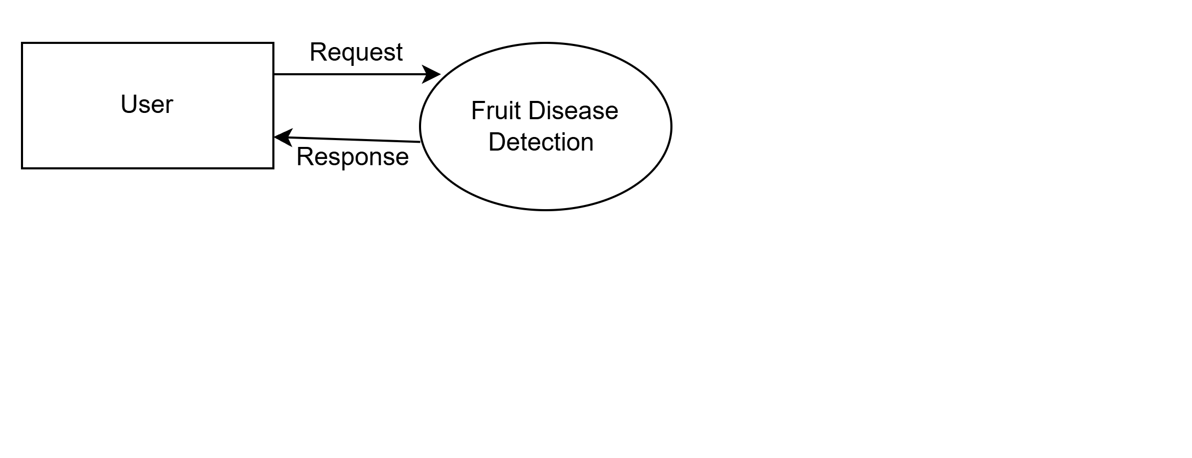
DATA FLOW DIAGRAM
LEVEL 0 - DFD
DFD0

Slide 14
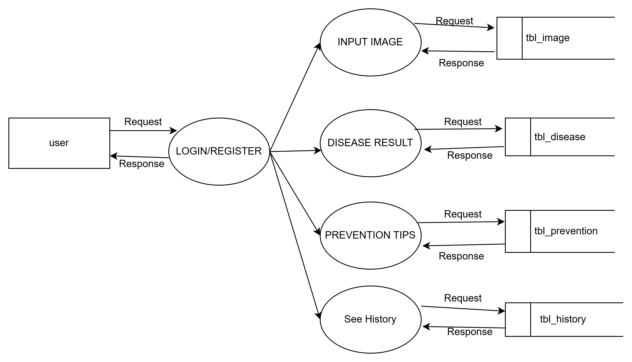
DATA FLOW DIAGRAM
LEVEL 1-USER

Slide 15
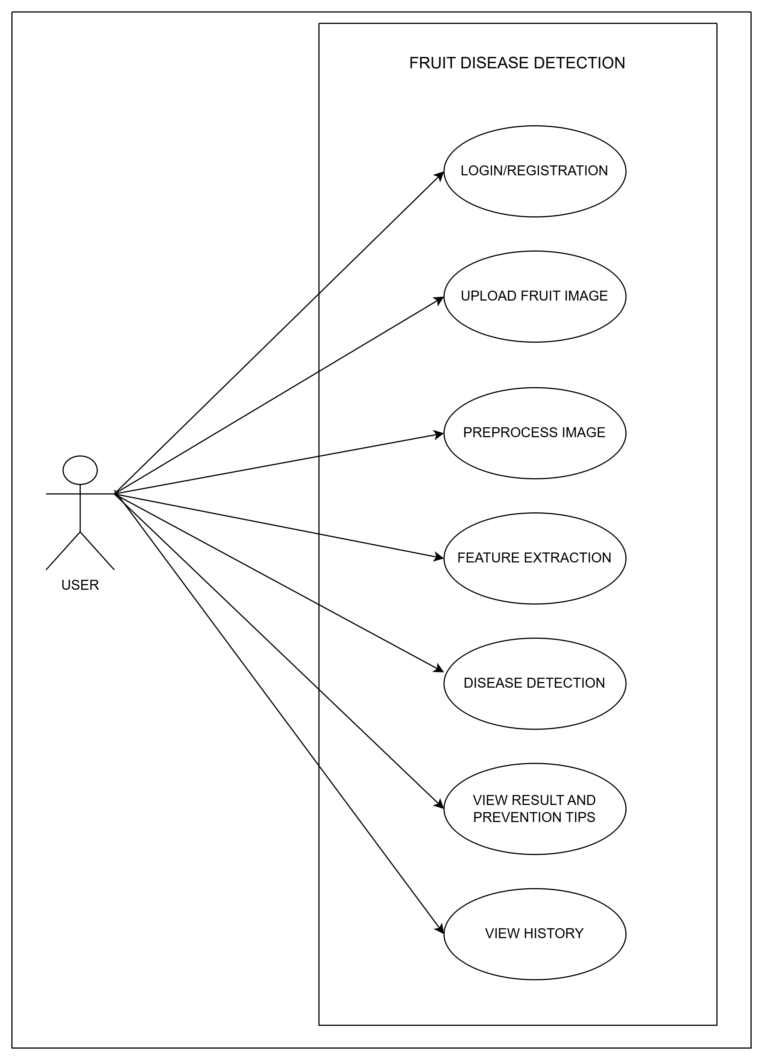
USE CASE DIAGRAM

Slide 16
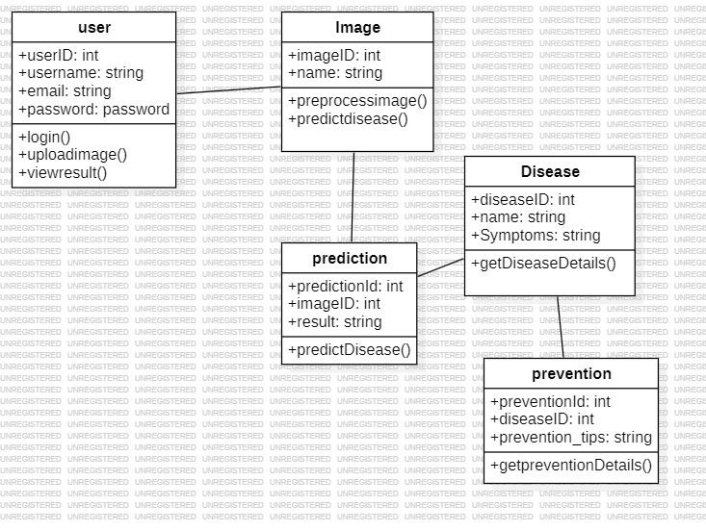

CLASS DIAGRAM

Slide 17
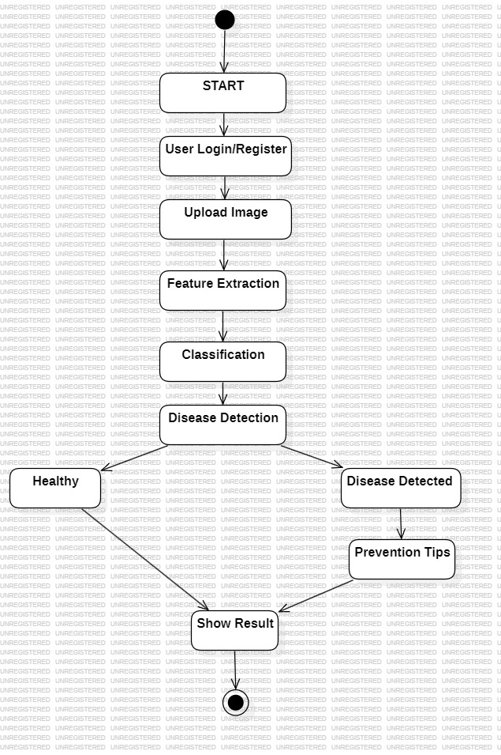
STATE DIAGRAM

Slide 18
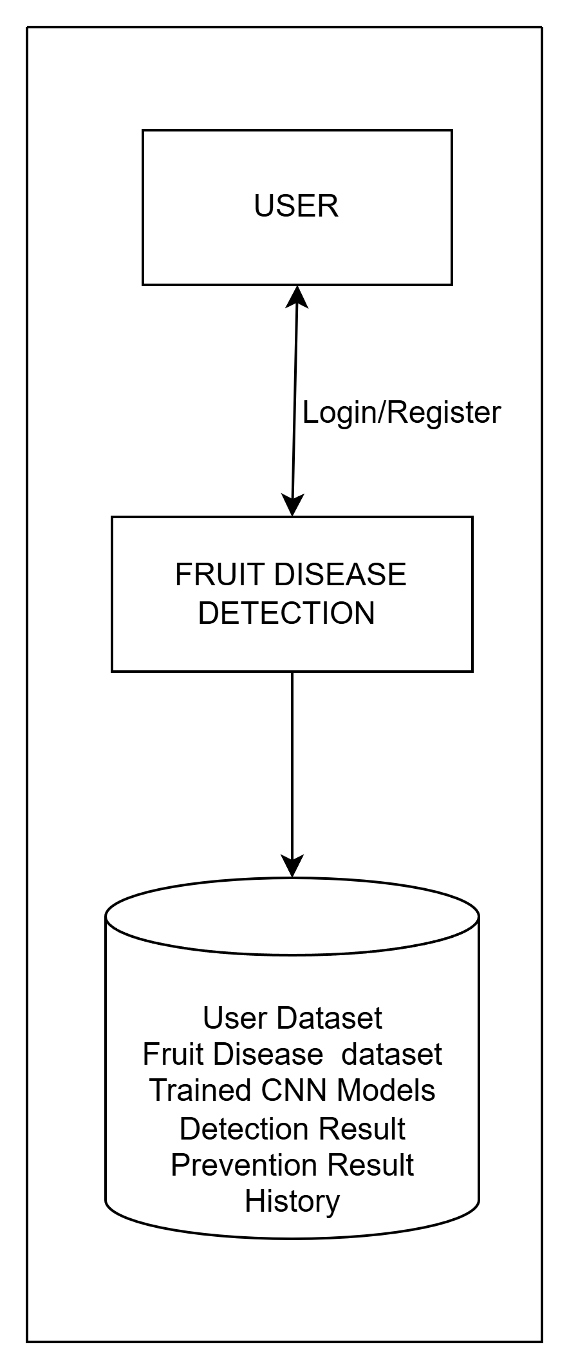
SYSTEM ARCHITECTURE

Slide 19
RESULT ANALYSIS
CNN model successfully detects healthy and diseased fruits.
Achieved ~90–95% accuracy on test data.
Provides real-time detection with instant prevention tips.
Works best for fruits with distinct disease patterns.
Reduces manual inspection effort and improves efficiency.
User interface is easy-to-use and suitable for farmers and gardeners..

Slide 20
FUTURE SCOPE
Expand to more fruit types and disease categories.
Develop a mobile app for farmers to detect diseases in the field.
Detect early-stage or hidden symptoms for proactive treatment.
Integrate with IoT devices, drones, or smart farms for automated monitoring.
Include personalized treatment tips and support.
Enable continuous learning by updating the model with new data.

Slide 21
CONCLUSION
Successfully implemented real-time fruit disease detection using CNN.
Provides instant disease diagnosis and prevention tips, helping reduce crop loss.
Enhances efficiency, productivity, and decision-making in agriculture.
Scalable for mobile apps, smart farms, and large-scale deployment.
Promotes sustainable, technology-driven farming and modern crop management.

Slide 22
REFERENCES
Multiple Fruit Disease Detection Using Deep Learning[Varadraj Jadhav, Harshal Giri, Harish Thore, Kshitij Patil, Hemant Pawar, Dr. Tushar Phadtare(2021)]
Optimized Deep Learning Framework for Pomegranate Disease Detection [R. K. Sharma, A. Verma, et al. (2024, ScienceDirect)]
CNN and SVM-Based Model for Watermelon Disease Classification [P. Kumar, S. R. Gupta, et al. (2023, ResearchGate)]
Guava Disease Detection Using Deep Convolutional Neural Networks [R. S. Prasad, K. S. Raju, et al. (2021, MDPI)]
Fruit Disease Detection Using Deep Convolutional Neural Networks [Gupta R., Sharma A., and Verma K. (2023)]
Automated Apple Leaf Disease Detection Using CNN [N. Singh, R. Kaur, et al. (2022, IEEE]
Deep Learning Approach for Banana Leaf Disease Identification [A. Das, S. Roy, et al. (2023, Springer]

Slide 23
THANK YOU

