Slide 1
Treemap using Qlik Sense Voronoi Tessellations using RAWGraphs
Presented by
Ashwini Cherukuri
44-599 Introduction to Data Visualization
April 4, 2017

Slide 2
Outline
What is a Treemap?
Qlik Sense
Dataset & Source
Goal
Demo

Slide 3
What is a Treemap?
Space-constrained visualization of hierarchical structure of a tree diagram while displaying quantities for each category via area size
Area size is displayed in a part-to-whole relationship
The way rectangles are ordered is dependent on the tiling algorithm
Squarified algorithm which keeps each rectangle as square as possible is commonly used

Slide 4
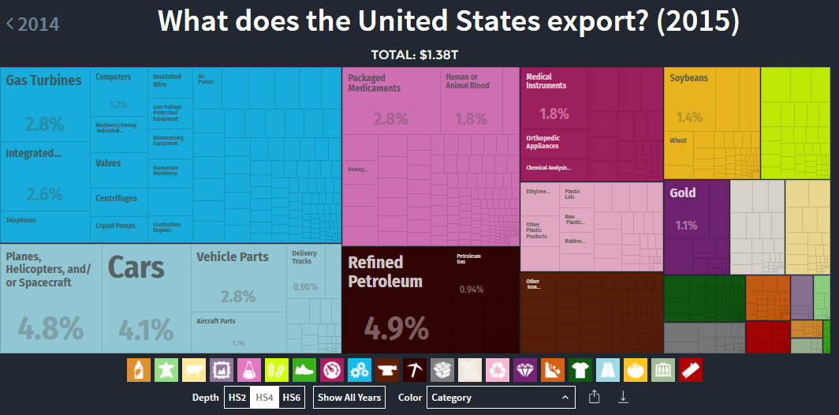
Treemap example
Figure 1: Tree Map example with US exports

Slide 5
Qlik Sense
It has different version such as Desktop, Server and Cloud
It makes easier to explore data and make decisions
Drag and drop functionality
Snapshots
Changes can be made immediately
Accessing data from any location

Slide 6
Dataset & Source
Dataset: Impaired driving death rate by age and gender during the year 2012 and 2014 in United States. Found this data on the DATA.GOV website.
Here is the link to find the dataset :
https://catalog.data.gov/dataset/impaired-driving-death-rate-by-age-and-gender-2012-all-states-587fd

Slide 7
Goal
Goal:
What is the age group that is most prone to driving related deaths?

Slide 8
Sample Data
State | Year | Age Group | Gender | Metric
United States | 2012 | all | all | 3.3
Arizona | 2012 | all | all | 3.6
United States | 2012 | 0-20 | all | 1.3
Arizona | 2012 | 0-20 | all | 1.6
United States | 2012 | 21-34 | all | 6.7
Total number of records for this dataset are 624

Slide 9
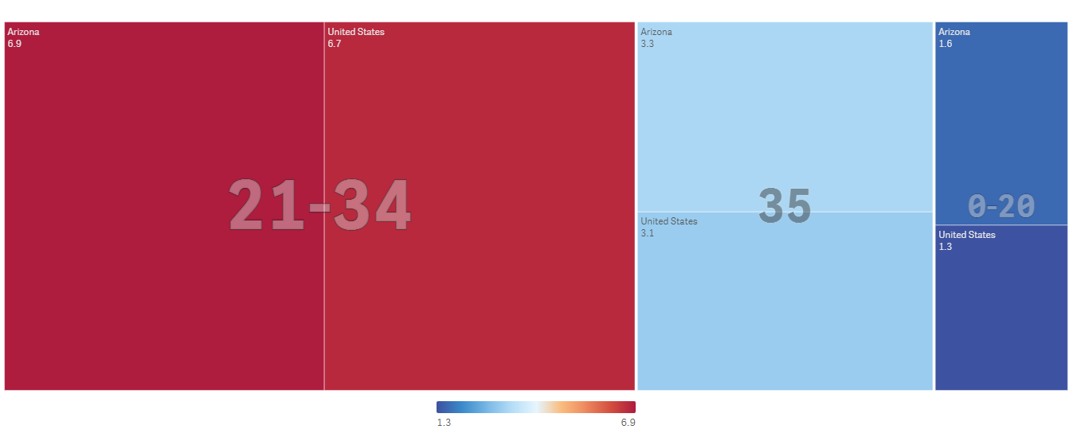
What is the age group that is most prone to driving related deaths?
Figure 2: Treemap explaining the goal with considering two states.

Slide 10
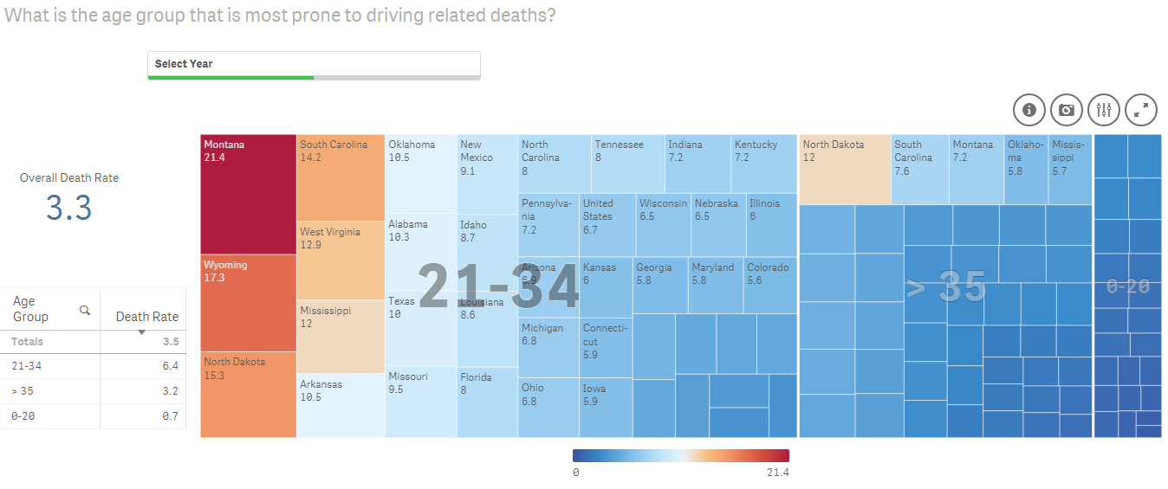
What is the age group that is most prone to driving related deaths?
Figure 3: Treemap explaining the goal with complete records.

Slide 11


Slide 12
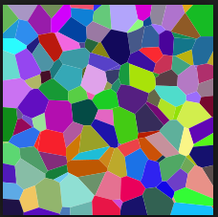
Outline
Voronoi Tessellations
Real time applications
Sample Data
Significance
RAWGraphs
Goal
Demo
Lessons Learned
Figure 4: Voronoi Tessellations

Slide 13
Voronoi Tessellations
It was discovered by the Steven Fortune,1986
It is a subdivision of the space into n cells
Plane Sweep algorithm and Delaunay triangulation are used
Voronoi Tessellations is a partitioning of a plane into regions based on distance to points in a specific subset of the plane.
https://www.nytimes.com/2014/08/16/upshot/mapping-migration-in-the-united-states-since-1900.html

Slide 14
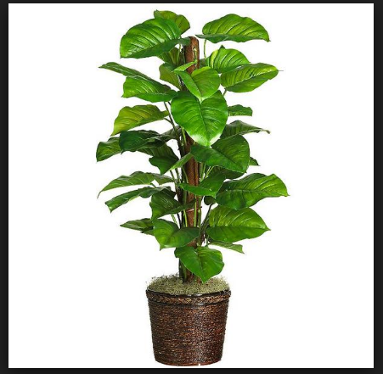
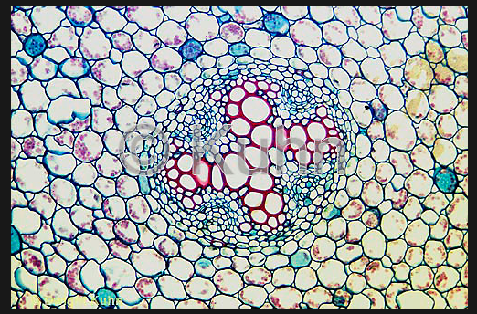
Real time applications
Real time applications
Natural Sciences
Biology – microscopic plant cells structure

Slide 15
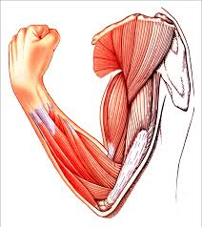
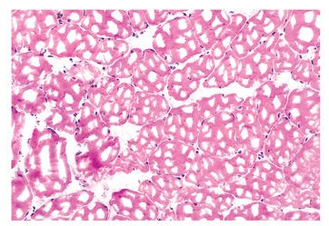
Real time applications(Cont..)
Health
Medical diagnosis - Model muscle tissues

Slide 16
Sample Data
Alphabets | Series 1 | Series 2
A | 2 | 4
B | 5 | 6
C | 3 | 2
D | 1 | 1
Series of words are taken to fill the data in series 1 and series 2.
The data is filled in the below way:
W o r d s
15 18 4 19 18
R a p i d
1 16 9 4 3

Slide 17
Y- Axis
.
B
6
5
4
3
2
1
0
\
.
A
\
Series - 2
/
\
.
C
.
\
D
0 1 2 3 4 5 6 7 8 9
X- Axis
Series - 1

Slide 18
Y- Axis
.
B
6
5
4
3
2
1
0
.
A
Series - 2
.
C
.
D
0 1 2 3 4 5 6 7 8 9
X- Axis
Series - 1

Slide 19
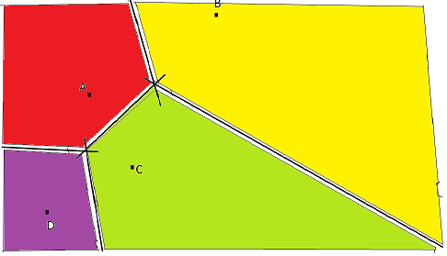
Y- Axis
.
B
6
5
4
3
2
1
0
\
.
A
\
Series - 2
\
.
C
.
\
D
0 1 2 3 4 5 6 7 8 9
X- Axis
Series - 1

Slide 20
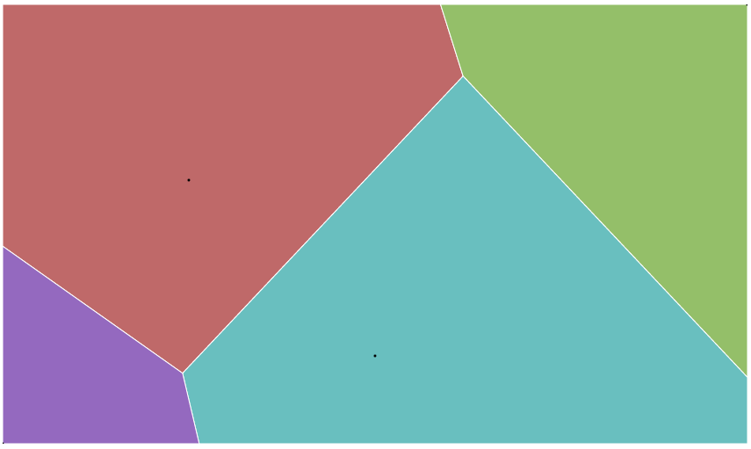
Output
B
A
C
D
Figure 5: Nearest neighbors for the given data

Slide 21
Significance
Significance
Composition
Proportion
Identify the relationship

Slide 22
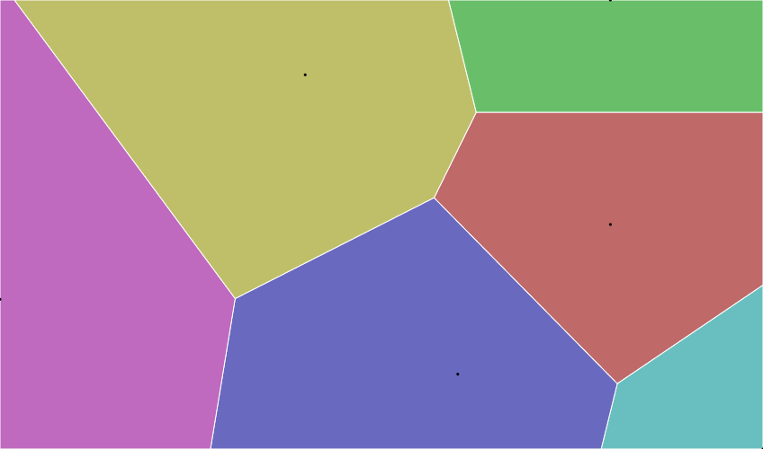
Voronoi Tessellations Example
Alphabet | Series 1 | Series 2
A | 5 | 3
B | 6 | 4
C | 7 | 6
D | 1 | 7
E | 2 | 5
F | 3 | 2
G | 4 | 6
Figure 6: Nearest neighbors for the given data

Slide 23
RAWGraphs
It is a open source online tool
It is built on D3.js
It is used to customize vector-based visualizations on top of D3.js through a simple interface.
Complex data can be represented easily using RAW
It takes data in csv, excel and tsv or else we can also copy and paste the data

Slide 24
Goal
Goal:
Who are the nearest neighbors for the alphabets?
Statistical Research
Data Processing
Data Science
Machine Learning

Slide 25
Sample Data
Alphabets | Series 1 | Series 2
A | 16 | 20
B | 8 | 5
C | 12 | 12
D | 19 | 3
E | 22 | 18
F | 1 | 9
G | 1 | 17
Total number of records for this dataset are 26

Slide 26
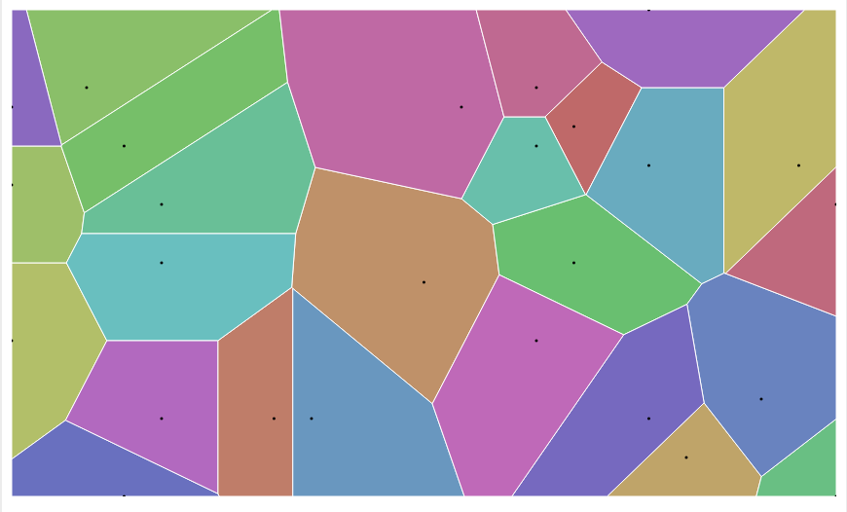
Who are the nearest neighbors for the alphabets?
Figure 7: Voronoi tessellations finding the nearest neighbors

Slide 28
Lessons Learned
To find out the appropriate data for visualization
Learned how to filter and sort the data
Tried to implement using maps with the following dataset in qlik sense and spot fire
Learned what data is appropriate and how to use voronoi diagram
n
Machine Learning

Slide 29


Slide 30


