Slide 1
ConnectHub
PROJECT OVERVIEW
The ConnectHub is a backend web application designed to solve the common problem of scattered contact information across multiple platforms. It provides users with a centralized, organized system to store, search, and categorize their professional and personal contacts.
Key Objectives:
• Provide secure user authentication and data isolation
• Enable efficient contact management through CRUD operations
• Implement flexible categorization using tags
• Offer fast search and filtering capabilities
• Deliver a responsive, cross-device user experience
Target Users:
• Freelancers and consultants managing client relationships

Slide 2
• Small business owners tracking vendor and customer contacts
• Students and young professionals building their network
• Event organizers managing attendee and volunteer information
• Anyone seeking a simple, privacy-focused contact management solution
PROJECT INSTRUCTION
1️⃣ Install Node.js (If Not Installed)
Download and install Node.js from: https://nodejs.org/
After installation, verify:
node -v
npm -v

Slide 3
2️⃣ Create a Backend Project Folder
• Choose or create a directory where you want your backend.
• Open your terminal or command prompt.
• Navigate to the selected directory:
cd your-project-folder
• Create a new backend folder:
mkdir server
cd server
3️⃣ Initialize Node Project
Run: npm init -y
This will create a package.json file.
4️⃣ Install Required Dependencies

Slide 4
Install Express:
npm install express
npm install mongoose
For development (auto-restart server):
npm install nodemon --save-dev
5️⃣ Create Basic Server File
Inside the server folder:
• Create a file called: server.js
Add this code :

Slide 5
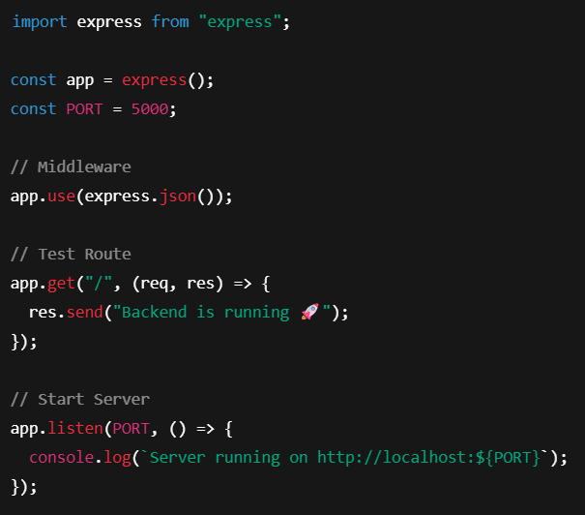
6️⃣ Enable ES Modules (Important)
Open package.json and add: "type": "module"
Example:

Slide 6
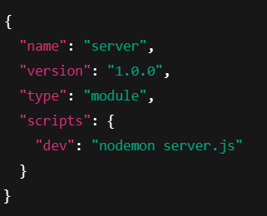
7️⃣ Start the Backend Server
Run: npm run dev
OR if not using nodemon: node server.js
8️⃣ Open in Browser
Open: http://localhost:5000
You should see: Backend is running
PRE-REQUISITES
Software Requirements

Slide 7
Software | Purpose
Node.js | JavaScript runtime for backend
MongoDB | NoSQL database for data storage
npm | Package manager
Git | Version control system
Code Editor | VS Code, WebStorm, or similar
Knowledge Requirements
• JavaScript ES6+ syntax and concepts
• Node.js and Express.js for RESTful API development
• MongoDB and Mongoose ODM
• JWT authentication and bcrypt password hashing
• Git version control workflow

Slide 8

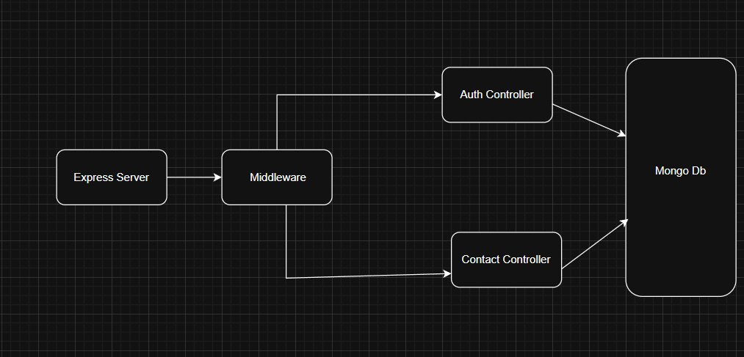
PROJECT THUMBNAIL
PROJECT ARCHITECTURE
High-level architecture diagram illustrating the three-tier backend structure.

Slide 9
Node.js + Express Backend
• RESTful API architecture
• JWT authentication middleware
• MVC pattern (Models, Controllers, Routes)
• Input validation and error handling
MongoDB Database
• Document-based NoSQL storage
• Mongoose ODM for schema modeling
• Two collections: Users and Contacts
• Indexed fields for optimized queries
TECHNICAL ARCHITECTURE
Backend Architecture (Node.js + Express)
• Controllers: Business logic for authentication and CRUD operations
• Models: Mongoose schemas defining data structure

Slide 10
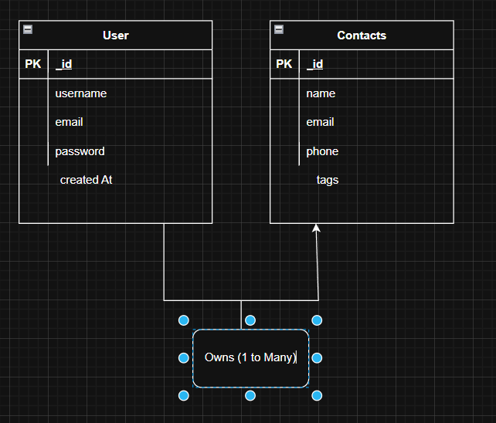
• Middleware: JWT verification, error handling, validation
• Configuration: Database connection and environment variables
Database Architecture (MongoDB)
• Users Collection: _id, name, email, password (hashed), timestamps
• Contacts Collection: _id, userId (FK), name, email, phone, notes, tags[], timestamps
• Relationships: Many-to-One (Contacts → User)
• Indexes: email (unique), userId, name, tags (for search)
ER Diagram

Slide 11
Features
Core Features
# | Feature | Description
1 | User Authentication | JWT-based registration, login, and session management with bcrypt password hashing
2 | Contact CRUD | Create, read, update, and delete contacts with full validation and error handling
3 | Tag Categorization | Organize contacts with multiple tags (Work, Family, Friends, etc.) and filter by category
4 | Real-time Search | Debounced search across name, email, and tags with instant results
Roles and Responsibility
User -
Registration - Register on the application using the name, email , password
Login - Login on the application using the email and registered password
3. Search - Search for a contact using name , email or tags

Slide 12
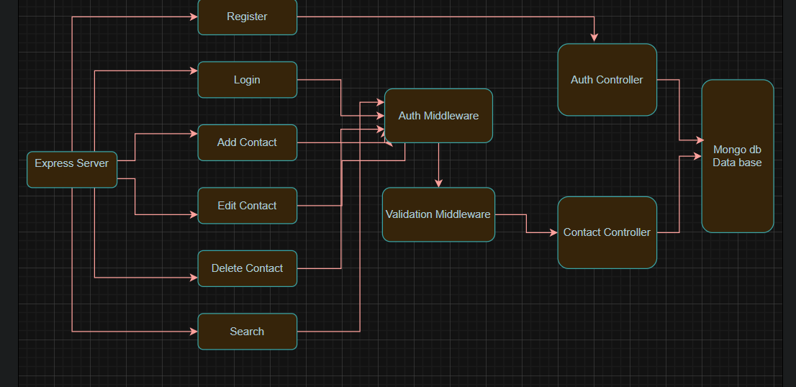
4. Add Contact - Add new contact - name , email , phone , notes , tags
5. Edit Contact - Edit the existing contact
6. Delete Contact - Delete any contact
User Flow
Project Setup and Configuration
Folder Structure

Slide 13
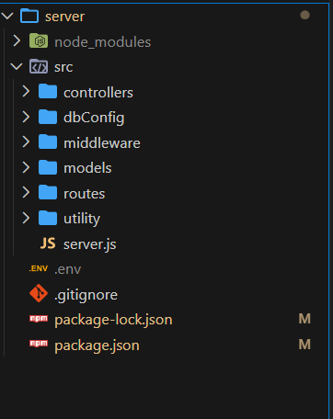
Project Setup
1. Install required tools and software:
• Node.js.
• MongoDB.
2. Create project folders and files:
• Server folders.

Slide 14
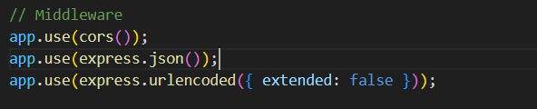
3. Install Packages:
Backend npm Packages
• Express.
• Mongoose.
• Cors.
Backend Development
• Setup express server
• Create index.js file in the server (backend folder).
• Create a .env file and define port number to access it globally.
• Configure the server by adding cors, body-parser.
• User Authentication:
• Create routes and middleware for user registration, login, and
• Set up authentication middleware to protect routes that require user authentication.

Slide 15
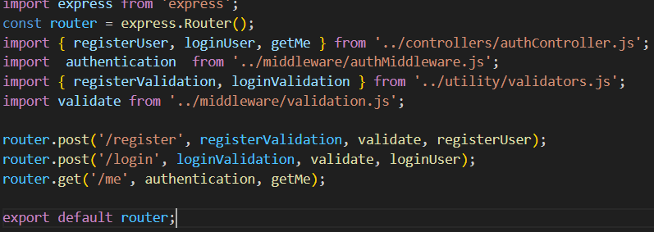
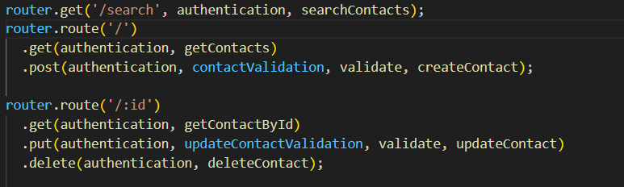
• Define API Routes:
• Create separate route files for different API functionalities such as user authentication and crud operation for contacts
• Implement route handlers using Express.js to handle requests and interact with the database.

Slide 16
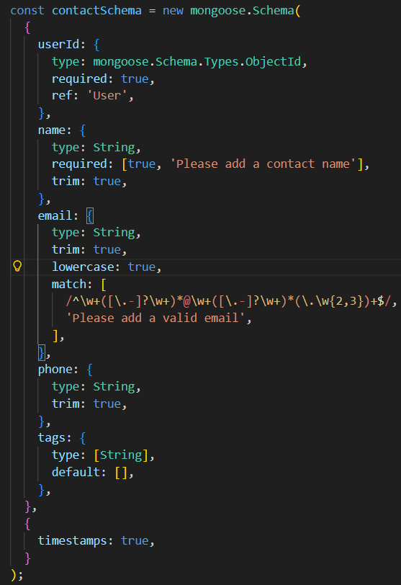
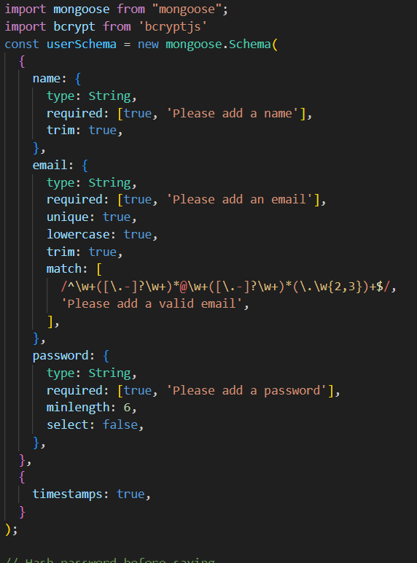
• Implement Data Models:
• Define Mongoose schemas for the different data entities like user and contact
• Create corresponding Mongoose models to interact with the MongoDB database.
• Implement CRUD operations (Create, Read, Update, Delete) for each model.
• Implement CRUD operations (Create, Read, Update, Delete) for each model to perform database operations.

Slide 17
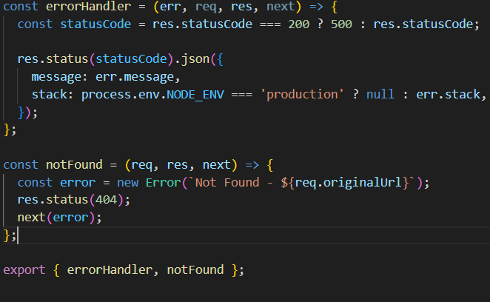
• Error Handling:
• Implement error handling middleware to catch and handle any errors that occur during the API requests.
• Return appropriate error responses with relevant error messages and HTTP status codes.
Database Configuration and Setup
1. Configure MongoDB:
• Install Mongoose.

Slide 18
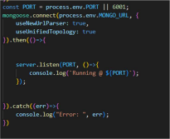
• Create database connection.
• Create Schemas & Models.
2. Connect database to backend:
Now, make sure the database is connected before performing any of the actions through the backend. The connection code looks similar to the one provided below.
3. Configure Schema:
Firstly, configure the Schemas for MongoDB database, to store the data in such pattern. Use the data from the ER diagrams to create the schemas.
The schemas are looks like for the Application.

Slide 19
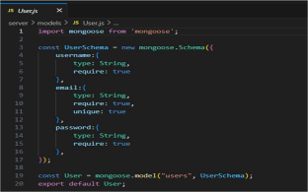
Project Execution
Execution Steps
Open the project folder in the terminal
Make sure you have a start script in the package.js file
Use the command npm start to start the server
You will the Running on PORT message on the successfully starting the server
You will also see the database connected message if the database is connected successfully
Use the Thunder client or Postman for using the created api’s

Slide 20
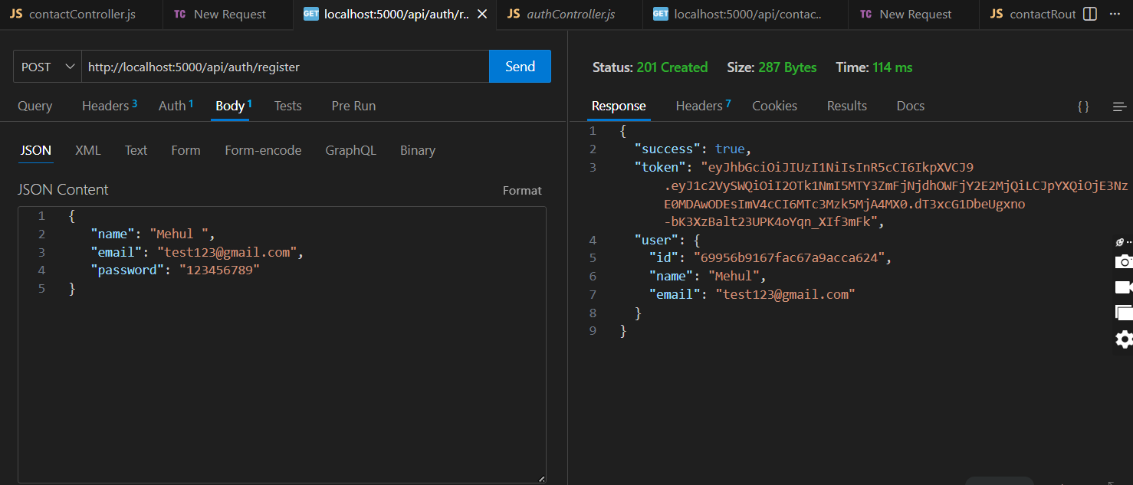
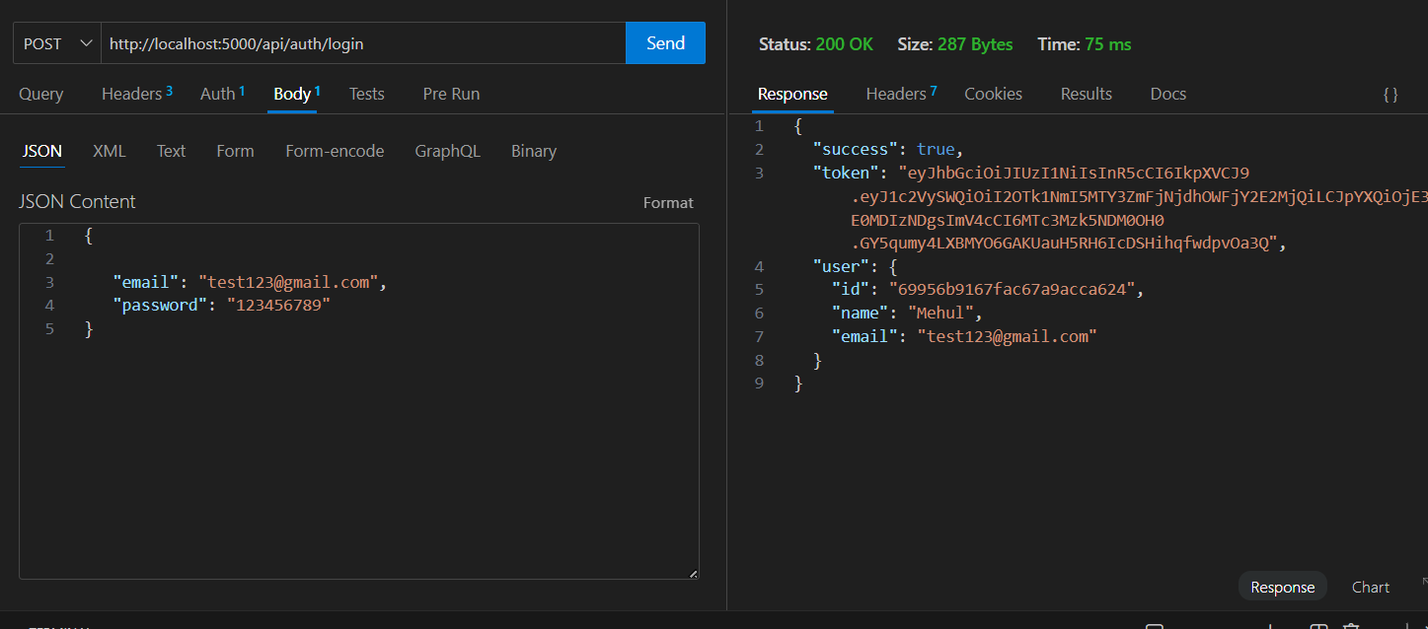
Output Screenshots
Register Api
Login Api

Slide 21
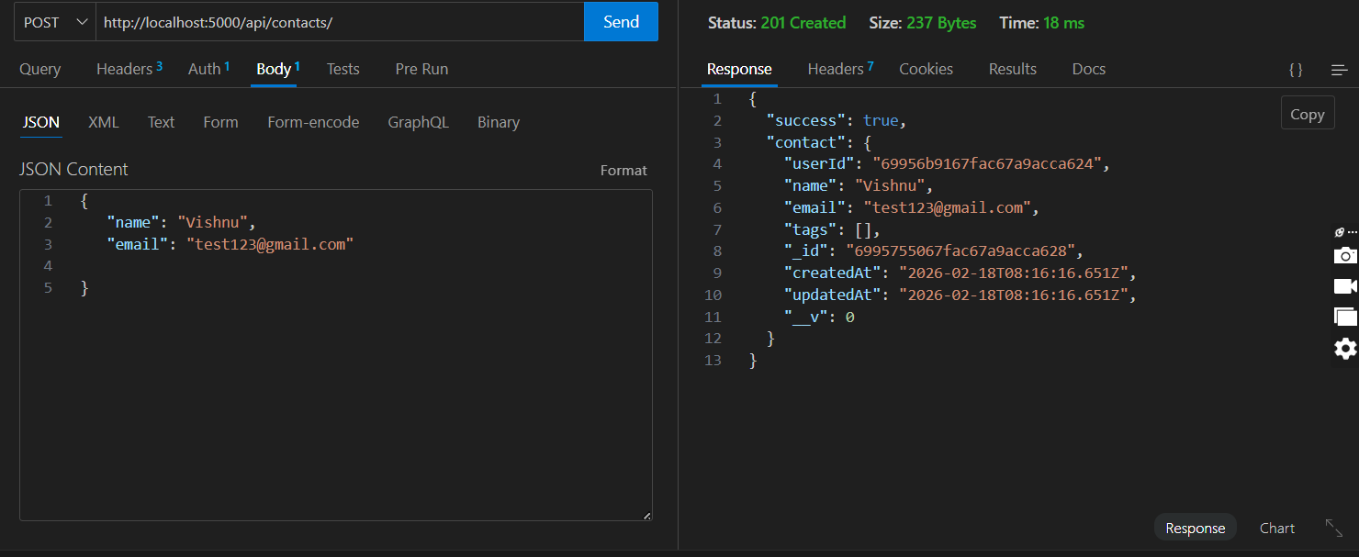
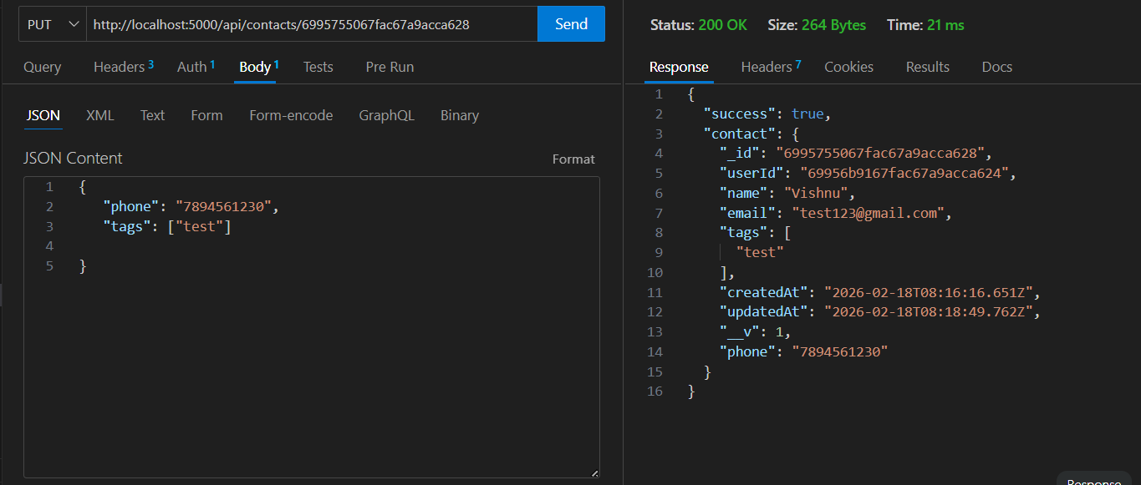
3. Create New Contact
Update Contact

Slide 22
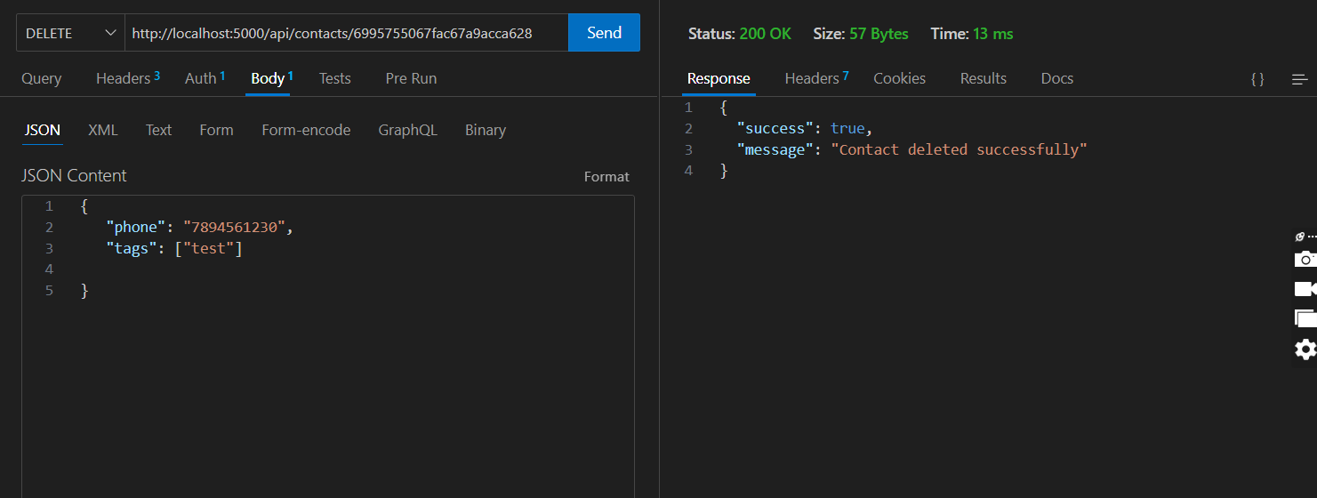
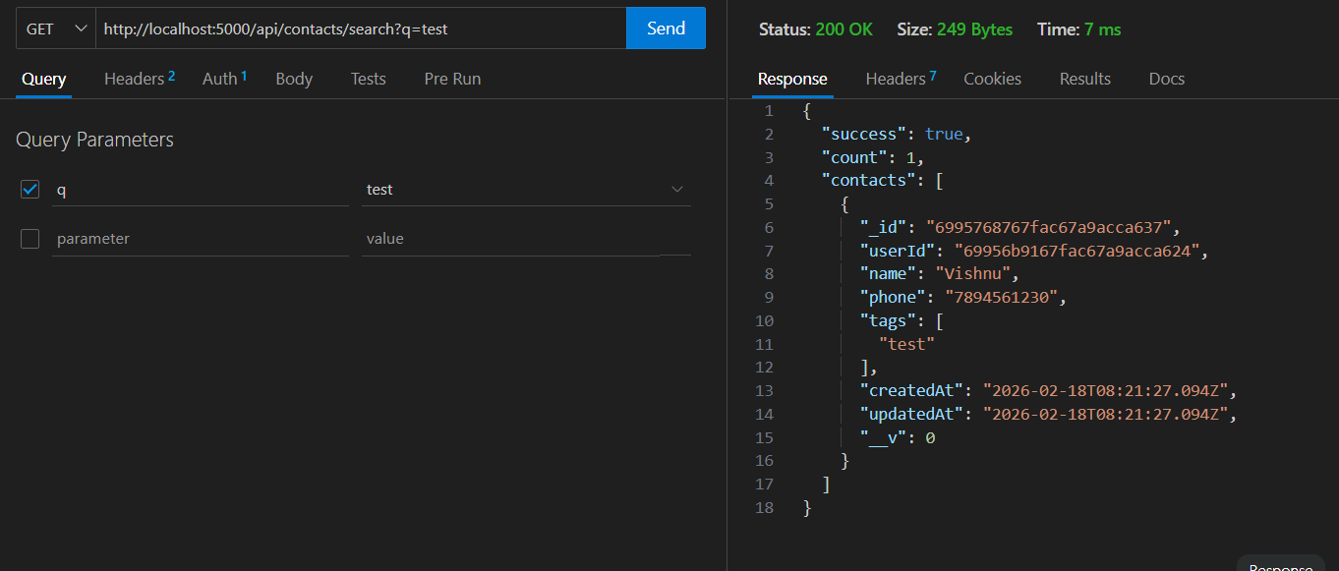
Delete Contact
Search Contact

Slide 23
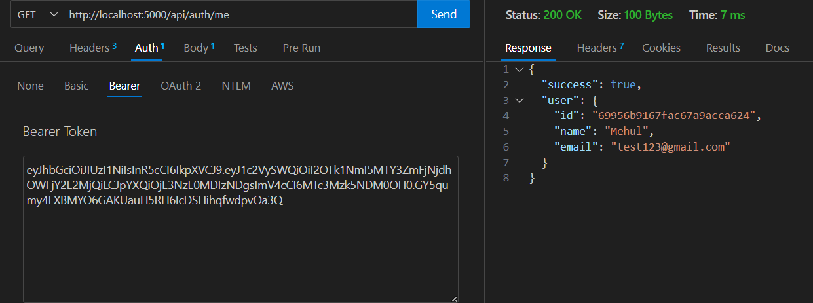
Get The Current User
Project Demo
Contact Manager.webm
Code Link
Contact-Manager

