Slide 1
PROJECT PRESENTATION
STUDENT INTERNSHIP
TRACKER
A simple system to manage applications and record internship experiences
Presented by
- 24ME1A0532
- 24ME1A0533
- 24ME1A0563

Slide 2
1. Introduction
InternTrack helps students organize internship applications in one place.
Application Tracking
Progress Monitoring
Experience Record
Store company name, role, application date and current status.
View applications by stages such as Applied, Selected and Rejected.
Save internship duration and a short learning summary after completion.
The goal is to reduce manual tracking and keep internship information clear and accessible.
02

Slide 3
2. Problem Statement
Students may apply to several internships at different companies.
• Application details can be scattered across notes, emails and spreadsheets.
• It may be difficult to remember the current status of each application.
• Completed internship details and learning outcomes may not be recorded consistently.
• Manual tracking can become confusing as the number of applications increases.
Need: one organized place to manage applications and completed experiences.
03

Slide 4
3. Project Objectives
Add & Manage
Track Status
Create, view, edit and delete internship applications.
Maintain the status of every application.
01
02
Record Completion
Save Learning
Capture duration when an internship is completed.
Record a short description of skills and knowledge gained.
03
04
04

Slide 5
4. Proposed System & Key Features
Application Management
Status & Completion
• Add a new application
• View saved applications
• Edit company, role, date or status
• Delete an application
• Applied
• Selected
• Rejected
• Internship Completed
When completed, duration and learning description are required.
05

Slide 6
5. Technology Stack
Frontend
Backend
Database
HTML – page structure
CSS – styling
JavaScript – interactions
Java
Spring Boot
REST API
MySQL
Store application records
Relational table design
Implementation note: the current browser prototype uses HTML, CSS, JavaScript and localStorage. Spring Boot and MySQL are the planned backend and database integration.
This distinction keeps the presentation accurate about what is currently demonstrated.
06

Slide 7
6. System Architecture
USER / STUDENT
WEB FRONTEND
JAVA BACKEND + DB
Enters and manages
internship details
HTML • CSS • JavaScript
Forms and application list
Spring Boot API
MySQL data storage
Data flow: student input → frontend validation → backend processing → database storage → updated application list.
07

Slide 8
7. Database Design
Suggested table: internships
Field | Purpose
id | Unique application identifier (Primary Key)
company_name | Company or organization name
role | Internship role or position
application_date | Date of application
status | Applied / Selected / Rejected / Internship Completed
duration | Internship duration; required on completion
learning_description | Short summary of learning; required on completion
08

Slide 9
8. Workflow, Testing & Future Scope
Workflow
Testing Checklist
Future Enhancements
1. Student opens tracker
2. Adds application details
3. Updates status when it changes
4. On completion, enters duration and learning
5. Reviews saved records
• Add a valid application
• Edit and delete a record
• Filter by status
• Verify required completion fields
• Confirm records display correctly
• Connect Spring Boot REST APIs
• Integrate MySQL database
• Add login and student profiles
• Export application reports
• Add reminders and notifications
09

Slide 10
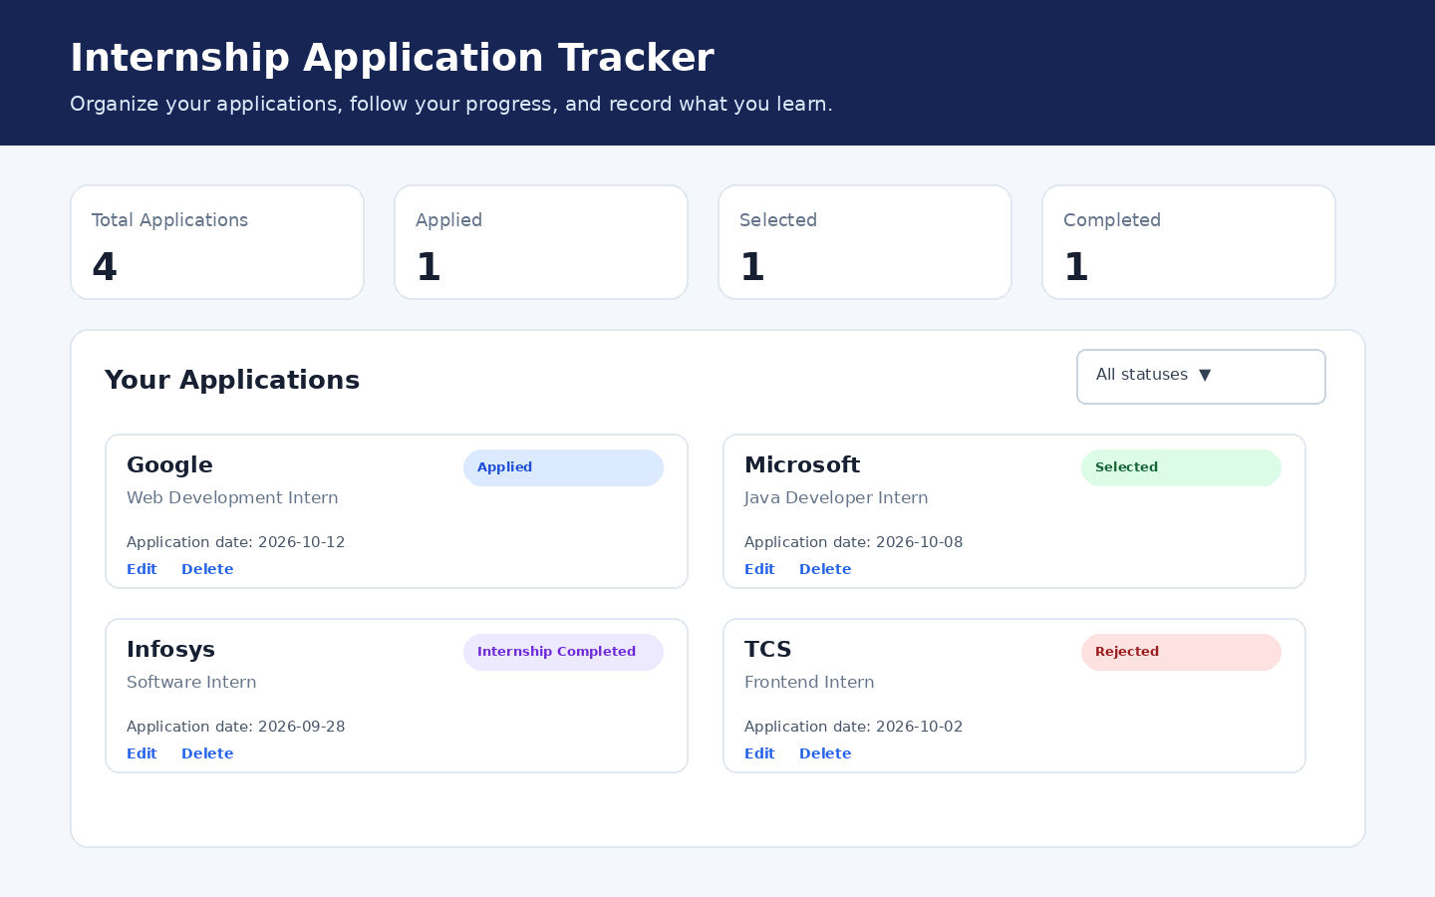
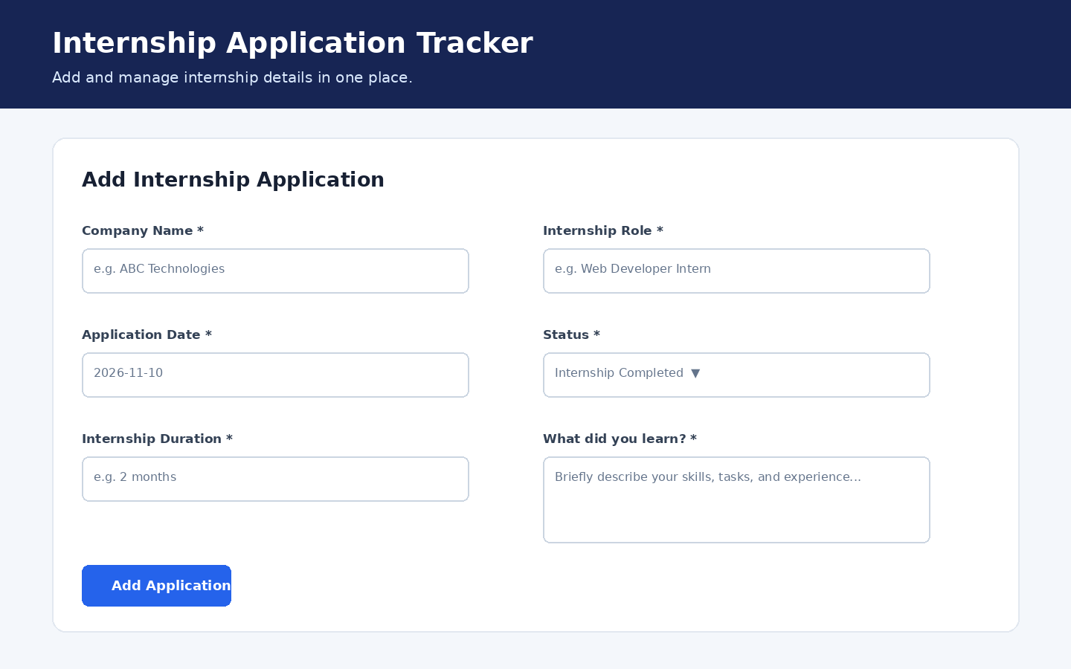
9. Website Preview – InternTrack
The browser prototype demonstrates how students can add applications, monitor status and save completed internship experiences.
Dashboard & Progress
Summary cards show total, applied, selected and completed applications. The list displays each company, role, date and status.
Application Form
Students enter company, role, date and status. When marked completed, duration and learning details are required.
Prototype note: records are stored in the browser using localStorage; Spring Boot and MySQL are planned integrations.
10

Slide 11
THANK YOU
STUDENT INTERNSHIP TRACKER | INTERNTRACK

