Slide 1

Project Title - Seasonal Agriculture Performance Analysis
Student Name: Aswini Bojja
College Name- Kakinada Institute of Engineerinng and Technology
AICTE STU ID :STU6a6cbdb7e9a261785511351

Slide 2

PROBLEM STATEMENT
Agricultural activities are influenced by seasonal variations in environmental conditions, farming practices, resource availability and market conditions. As a result, agricultural performance may differ from one season to another.
However, raw agricultural data does not clearly explain how agricultural performance changes across seasons or what patterns can be observed in different seasonal conditions.
The problem is to analyze the given agricultural dataset and investigate seasonal differences in agricultural performance by identifying meaningful patterns, trends, relationships and variations within the available data.

Slide 3
Project Description
This project analyzes agricultural data to understand how farming performance changes in different seasons. It studies the data to find patterns, trends, and differences between seasons. The project helps us understand which seasons perform better and how different factors affect agricultural performance.

Slide 4

WHO ARE THE END USERS?
Farmers & Agricultural Practitioners
Agricultural Policy Makers & Government Agencies
Financial Institutions & Agri-Insurers
Agri-Tech Developers & Advisory Services

Slide 5

Technology Used
Python
Pandas
Numpy
Matplotlib
Seaborn

Slide 6
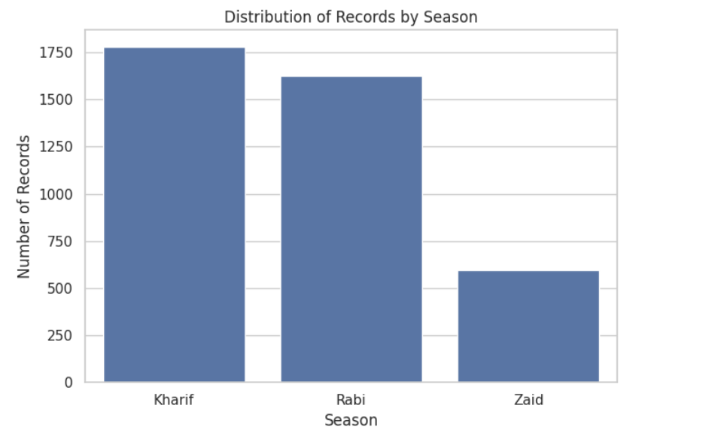
RESULTS
The Kharif season contains the highest count at roughly 1,770 records, followed by Rabi (around 1,620) and Zaid (around 600).

Slide 7
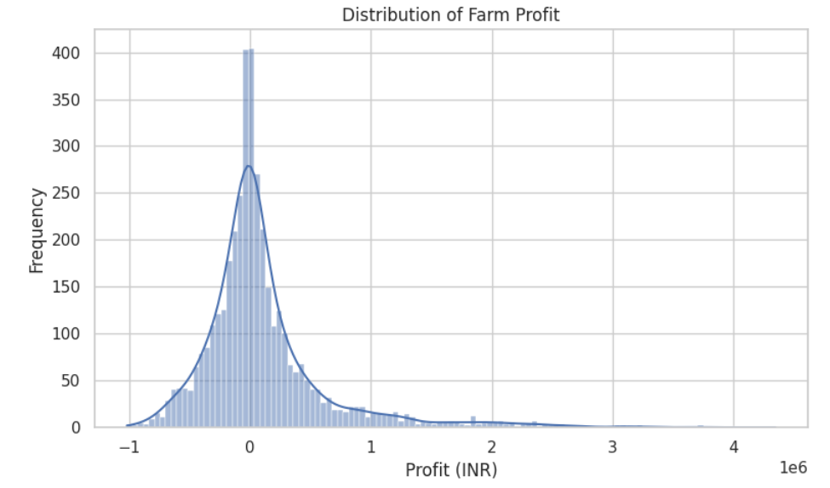
RESULTS
The data is strongly right-skewed, meaning most farms break even or make minor losses, while a few outliers generate high profits up to 4 million INR.

Slide 8
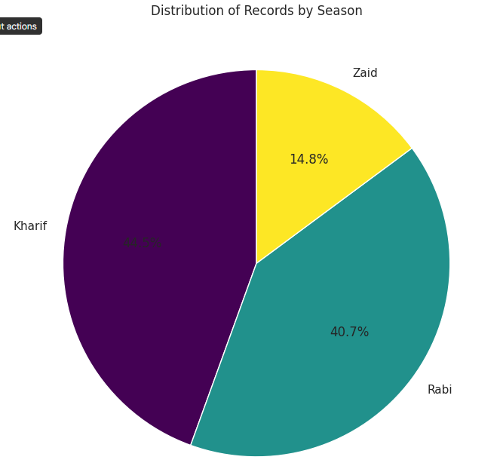
RESULTS
The Kharif season accounts for the largest share at 44.5%, followed closely by Rabi at 40.7%, while Zaid represents the smallest portion at 14.8%.

Slide 9
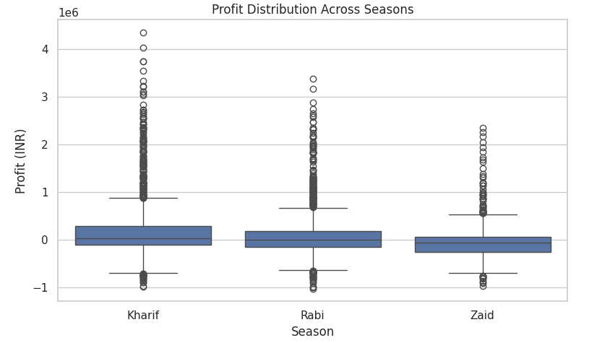
RESULTS
Kharif yields the highest extreme profits with outliers exceeding 4 million INR, followed by Rabi and then Zaid, which shows the lowest maximum returns

Slide 10
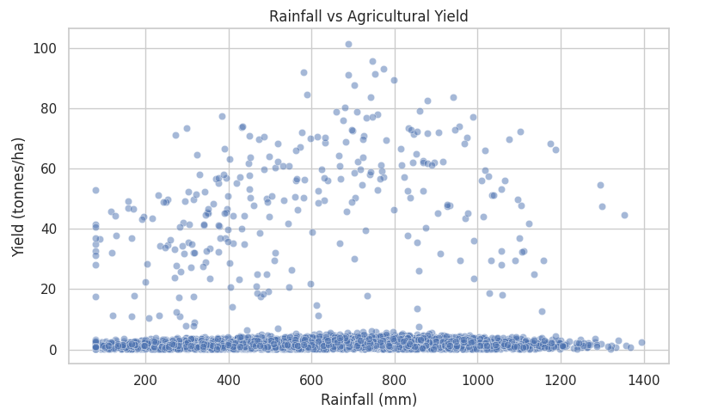
RESULTS
For the higher-yielding farms, productivity peaks between 600 mm and 1000 mm of rainfall, reaching up to 100 tonnes/ha before declining at extreme rainfall levels.

Slide 11
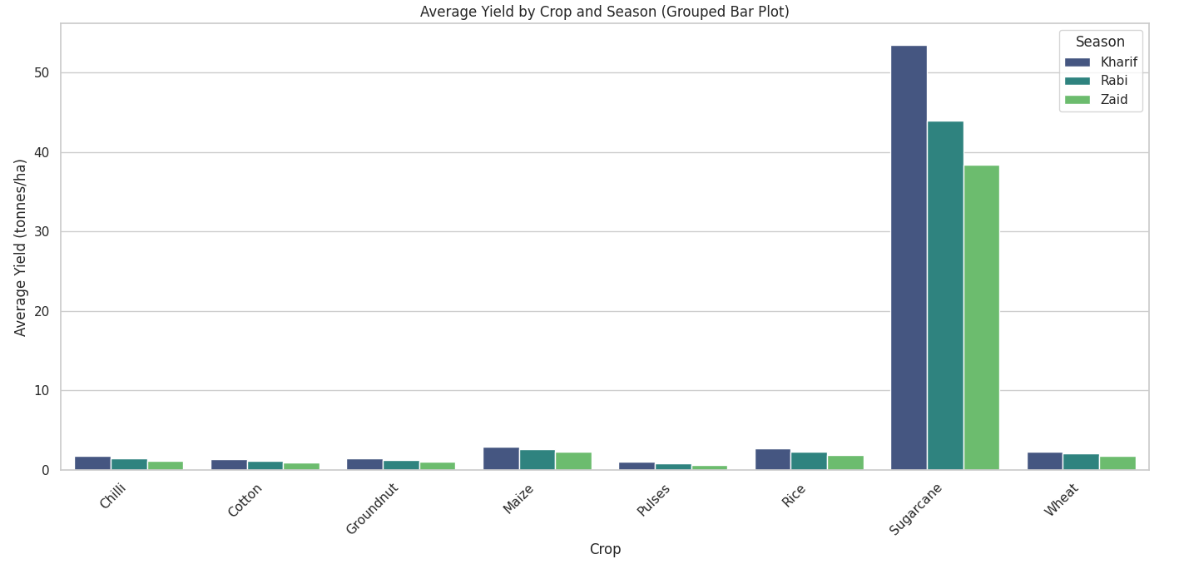
RESULTS
Across almost every crop type, the Kharif season generates the highest average yield, followed closely by Rabi, while Zaid consistently produces the lowest.

Slide 12
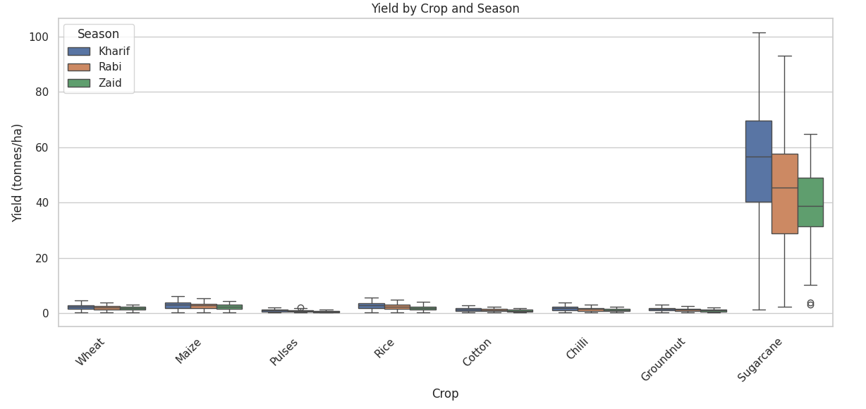
RESULTS
Across nearly all crops, Kharif consistently delivers the highest median yield and maximum range, while Zaid tends to show the lowest performance.

Slide 13
Future scope
Yield Prediction Models: Build machine learning models to forecast crop yield and farm revenue based on weather and soil data.
Precision Irrigation: Implement smart watering systems to optimize rainfall usage and maintain the ideal 600–1000 mm moisture range.
Zaid Season Improvement: Test shade-net farming and drought-resistant crops to increase low off-season returns.
Smart Advisory Tools: Develop mobile apps providing real-time seasonal and crop recommendation guides for farmers.
Targeted Financial Support: Create data-driven risk models to help banks and governments offer tailored crop insurance and loans.

Slide 14
GitHub Link
https://github.com/aswinis1/Seasonal-Agriculture-Performance-Analysis.git

Slide 15

VOIS Course completion certificate - Course name- Data Visualization

Slide 16
Thank you
.
.

