Slide 1

Social Network Advertisements based on Random Forest Classification
Aswin KS

Slide 2
Topics
Introduction
Data Analysis
Classification
Random Forest
Dataset Selection
Importing the Libraries
Splitting the data into training and test data
Data Visualization
Predicting test result
Confusion matrix
Visualization
Evaluation matrix

Slide 3
Introduction
Our model describes a dataset that lists customers age, salary and whether or not they were persuaded by advertisements to make a purchase.
The first two columns are the independent variables, such as ‘Age’ and ‘Estimated Salary,’
The last column, which is the dependent column, ‘Purchased,’ which is represented in binary format
Using this data, we developed a Classifier for a specific product that predicts whether an individual of a specific age and earning a certain salary will purchase a product promoted on a social media platform
We have developed a GUI for flexibility and visual representation that executes the entire model as a user-interfered application.

Slide 4
DATA Analysis
Data analysis is the process of systematically inspecting, cleaning and transforming data to find meaningful information and creating insights using it
Machine learning is a subset of AI, which enables the machine to automatically learn from data, improve performance from past experiences, and make predictions.
MACHINE LEARNING

Slide 5
CLASSIFICATION
Classification is a Supervised machine learning in which output variable is categorical, such as "Yes" or No, Male or Female, Red or Blue, etc. The classification algorithms predict the categories present in the dataset.
Some popular classification algorithms are :
Random Forest Algorithm
Decision Tree Algorithm
Logistic Regression Algorithm
Support Vector Machine Algorithm

Slide 6
Random forest algorithm
Random Forest is a popular machine learning algorithm that belongs to the supervised learning technique. It can be used for both Classification and Regression problems in ML.
It is a classifier that contains a number of decision trees on various subsets of the given dataset and takes the average to improve the predictive accuracy of that dataset. Instead of relying on one decision tree, the random forest takes the prediction from each tree combines the output of multiple decision trees to reach a single result.

Slide 7
Data source
Kaggle Machine Learning Repository: Social Network Advertisements data set
https://www.kaggle.com/datasets/rishidamarla/social-network-advertisements

Slide 8
1.Importing the Libraries
As always, the first step include importing the libraries which are the NumPy,
Pandas and the Matplotlib.
Pandas : We used pandas for data analysis and associated manipulation of tabular data in Data Frames
Seaborn : We used seaborn to plot graphs
Matplotlib: We used this library to create visualizations
Sklearn: We imported this library to do random forest classification
Tkinter: We used this module to create simple GUI for the application

Slide 9
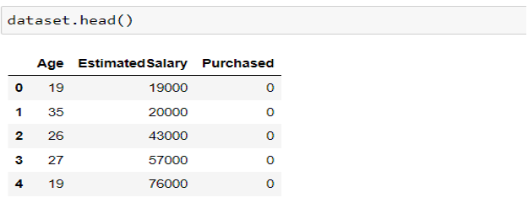
2. Importing the dataset
Read the Data set using pandas library
This command create a dataset object which contain the content of the .CSV file.
Then using the head function we display the first 5 rows of the datatset

Slide 10
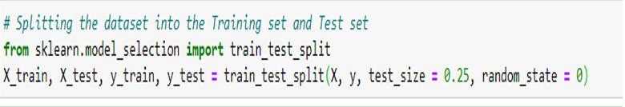
3. Splitting the data into training and test data
25% of the data will be kept as the Test set
75% will be used for training as the Training set
So, out of the 400 rows, 100 will be assigned as test set and the remaining 300 will be used for the training purpose
train_test_split() function: It is used to split our data into train and test sets.

Slide 11
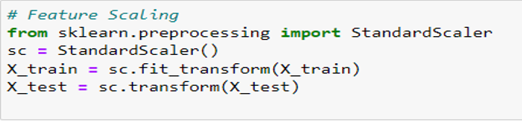
4. Feature scaling
In order to scale the values of X down to a narrower range, we must take feature scaling, which will speed up the program
It helps to normalize the data within a particular range.
we reduce the X train and X test to a narrow range of -2 to +2. As an illustration, a salary of 75000 is scaled down to 0.16418997

Slide 12
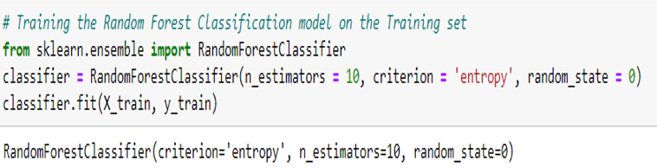
5. Training the Random Forest Classification model on the Training Set
In this step, we use the RandomForestClassifier Class to fit the training set to our model
Here we have choose ‘entropy’ as our criterion
Classifier.fit() function of sklearn fit method uses the training data as an input to train the machine learning model.

Slide 13
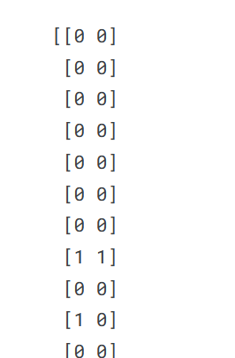
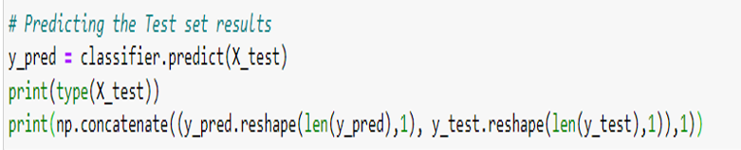
6. Predicting the test set results
In this step we used the classfier.predict() function to create the predict results
The predict results are then saved in a variable called y_pred

Slide 14
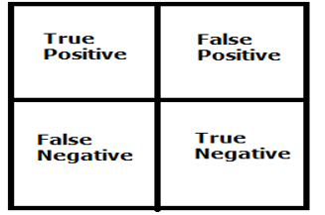
7. Confusion matrix
A confusion matrix is a table that is used to define the performance of a classification algorithm. A confusion matrix visualizes and summarizes the performance of a classification algorithm.
Calculating a confusion matrix can give you a better idea of what your classification model is getting right and what types of errors it is making.
When the true values of the Test Set are known, a table called the confusion matrix is used to display the proportion of correct and incorrect predictions on a classification task.
The True values are the number of correct predictions made.

Slide 15
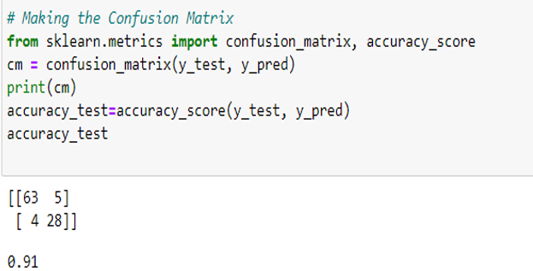
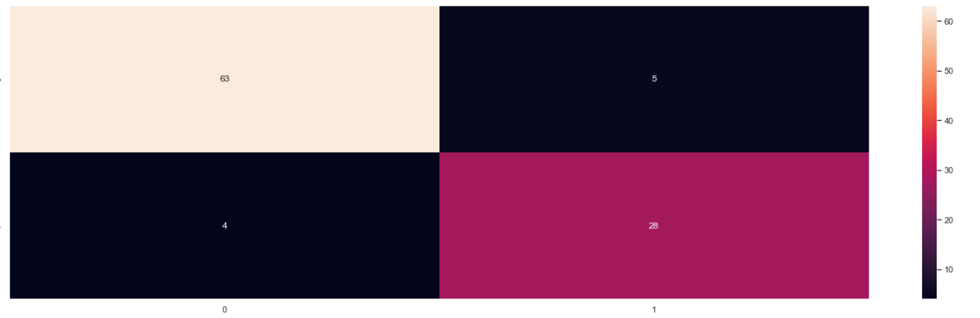
Confusion matrix
Displaying the confusion matrix

Slide 16
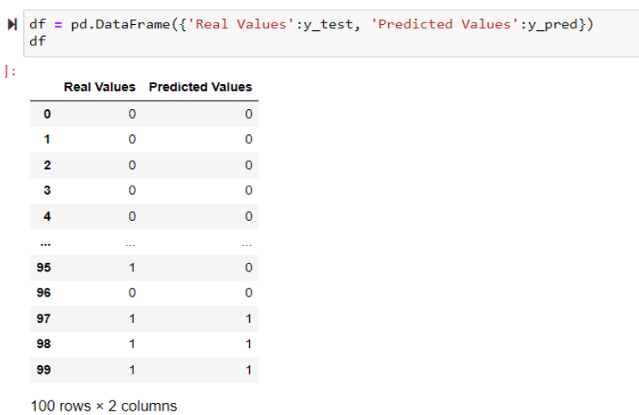
8. Comparing the Real Values with Predicted Values
To compare the categorised values of the original Test set (y test) and the predicted results (y pred), a Pandas DataFrame is constructed in this stage.
This extra step, which is mostly employed in Classification to assess the precision of the predicted value, is not as helpful as the Confusion matrix. Try to identify the value that was predicted wrongly!

Slide 17
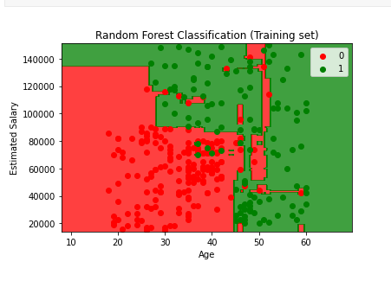
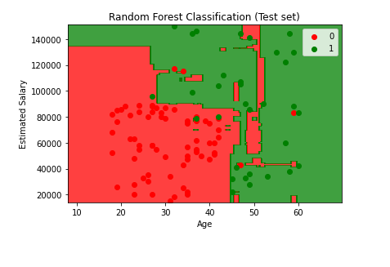
9. VISUALIZING THE RESULT
We used matplotlib to visualize the data points for training and test set.
The show() function in pyplot module of matplotlib library is used to display figures.

Slide 18
10. Evaluation Matrix
Evaluation metrics are used to measure the quality of the machine learning model.
The evaluation metrics help us understand how well our model has performed for the given data. In this way, we can improve the model's performance by tuning the hyper-parameters.
Performance matrix used for evaluation
1. Accuracy
2. Precision
3. F-Score

Slide 19
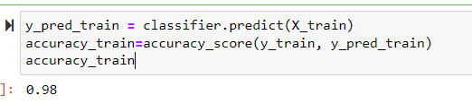
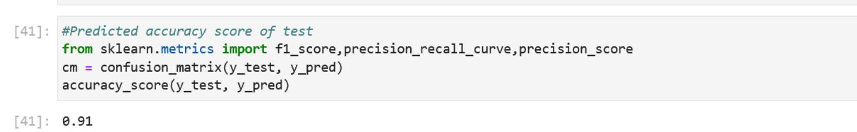
ACCURACY
The accuracy metric can be stated as the number of correct predictions to the total number of predictions.

Slide 20
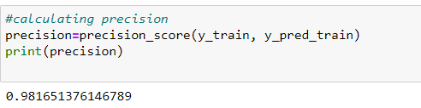
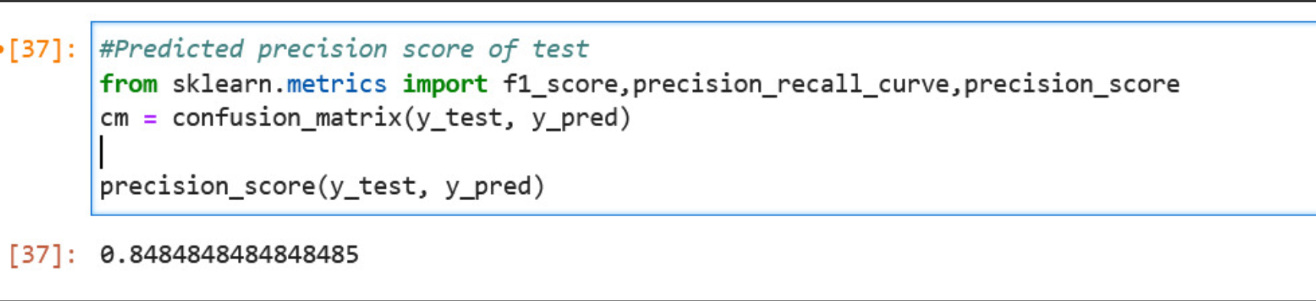
PRECISION
Precision is the percentage of correctly predicted instances relative to the total number of cases.

Slide 21

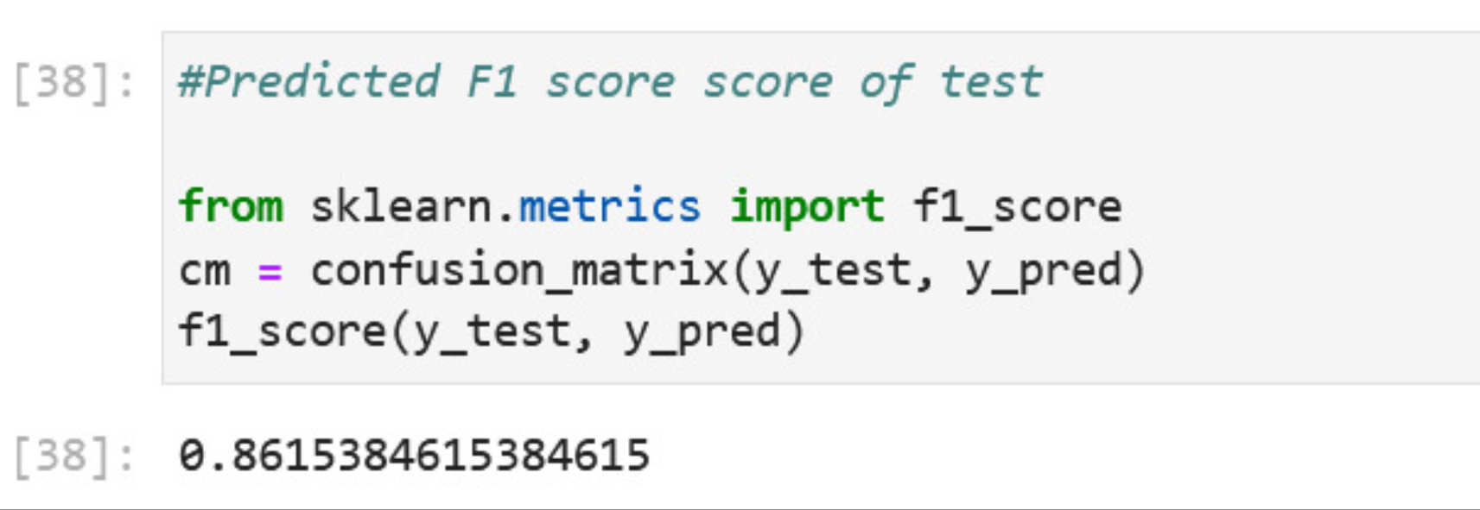
F1 SCORE
The F-score, also called the F1-score, is a measure of a model’s accuracy on a dataset. It is used to evaluate binary classification systems, which classify examples into ‘positive’ or ‘negative’.

Slide 22
THANK YOU

