Slide 1
（1）Validation of CUENUF in DPD
A single polyelectrolyte
Charge fraction: θ=0，0.24，0.48，0.76, 1.0
Length: Np=50
Charge magnitude: e/2 assigned uniformly on beads.
Counter icons: -e
75 molecules containing: 75 cations and 75 anions with charge e and –e respectively.
Number of total beads: 10125
Box volume: 15*15*15, ρ=3
Equilibrium bond distance: r0=0
Spring constant: K=4.0
Alpha between polymer and water: α_{pw}=80.42, others: α=78.3

Slide 2
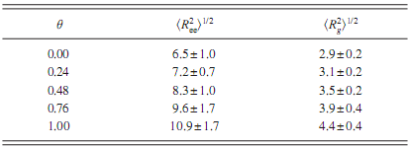
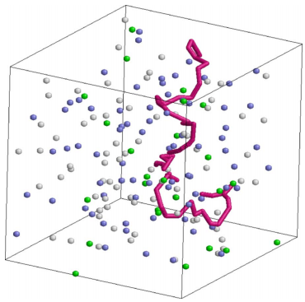
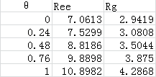

CUENUF:
PPPM:
Precision: CUENUF > PPPM

