Slide 1
DIGITAL LIBRARY & BOOKS PUBLISHING
PLATFORM

Slide 2
DIGITAL LIBRARY & BOOKS PUBLISHING
PLATFORM
This project is a web-based platform that allows users to read books and publish their own stories. It includes modules for admin, authors, and readers, along with features like content management, interaction, and basic security to protect original work.

Slide 3
Submitted By :
Aswin Manoj
Guided By :
Asst.Prof.Reena Cherian
DIGITAL LIBRARY & BOOKS PUBLISHING PLATFORM

Slide 4
Content
USERS AND MODULES
UML DAIGRAMS

Slide 5
SYSTEM SPECIFICATION
Front End : Standard Web Technologies(HTML, CSS, JavaScript, used with WampServer).
Back End :PHP(WampServer)
Database :MYSQL Server

Slide 6
USERS
ADMIN
AUTHOR
READER

Slide 7
ADMIN
Login
Manage Users
Manage Books
Approve Books
View Reports
Manage Complaints

Slide 8
AUTHOR
Registration & Login
Manage Books
Manage Profile
View Status
Payments
View Feedback

Slide 9
READER
Registration & Login
Browse Books
Read/Purchase
Add to Wishlist
Payments
Manage Profile
Feedback

Slide 10
UML DIAGRAMS
Use Case Diagram
Activity Diagram
Sequence Diagram
Class Diagram

Slide 11
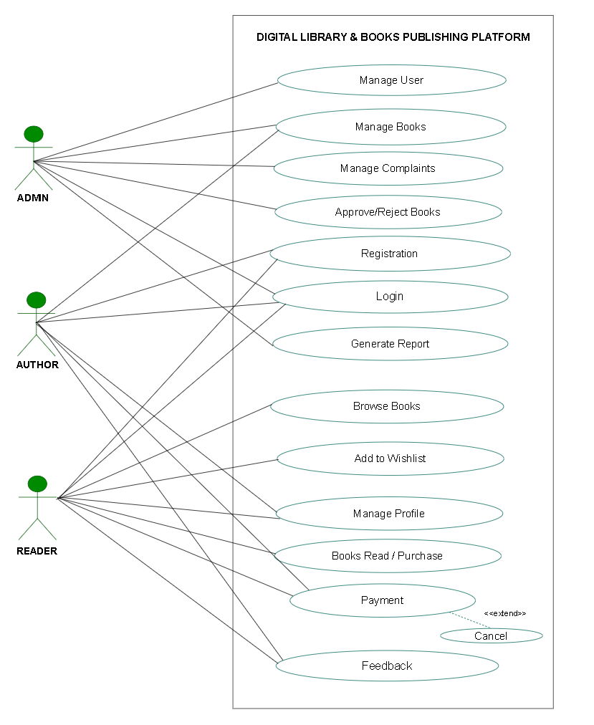
Use case Diagram

Slide 12
Activity Diagram

Slide 13
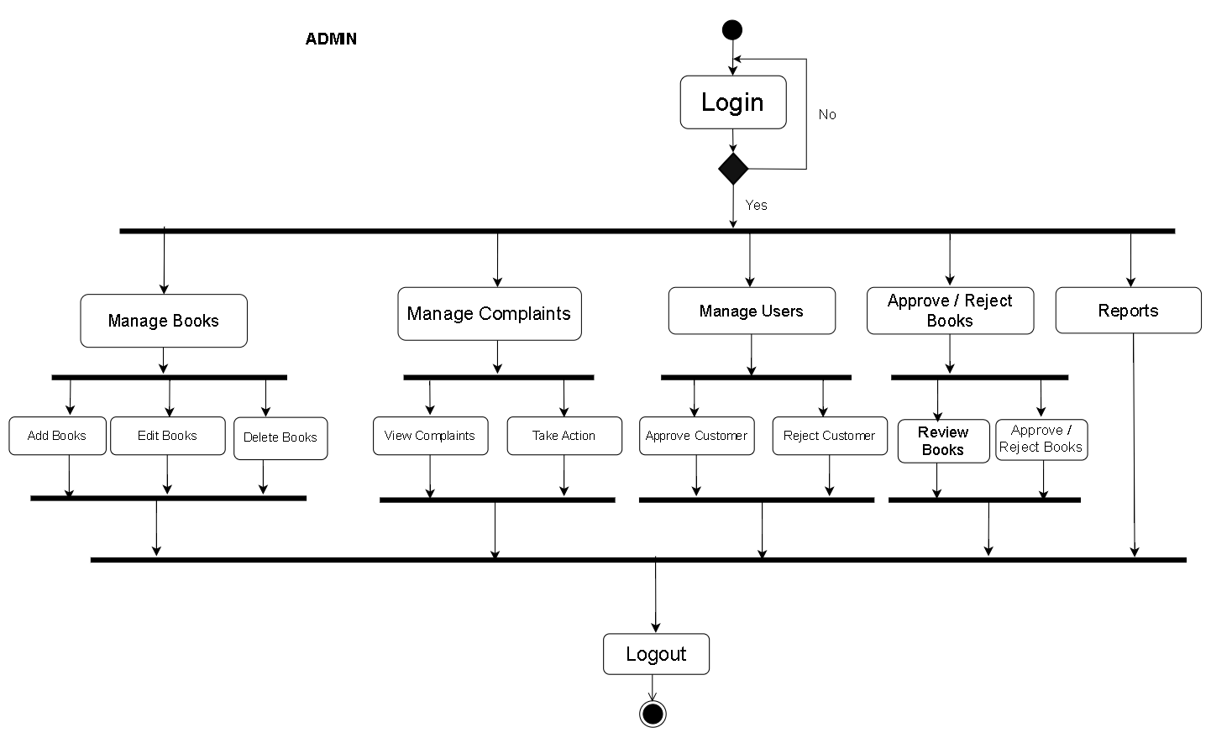
Admin

Slide 14
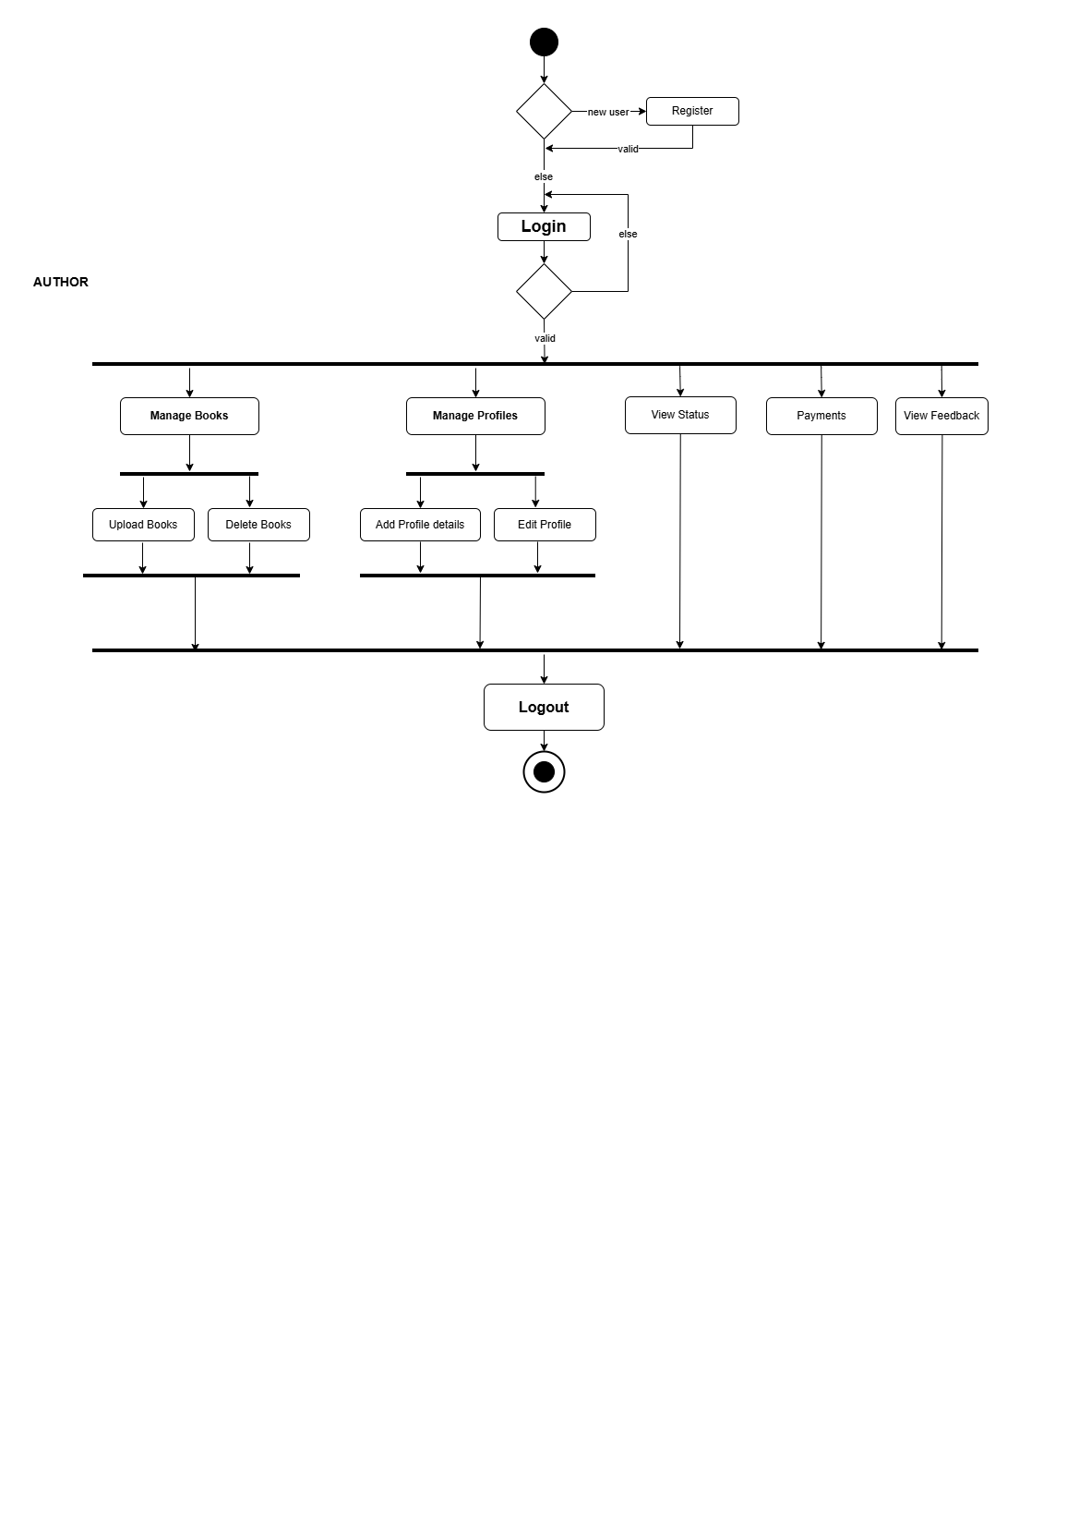
Author

Slide 15
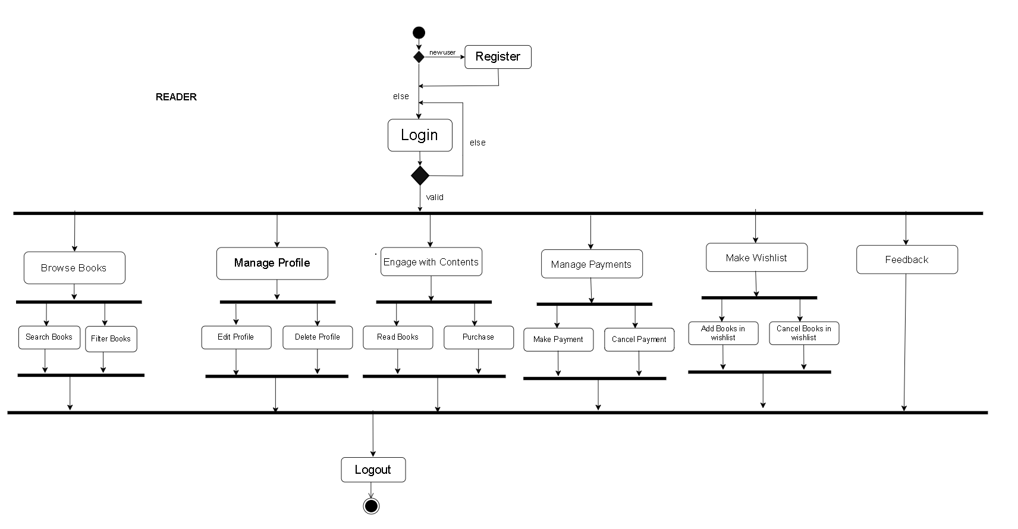
Reader

Slide 16
Sequence Diagram

Slide 17
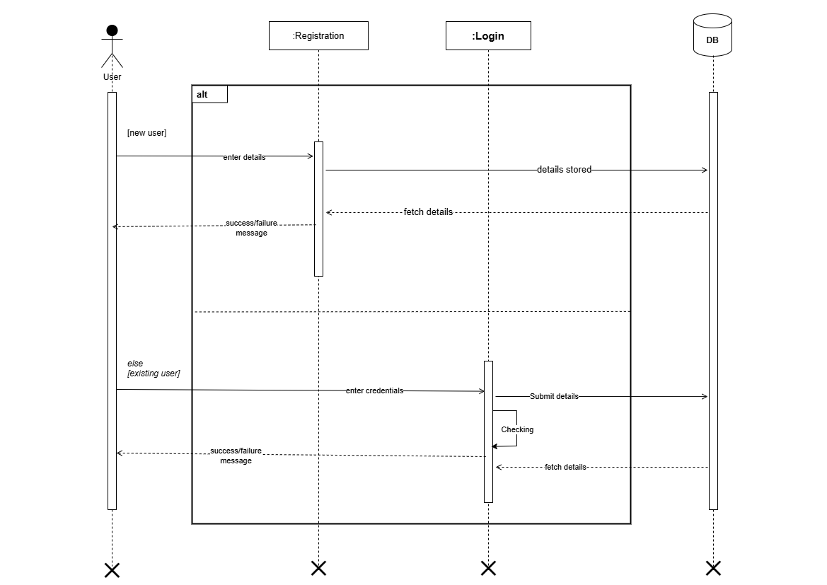
Registration & Login

Slide 18
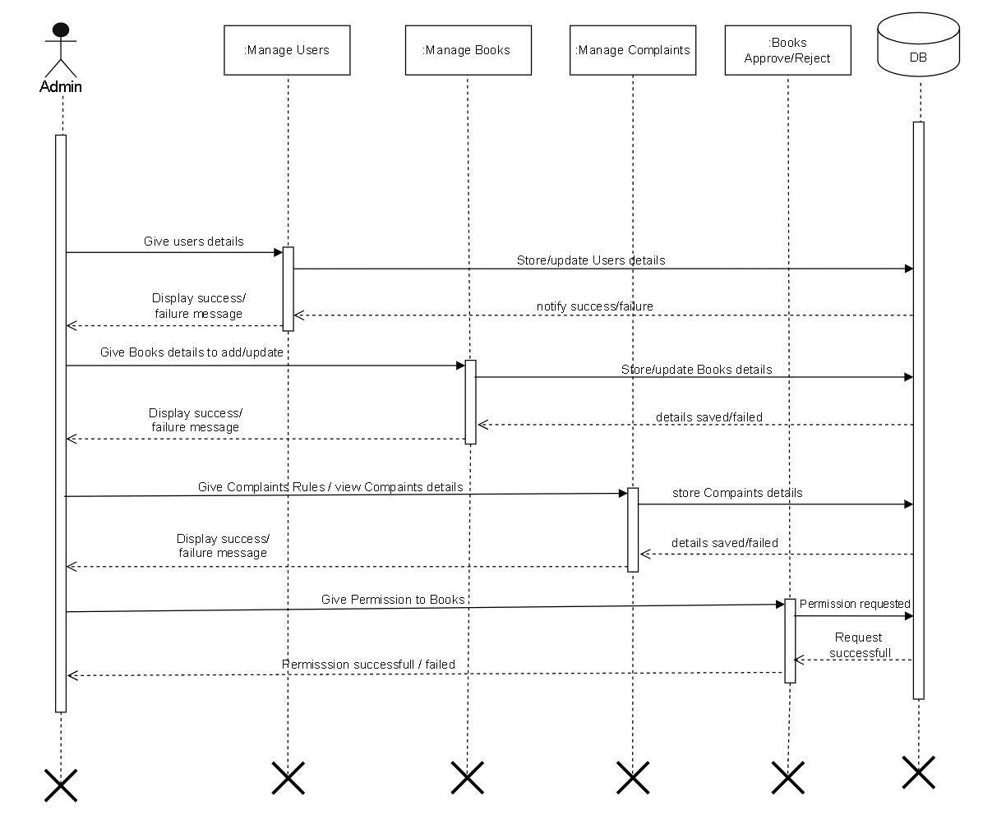
Admin

Slide 19
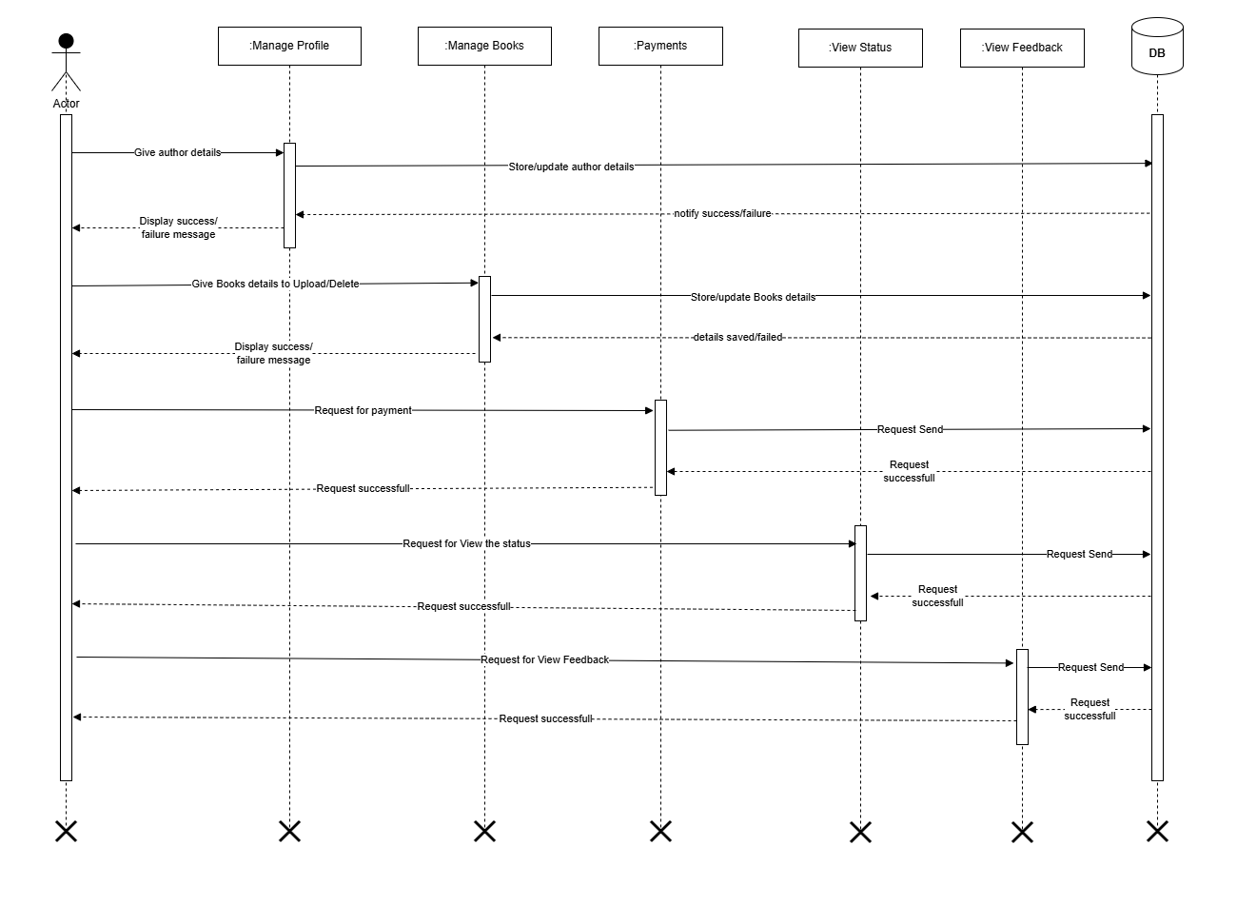
Author

Slide 20
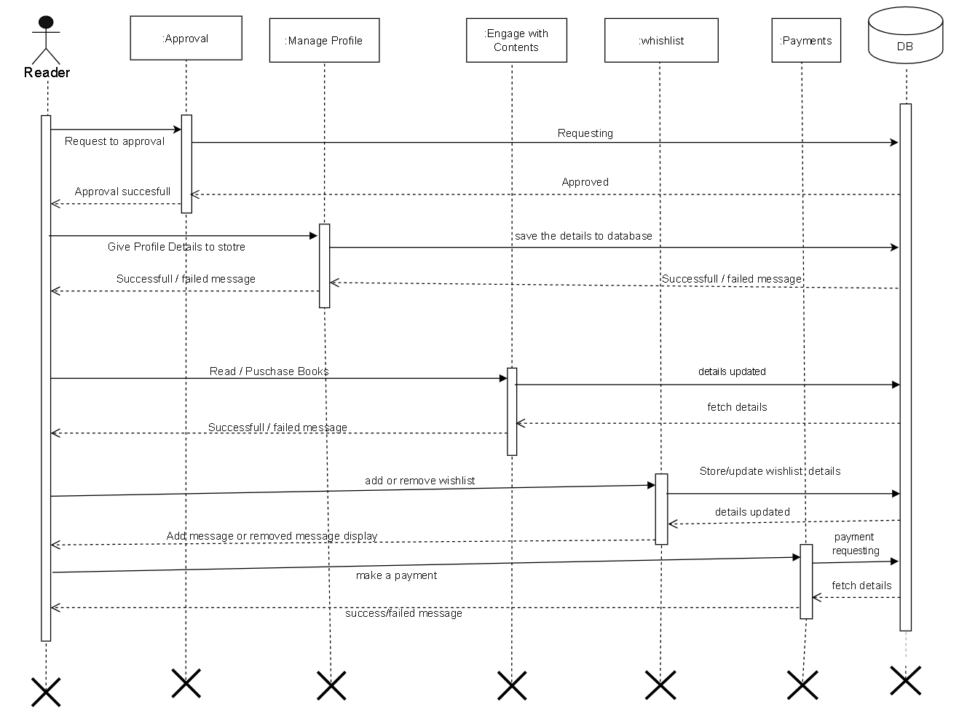
Reader

Slide 21
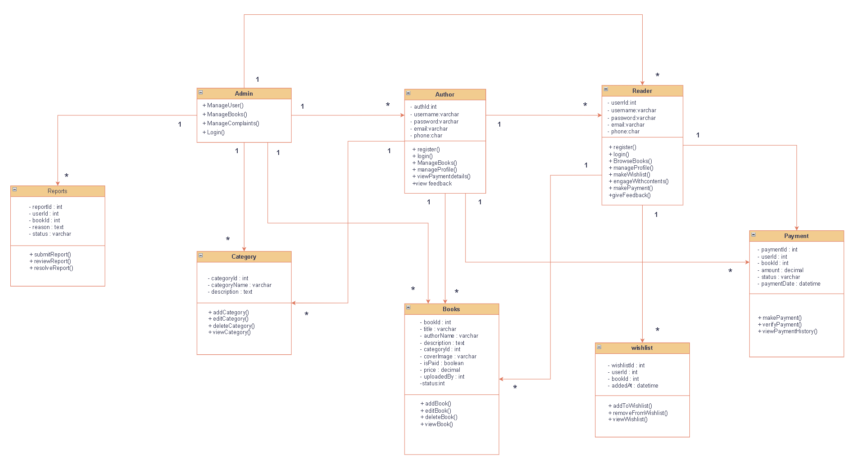
Class Diagram

Slide 22
TABLE CONTENTS

Slide 23
Authorregistration
Manages author accounts, including their publication permissions status.
Field Name | Datatype | Constraints | Description
authid | int | Primary Key, Auto Increment | Unique identifier for each author.
username | varchar(20) | Not Null | The author's profile/login name.
password | varchar(25) | Not Null | The account password.
email | varchar(30) | Not Null | The author's email address.
phone | char(10) | Not Null | 10-digit contact number.
status | int | Not Null, Default '1' | Verification status (e.g., pending, approved).

Slide 24
Readerregistration
Stores information about the library readers/users who browse, buy, and review books.
Field Name | Datatype | Constraints | Description
userId | int | Primary Key, Auto Increment | Unique identifier for each reader.
username | varchar(30) | Not Null | The reader's profile/login name.
password | varchar(25) | Not Null | The account password.
email | varchar(30) | Not Null | The reader's email address.
phone | char(10) | Not Null | 10-digit contact number.
status | int | Not Null, Default '1' | Account status.

Slide 25
Category
Defines genres or groupings for the digital books.
Field Name | Datatype | Constraints | Description
cid | int | Primary Key, Auto Increment | Unique identifier for the category.
cname | varchar(30) | Not Null | Name of the book genre.
cdesc | text | Not Null | Brief write-up of what the genre covers.
cimage | varchar(255) | Not Null | File path/URL for the category banner.
status | int | Not Null, Default '1' | Availability status

Slide 26
Books
Holds metadata, pricing, file paths, and descriptions for all available digital volumes.
Field Name | Datatype | Constraints | Description
bid | int | Primary Key, Auto Increment | Unique identifier for each book.
bname | varchar(50) | Not Null | Title of the book.
AuthorName | varchar(20) | Not Null | Text name of the author.
description | text | Not Null | Brief synopsis of the story.
cid | int | ForeginKey REFERENCES category(cid) | Maps the book to a specific genre.
CoverImage | varchar(255) | Not Null | File path for the book's cover art.
story | text | Not Null | File path/text for the actual book file (PDF).
is_paid | varchar(10) | Not Null | Classification ('free' or 'paid').
price | int | Not Null | Cost of the book (0 if free).
AddedDate | date | Not Null | The date the book was published to the app.
status | int | Not Null, Default '1' | Moderation status.

Slide 27
Purchases
Logs instances where a user initiates a buy action for a paid e-book.
Field Name | Datatype | Constraints | Description
purchaseid | int | Primary Key, Auto Increment | Unique transaction record ID.
userId | int | ForeginKey (References readerregistration(userId)) | The individual buying the book.
bid | int | ForeginKey (References books(bid)) | The book being purchased.
amount | int | Not Null | Transaction total price.
purchase_date | datetime | Not Null | Timestamp of the transaction.
payment_status | varchar(15) | Not Null, Default 'pending' | State of payment ('completed', 'failed').
transaction_id | varchar(100) | Not Null, Default '' | Gateway transaction reference code.
status | int | Not Null, Default '1' | System tracking status.

Slide 28
Payments
Records the final, successful gateway clearings associated with book orders.
Field Name | Datatype | Constraints | Description
payid | int | Primary Key, Auto Increment | Unique settlement record ID.
purchaseid | int | ForeignKey (References purchases(purchaseid)) | Associated invoice entry ID.
userId | int | ForeignKey (References readerregistration(userId)) | Payer's unique identity link.
bid | int | ForeignKey (References books(bid)) | Settled asset catalog ID.
amount | int | Not Null | Total currency captured.
payment_method | varchar(20) | Not Null, Default 'UPI' | Medium used (e.g., UPI, Card).
transaction_id | varchar(100) | Not Null, Default '' | Processing house tracking ID string.
payment_date | datetime | Not Null | Exact settlement timestamp.
status | int | Not Null, Default '1' | Ledger balancing record status.

Slide 29
Downloads
Tracks which readers have retrieved file assets locally.
Field Name | Datatype | Constraints | Description
downloadid | int | Primary Key, Auto Increment | Unique download instance ID.
userId | int | ForeginKey (References readerregistration(userId)) | Account accessing file streams.
bid | int | ForeginKey (References books(bid)) | Target volume file being copied.
download_date | datetime | Not Null | Date/time stamp copy happened.
status | int | Not Null, Default '1' | Audit indicator field.

Slide 30
Reviews
Houses text-based evaluations and ratings written by users for individual entries.
Field Name | Datatype | Constraints | Description
reviewid | int | Primary Key, Auto Increment | Unique comment record identifier.
bid | int | ForeginKey (References books(bid)) | Target book entity being critied.
userId | int | ForeginKey (References readerregistration(userId)) | Author profile who wrote the entry.
rating | tinyint | Not Null, Default '5' | Numerical score (typically 1 to 5).
review_text | text | Not Null | Text content of the written feedback.
review_date | datetime | Not Null | Timestamp of publication.
status | int | Not Null, Default '1' | Moderation configuration parameter.

Slide 31
Wishlist
Tracks books saved by users to view or purchase later.
Field Name | Datatype | Constraints | Description
wid | int | Primary Key, Auto Increment | Unique identification item bookmark.
bid | int | ForeignKey (References books(bid)) | Book added to the wishlist.
userId | int | ForeignKey (References readerregistration(userId)) | User bookmark profile reference index.
AddedDate | datetime | Not Null | Timestamp item was cataloged.
status | int | Not Null, Default '1' | Activity visibility index.

Slide 32
Complaints
Manages issues filed by users regarding technical difficulties or billing.
Field Name | Datatype | Constraints | Description
complaintid | int | Primary Key, Auto Increment | Ticket reference number index identifier.
userId | int | ForeignKey (References readerregistration(userId)) | Submitting platform user profile element.
bid | int | ForeignKey (References books(bid)) | Book related to the problem (if any).
complaint_type | varchar(30) | Not Null | Category classifications group identifier.
subject | varchar(100) | Not Null | Quick summarization header text line.
description | text | Not Null | In-depth description details of the problem.
admin_reply | text | Null Allowed | Written text answer response block.
filed_date | datetime | Not Null | Timestamp ticket created inside backend.
resolved_date | datetime | Null Allowed | Timestamp status flipped finalized.
status | int | Not Null, Default '1' | Processing progression tracker code.

Slide 33
Feedback
System-wide structural opinions given by either readers or authors.
Field Name | Datatype | Constraints | Description
feedid | int | Primary Key, Auto Increment | Unique record tracking token identity.
sender_id | int | ForeignKey (REFERENCES readerregistration(userId), authorregistration(authId)) | ID linking to author or reader tables.
sender_type | varchar(10) | Not Null | Defines source profile domain type.
subject | varchar(100) | Not Null | Focus topic descriptor text line.
message | text | Not Null | Main message body contents text field.
feedback_date | datetime | Not Null | Calendar timestamp captured by server.
status | int | Not Null, Default '1' | Operational review tracking integer.

Slide 34
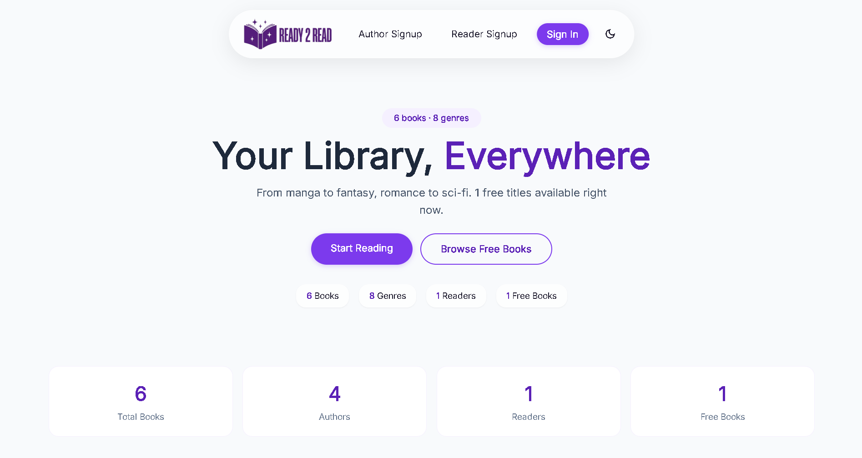
LANDING PAGE

Slide 35
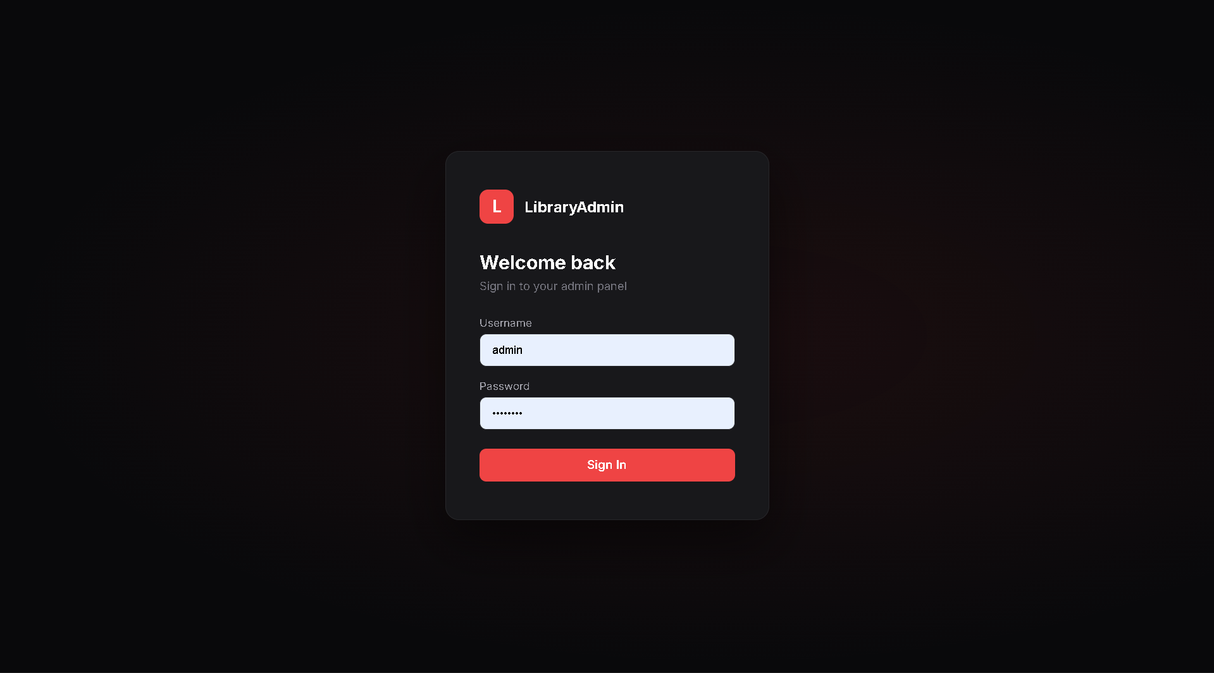
ADMIN SIDE LOGIN

Slide 36
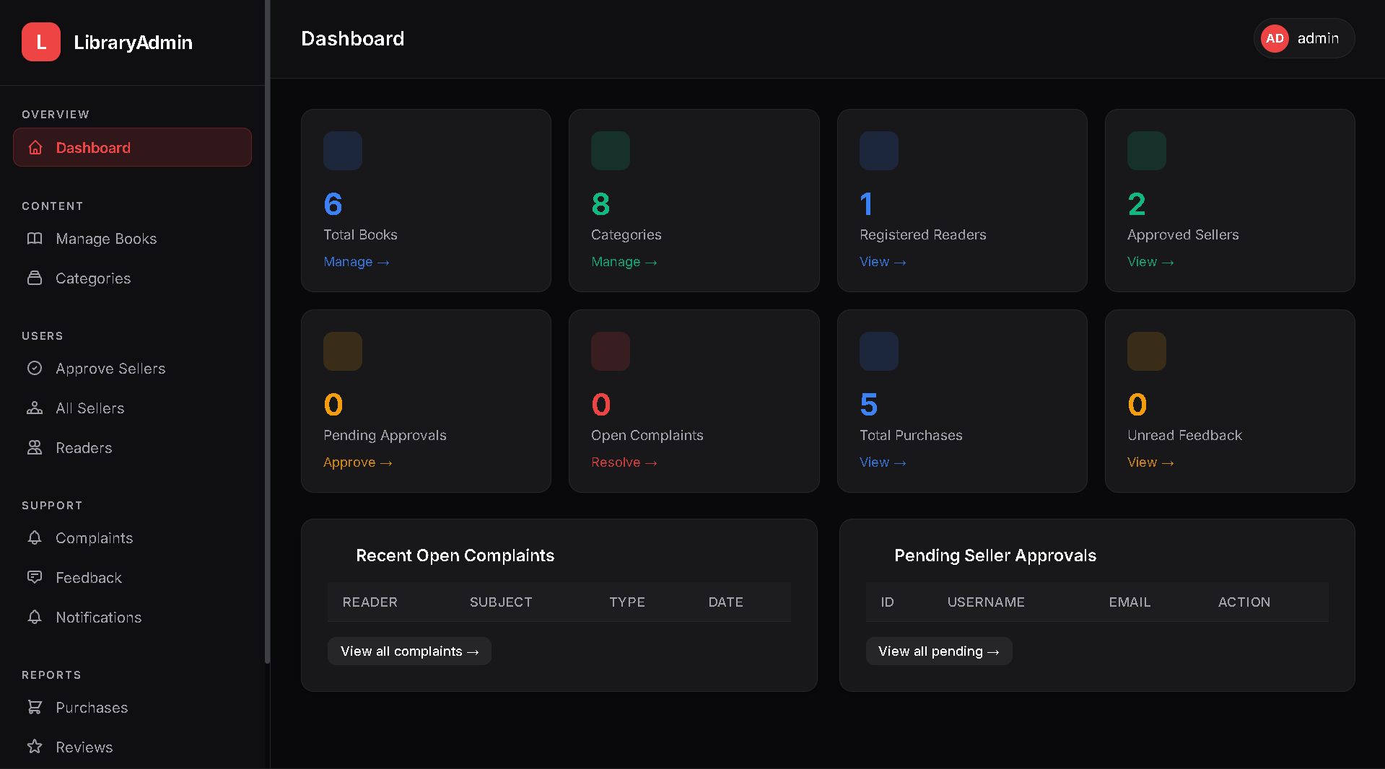
ADMIN DASHBOARD

Slide 37
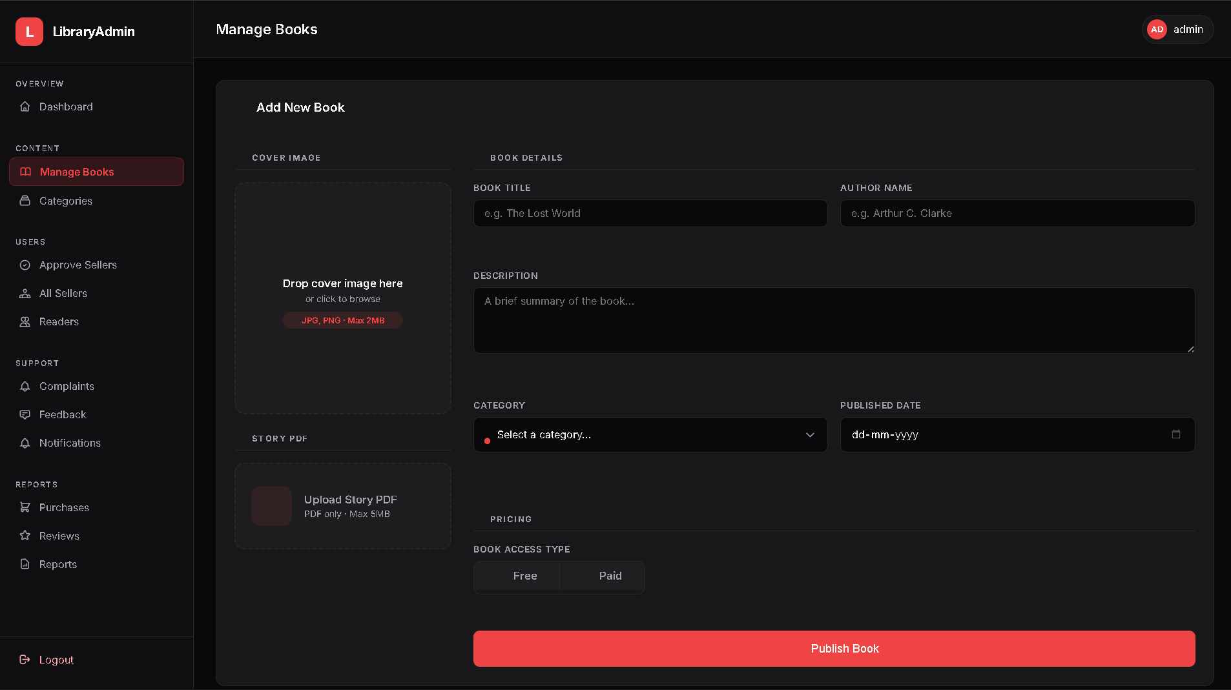
ADMIN MANAGE BOOKS

Slide 38
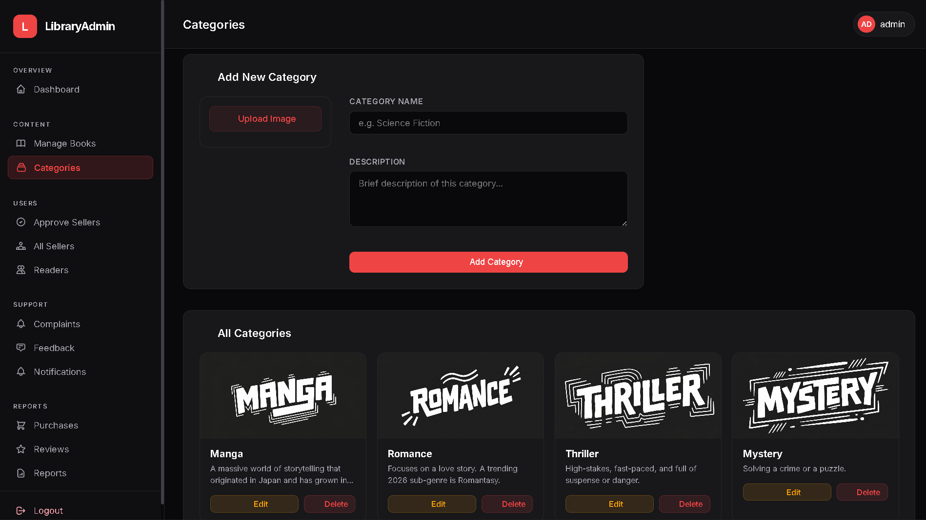
ADMIN MANAGE CATEGORIES

Slide 39
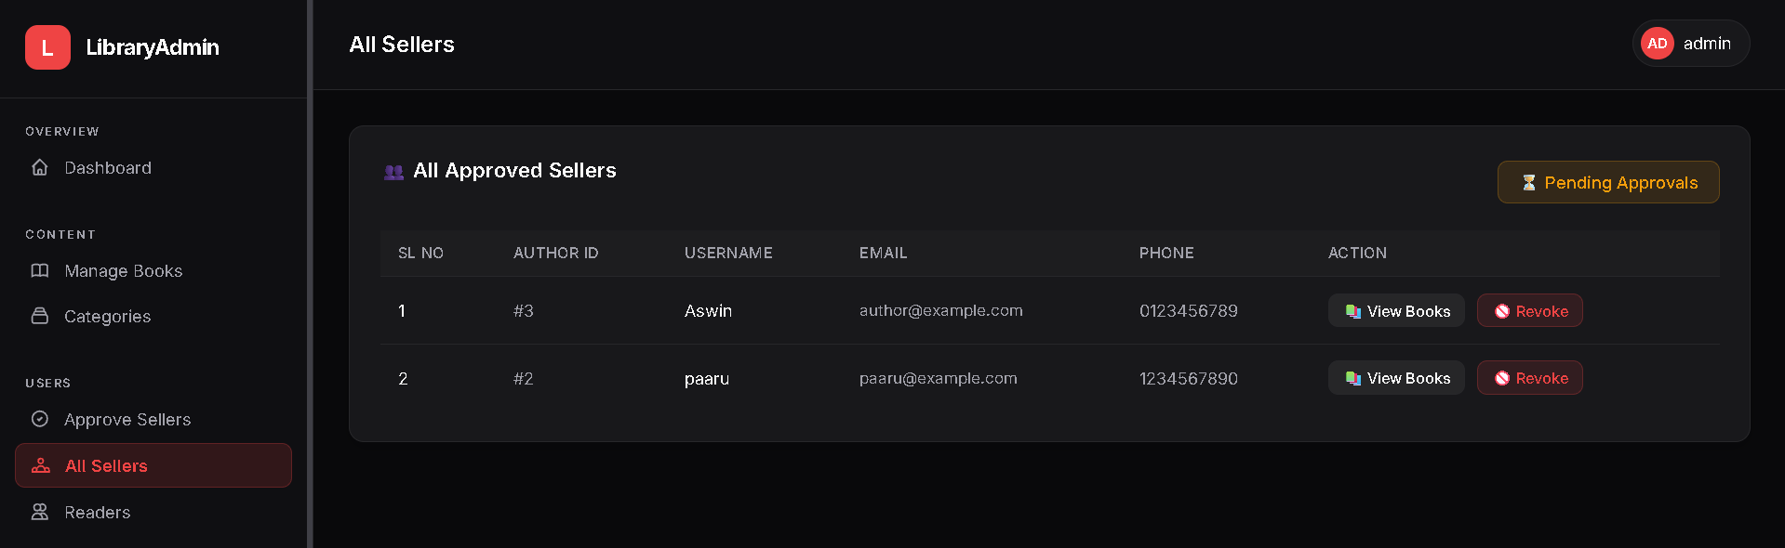
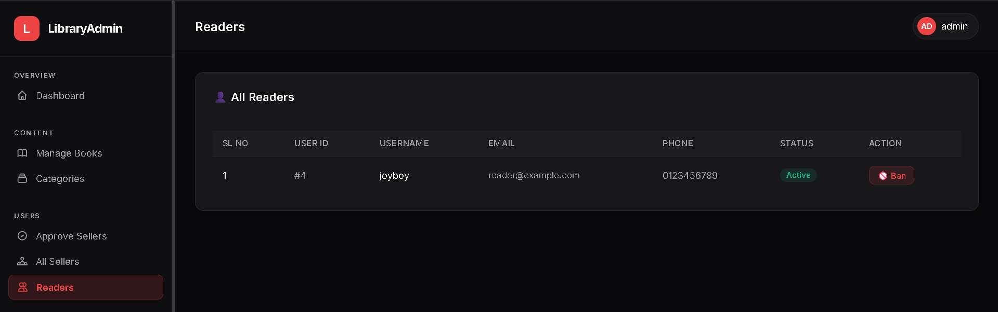
ADMIN MANAGE USERS

Slide 40
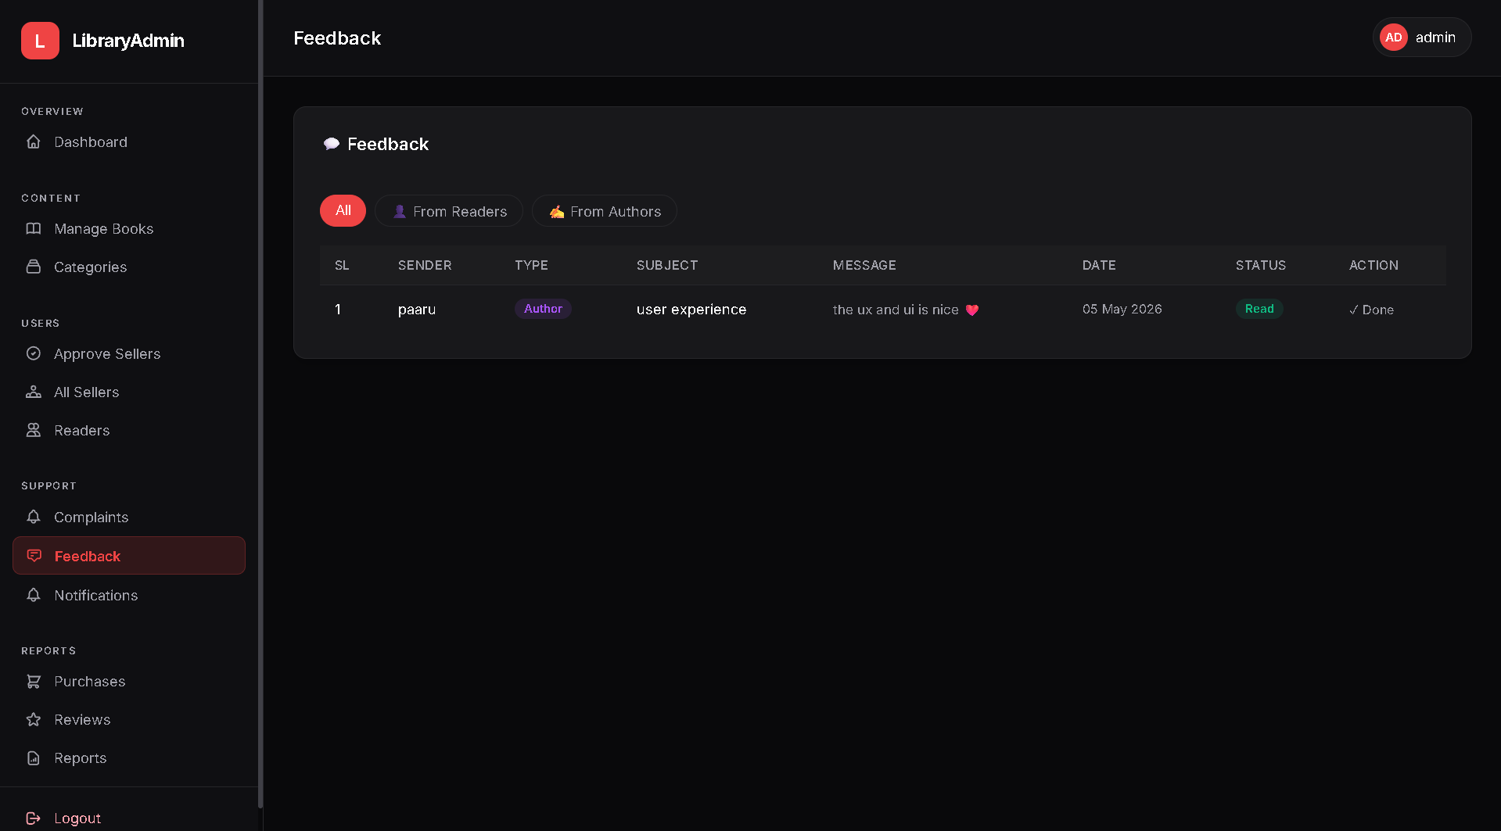
ADMIN VIEW FEEDBACK

Slide 41
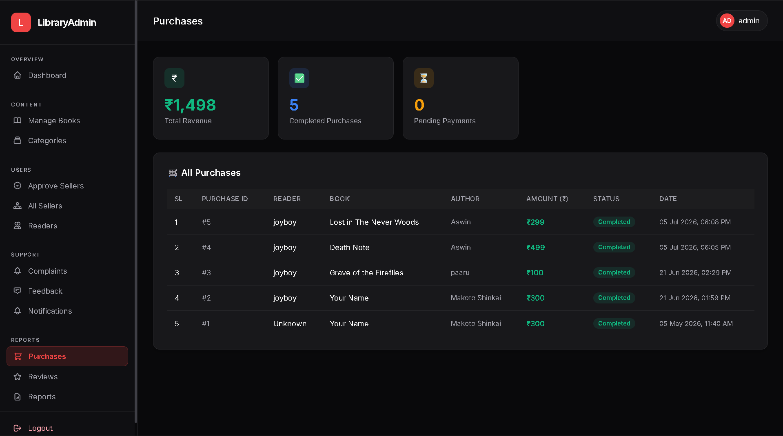
ADMIN SIDE REPORTS
PURCHASE

Slide 42
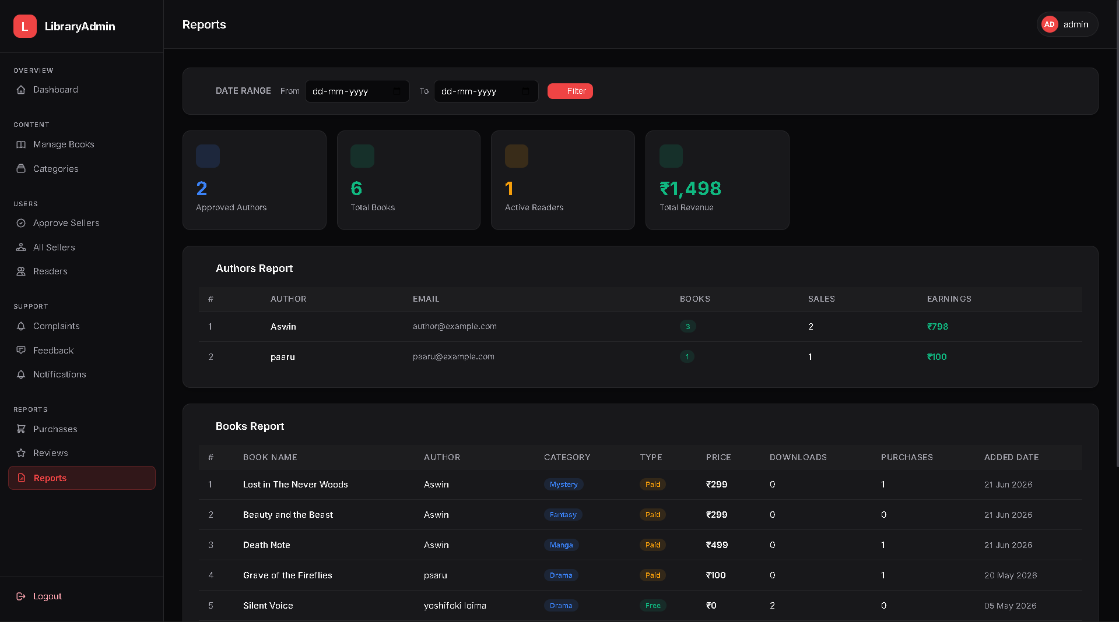
ALL REPORTS IN DATE WISE

Slide 43
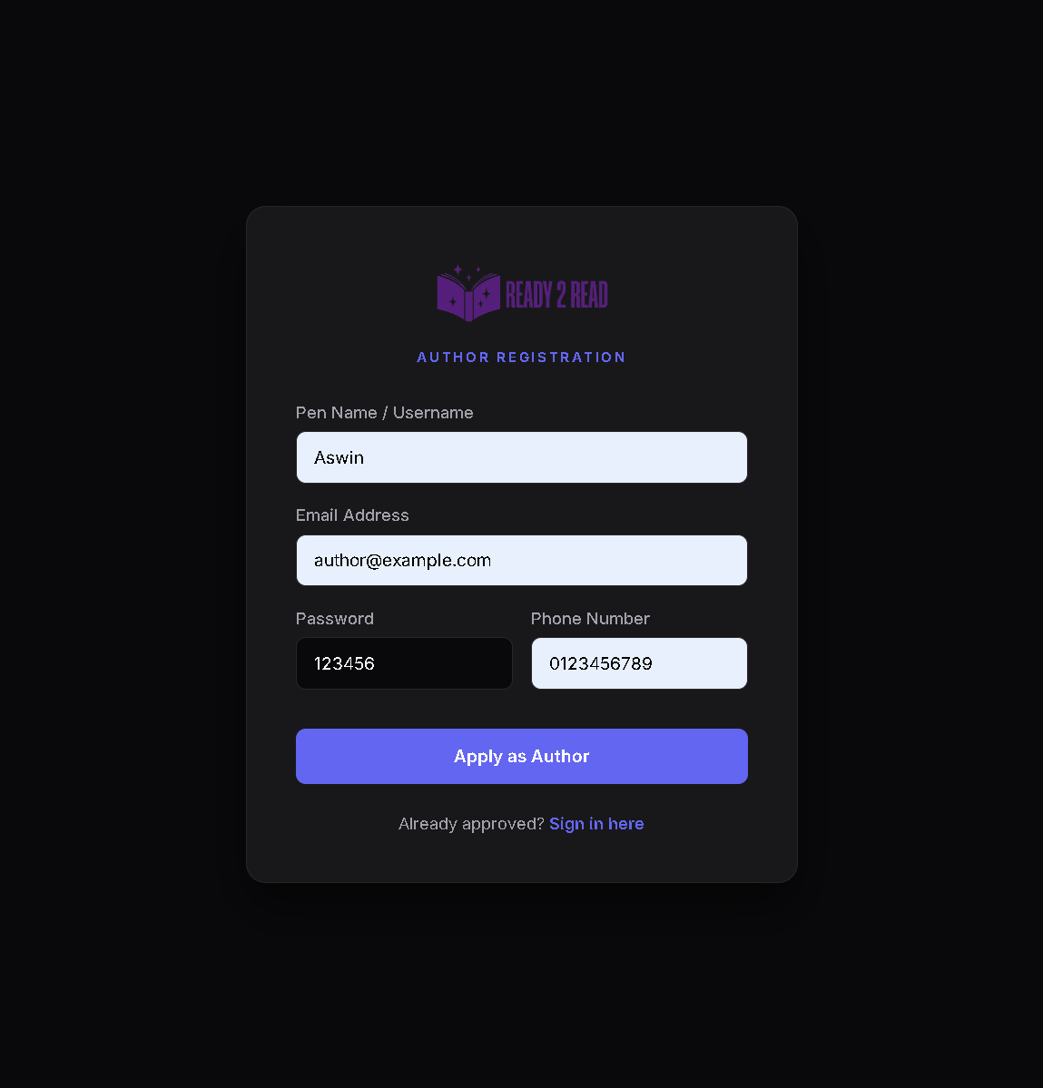
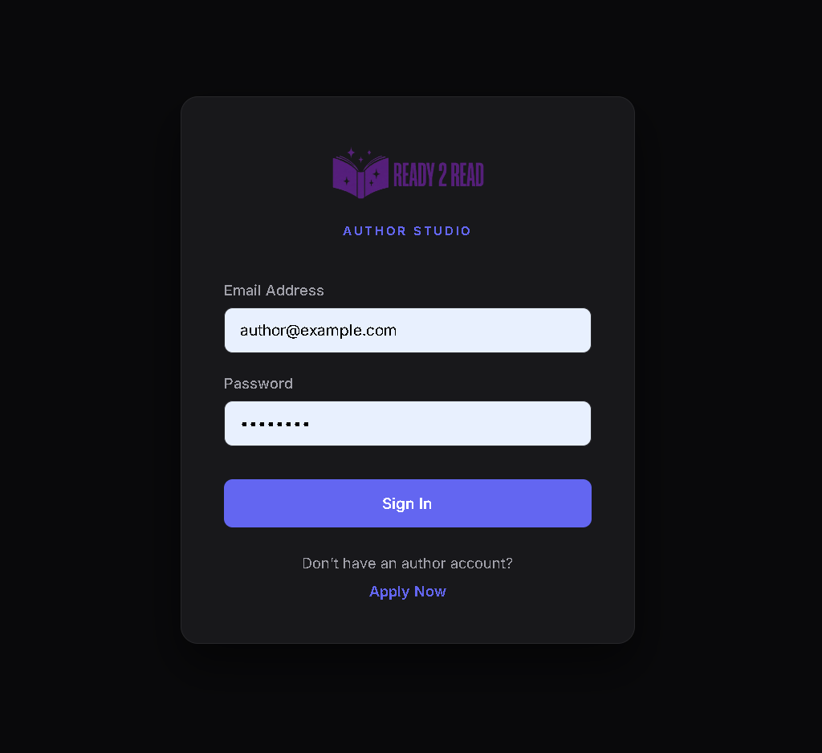
AUTHOR SIDE REGISTRATION & LOGIN

Slide 44
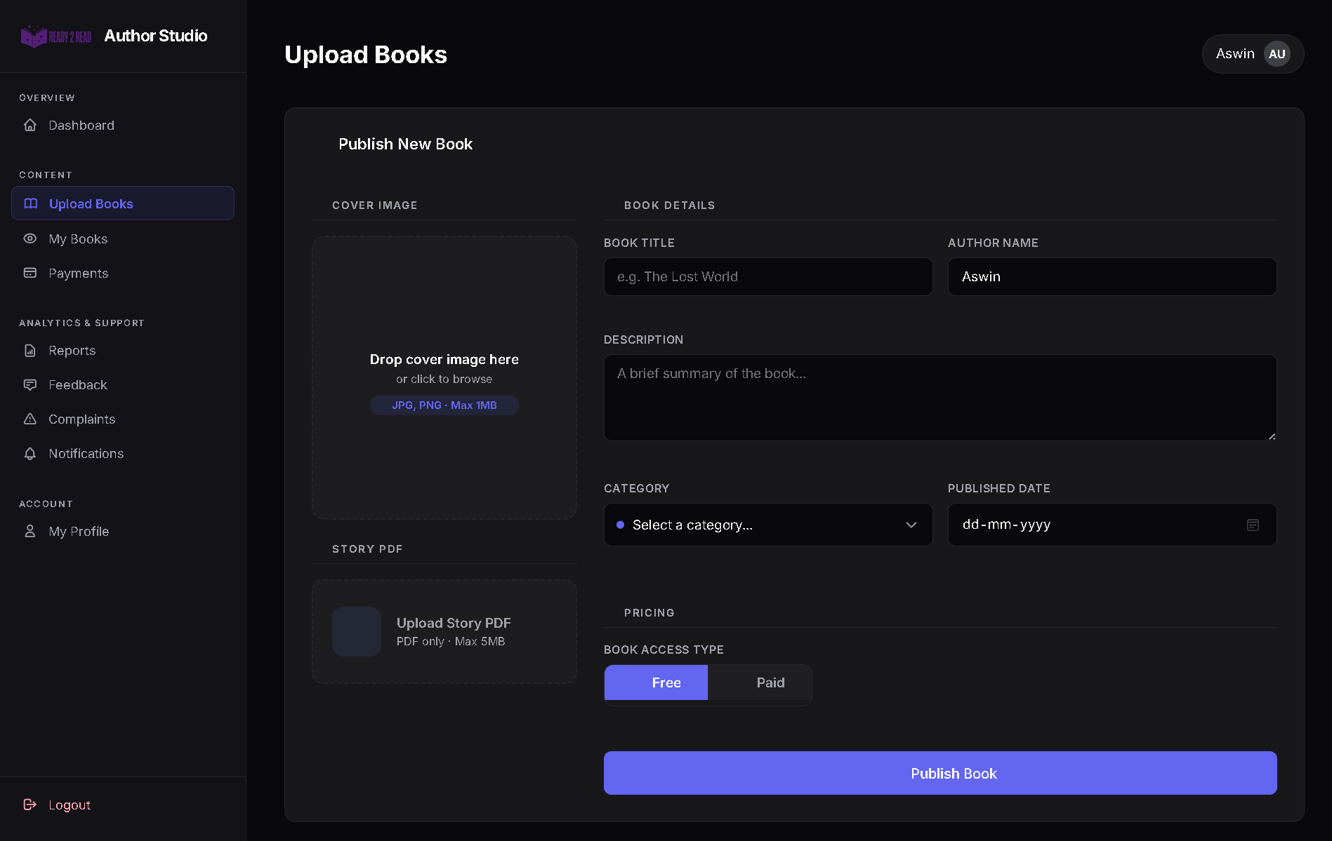
AUTHOR SIDE MANAGE BOOKS

Slide 45
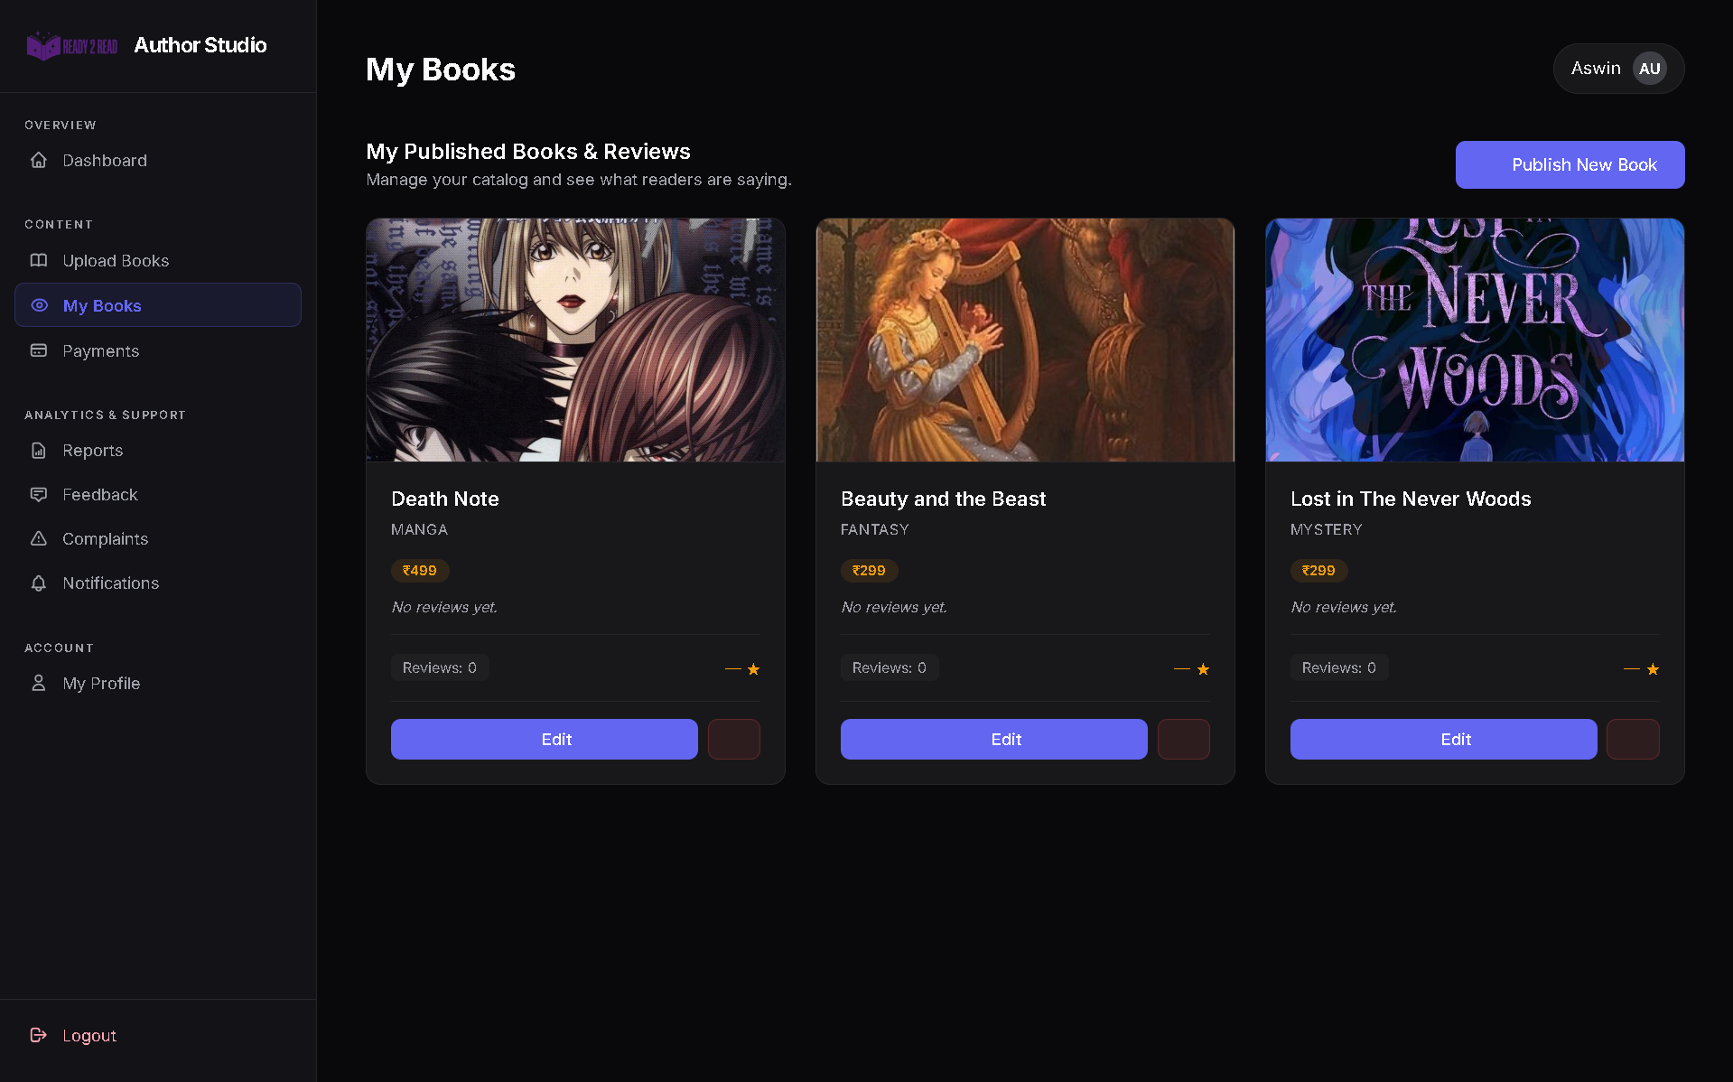
VIEW AUTHOR’S BOOKS

Slide 46
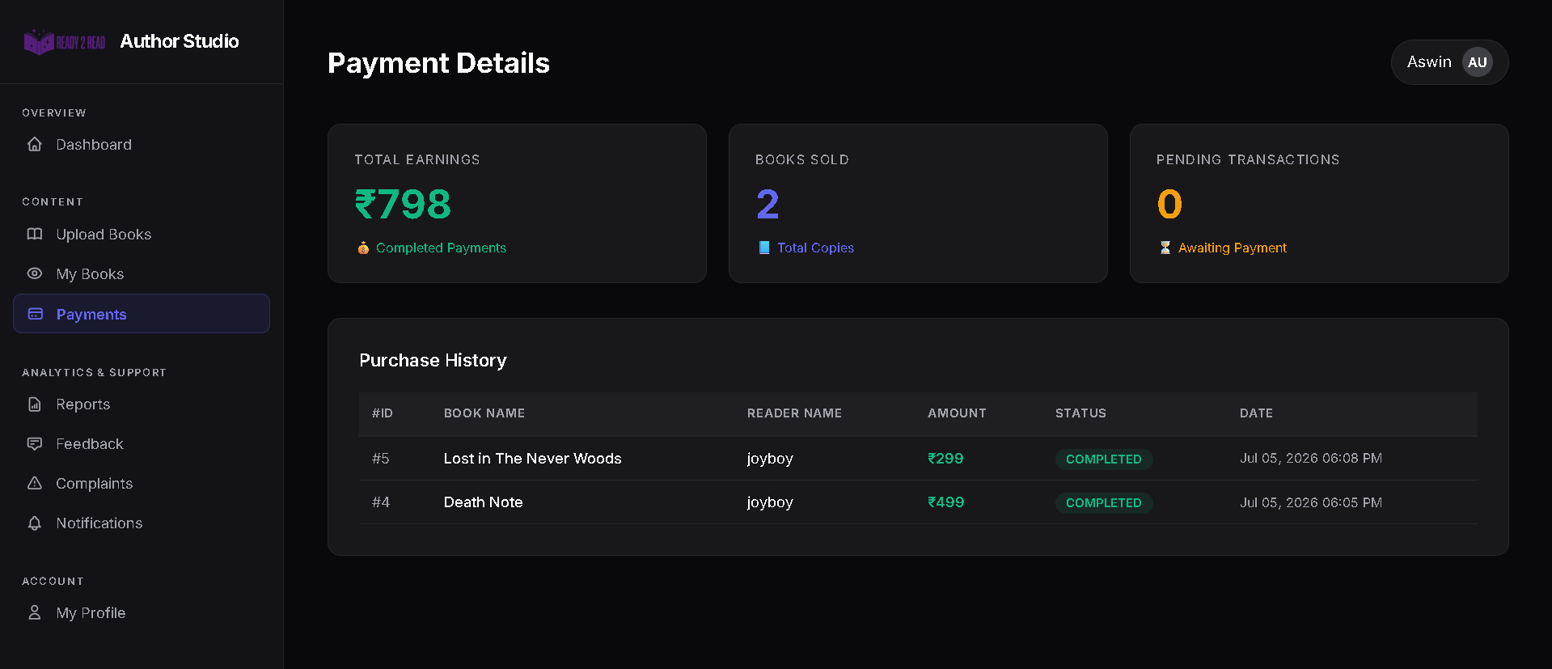
VIEW AUTHOR’S PAYMENTS

Slide 47
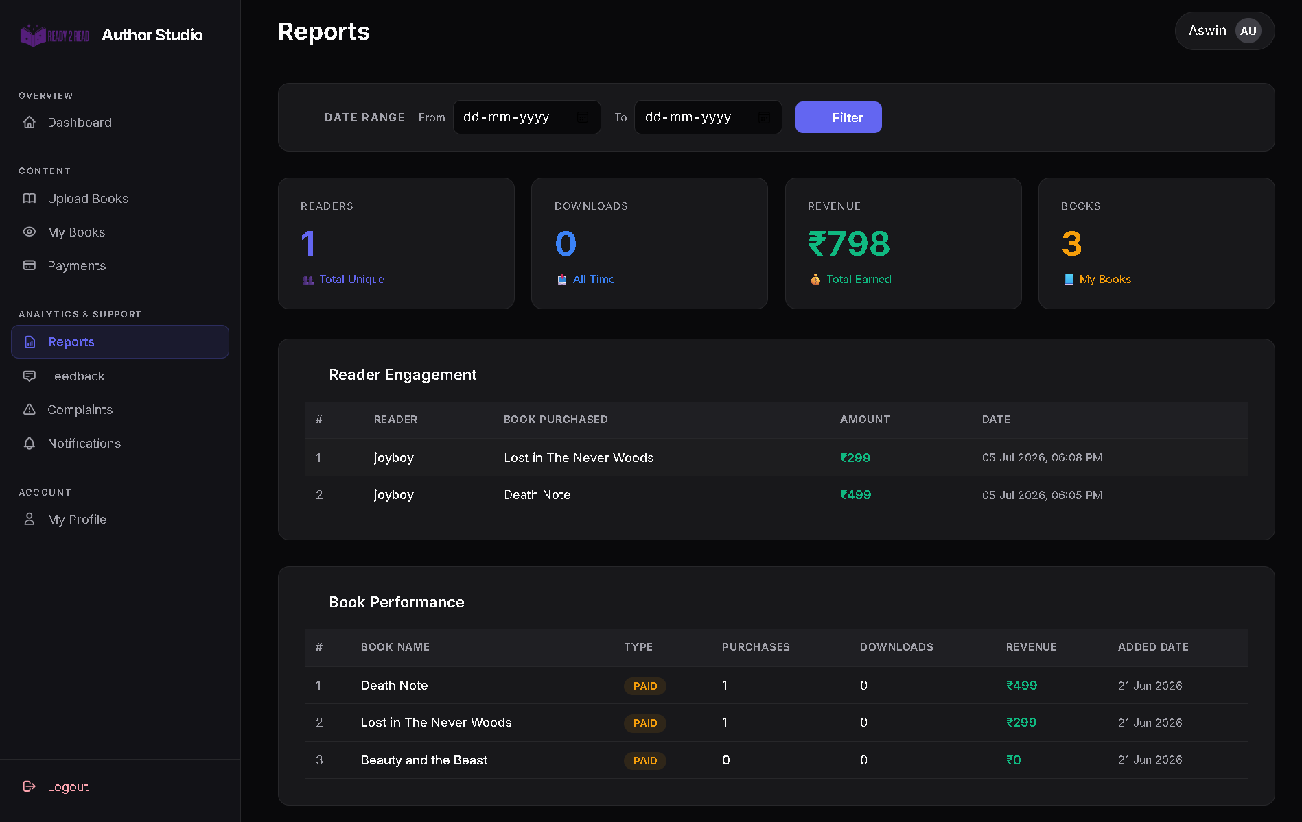
AUTHOR REPORTS

Slide 48
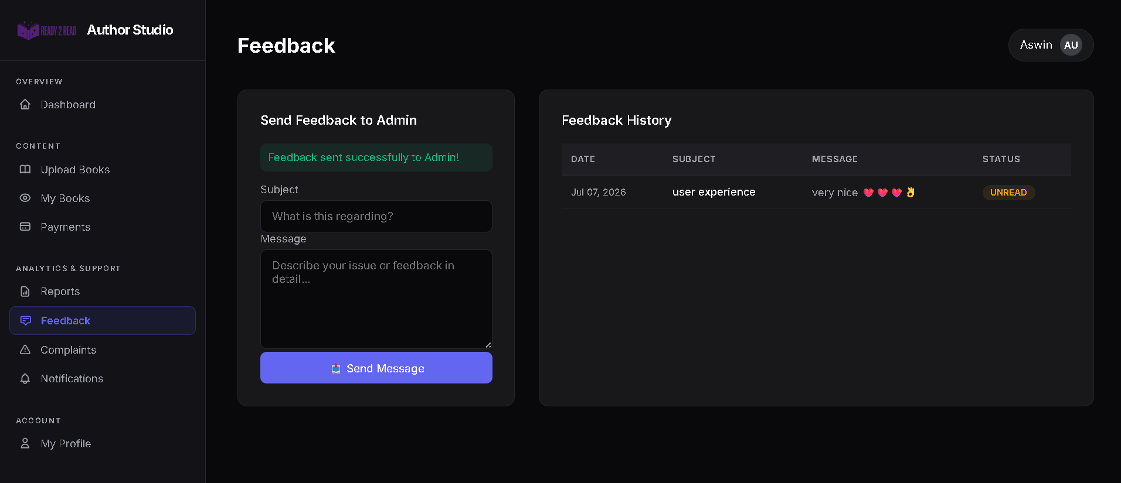
AUTHOR FEEDBACK

Slide 49
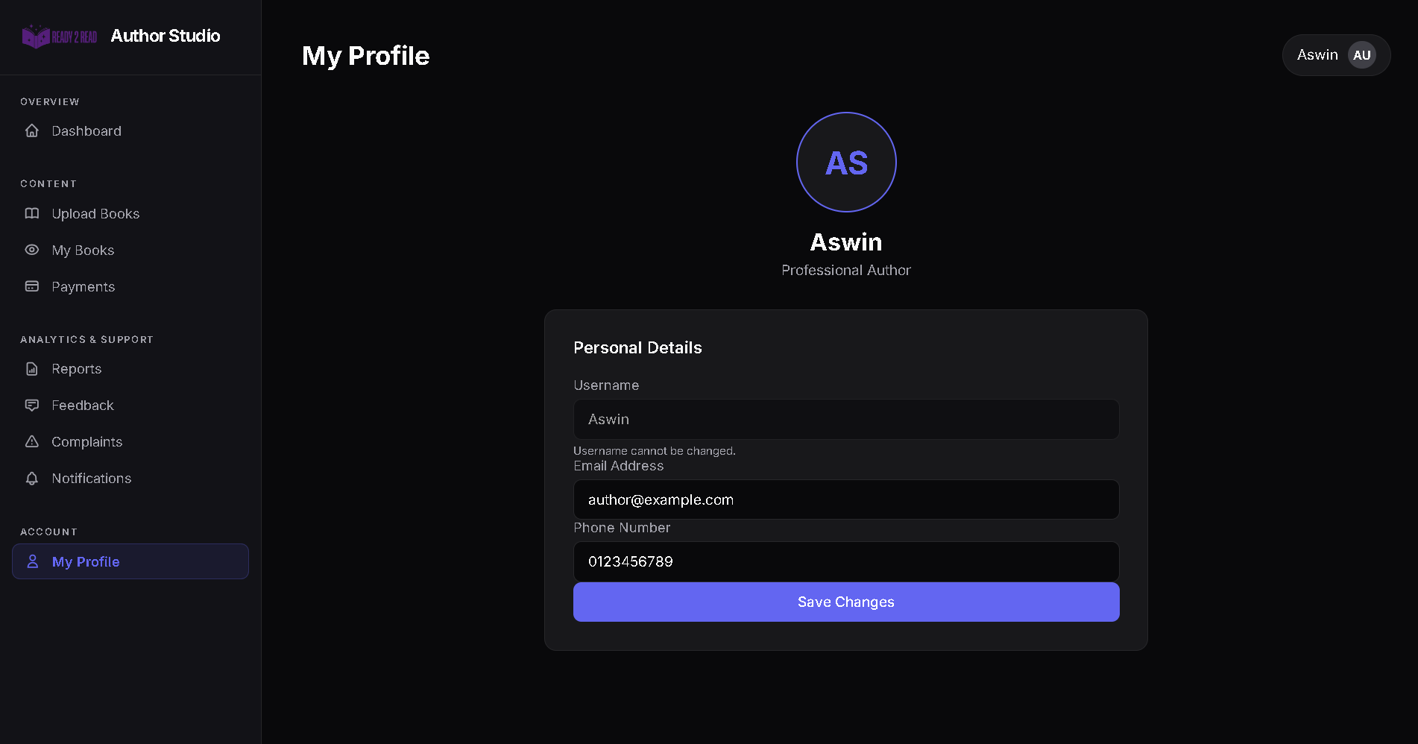
AUTHOR PROFILE

Slide 50
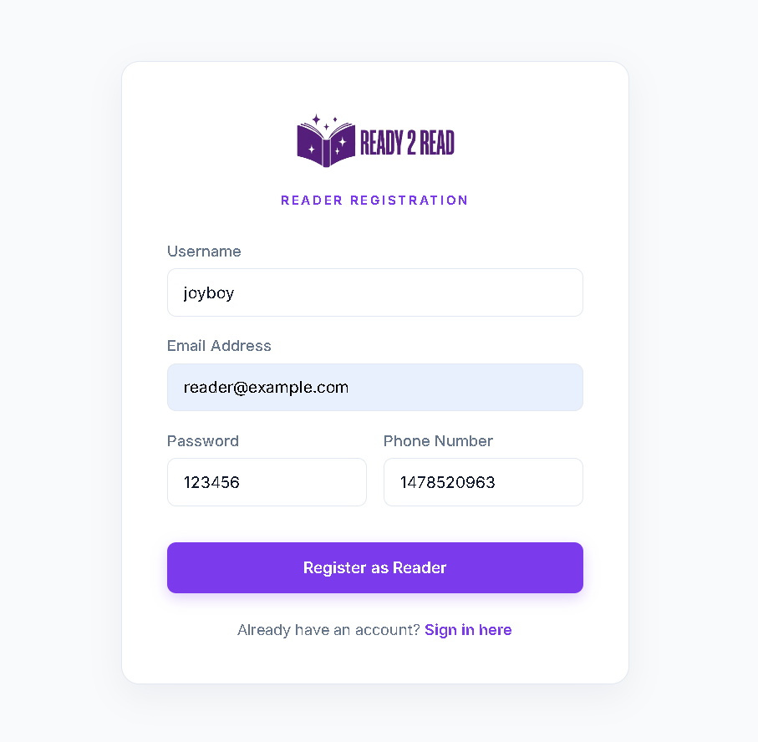
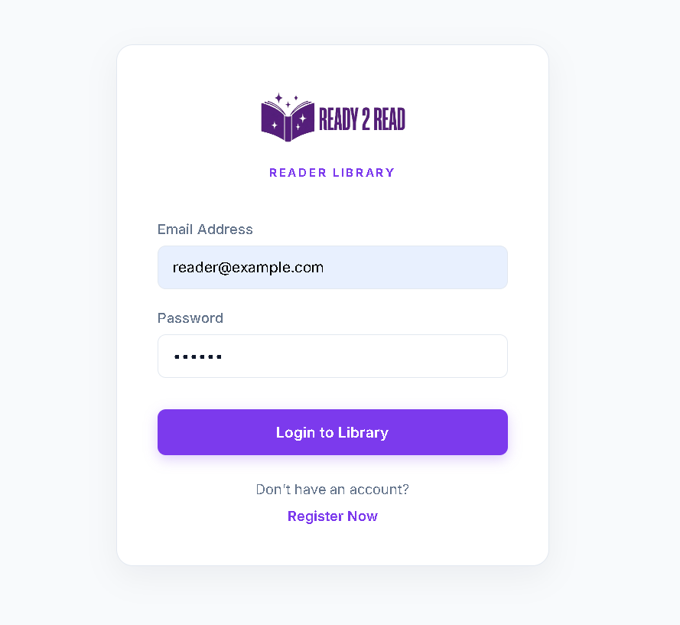
READER SIDE REGISTRATION & LOGIN

Slide 51
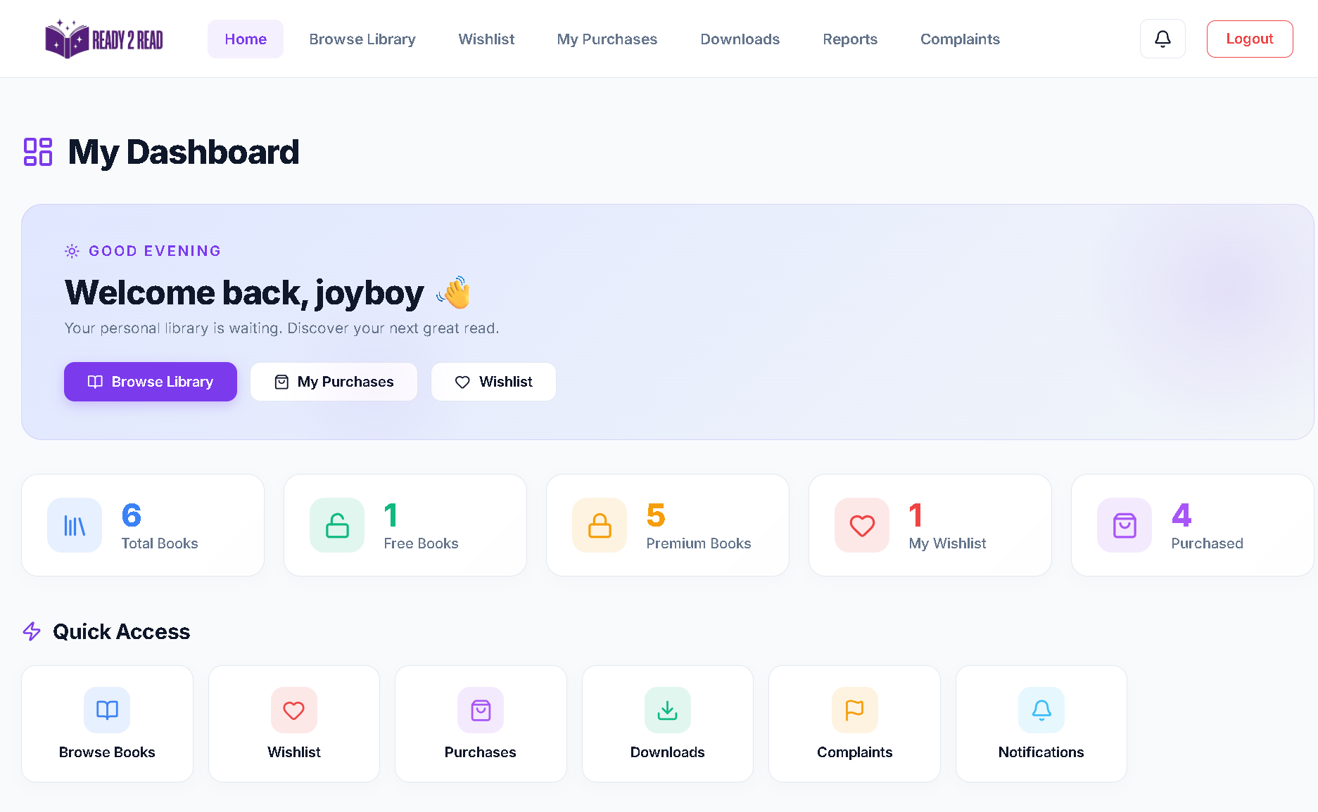
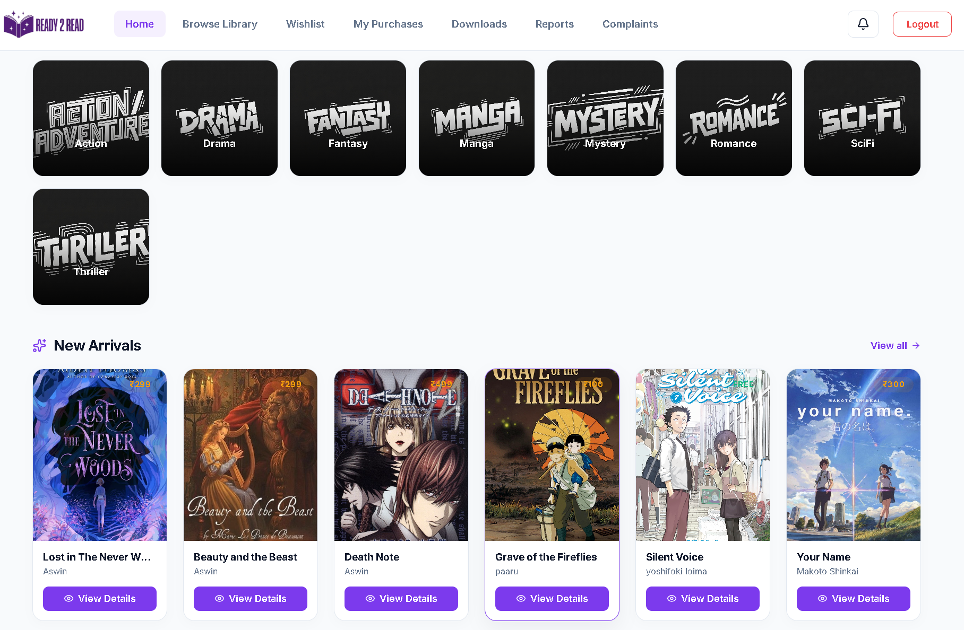
READER DASHBOARD

Slide 52
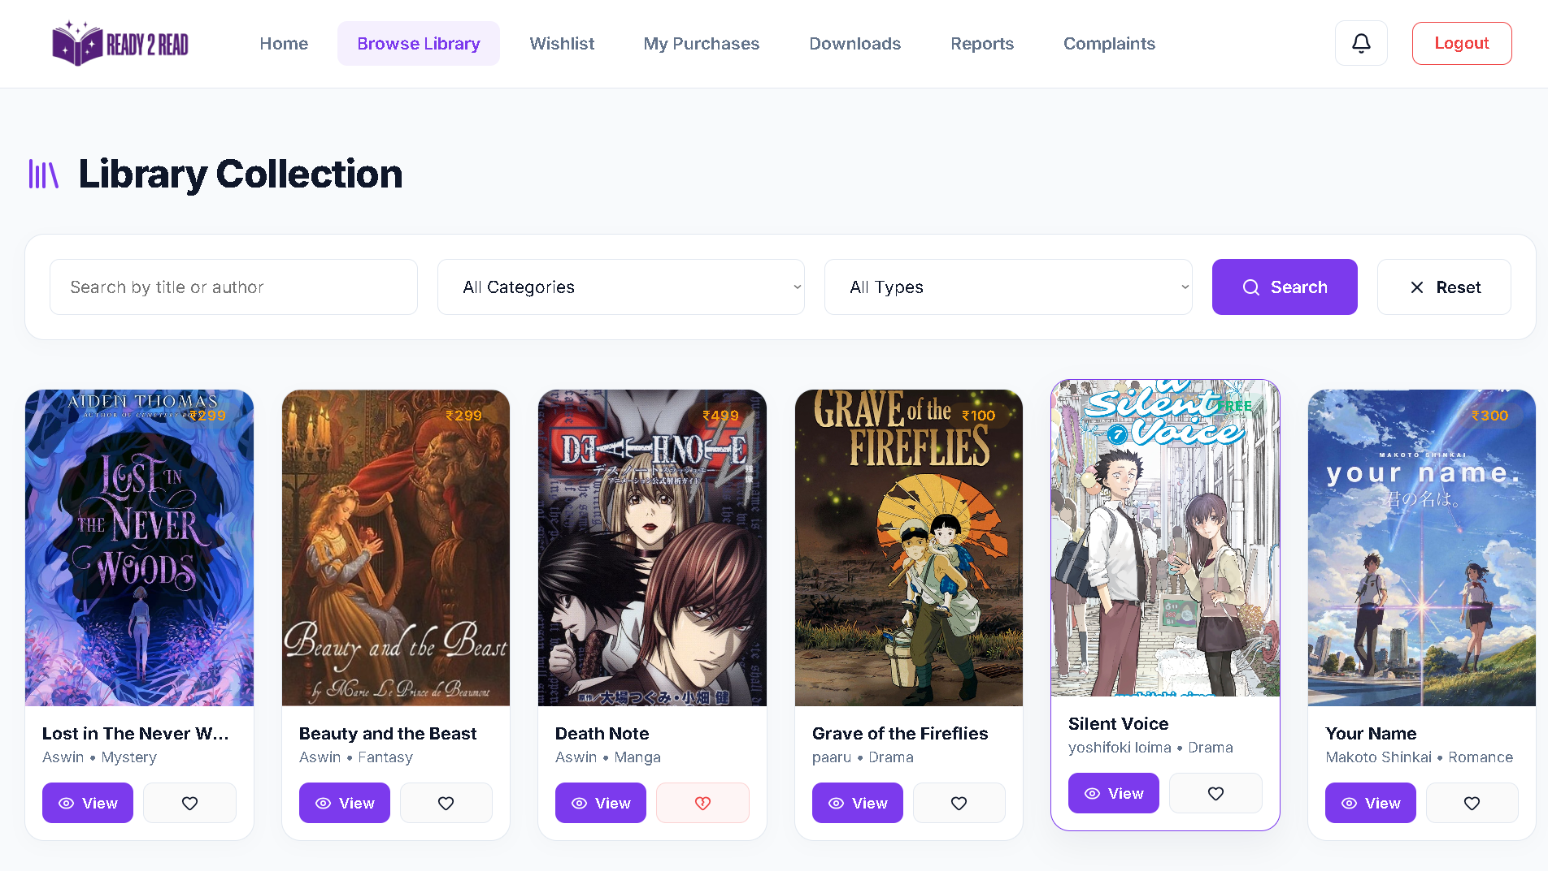
BROWSE BOOKS

Slide 53
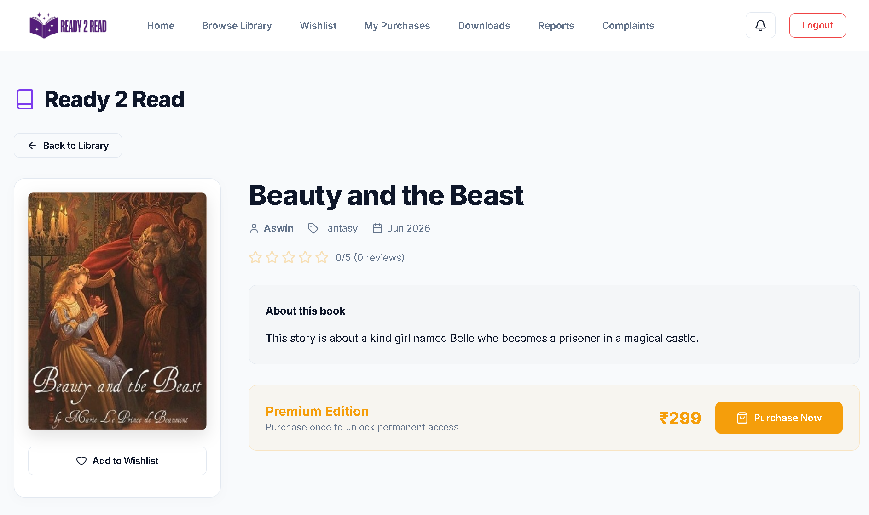
BOOKS DEATILS

Slide 54
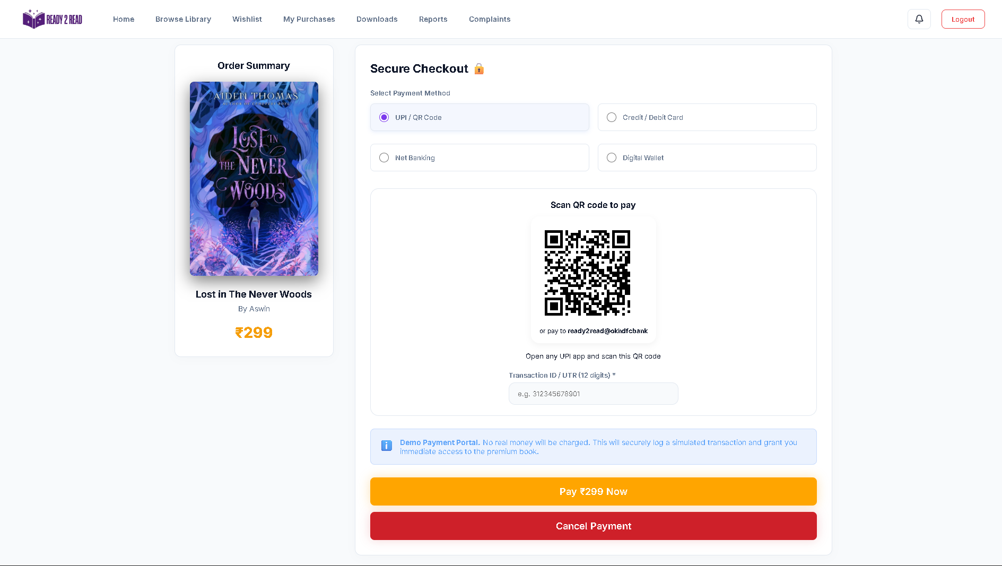
PAYMENT METHODS

Slide 55
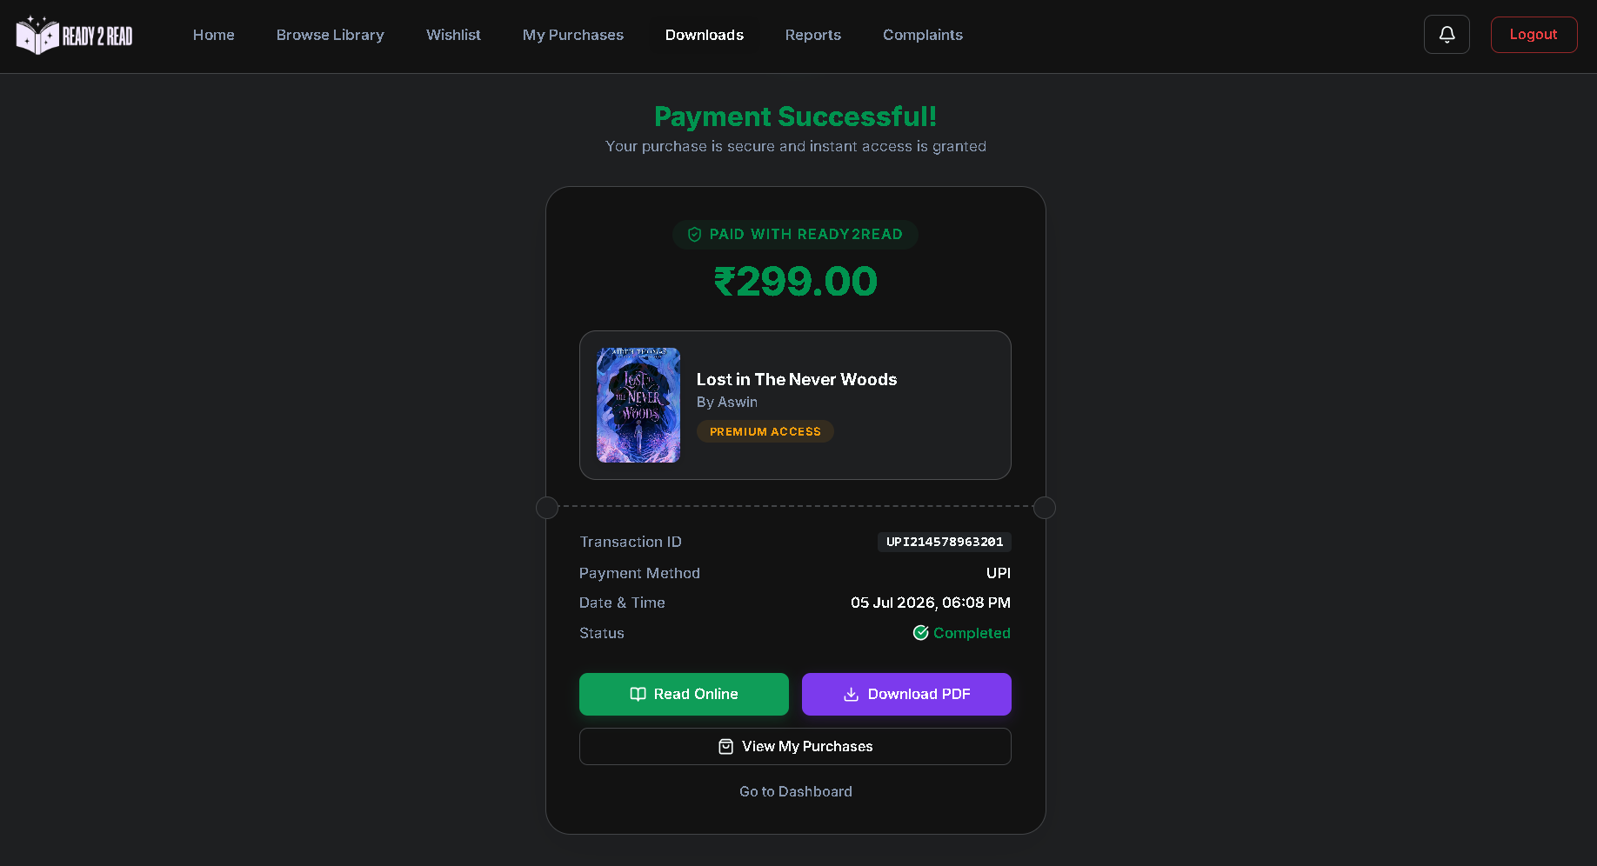
PAYMENT SUCCESSFUL

Slide 56
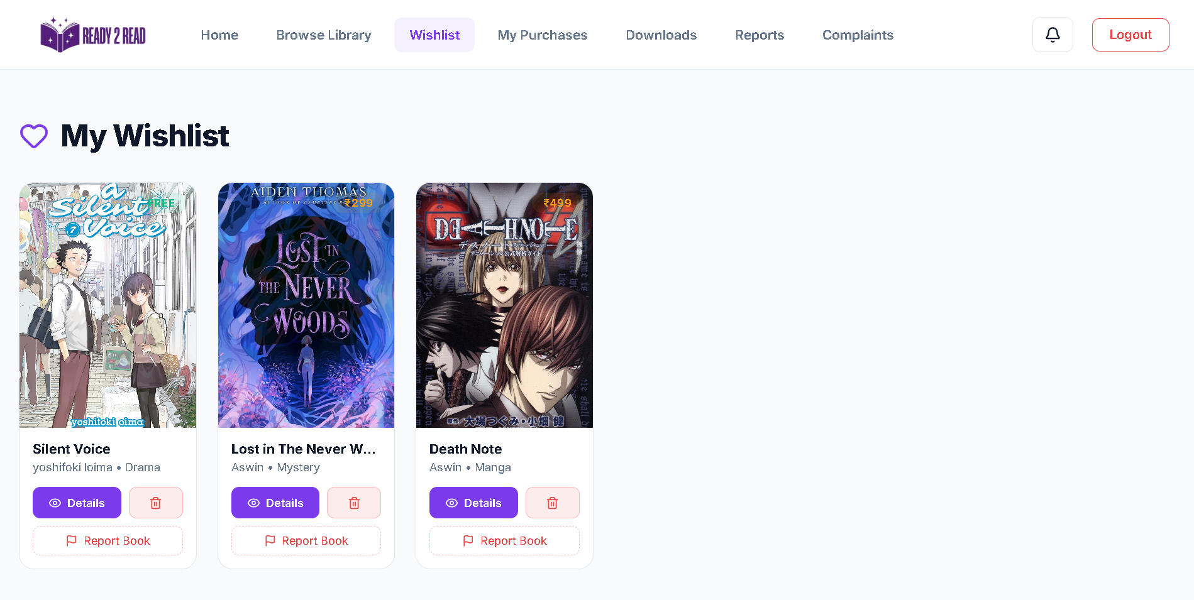
WISHLIST

Slide 57
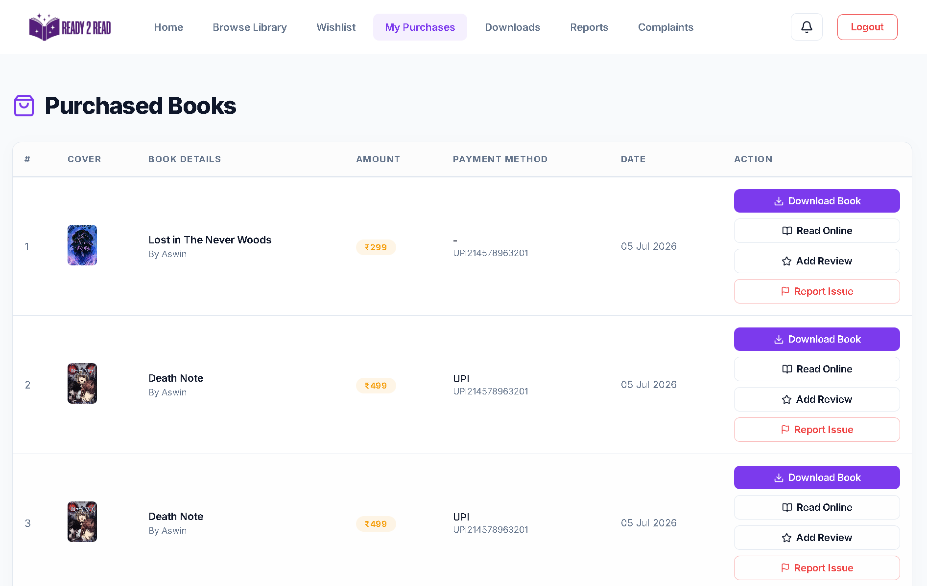
PURCHASE

Slide 58
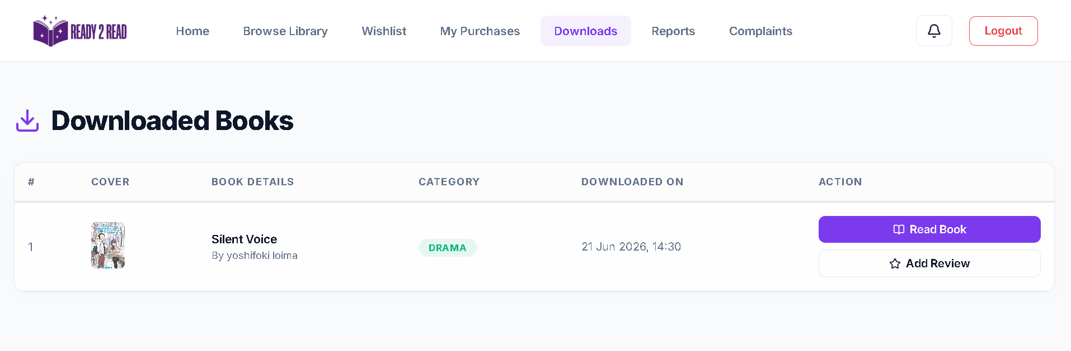
DOWNLOADS

Slide 59
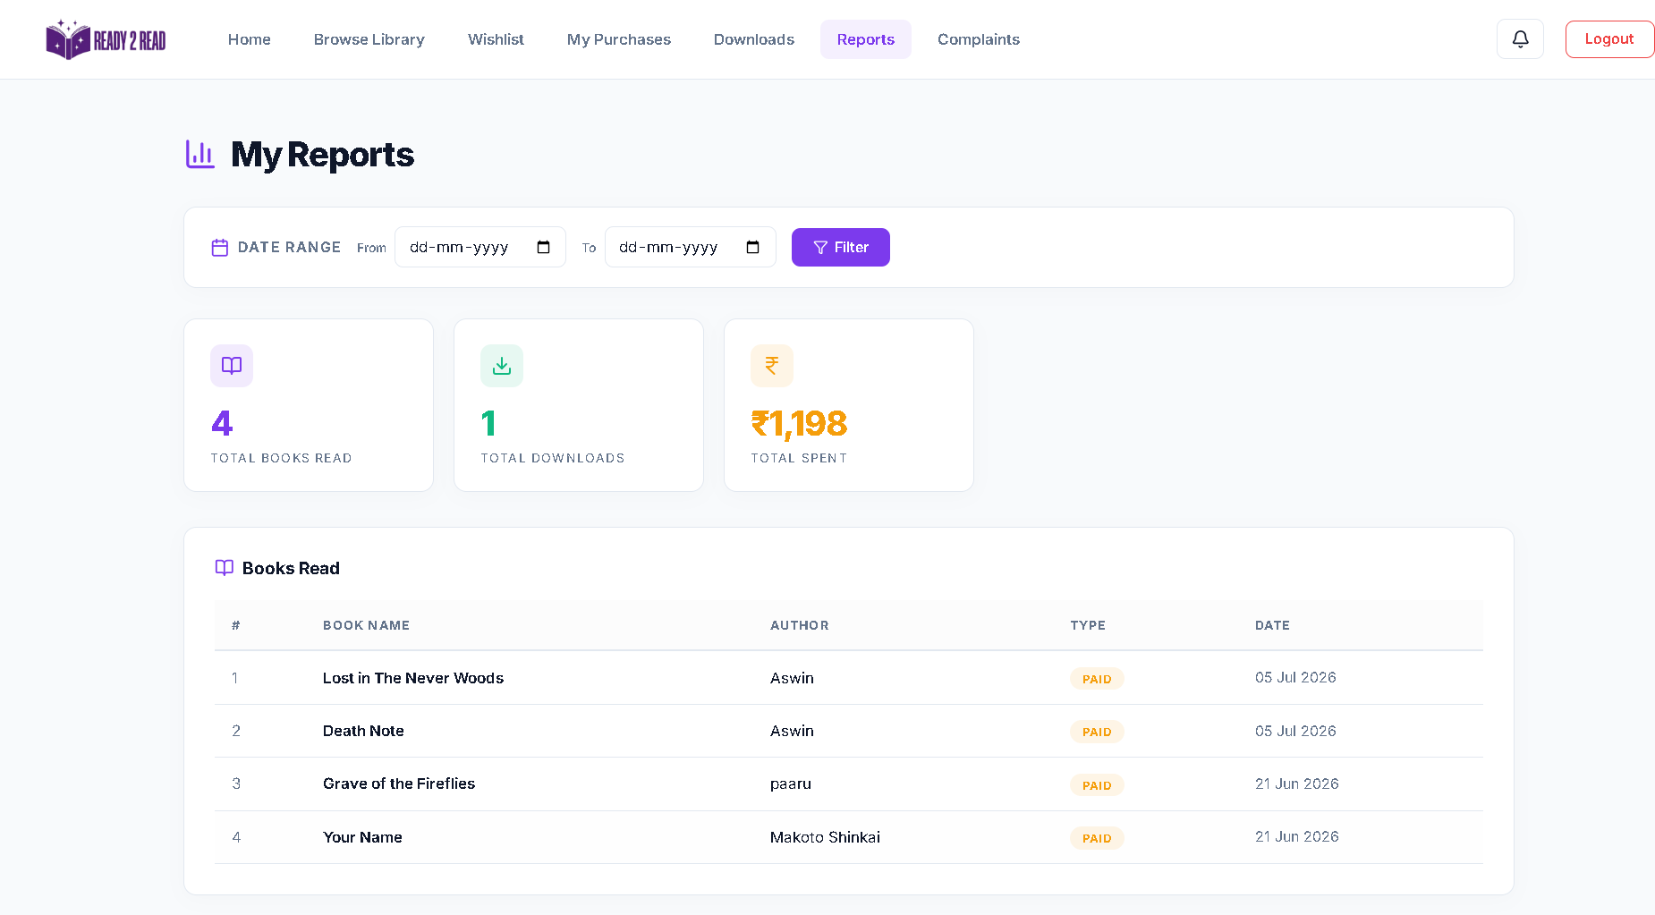
REPORTS

Slide 60
THANK YOU

