Slide 1
Verdana Pro Cond Black
SKETCHS
A
Word Jam
B
C
A
Word Jam
B
C

Slide 2

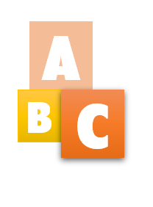


Slide 3
Presplash

Slide 4












1
2
win.png
Source: https://www.freepngimg.com/png/58348-alarm-icon-cartoon-timer-clock-free-photo-png
Author: https://www.freepngimg.com/
img.png
Author: https://craftpix.net/
Source: https://opengameart.org/content/game-coins-sprite
Coin Sprite sheet (converted to 30x30 animated gif with 100 milliseconds animation delay, loop forever)

Slide 5
Box Layout
CROSS WORD AREA
Layout Design
COIN DISPLAY
TIME DISPLAY
50%
Box Layout
corner
STATUS STUFF
MY NAME
Box Layout

