Slide 1
NEWSPAPER
A DIGITAL VIEW INTO EVENTS AROUND YOU
Team members
Aswin Prasad
Jayasurya Pinaki
Rajeev Sebastian

Slide 2
Overview
This is an online interactive news site where newsreaders can interact with news articles posted by editors.
Users can like, comment and subscribe to a category of newspapers. They will receive notifications based on their subscription and articles they have commented.
Editors can view and analyze statistics that are based on the newsreader's interaction with the article they have posted.

Slide 3
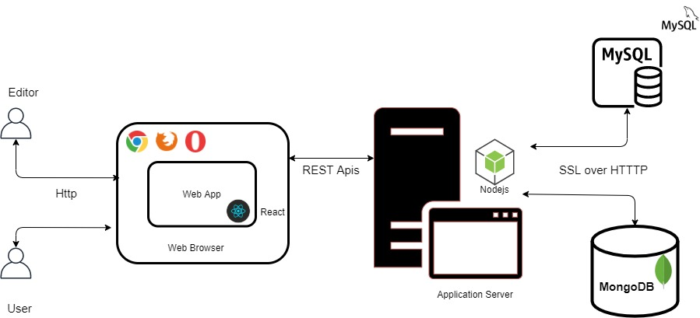
Architecture Diagram

Slide 4
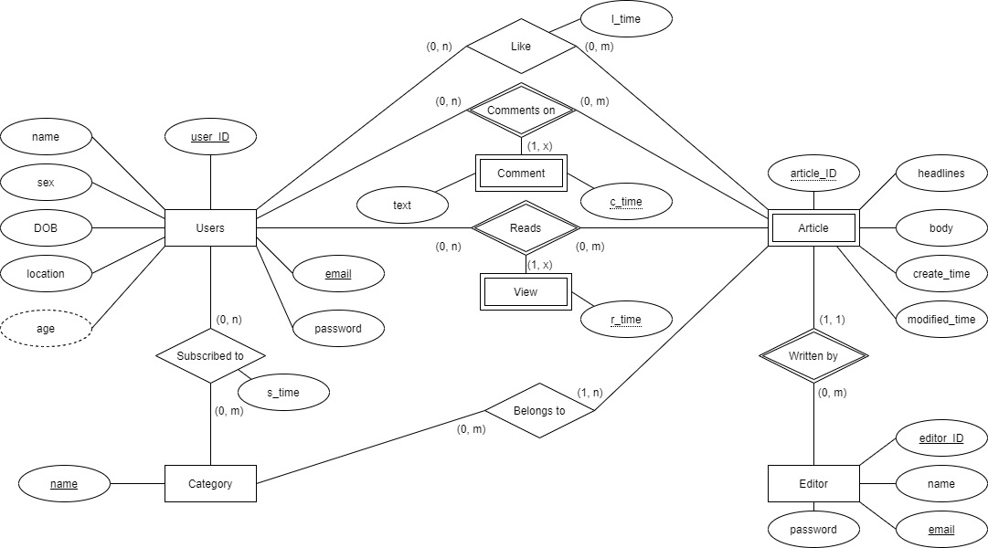
Entity Relationship Diagram (ERD)
Notes:
Explain the entities
Objects
Article: It has a text-based headline and a body that is posted by an editor.
Category: Each article is tagged to one or more categories. This is a grouping of similarly
themed articles (Sports, Politics, Business, Science, etc).
Actors
Newsreader: View, read and leave feedback on an article.
Editor: Post article and view analytics based on all the articles posted by them.

Slide 5
Use cases and need for NoSQL
Comments use-case.
Comments growth and fetching.
Notes:
MySQL supports most use-cases, but a feature like comments, in which in each article there can be thousands of comments. The table can grow quickly and fill up the MySQL size, MongoDB with its horizontal scaling can solve this problem. Also as all comments are in a single MongoDB collection, fetching doesn’t require joins.

Slide 6
Indexes
We have made use of indexes on primary key as they are the search parameters on 95 % of our queries.
This improves the performance to a great degree.
Since we have made use of MongoDB we can get the auxiliary data like comments like information using simple reads supported by the document model.

Slide 7
Normalization and denormalization
Our database is in 3NF form.
In order to provide a framework to store different type comments easily such as gif, images, sounds we have stored all comments in mongoDB as well. Though this causes redundancy we can avoid joins and get all the comments for a given article with just a simple read.
Notes:
All the tables in our database are in 3NF. We initially created tables by intuition and the properties of functional dependencies (For example, tables should only have related data in them). Our tables were automatically in 3NF.
But at some places we also had to use denormalized data. For example we kept the article data in mongoDB collection. In that we append comments whenever some comment is added. The data is not in normalised form, but the read performance is greatly improved because of the absence if join.

Slide 8
Views
Get article
Notes:
Because of our DB design, we have to fetch an article by joining article and editor table. And viewing an article is a common task. So we create a article_view, which is a join of those two tables.

Slide 9
Stored procedures
Stored procedures can take multiple values as inputs and perform operations based on the inputs provided while returning different results
Used to check if user has already liked an article, check if the email provided is duplicate while updating user or editor information.
Notes:
We used stored procedures at multiple places. for complex scenarios that required multiple continuous queries, we used stored procedures to combine them as one meaningful entity with defined inputs and outputs.
For example, in LIKE_Article feature, instead of checking if already liked and then liking the article. We wrote one stored procedure to do it in one block of code.

Slide 10
Transaction and concurrency control
exports.moduleName = async (req, res) => {
await SQLConnection.beginTransaction()
let mongoConnection = await Collection.startSession();
mongoConnection.startTransaction();
try {
// MySQL operations
// MongoDB operations
await mongoConnection.commitTransaction();
await mongoConnection.endSession();
await SQLConnection.commit();
} catch (error) {
await mongoConnection.abortTransaction();
await mongoConnection.endSession();
await SQLConnection.rollback()
}
}
Notes:
Transactions - We combined Mongo and MySQL transaction feature. When something fails, all changes are rolled back.
Concurrency control - Since InnoDB makes use of 2 phase locking protocol, we have made use of “REPEATABLE READ” as our default transaction control mechanism to avoid the Dirty read and Non repeatable read problems that can occur. Suppose an update to an account fails then while fetching the user account details, we must ensure consistency that was present in the previous state)

Slide 11
DEMO

