Slide 1

Group 7
Aswin Prasad
Farha Kauser
Jayasurya Pinaki
Maaz Sirkhot
Shubhangi Yadav

Slide 2
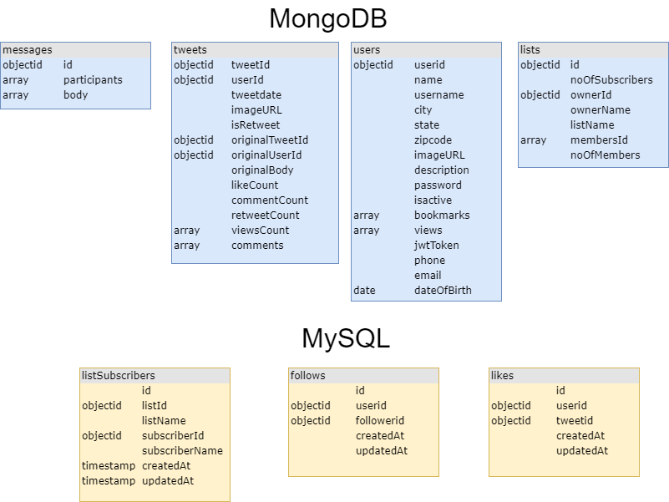
Database Model

Slide 3
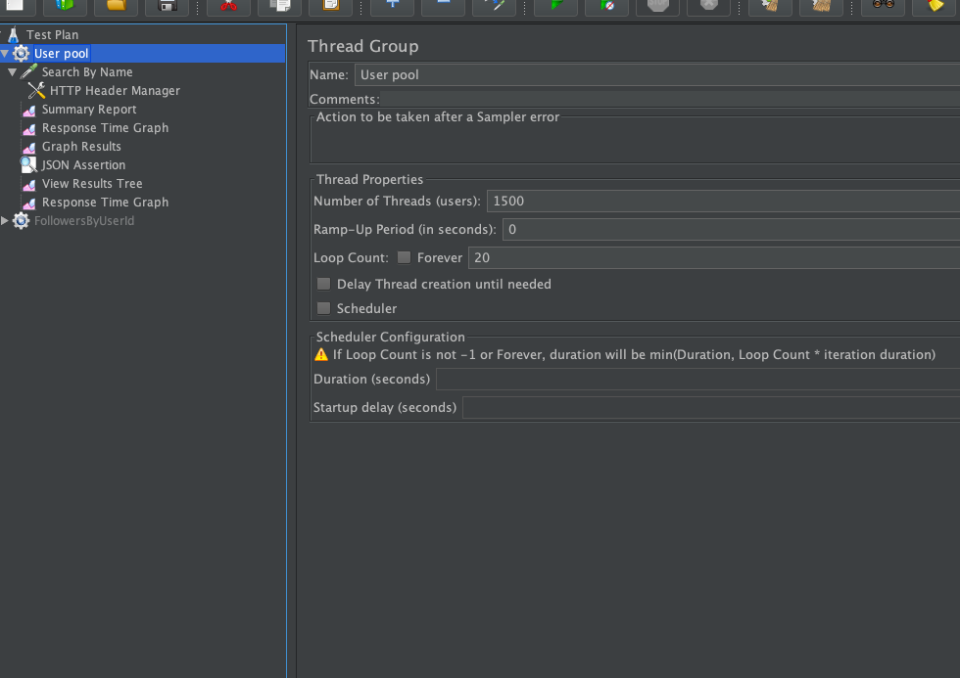
Test scenario

Slide 4
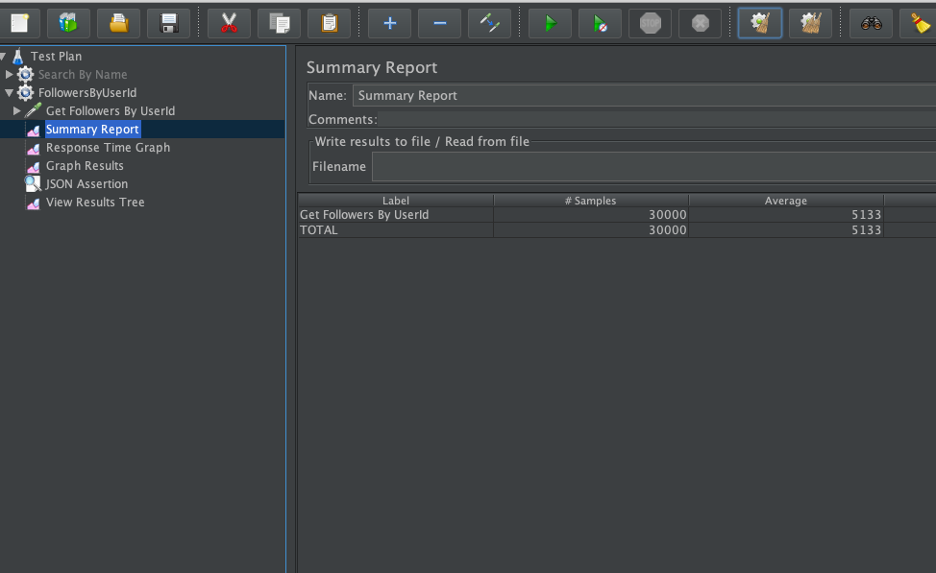
Base Average time : 5155ms

Slide 5
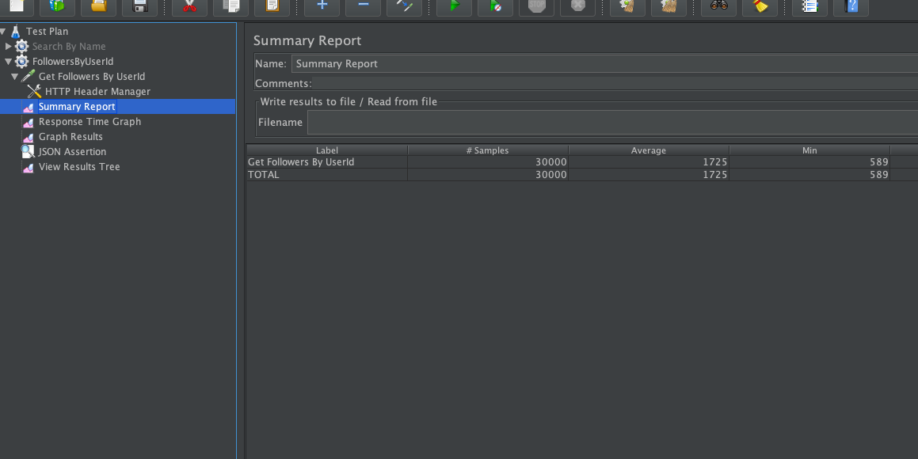
With DB Connection Pooling Average time : 1725ms Improvement: ~66%
Notes:
There is a notable improvement when using connection pooling, as there is not need to open and close connection on the fly. And a pool are connections can be used repeatedly.

Slide 6
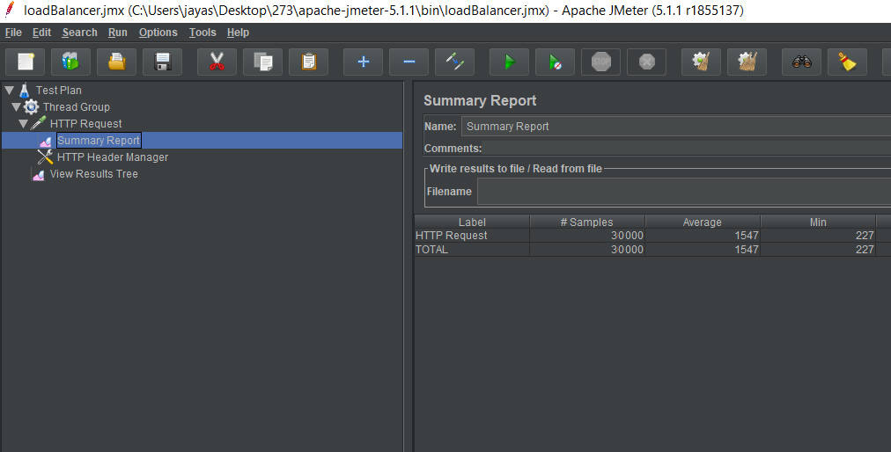
With Redis Average time: 1547ms Improvement: ~70%
Notes:
There is a notable improvement when using connection pooling, as there is not need to open and close connection on the fly. And a pool are connections can be used repeatedly.

Slide 7
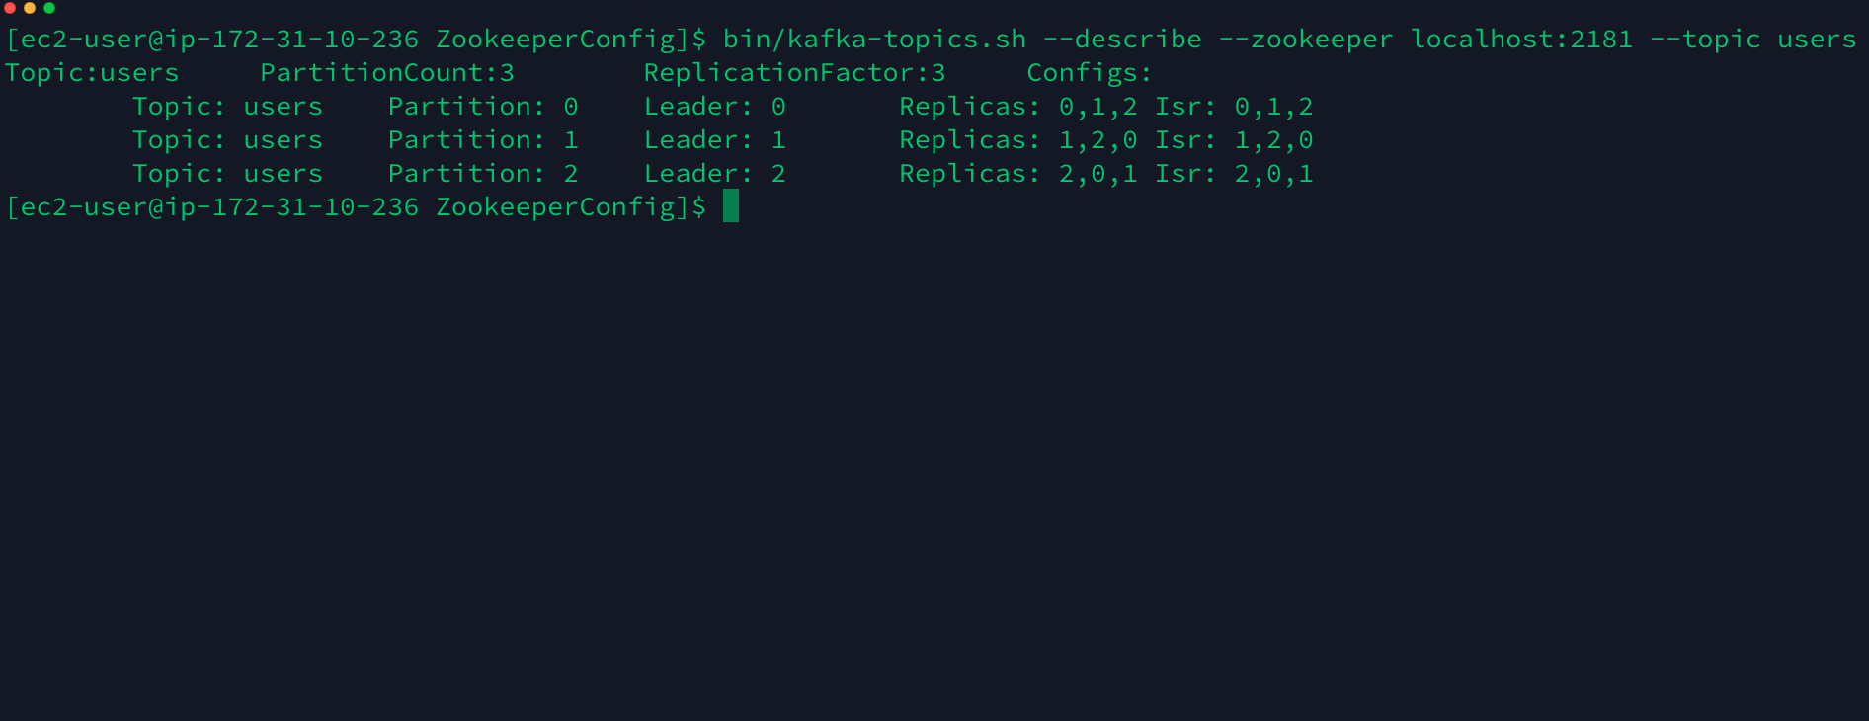
Kafka Setup

Slide 8
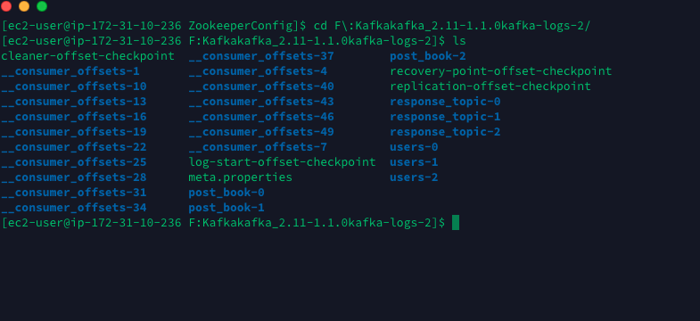
Kafka partitions

Slide 9
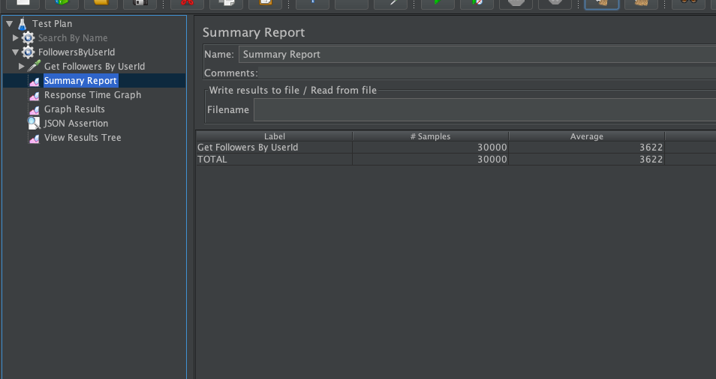
With Kafka (3 partitions) Average time: 3622ms

Slide 10
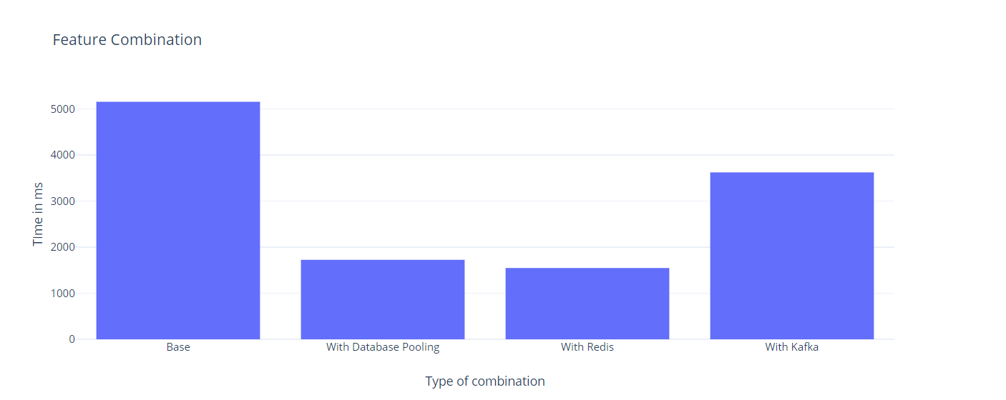
Results comparison with feature combination
Test No | Configuration | Average time
1 | Base | 5155ms
2 | With Database Pooling | 1725ms
3 | With Redis | 1547ms
4 | With Kafka | 3622ms

Slide 11
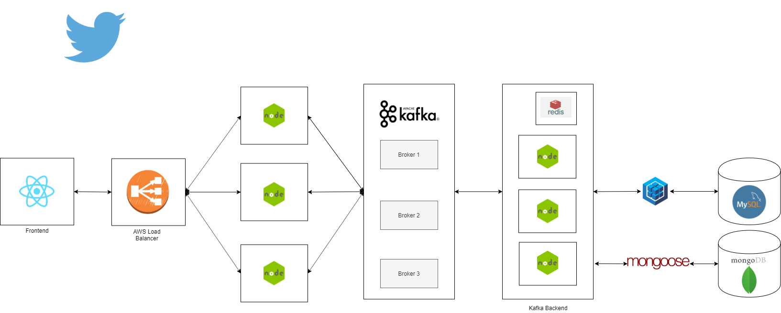
Distributed System Architecture

Slide 12
Distributed systems (1 Backend Server) Average time: 5133ms

Slide 13
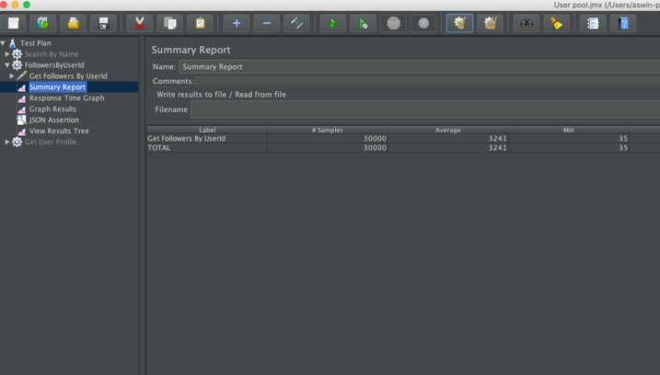
Distributed systems (2 Backend Servers) Average time: 3241ms

Slide 14
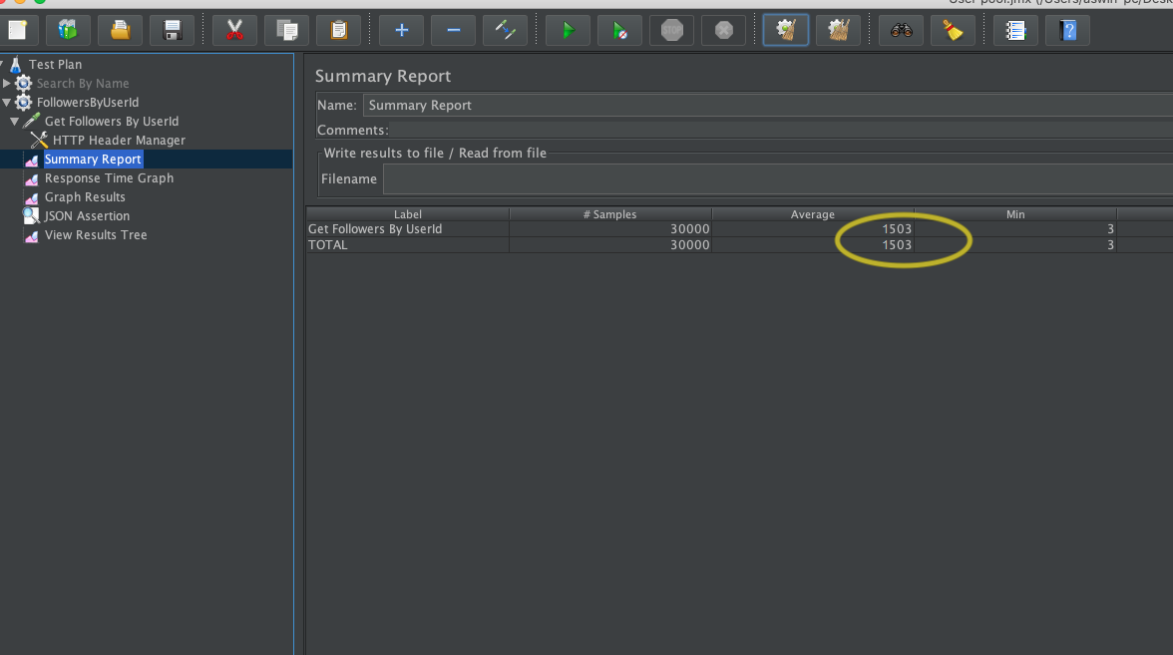
Distributed systems (4 Backend servers) Average time: 1503ms

Slide 15
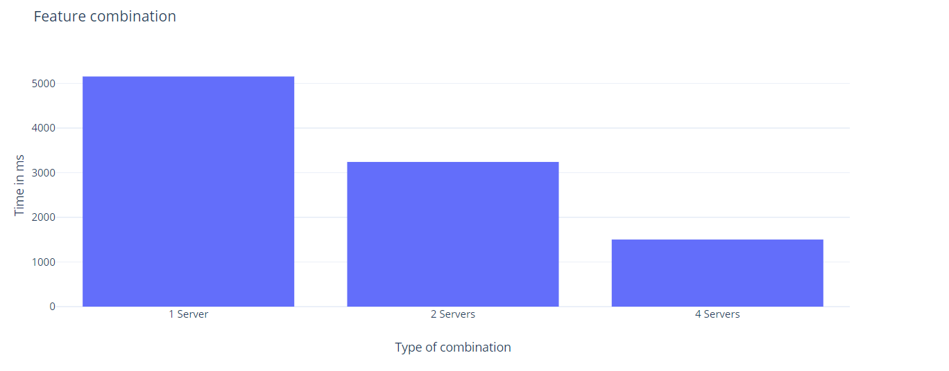
Results comparison with distributed system
Test No | Configuration | Average time
1 | 1 Backend Server | 5155ms
2 | 2 Backend Servers | 3241ms
3 | 4 Backend Servers | 1503ms

