Slide 1
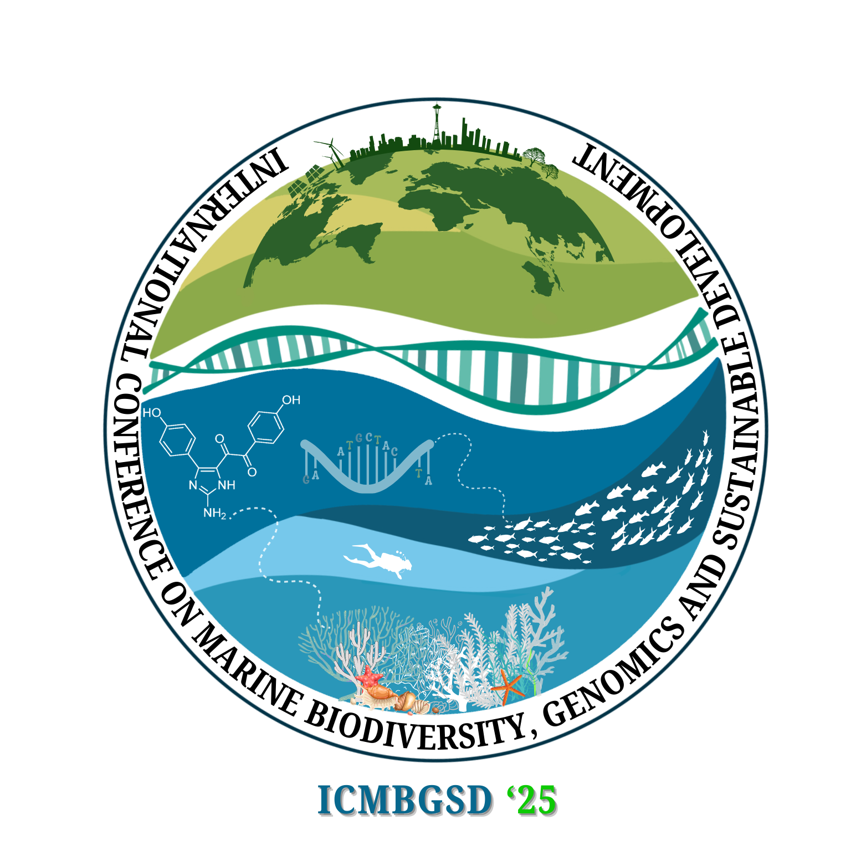

International Conference on Marine Biodiversity, Genomics, and Sustainable Development” April 9-11, 2025
CUSAT, Cochin
Antibiotic resistance pattern of Cochin estuary core sample
: A case study
Your University Logo Here
Jasna Vijayan¹, Sabira P.A¹, Akhil Prakash E¹, Parvathy K. R¹, Reshmi¹, P.S Sunil², Mohamed Hatha Abdulla^{1*}
¹Department of Marine Biology, Microbiology and Biochemistry, School of Marine Science, CUSAT, Cochin – 682 016, Kerala, India.
²Department of Marine Geology and Geophysics, School of Marine Science, CUSAT, Cochin – 682 016, Kerala, India
References
Cury JC, et al. 2011, PLoS ONE 6(1)
Suttle C.A., 2005, Nature 437: 356–361
Acknowledgments:
We sincerely thank the Department of Marine Biology, Microbiology and Biochemistry, School of Marine Science and grateful for the UGC-Kothari postdoctoral research fellowship grant (DSKPDF-UGC)
Cochin University of Science and Technology Corresponding author E-mail

