Slide 1
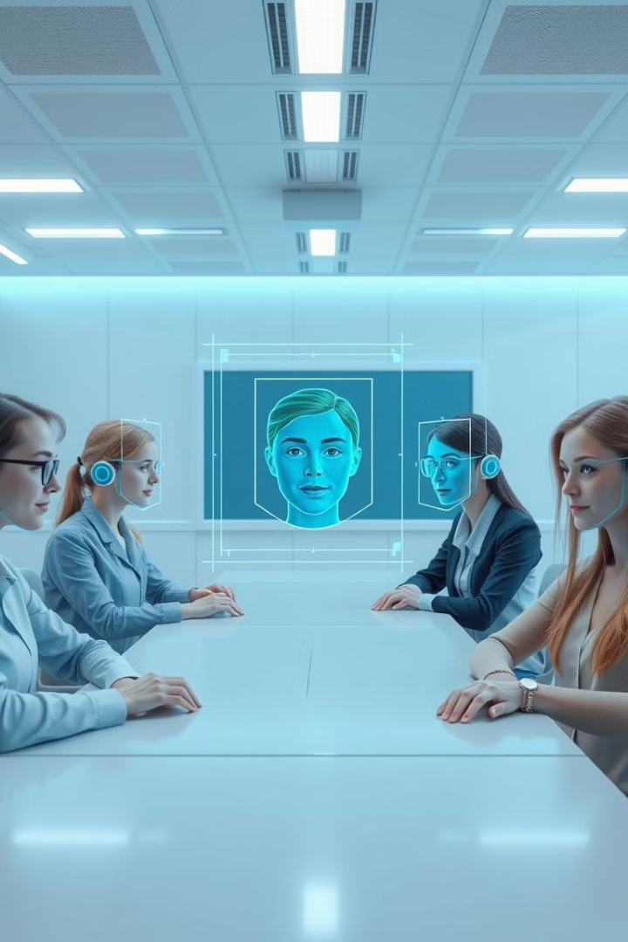
Face Recognition Attendance System
This project introduces an automated attendance system using face recognition technology. It streamlines attendance marking, reduces errors, and enhances data organization in educational settings.
by Aswin R
Guided by Dr.Sheeba K

Slide 2
Evolution of Attendance Systems
Traditional Methods
Face Recognition
Manual entry - Time-consuming and error-prone.
Efficient, touch-free alternative. Improves accuracy and speed of attendance tracking.
Page - 02

Slide 3

Challenges of Manual Systems
1
Time Consumption
2
Error Proneness
Recording attendance manually takes significant time, especially in large classrooms.
Manual entries often lead to inaccuracies, including proxy attendance.
3
Data Management
Keeping attendance records updated and organized is challenging for educators.
Page - 03

Slide 4
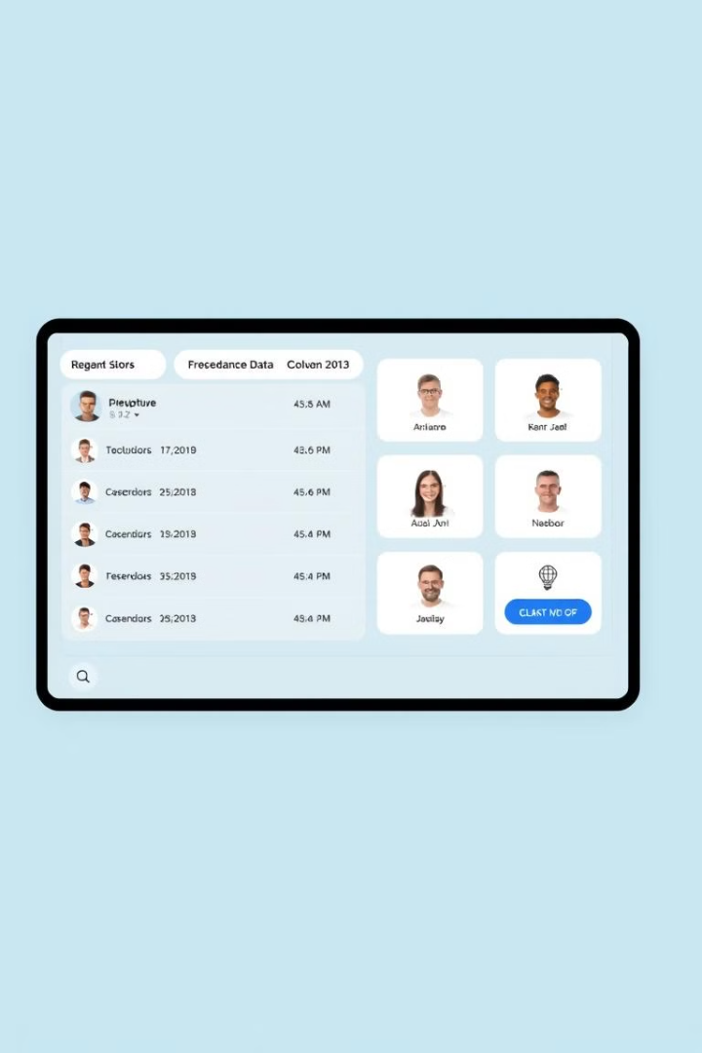
Project Objectives
1
Face Detection
Design a system for real-time student face detection and recognition.
2
Subject-wise Recognition
Implement mechanism for organizing attendance records by subject and date.
3
Data Organization
Ensure attendance data is well stored and maintained.
4
User-friendly Interface
Develop interface for educators to easily manage and review attendance records.
Page - 04

Slide 5
Workflow
User
Face Recognition
Teacher Login
Capture images
Auto mail
Train Model
Edit Timetable
Delete Students
Delete Attendance
Page - 05

Slide 6
Face Recognition
1
FaceNet ( InceptionResnetV1)
2
MTCNN
From the facenet-pytorch library. FaceNet works by generating unique 128-dimensional embeddings for each face, effectively creating a “fingerprint” for each individual
(Multi-task Cascaded Convolutional Networks), also from the facenet-pytorch library. MTCNN detects faces by using a cascade of networks to quickly identify and refine facial regions, ensuring precise detection of facial boundaries and features
Page - 06

Slide 7
Capture Image, Training Model
1
Open CV
2
InceptionResnetV1
OpenCV handles the live video feed from a camera, allowing individual frames to be extracted and saved as images. These images serve as the training dataset for each new student, linking their facial data with their unique IDs.
model, pre-trained on the VGGFace2 dataset, generates unique facial embeddings from the captured images. These embeddings are high-dimensional vectors representing facial features, which are then stored and used to identify students during recognition.
Page - 07

Slide 8
Delete Student Attendance, Details
1
Delete Student Details
2
Delete Student Attendance
Searches for the student's ID in the database and removes their record.
Finds the specific attendance entry by date and subject, then removes the student's record from the database.
Page - 08

Slide 9
Edit time table
1
Automated Attendance
2
Edit Timetable
Attendance is now recorded automatically based on the timetable, with no need for manual entry. When a student is recognized during a scheduled class time, attendance is marked without teacher intervention.
Allows the teacher to modify class schedules by updating timetable.json, specifying the subjects, start times, and end times for each day
Page - 09

Slide 10
Auto Mail
1
Yagmail
The automated emailing system uses the yagmail library in Python, which simplifies the process of sending emails. It allows the system to automatically generate and send attendance reports to designated recipients without requiring manual intervention.
Page - 10

Slide 11
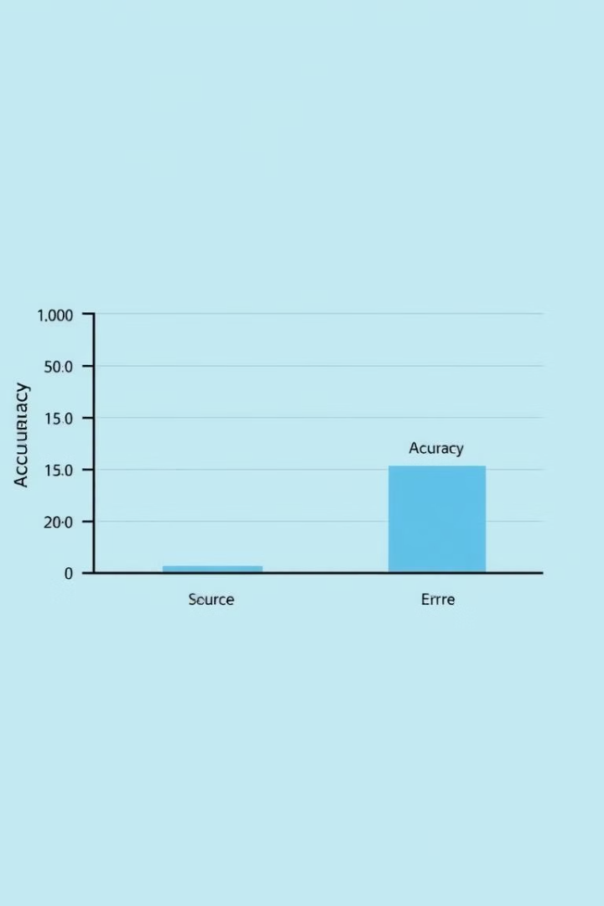
Results and Performance
Recognition Accuracy
High percentage of correctly identified students
False Positive Rate
Low rate of incorrect identifications
False Negative Rate
Low rate of missed recognitions
Processing Time
Quick average time for recognition and logging
Page - 11

Slide 12

Future Enhancements
Anti-Spoofing Measures
Cloud Storage
Implement security features to verify authenticity of captured faces.
Utilize cloud technology for secure storage and remote access.
1
2
3
Mobile Application
Develop app for easy access to attendance records on-the-go.
Page - 12

Slide 13
References
1. S. Qi, X. Zuo, W. Feng and I. G. Naveen, "Face Recognition Model Based On MTCNN And Facenet," 2022 IEEE 2nd International Conference on Mobile Networks and Wireless Communications (ICMNWC), Tumkur, Karnataka, India, 2022, pp. 1-5, doi: 10.1109/ICMNWC56175.2022.10031806.
2. Z. Yang, W. Ge and Z. Zhang, "Face Recognition Based on MTCNN and Integrated Application of FaceNet and LBP Method," 2020 2nd International Conference on Artificial Intelligence and Advanced Manufacture (AIAM), Manchester, United Kingdom, 2020, pp. 95-98, doi: 10.1109/AIAM50918.2020.00024.
3. W. Ji and L. Jin, "Face Shape Classification Based on MTCNN and FaceNet," 2021 2nd International Conference on Intelligent Computing and Human-Computer Interaction (ICHCI), Shenyang, China, 2021, pp. 167-170, doi: 10.1109/ICHCI54629.2021.00042.
Page - 13

