Slide 1
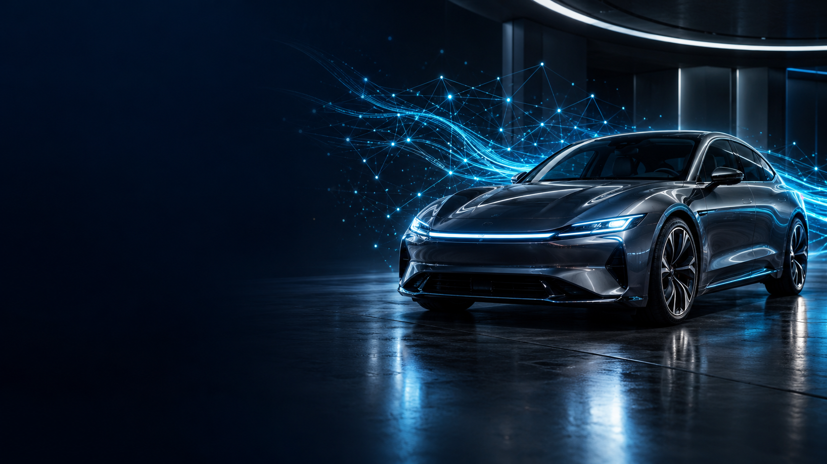
AUTOMOTIVE AI / EDGE INTELLIGENCE
AUTOSYNAPSE
A Neural Knowledge Fabric for Temporal
Automotive Intelligence and Explainable
Vehicle Reasoning
Connecting Signals. Reconstructing Events. Understanding Vehicles.
An offline-capable intelligence layer designed to connect vehicle history with traceable engineering evidence.
LOCAL AI
VEHICLE MEMORY
TEMPORAL ANALYSIS
EXPLAINABLE DIAGNOSTICS
ARCHITECTURE & RESEARCH CONCEPT • 2026
Notes:
Cover visual is generated concept art, not a photograph of the AUTOSYNAPSE prototype. Project status and title are based on the supplied research report; the system is at the architecture and planning stage.

Slide 2
AUTOSYNAPSE
ENGINEERING PROPOSAL
Fragmented Vehicle Signals, Unified Intelligence
The proposal connects distributed history to a bounded, evidence-grounded diagnostic workflow.
ENGINEERING FRICTION
PROPOSED AUTOSYNAPSE RESPONSE
01
Fragmented records
01
Normalize inputs
ECU, BMS, ADAS and diagnostic data arrive in separate channels.
Typed records, units, timestamps and quality flags.
02
Keep local history
02
Manual triage
SQLite stores time-indexed samples, events and sessions.
Engineers may repeat filters and joins to follow a warning across logs.
03
Detect unusual patterns
03
Thin time context
Statistics and anomaly models flag; they do not diagnose.
Pre-event and post-event history takes work to reconstruct.
04
Correlate events
A temporal graph links episodes, warnings and provenance.
04
Cloud trade-offs
Connected inference can raise privacy, latency and availability concerns.
05
Ask in natural language
A compact local SLM maps a question to approved tools.
05
Raw signals
06
Explain with evidence
Codes and telemetry need engineering interpretation.
Python calculates; the answer cites records or abstains.
RAW VEHICLE DATA
→
TEMPORAL FABRIC
→
ENGINEERING INSIGHT
CAN-style • BMS • ADAS • DTC
Normalized • linked • provenance-aware
Evidence-linked explanation or abstention
Example question “Why did battery temperature rise before the overheating warning?”
AUTOSYNAPSE / DESIGN PROPOSAL
PROPOSED • NOT BENCHMARKED
02 / 10
Notes:
Based on the supplied research report, especially its executive summary and Sections 3, 5, 8 and 9. The response path is a proposal, not a demonstrated implementation.

Slide 3
AUTOSYNAPSE
ENGINEERING PROPOSAL
A Different Workflow for Vehicle Diagnosis
The distinction is integration, temporal context and evidence handling; existing tool capabilities vary.
DIMENSION
COMMON DIAGNOSTIC WORKFLOW
AUTOSYNAPSE DESIGN
Interaction
Operator navigates menus, filters or command tools.
Natural-language prompt routed through validated tools.
History
The operator selects records and time ranges to inspect.
One query can expand a time window across linked sources.
Event context
Warnings and sensor traces are often reviewed separately.
Events connect to signal episodes, sessions and nearby records.
Analytics
Rules, thresholds and product-specific analytics.
Python baselines plus ML anomaly flags; scores remain non-diagnostic.
Deployment
Varies by platform and service model.
Local-first design goal; core query path needs no cloud API.
Evidence
Codes and measurements may require manual context.
Answer carries source paths and certainty labels; weak evidence can abstain.
TEMPORAL DIAGNOSTIC INTELLIGENCE
Signal episode
warning
From code lookup to a context-aware event reconstruction.
earlier
trend
event
evidence
AUTOSYNAPSE / DESIGN PROPOSAL
PROPOSED • NOT BENCHMARKED
03 / 10
Notes:
Workflow comparison derived from the supplied report, Sections 3 and 11. It describes the proposed integration and interaction model; it does not assert that all conventional tools lack any listed capability.

Slide 4
AUTOSYNAPSE
ENGINEERING PROPOSAL
AUTOSYNAPSE Architecture
Six connected layers; source data remains traceable from the local evidence package back to raw records.
01 DATA SOURCES
Sensors • ECUs • CAN / CAN-FD* • BMS • ADAS • DTC logs • vehicle simulator
↓
02 ACQUISITION + NORMALIZATION
Python adapters • timestamp sync • Pydantic schema • unit checks • quality flags • event labels
↓
03 LOCAL VEHICLE MEMORY
SQLite • indexed raw samples • diagnostic / ADAS events • sessions • source provenance
LOCAL EXECUTION BOUNDARY
↓
04 ANALYTICS + KNOWLEDGE GRAPH
Episode segmentation • temporal edges • trend / slope • Isolation Forest flag • event correlation
↓
05 NATURAL-LANGUAGE INTELLIGENCE
Intent + time range • allow-listed tool router • graph retrieval • evidence subgraph • local SLM
↓
06 USER INTERACTION
Engineering dashboard • assistant • telemetry graph • event timeline • evidence trail / report
RAW SAMPLES
Dense telemetry stays time-indexed; the graph holds episodes and events, not every raw sample.
CORE QUERY PATH DESIGNED TO RUN LOCALLY
* CAN/CAN-FD and model candidates require adapter, compatibility and resource validation.
AUTOSYNAPSE / DESIGN PROPOSAL
PROPOSED • NOT BENCHMARKED
04 / 10
Notes:
Architecture adapted from the supplied design report, Sections 5–9. Data sources and all model/runtime choices are proposed. The local boundary is a design target, not a completed hardware deployment.

Slide 5
AUTOSYNAPSE
ENGINEERING PROPOSAL
Technology Stack
Candidate prototype components, grouped by the job each one would perform.
01 DATA ACQUISITION
04 FRONTEND + VISUALIZATION
Python simulator • CAN-style telemetry
python-can: future CAN interface • CARLA: optional advanced simulation
React • Tailwind CSS • Plotly or Recharts • WebSockets
02 BACKEND + STORAGE
FastAPI • SQLite • SQLAlchemy • Pydantic
05 DEPLOYMENT + TESTING
ARM Linux target • quantization / profiling
VS Code • pytest • target-device benchmarking
03 AI + ANALYTICS
SmolLM2-360M-Instruct / Qwen2.5-0.5B-Instruct candidates
llama.cpp • NumPy • Pandas • scikit-learn / Isolation Forest
PROPOSED DATA PATH
SIMULATOR
→
FASTAPI
→
SQLITE +
ANALYTICS
→
LOCAL SLM
→
REACT UI
LIGHTWEIGHT MODEL FOR LANGUAGE
Deterministic tools retrieve and calculate; the SLM explains verified evidence.
Proposed stack only. Model fit, licensing, ARM compatibility and resource use require validation.
AUTOSYNAPSE / DESIGN PROPOSAL
PROPOSED • NOT BENCHMARKED
05 / 10
Notes:
Component names reflect the supplied report and requested design brief. FastAPI documentation: https://fastapi.tiangolo.com/. Model candidates: https://huggingface.co/HuggingFaceTB/SmolLM2-360M-Instruct and https://huggingface.co/Qwen/Qwen2.5-0.5B-Instruct. Runtime: https://github.com/ggml-org/llama.cpp. No component is represented as integrated or benchmarked.

Slide 6
AUTOSYNAPSE
ENGINEERING PROPOSAL
How the System Investigates and Explains
Two controlled paths: ingest vehicle history, then answer a time-bounded engineering question.
INGEST-TIME / VEHICLE HISTORY
01
›
02
›
03
›
04
›
05
Generate / receive
Normalize
Store locally
Build episodes
Screen patterns
Simulated signals, DTCs and ADAS events
Validate fields, units, clocks and gaps
SQLite records with source provenance
Segments, temporal edges and sessions
Trend tools and statistical flags
QUERY-TIME / ENGINEERING QUESTION
06
›
07
›
08
›
09
›
10
Ask a question
Parse + validate
Retrieve evidence
Calculate + label
Explain + display
“What happened before the warning?”
Intent, entities and allowed time range
Graph tools expand the event window
Python checks values; certainty is tagged
Local SLM response links to the timeline
52°C
SIMULATED EXAMPLE / 15-MINUTE CONTEXT
OVERHEAT WARNING
47°C
Query focuses on 10:20–10:30
EVIDENCE-GROUNDED RESPONSE
43°C
The warning was recorded at 10:30. The visible simulated trace rises from 38°C to 52°C; that sequence supports investigation but does not establish a root cause.
40°C
38°C
10:15
10:18
10:21
10:25
10:30
10-MIN QUERY WINDOW
Observed values only • hypothesis requires more evidence
SLM UNDERSTANDS
→
TOOLS RETRIEVE
→
PYTHON ANALYSES
→
SLM EXPLAINS
Illustrative values from the project brief; not measured vehicle data.
AUTOSYNAPSE / DESIGN PROPOSAL
PROPOSED • NOT BENCHMARKED
06 / 10
Notes:
The values 10:15 / 38°C, 10:18 / 40°C, 10:21 / 43°C, 10:25 / 47°C and 10:30 / 52°C are a simulated example provided in the brief. The plotted 15-minute context is distinct from the query window (10:20–10:30). The example does not demonstrate causation.

Slide 7
AUTOSYNAPSE
ENGINEERING PROPOSAL
Feasibility and Viability
The architecture is plausible to prototype; target-device and model evidence are still pending.
TECHNICAL
OPERATIONAL
ECONOMIC
EDGE DEPLOYMENT TARGET
SQLite + Python keep the core simple.
Core query path is designed for offline use.
Open-source choices where licensing permits.
~2 GB
Small SLM candidates have local runtimes.
Tools are read-only and allow-listed.
Less dependence on per-query cloud inference.
RAM target
Adapters separate sources from reasoning.
Evidence labels support review and abstention.
Reusable modules across data sources.
ARM Cortex-A5x class
2 CPU cores
Local SQLite storage
Quantized SLM candidate
Optional network; offline core path
Graph adds explicit time and provenance.
Dashboard modules can grow incrementally.
Time savings are a hypothesis to measure.
DESIGN TARGET — NOT VALIDATED
PLANNING STATUS
Architecture
Prototype
ARM profiling
Model benchmark
DEFINED
PLANNED
PENDING
PENDING
The 2-core / ~2 GB envelope and any latency targets must be measured on the chosen board.
AUTOSYNAPSE / DESIGN PROPOSAL
PROPOSED • NOT BENCHMARKED
07 / 10
Notes:
Feasibility points are planning assessments from the supplied report. The report frames the 2 GB / two-core resource envelope as a target to test, not achieved performance. No measured latency, memory footprint, accuracy or operating-cost data are available.

Slide 8
AUTOSYNAPSE
ENGINEERING PROPOSAL
Planned Advantages and Future Scope
A staged path from a simulator-backed prototype to broader vehicle integration.
PLANNED ADVANTAGES
FUTURE EXTENSIONS
Offline-capable core query path
Natural-language access to history
CONNECTIVITY
CAN/CAN-FD + DBC • SOME/IP • Android Vehicle HAL • QNX
Event-centred reconstruction
Traceable sources and certainty labels
INTELLIGENCE
Time-series forecasting • deeper ADAS event analysis
Weeks of telemetry can be searched
Modular source adapters
PLATFORM
Multi-vehicle views • digital twins • edge optimization
ROADMAP / SEQUENCE ONLY — NO DATES CLAIMED
A FUNCTIONAL PROTOTYPE
B VEHICLE INTEGRATION
C ADVANCED INTELLIGENCE
Simulator + ground truth
SQLite • analytics • local assistant
CAN adapters + DBC decoding
Platform and protocol extensions
Forecasting • multi-vehicle
ADAS analysis • digital-twin signals
Real protocols, deployment and model selection are future work; the first build should establish correctness against labelled scenarios.
AUTOSYNAPSE / DESIGN PROPOSAL
PROPOSED • NOT BENCHMARKED
08 / 10
Notes:
Roadmap and extensions reflect the supplied report, Sections 10.1–10.4. All benefits are planned capabilities and future extensions, not completed features.

Slide 9
AUTOSYNAPSE
ENGINEERING PROPOSAL
Research Foundations and Technical References
Selected primary papers and official documentation • full verified links are in references.txt.
AI + RUNTIME
AUTOMOTIVE + SYSTEMS
ANALYTICS + TEMPORAL METHODS
SmolLM2: When Smol Goes Big
ISO 11898-1:2024
Isolation Forest
Ben Allal et al. • 2025 • arXiv:2502.02737
Road vehicles — CAN — data link / coding sublayer
Liu, Ting & Zhou • ICDM • 2008 • DOI 10.1109/ICDM.2008.17
Temporal Graph Networks
Qwen2.5 Technical Report
CARLA: An Open Urban Driving Simulator
Rossi et al. • 2020 • arXiv:2006.10637
Qwen Team • 2024 • arXiv:2412.15115
Dosovitskiy et al. • CoRL / PMLR 78 • 2017
Inductive Representation on Temporal Graphs
Xu et al. • ICLR • 2020 • arXiv:2002.07962
llama.cpp
AUTOSAR Adaptive Platform
PCMCI
ggml-org • official repository • accessed 2026
Official platform docs • Release R25-11
Runge et al. • Science Advances • 2019 • DOI 10.1126/sciadv.aau4996
Granger causality
FastAPI Documentation
CAN fundamentals
Granger • Econometrica 37(3) • 1969 • DOI 10.2307/1912791
FastAPI project • official docs • accessed 2026
CAN in Automation • CAN dictionary v1.3 • 2026
Retrieval-Augmented Generation
Lewis et al. • NeurIPS • 2020 • arXiv:2005.11401
The supplied project report names methods but gives no formal bibliography; these sources ground methods and candidate components, not AUTOSYNAPSE performance.
AUTOSYNAPSE / DESIGN PROPOSAL
PROPOSED • NOT BENCHMARKED
09 / 10
Notes:
Verified source links, publication metadata and access date are listed in the companion references.txt. Primary sources include arXiv:2502.02737, arXiv:2412.15115, arXiv:2006.10637, arXiv:2002.07962, doi:10.1109/ICDM.2008.17, doi:10.1126/sciadv.aau4996, doi:10.2307/1912791 and arXiv:2005.11401. Official documentation: ISO, AUTOSAR, CAN in Automation, llama.cpp and FastAPI. No source validates AUTOSYNAPSE itself.

Slide 10

AUTOSYNAPSE
The future of automotive intelligence is not just about collecting data. It is about understanding it.
01
CONNECT
Unify fragmented vehicle information.
02
RECONSTRUCT
Turn history into an event timeline.
03
EXPLAIN
Ground insight in inspectable evidence.
From Raw Signals to Meaningful Intelligence.
THANK YOU
Questions & Discussion
ARCHITECTURE & RESEARCH CONCEPT • 2026
Notes:
Closing summary. AUTOSYNAPSE is a proposed system; the future capabilities described here have not yet been validated. Closing vehicle visual is generated concept art.

