Slide 1


Prototype Submission Phase
Image Recognition using Computer Vision in eBPF platforms

Slide 2
TEAM NAME and MEMBER DETAILS
Aswin Vijayakumar Afeef K K
THEME:
Open Innovation with Intel® oneAPI AI Analytics Toolkits

Slide 3
PROBLEM STATEMENT
Integrate Privacy and Discoverability in AI Systems by Providing a Private and Secure Data Transfer through Computing and Networking Systems

Slide 4
SOLUTION
Problem
The problem of processing personal data through Computer Vision and AI systems have caused issues with Data Protection
Impact Metrics
Improving Monitoring through Packet Sniffing by introduction of a Networking Protocol
A Hand-Shake Protocol for initiating the Computer Vision Results through a Vision Exchange Request
Less Power Usage due to the Usage of VEXF Protocol

Slide 5
SOLUTION
Frameworks/Tools/Technologies
C++, oneAPI, Python, Python-HPC and oneAPI supported Python
Assumptions, constraints, and solution decision points
Computer Networking Solution with C++ and Python, as there are popular packages such as pcap
eBPF Observability Solution demonstrated as integrated with C++ and Python code

Slide 6
SOLUTION
Ease of Implementation
A Python Package implementing VEXF Frames will only involve Code Quality, Performance-based Computing, Conducting tests on Ethernet and WiFi interfaces
A HTTP Request-Response Cycle is implemented through a Database, Web-Server and Edge-Computing platforms such as an MQTT Request Broker
Testing would involve distributing the solutions to various providers who will implement this Package, for Discoverability or Protecting their Personal Data and Intellectual Property Related Information
Open Source Helper Computer Programs could assist the Package to reach the Market

Slide 7
SOLUTION
Additional Scalability / Usability
Computing Systems such as Cloud and Edge, Sensors such as WiFi Sensors, Packet Sniffers for capturing Frames in Wireshark, Software such as HTTP Monitoring Tools like Telerik Fiddler
Typically, any interference can be represented using Data Structures involved in Reading and Transmitting a Vision Exchange Format Packet

Slide 8
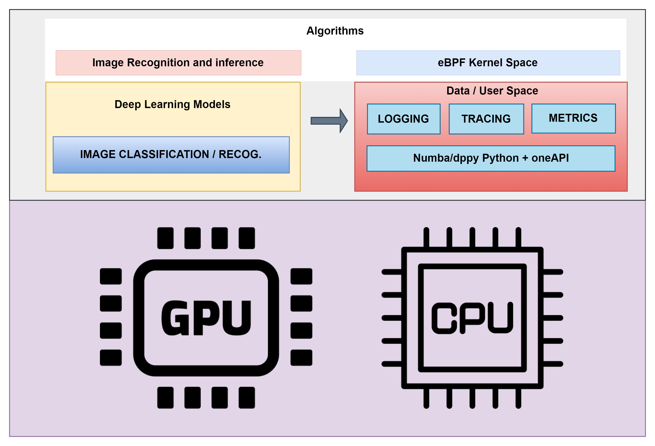
METHODOLOGY

Slide 9
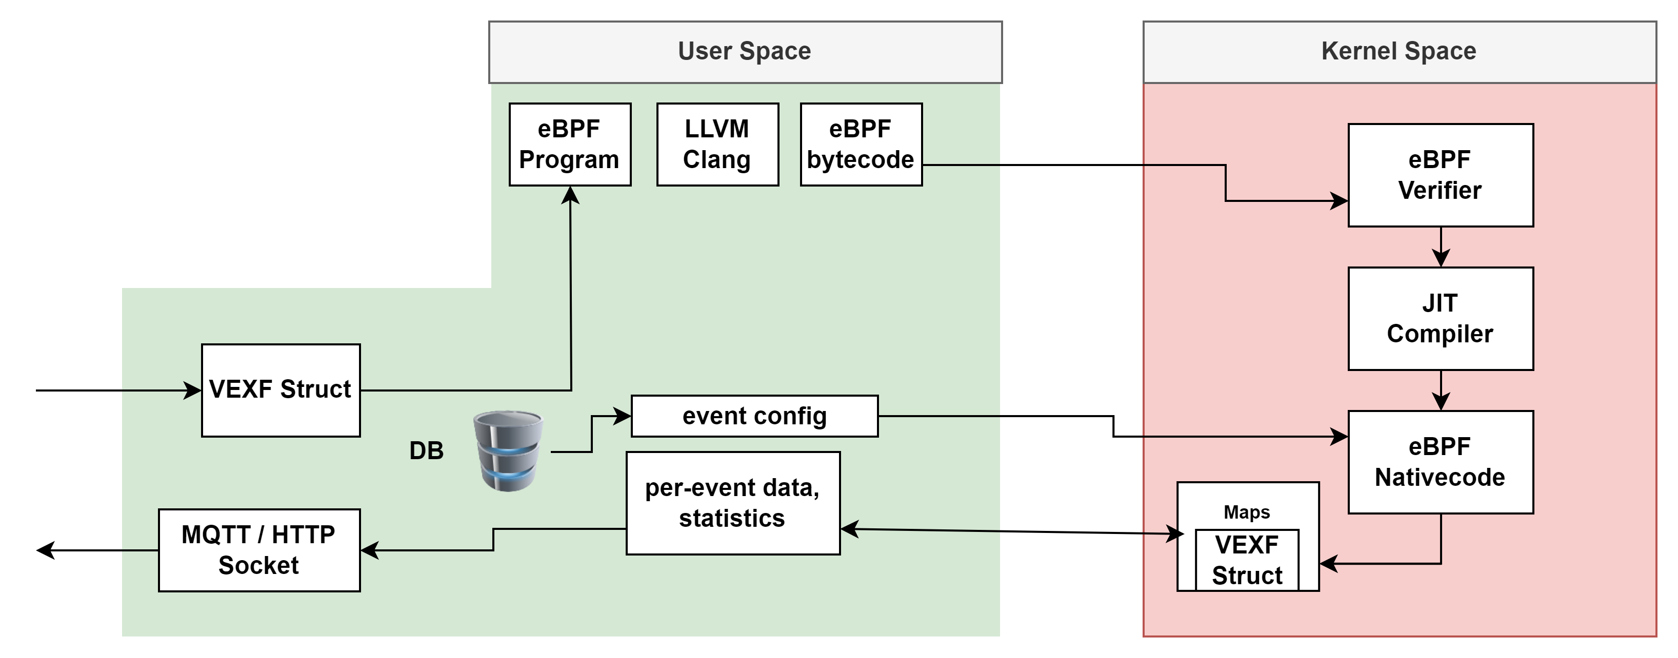
METHODOLOGY

Slide 10
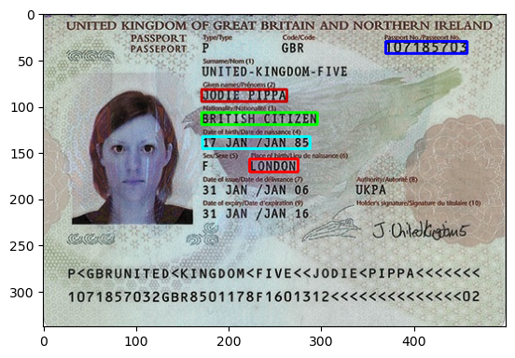
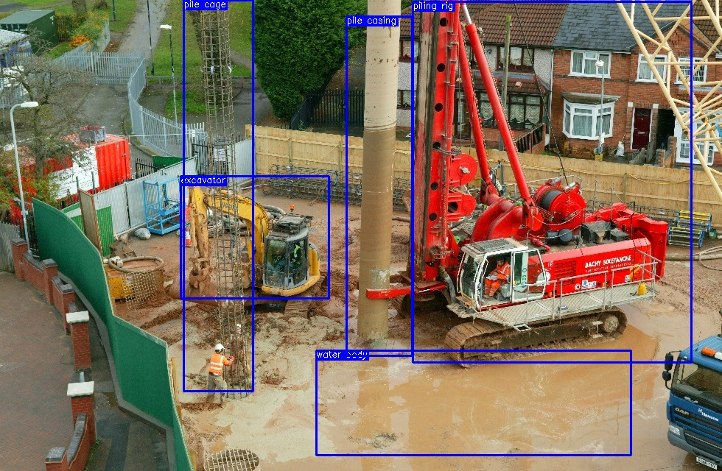

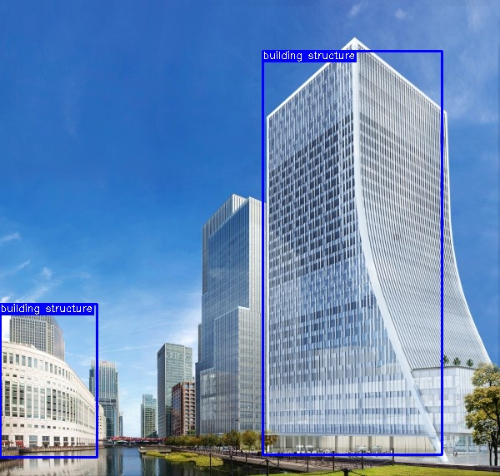
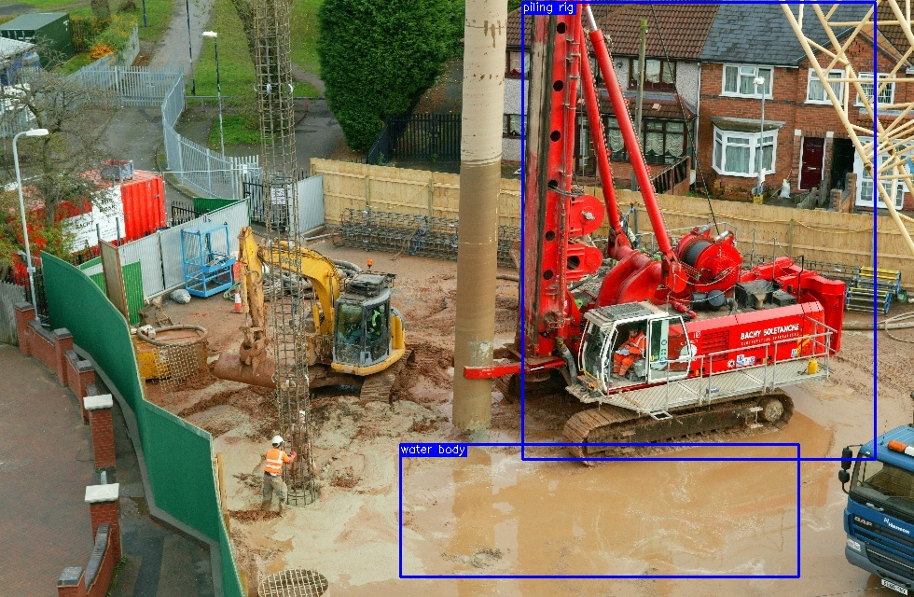
METHODOLOGY

Slide 11
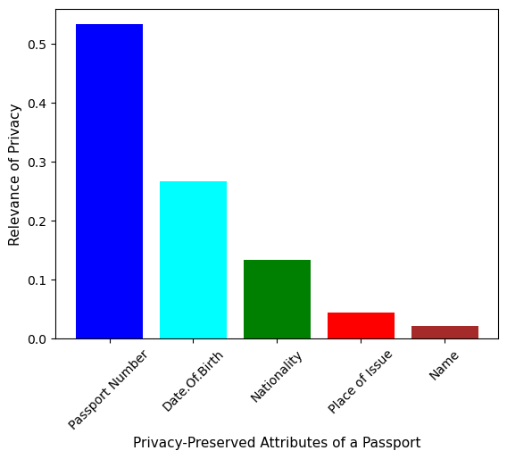
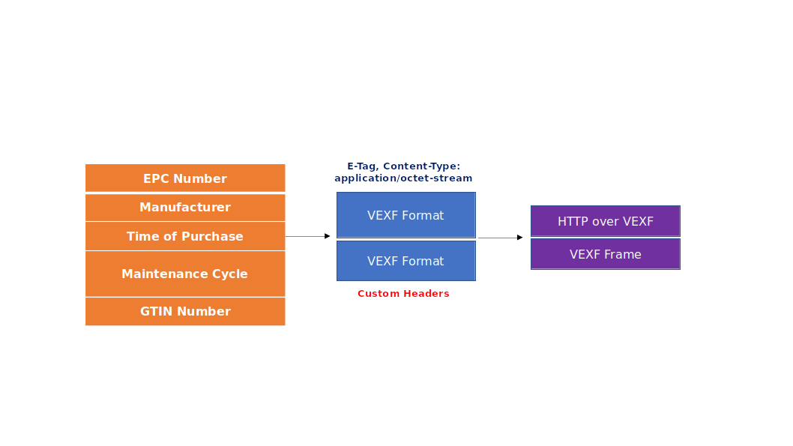
METHODOLOGY

Slide 12
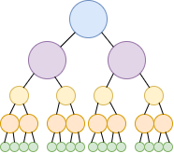
METHODOLOGY

Slide 13
METHODOLOGY
VEXF Frame
Discoverability by HTTP Request-Response using ETag(s)
ioctl Request
Observability by Parts
eBPF (extended Berkley Packet Filter)

Slide 14
WORKING PROTOTYPE
https://documents-secure-scanned.glide.page

Slide 15
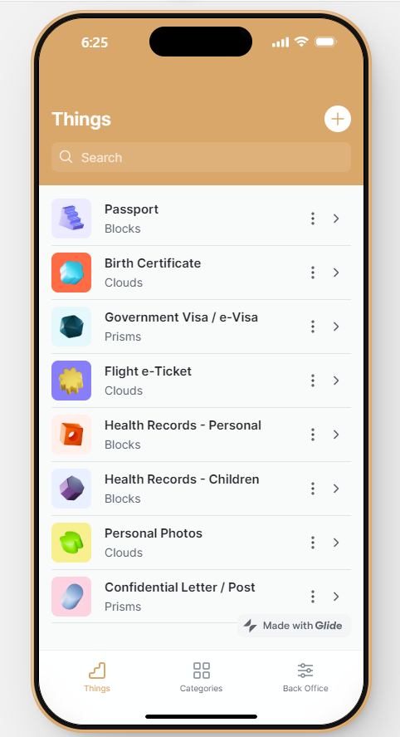
Attachments

