Slide 1
Bank Management System
Done By
- Aditya Goel
- Aswin VB
- Aswanth K
- Druval CR
- Komal Goenka

Slide 2

Table Of Contents
Objective & Scope of the Project
Problem Definition
UML Diagrams
Details of Hardware & Software used
ScreenShots
Data Dictionary

Slide 3
Objective & Scope of the Project
Objective
The main objective of the project is to computerize the processing of a small bank.
This system helps the user to maintain the records of a small bank.
The bank maintains the Account Holder details, Employee details and Transaction details.
Scope
This project is developed for a small bank.
Further, it can be easily customized for the use of any other bank.
This project will help them to create a working system into the latest concept of paper less office.

Slide 4
Problem Definition
The project “Bank Management System” shows a simple bank
Management procedure conducted in small banks.
The system should be developed to maintain the account holder records, employee records and their transaction details.
Account holder needs must be taken into account.
The system should be able to handle exceptional situations.

Slide 5
UML DIAGRAMS

Slide 6
UML DIAGRAMS
USE CASE DIAGRAM
CLASS DIAGRAM
ACTIVITY DIAGRAM
CRC DIAGRAM

Slide 7
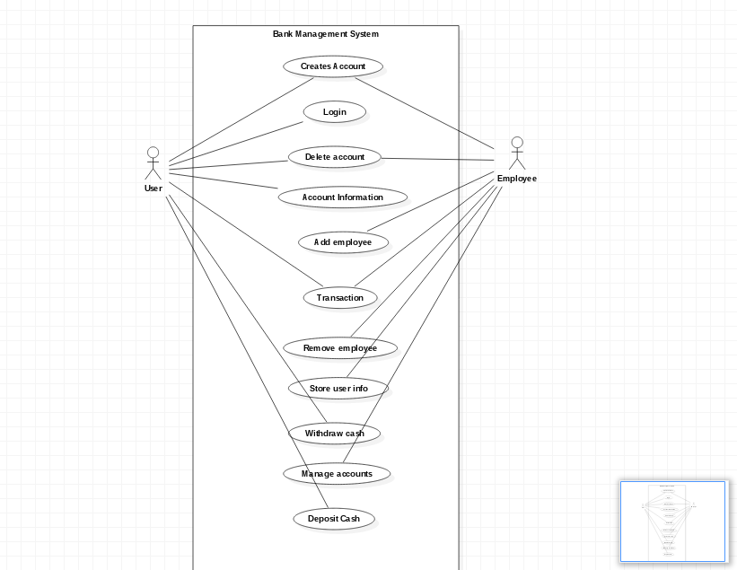
USE CASE DIAGRAM

Slide 8
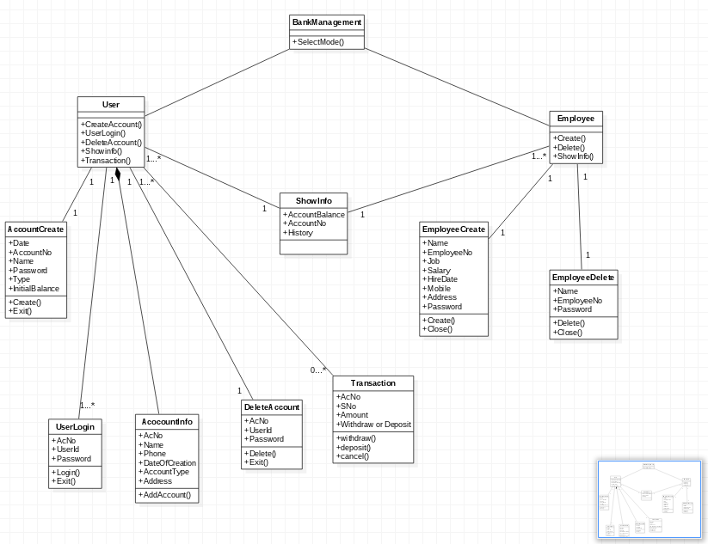
CLASS DIAGRAM

Slide 9
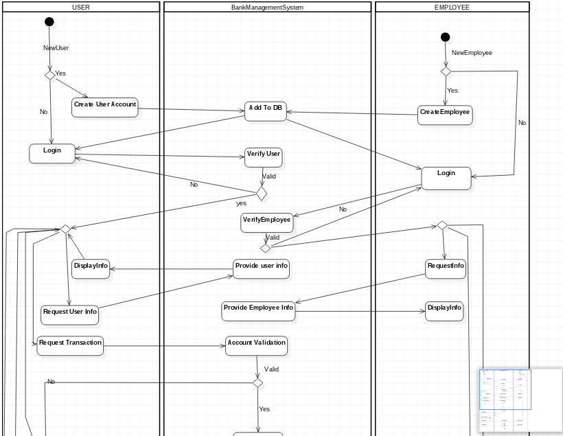
ACTIVITY DIAGRAM

Slide 10
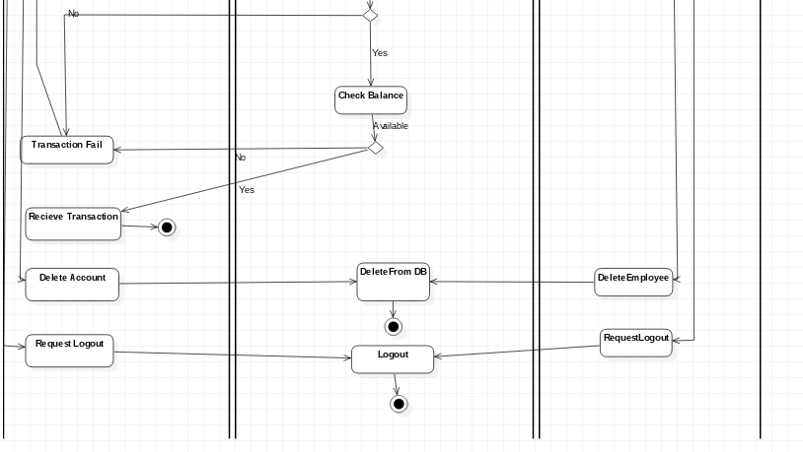
ACTIVITY DIAGRAM - CONT

Slide 11
CRC DIAGRAM
Doc File is Attached Along With this!

Slide 12
Details of Hardware & Software used
Java
NetBeans
MySQL

Slide 13
Screenshots

Slide 14
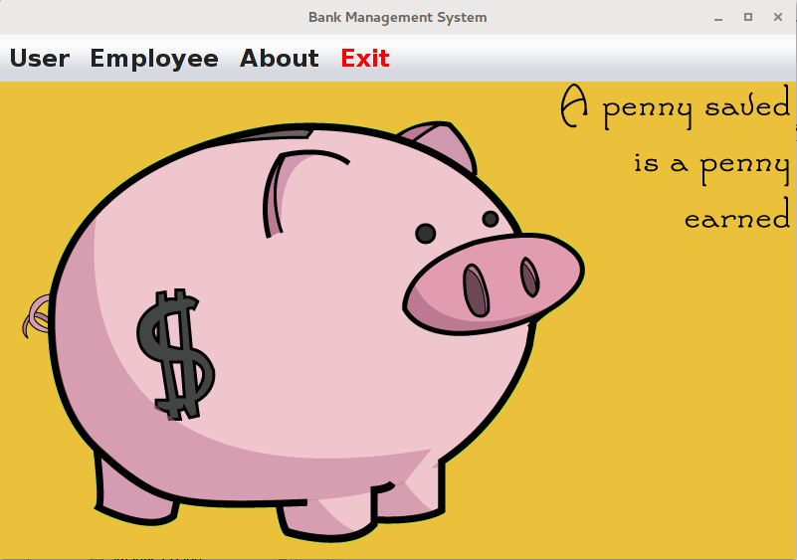
Landing Page

Slide 15
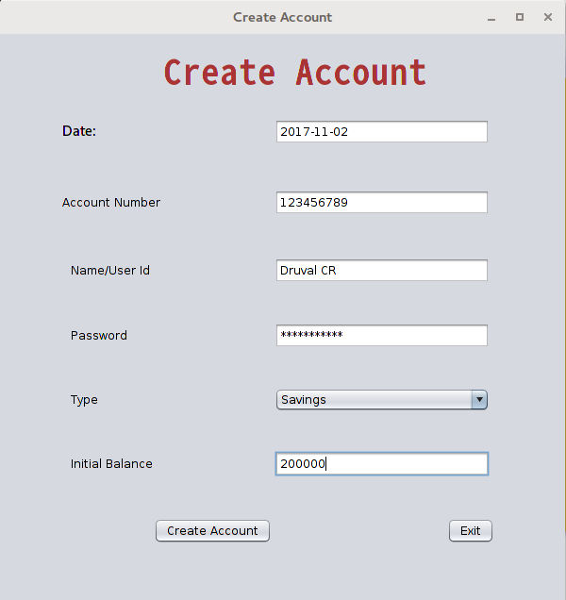
CREATE ACCOUNT

Slide 16
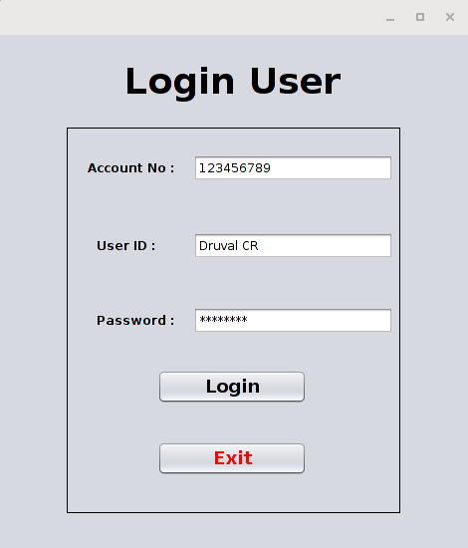
LOGIN USER

Slide 17
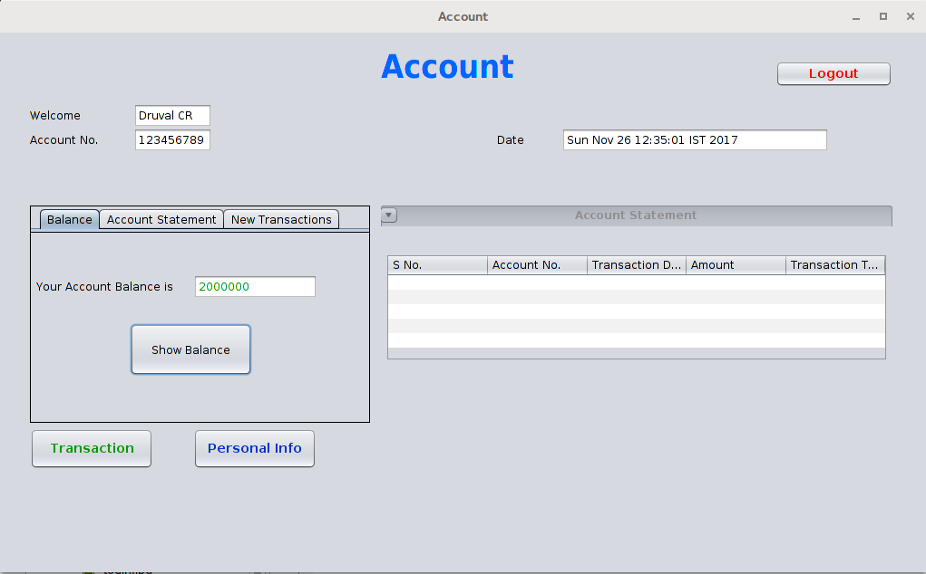
ACCOUNT

Slide 18
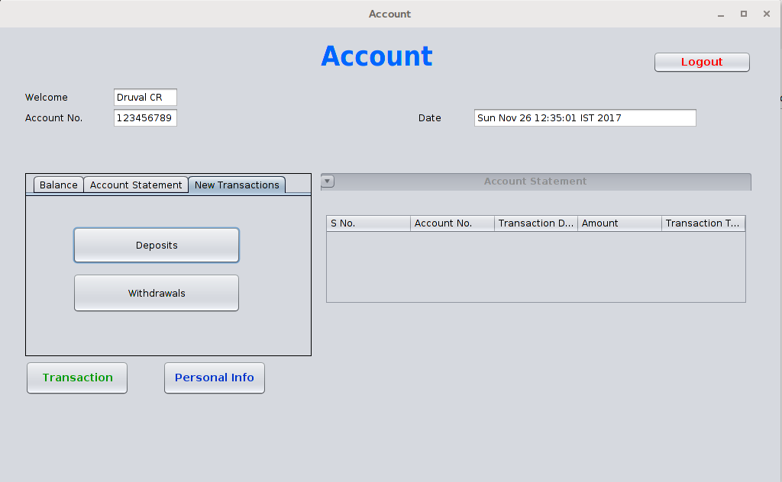
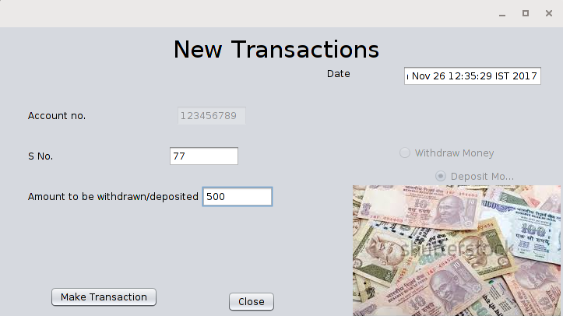
NEW TRANSACTIONS

Slide 19
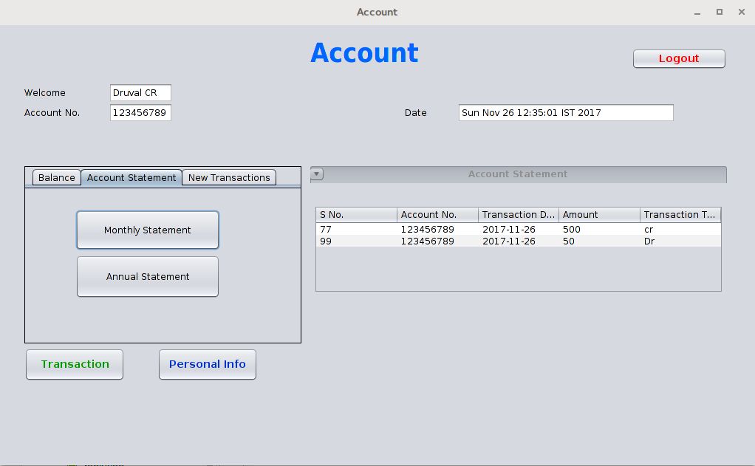
ACCOUNT STATEMENTS

Slide 20
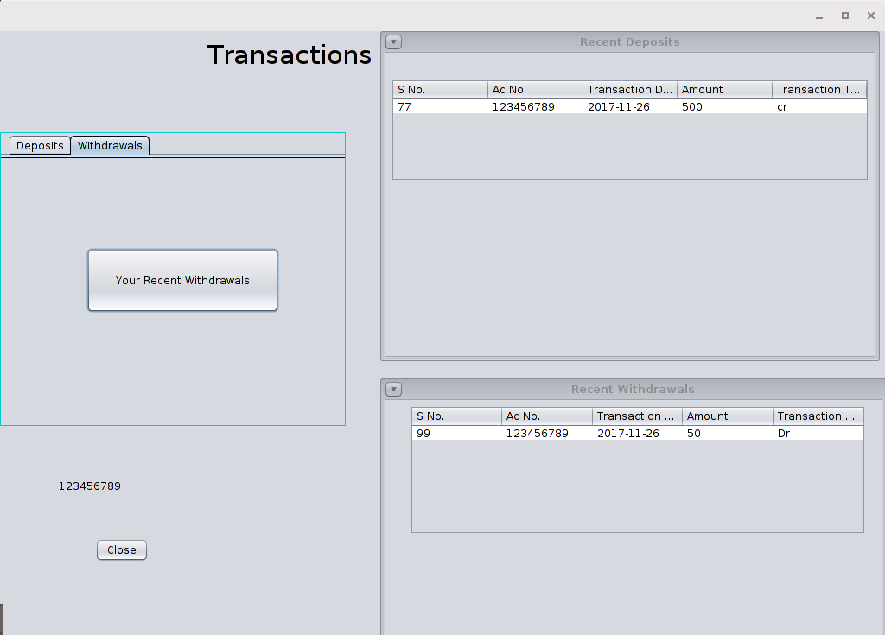
TRANSACTION DETAILS

Slide 21
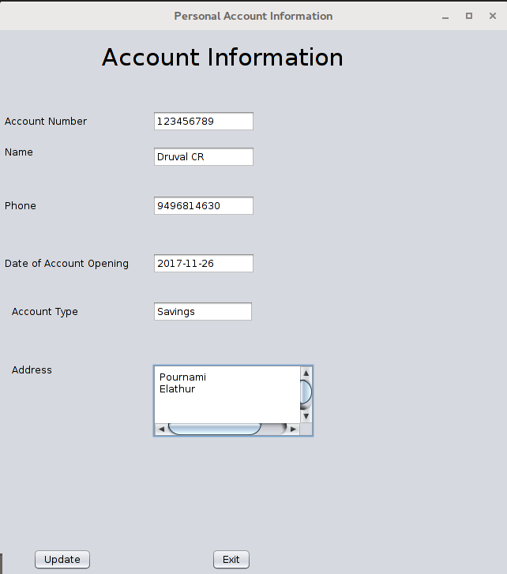
ACCOUNT DETAILS

Slide 22
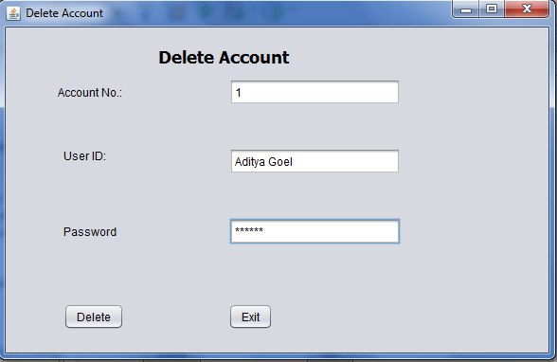
DELETE ACCOUNT

Slide 23
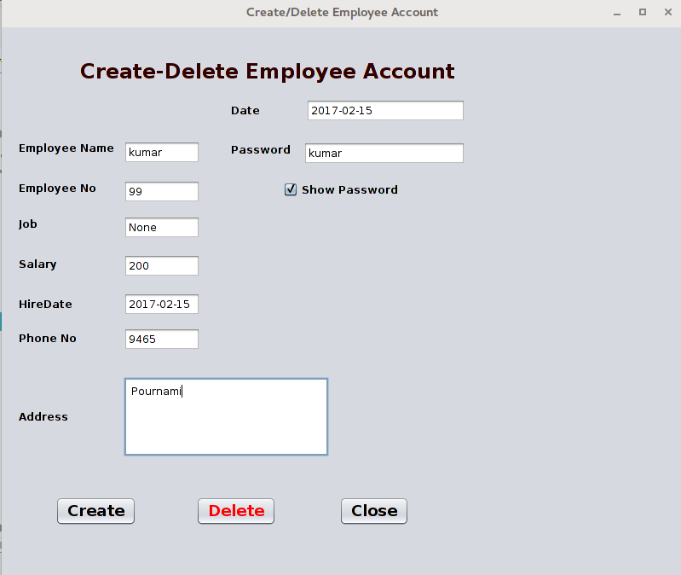
EMPLOYEE CREATION/DELETION

Slide 24
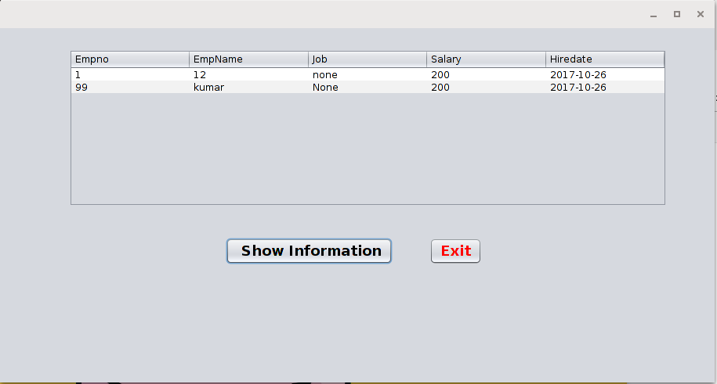
EMPLOYEE INFORMATIONS

Slide 25
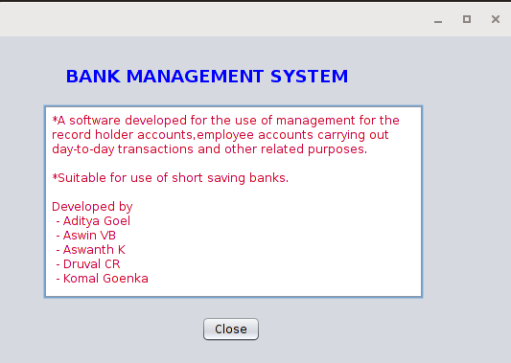
ABOUT :P

Slide 26
DATA DICTIONARY

Slide 27
DATA DICTIONARY
Various tables used in this project are as follows:
S# | Table Name | Uses
1 | Account | to store the Login details of Account Holders
2 | Account_Info | to store the account details of Account Holders
3 | Employees | to store the details of Employees
4 | Transaction | to store the details of all Transactions of the bank

Slide 28
Account Table
Data Name | Data type | Size | Remarks
AcNo | Integer | 6 | Primary Key
ID | Varchar | 30
Password | Varchar | 20

Slide 29
Account_Info Table
Data Name | Data type | Size | Remarks
AcNo | Integer | 6 | Foriegn Key(Account.AcNo)
Name | Varchar | 30
Address | Varchar | 50
Phone No | Integer | 10
Doac | Date
Typ | Varchar | 10
Balance | Float | 12,2

Slide 30
Employee Table
Data Name | Data type | Size | Remarks
EmpNo | Integer | 7 | Primary Key
EmpName | Varchar | 20
Job | Varchar | 20
Salary | Float | 10,2
HireDate | Date
Address | Varchar | 50
PhNo | Integer | 10
Password | Varchar | 20

Slide 31
Transaction Table
Data Name | Data type | Size | Remarks
SNo | Integer | 6 | Primary Key
AcNo | Integer | 6 | Foriegn Key(Account.AcNo)
Dot | Date
Amt | Float | 12,2
TType | Varchar | 2

Slide 32
Thank You!
Submitted By :-
ADITYA GOEL
ASWIN VB
ASWANTH K
DRUVAL CR
KOMAL GOENKA

