Slide 1
NLP EXPO

Slide 2
Data
Text / audio
Natural Language Processing
Audio
Speech Recognition
image/video
Computer Vision

Slide 3
Natural Language Processing

Slide 4
What is NLP?
NLP is a subfield of computer science, information engineering, and artificial intelligence
concerned with the interactions between computers and human languages
in particular how to program computers to process and analyze large amounts of natural language data.

Slide 5
how to process and analyze natural language data?
Answer: We Need Embedding Vectors

Slide 6
5 steps of AI/ML Lifecycle
Data processing
Feature Extraction
Apply ML Algorithms
Validation/Test Accuracy
Fine tuning

Slide 7
Which one playing major role here?
Answer: Data Processing & Feature Extraction

Slide 8
Data only Playing Major Role
Well Cleaned data and
Efficient Feature Embeddings will produce best results forever
Let’s Go For Feature Embeddings

Slide 9
Embedding
An embedding is a relatively low-dimensional space into which you can translate high-dimensional vectors.
Embeddings make it easier to do machine learning on large inputs like sparse vectors representing words.
A word embedding that is learned jointly with a neural network model on a specific natural language processing task, such as language modeling or document classification.
It requires that document text be cleaned and prepared such that each word is one-hot encoded.

Slide 10
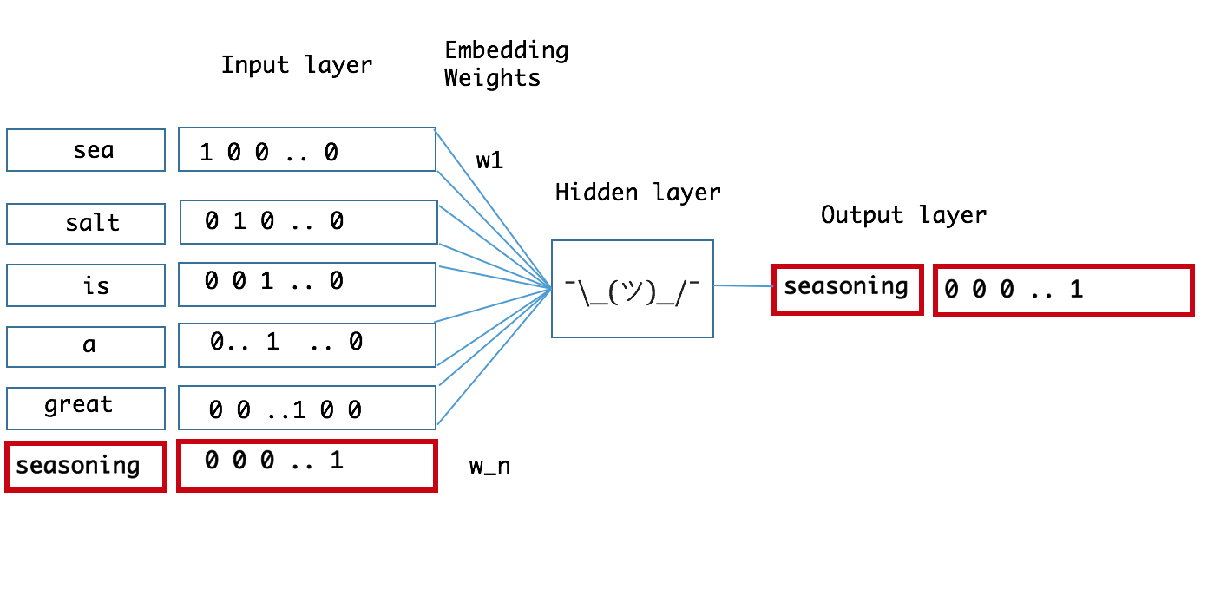

Slide 11
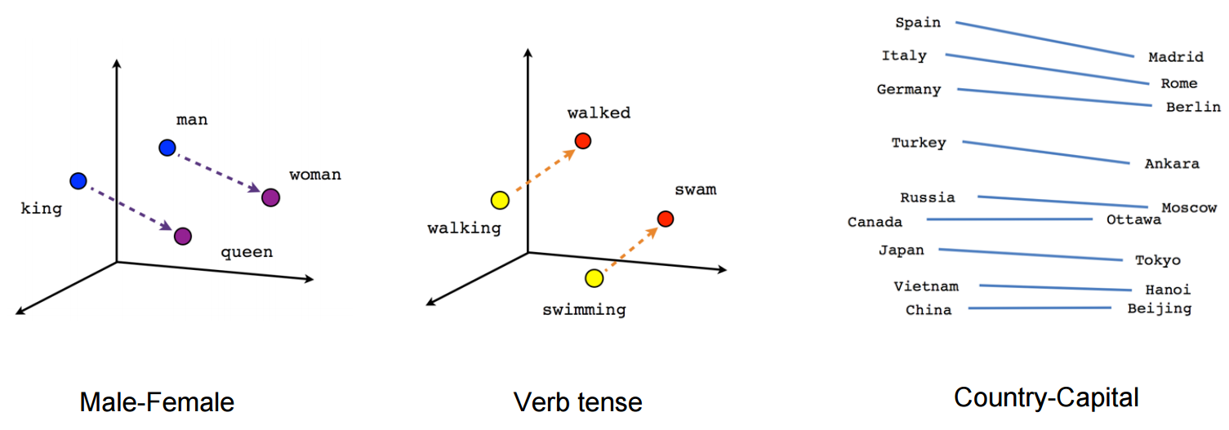

Slide 12
Word Embeddings
To use word embeddings, you have two primary options:
Use pre-trained models that you can download online (easiest)
Train custom models using your own data and the Word2Vec (or another) algorithm (harder, but maybe better!).
Online training / Resuming training(Continue the training)

Slide 13
Pre-trained Word Embeddings
Using a pre-trained model removes the need for you to spend time obtaining, cleaning, and processing (intensively) such large datasets.
Pre-trained models are also available in languages other than English, opening up multi-lingual opportunities for your applications.

Slide 14
Pre-trained Word Embeddings
The disadvantage of pre-trained word embeddings
the words contained within may not capture the peculiarities of language in your specific application domain.
Wikipedia may not have great word exposure to particular aspects of legal doctrine or religious text, so if your application is specific to a domain like this, your results may not be optimal due to the generality of the downloaded model’s word embeddings.

Slide 15
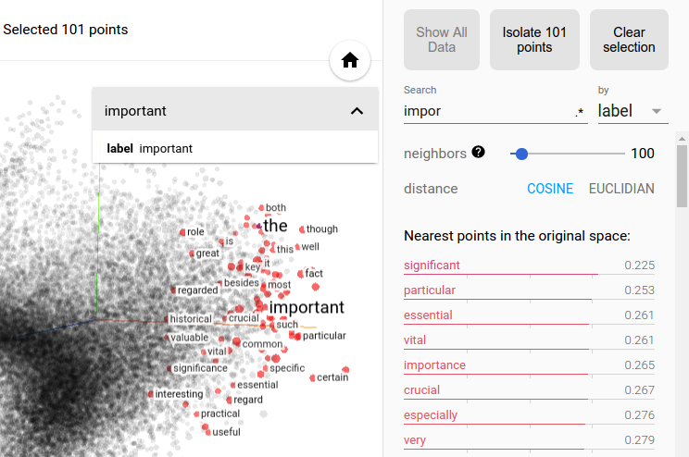
Word Embeddings Visualization
Let’s try this:
https://projector.tensorflow.org/

Slide 16
What is Language Modelling?
A statistical language model is a probability distribution over sequences of words.
Given such a sequence, say of length m, it assigns a probability to the whole sequence.
The language model provides context to distinguish between words and phrases that sound similar.
language models have played a key role in traditional NLP tasks such as speech recognition, machine translation, or text summarization. training better language models improves the underlying metrics of the downstream task (such as word error rate for speech recognition, or BLEU score for translation), which makes the task of training better LMs valuable by itself.

Slide 17
Language Modelling Algorithms
One-hot encoding
Skip-gram
CBOW
Nagative Sampling
Hierarchy Softmax

Slide 18
Open Source Libraries
Gensim
NLTK
Spacy
Open Source Community
Word2Vec, BERT - Google
GLoVe - Stanford NLP
Fasttext - Facebook AI Research
ELMo - AllenNLP
GPT-2 - OpenAI

Slide 19
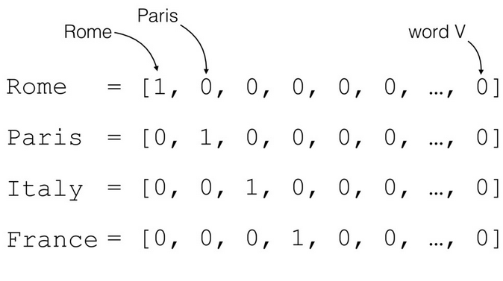
Onehot Encoding
One hot encoding is a process by which categorical variables are converted into a form that could be provided to ML algorithms to do a better job in prediction.

Slide 20
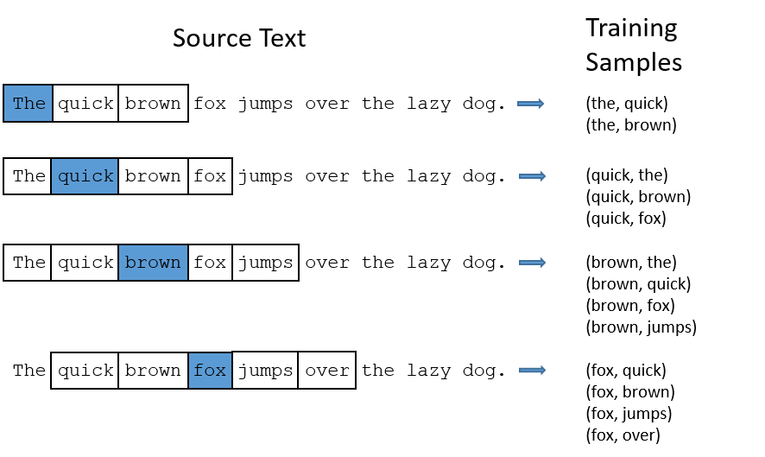
Skip-gram
find word representations that are useful for predicting the surrounding words in a sentence or a document. given a sequence of training words is to maximize the average log probability

Slide 21
Continues Bag of Words
The CBOW model architecture tries to predict the current target word (the center word) based on the source context words (surrounding words).
The bag-of-words model is used to represent an unordered collection of words as a vector.
One of the most common uses is for simple document classification, an example of this might be the task of classifying an email as spam.

Slide 22
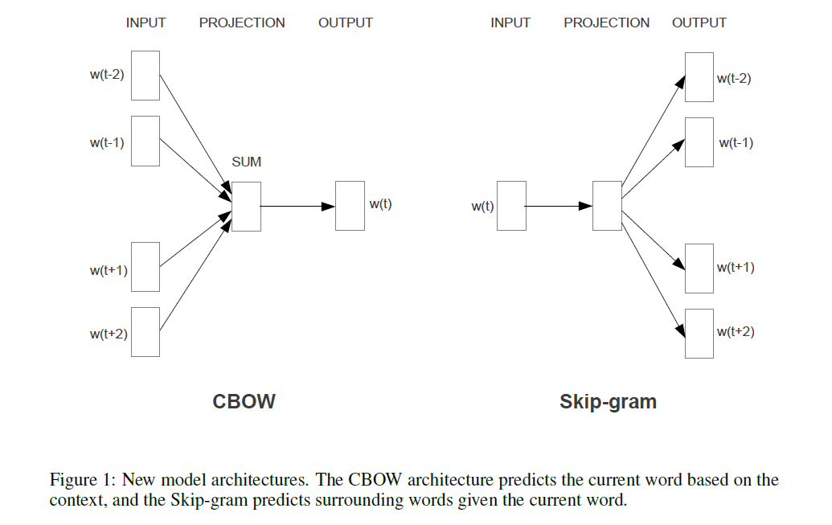

Slide 23
Any Questions and Doubts?

Slide 24
We will go for Practical Session :):):)

