Slide 1
PROJECT PRESENTATION
WORKHIVE
Freelancing & Escrow
Collaboration Platform
A MERN-stack marketplace connecting clients and freelancers.
TEAM DETAILS
GitHub: aswitha16-dappini/workhive
Team name: TrioTech
D.Aswitha-241FA04098
M.Thanuja-241FA04435
P.Akshaya-241FA04A62
Live demo: workhive-black.vercel.app
01/10

Slide 2
Introduction & Problem Statement
A focused workflow for freelance projects
THE PROBLEM
THE WORKHIVE SOLUTION
Clients can find it difficult to discover suitable talent, compare proposals and monitor delivery. Freelancers may face unclear requirements, scattered communication and uncertainty around payments.
WorkHive brings project discovery, proposal bidding, milestone tracking and a simulated escrow process into one role-based platform.
A connected project lifecycle
CLIENT
FREELANCER
AGREEMENT
DELIVERY
PAYMENT
Post project
Submit proposal
Accept bid
Complete milestones
Approve release
Escrow is represented as a simulated workflow in this student project; it is not real-money payment processing.
02/10

Slide 3
Project Objectives
The outcomes WorkHive aims to deliver
01 Connect both roles
Separate client and freelancer accounts, profiles and dashboards.
02 Simplify hiring
Let clients publish projects and freelancers browse opportunities.
03 Structure proposals
Support bids with pricing, delivery estimates and cover letters.
04 Track project delivery
Organize work into milestones and support submission and review.
05 Build trust and control
Use JWT authentication, role-based access and a simulated escrow flow.
03/10

Slide 4
Technologies & Tools Used
MERN stack and supporting development tools
FRONTEND
BACKEND
DATABASE
React 19
Vite • React Router • Axios
Responsive user interface
Node.js + Express
REST API • Routes • Controllers
Middleware and CORS
MongoDB Atlas
Mongoose ODM
Cloud document database
SECURITY
DEPLOYMENT
TOOLS
JWT + bcryptjs
Token-based authentication
Password hashing and role checks
Vercel + Render
Frontend hosting on Vercel
Backend service on Render
GitHub + npm
Version control and collaboration
Dependency and script management
MERN = MongoDB • Express.js • React • Node.js
04/10

Slide 5
System Architecture & Workflow
High-level application flow
USER
REACT SPA
EXPRESS API
MONGODB
Client / Freelancer
Pages • Router • Context
Routes • Controllers • Middleware
Mongoose models • Atlas
JSON requests and responses over HTTP / HTTPS
Typical user workflow
STEP 1
STEP 2
STEP 3
STEP 4
STEP 5
Register / login
Post or browse projects
Submit / accept proposal
Complete milestones
Review & release simulated funds
Protected API routes check the JWT identity and user role before allowing private actions.
05/10

Slide 6
Features & Functionalities
Main modules of the WorkHive platform
Authentication
Profiles
Client / freelancer registration, login, JWT tokens and role-based routing.
Freelancer skills, bio, hourly rate, rating and portfolio; client profile details.
Project marketplace
Proposal bidding
Project publishing, category browsing, keyword search and filters.
Bid amount, estimated timeline and cover letter submission.
Milestone collaboration
Simulated escrow
Milestone status, deliverable notes or links and client approval.
Proposal acceptance starts a simulated locked-funds flow; approval marks release.
06/10

Slide 7
Database Design & API Integration
Document models and REST API layers
Main data models / collections
API integration structure
Routes
User
Map URLs to HTTP operations
Account, role, email and hashed password
Controllers
Project
Handle auth, project, proposal and milestone logic
Owner, title, category, budget and skills
Middleware
Proposal
Project, freelancer, bid, timeline and cover letter
JWT verification and role authorization
Milestone
Axios
Frontend API communication
Contract, title, status and deliverables
Profiles
Mongoose
Read and write MongoDB documents
Freelancer and client profile information
React UI → Axios → Express route → Controller → Mongoose → MongoDB Atlas
07/10

Slide 8
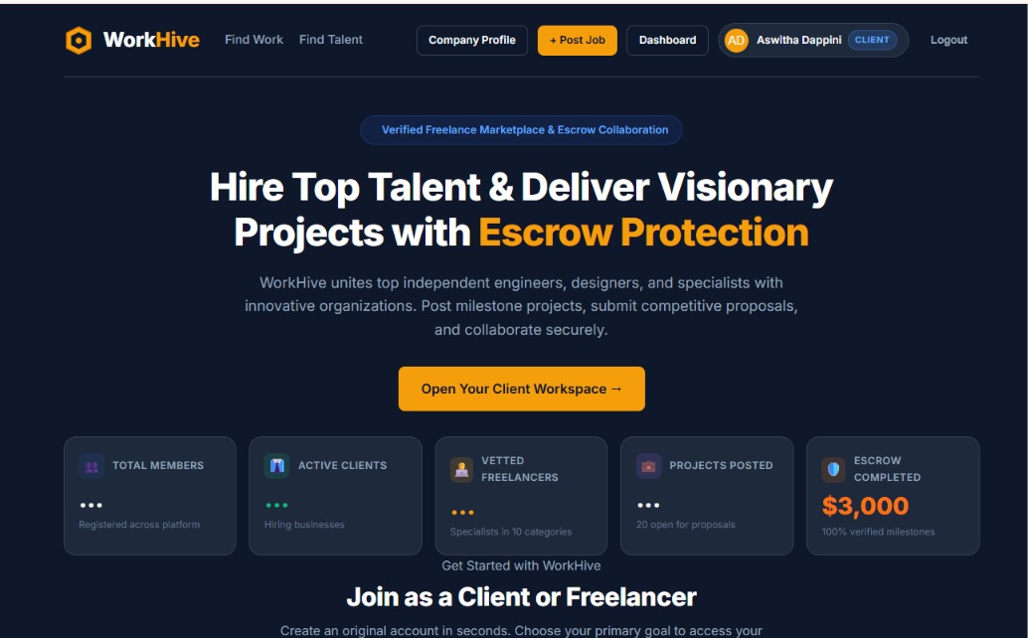
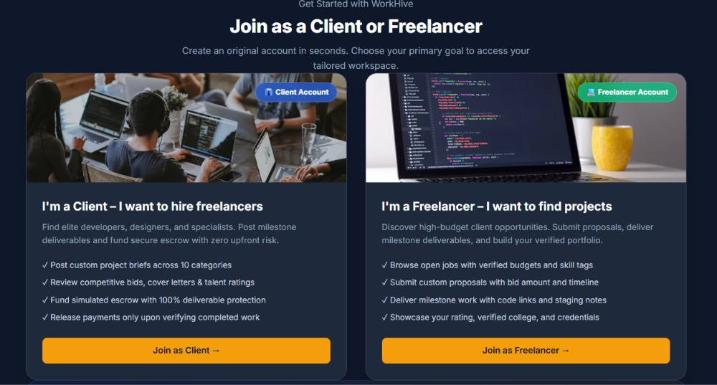
Project Screenshots
Live application: https://workhive-black.vercel.app
08/10

Slide 9
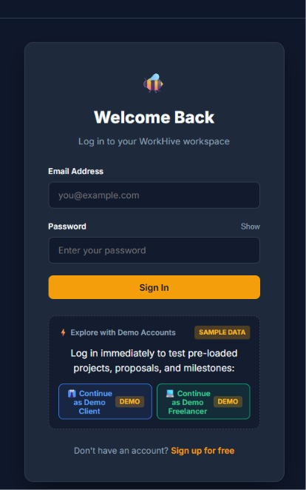
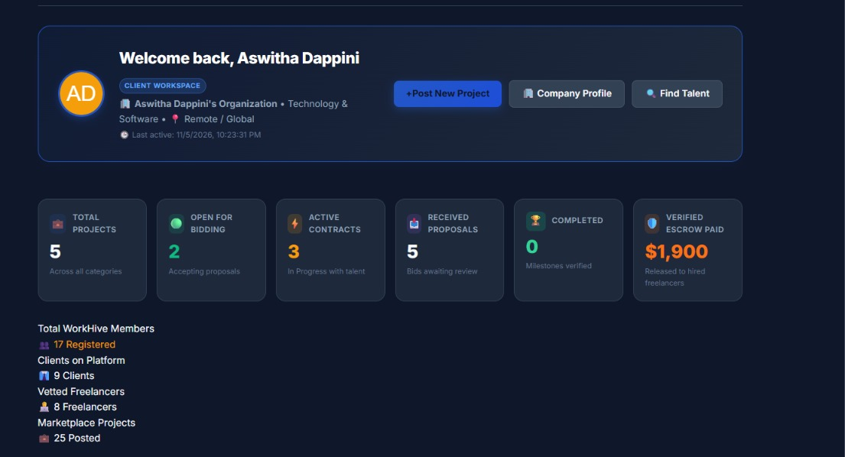
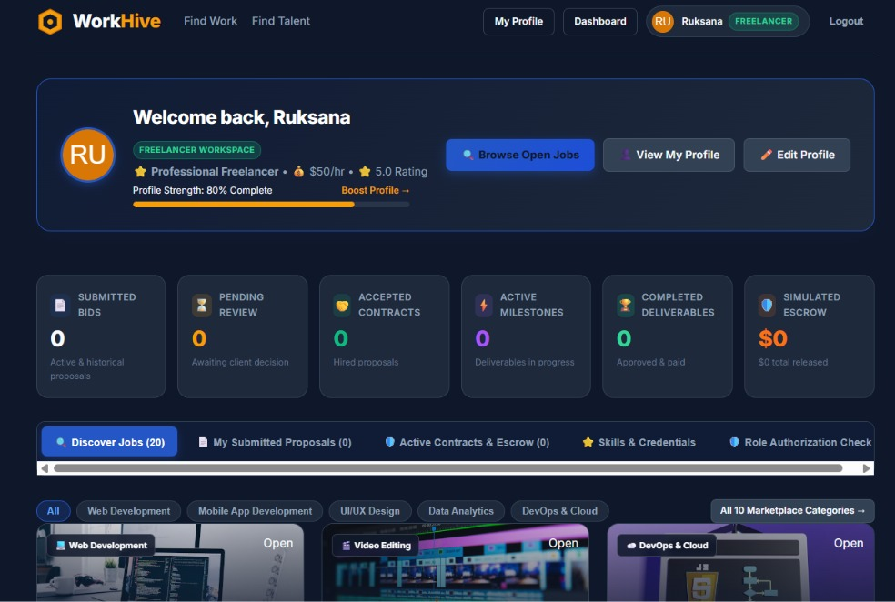
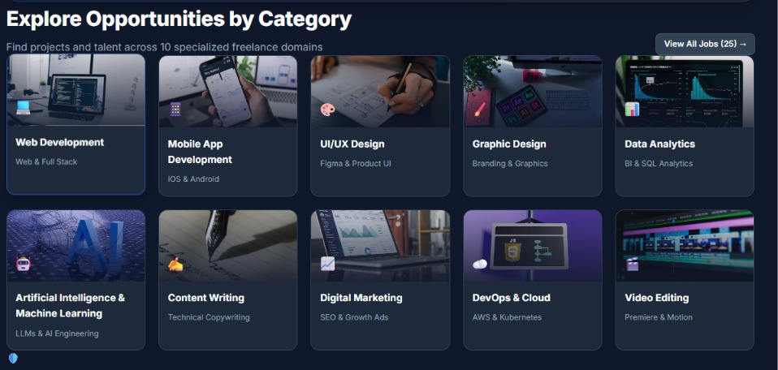

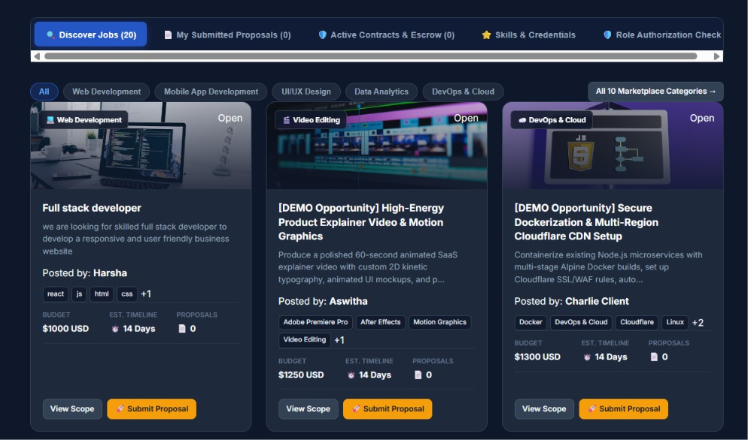

Slide 10
Challenges Faced & Future Scope
Lessons from implementation and possible improvements
CHALLENGES
FUTURE ENHANCEMENTS
• Designing separate experiences for clients and freelancers
• Securing private API endpoints with JWT and role checks
• Coordinating project, proposal and milestone states
• Configuring frontend / backend deployment and environment variables
• Keeping escrow clearly simulated
• Integrate a compliant real payment gateway
• Add real-time chat and notifications
• Introduce reviews and dispute resolution
• Expand admin tools, analytics and reports
• Improve automated testing, audit logs and accessibility
09/10

Slide 11
PROJECT SUMMARY
One platform.
A clearer way to collaborate.
WorkHive demonstrates how a MERN-stack application can connect clients and freelancers through project discovery, structured bidding, milestone-based delivery and a simulated escrow workflow.
01
02
03
Role-based marketplace
Organized project lifecycle
Secure API foundation
Thank you
GitHub: aswitha16-dappini/workhive
10/10

