Slide 1
Ray Tracing with Global Illumination
Presented by: Xiang yu 109417626
Based on course: Computer graphics
Advised by: Professor hong qin

Slide 2
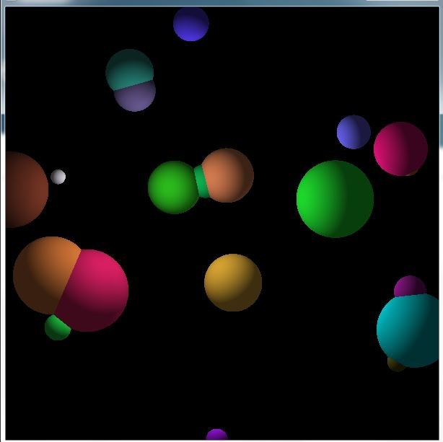
Program Results
One Point Light
Simple Ambient Light

Slide 3
Progress Report (1) Syllabus
1. Designed and Implemented the bone skeleton structure of our ray tracing system
2. Used 20+ Classes and 2000+ lines of Codes to build the whole system
3. Demo with objects of simple materials (matte) and simple lights (point light and simple ambient light)
4. Simple View with Orthogonal View Plane

Slide 4
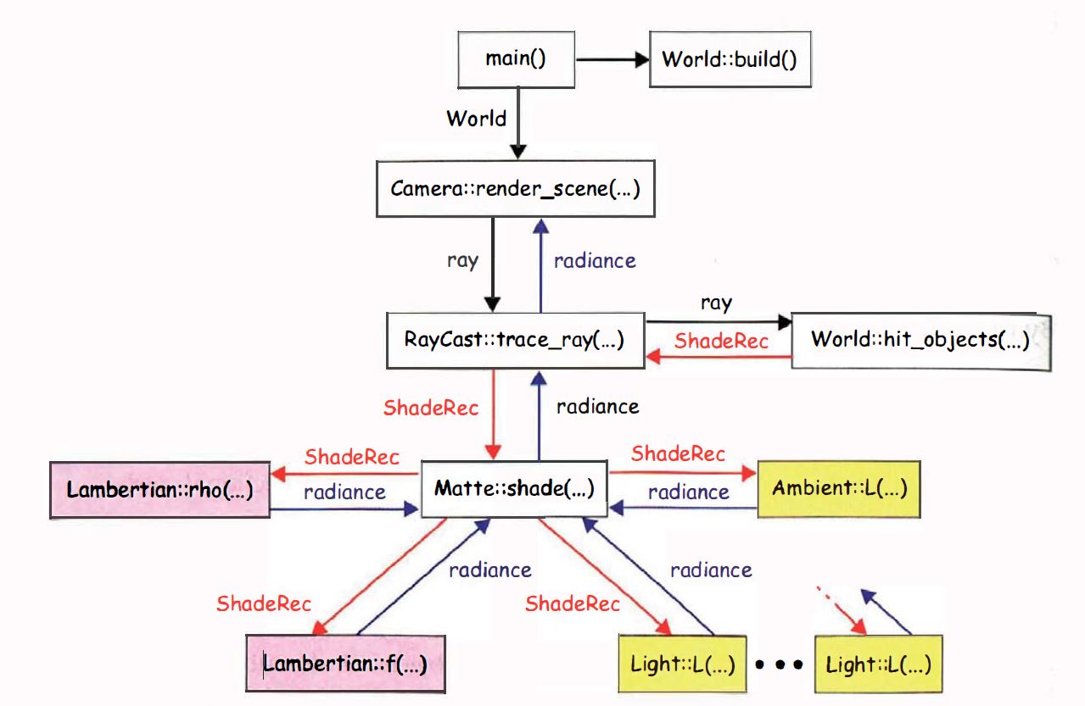
Progress Report (2) Skeleton

Slide 5
Progress Report (3) Classes
Basic Structure
Geometry
Point
Vector
Normal
Material
Matte
BRDF
Lambertian
GeometryObject
Sphere
Plane
Light
Ambient
PointLight
RGBColor
Ray Tracing Structure
Tracer
SimpleTracer
RayCast
ShadeRec
World
ViewPlane
Drawing

Slide 6
Future Structure
Camera
PinHole
Stereo
Material
Phong
BRDF
GlossySpecular
GeometryObject
Sphere
Plane
Light
Directional Light
Area Light
Sampler
(Several kinds of Samplers)
(For Anti-Aliasing)
Environmental Light
1. To improve the framework of the whole system
2. To add User-interface with interactive operations
3. To add other kinds of camera-views, objects(complicated, maybe with mesh), materials and lights
4. To implement global illumination (our key point)

Slide 7
Global Illumination
Traditional Approach
1. Light Transport
2. Path Tracing (for indirect illumination)
3. Sampling the Lights (for direct illumination)
Our proposed Approach
1. Use VPL(Vertical lane Launch) to simulate Global Illumination
2. Use Computer Techniques to accelerate ray tracing procedure (parallel computing and so on)

Slide 8
Thanks!
Future work will come soon…

