Slide 1
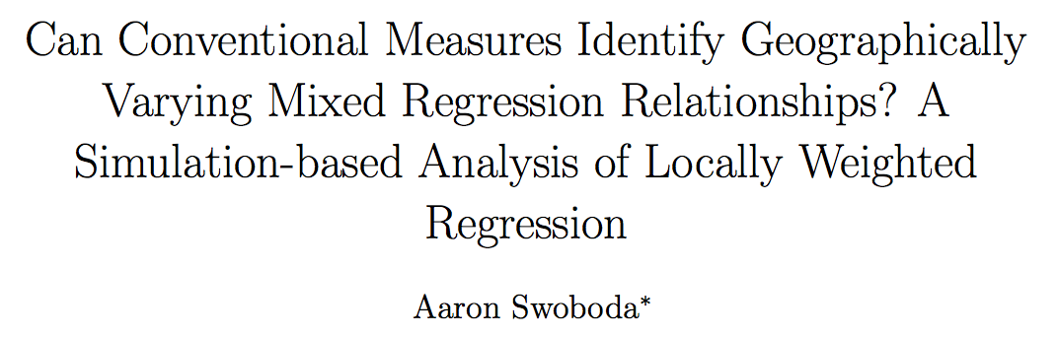



Slide 3
Locally Weighted Regression (LWR)
to the Rescue?

Slide 4

OLS
LWR

Slide 5
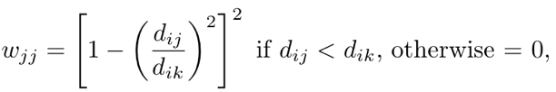
OLS
LWR

Slide 6
Bandwidths are commonly selected with…
Leave One Out Cross Validation
Akaike Information Criterion
Generalized Cross Validation
Standardized Cross Validation

Slide 7
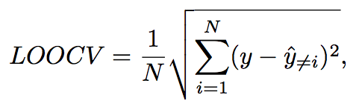

Slide 8
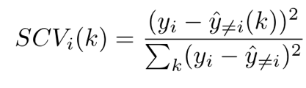



Slide 9
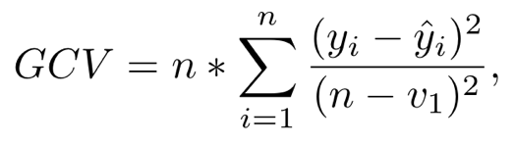

Slide 10


Slide 11

“Global” OLS
Mixed Models
“Local”Regression

Slide 12
“Global” OLS
Mixed Models
“Local”Regression

Slide 13
The Researcher’s Problem
Choose a bandwidth and a model

Slide 14
The Researcher’s Problem
Choose a bandwidth and a model
Can we do both with conventional metrics?

Slide 15
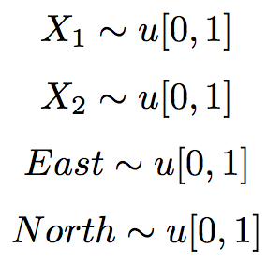

Experiment Data Generation Process

Slide 16

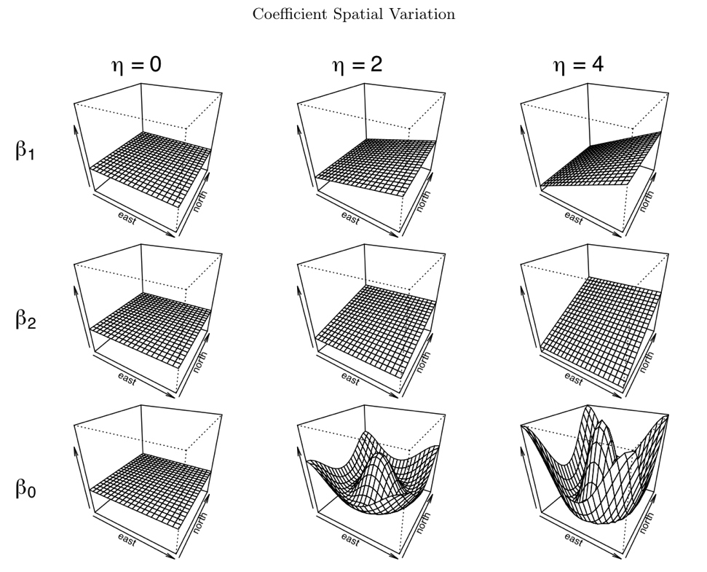
Global
Local
(more) Local

Slide 17


With Our Data…
Estimate all models
7 bandwidths each
50 combinations total

Slide 18
Calculate the values of the four metrics
(LOOCV, GCV, SCV, AIC)
Is the model with the optimized metric value the correct model?

Slide 19
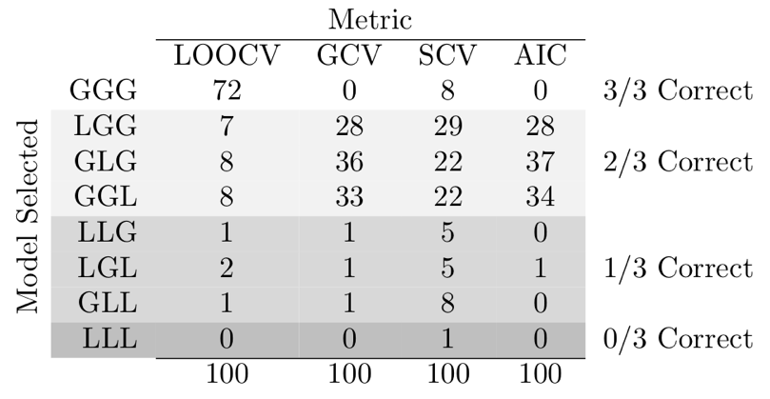
Start Simple… True Model: GGG

Slide 20
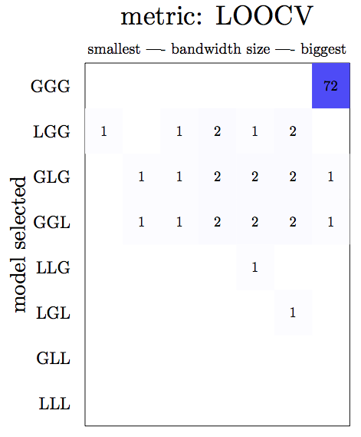
True Model: GGG

Slide 21
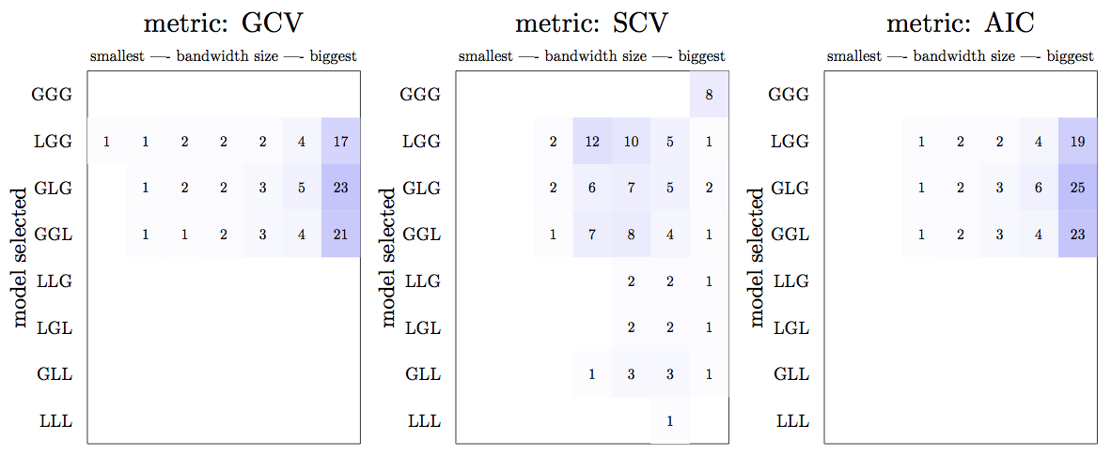
True Model: GGG

Slide 22
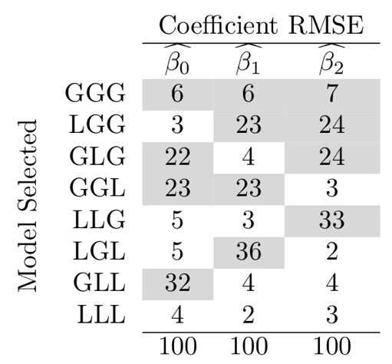
True Model: GGG

Slide 23
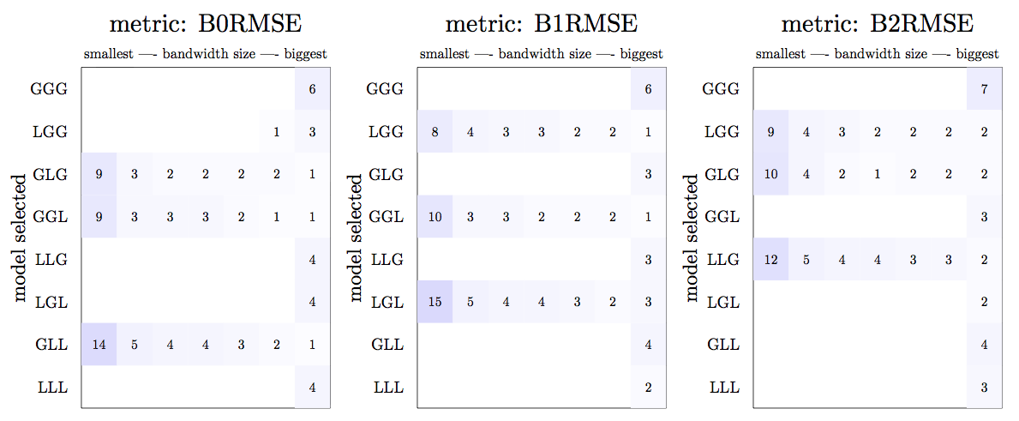
True Model: GGG

Slide 24
True Model: GGG
Most accurate coefficient estimates:
- Tend not to be the correct model
- Allow other coefficients to vary

Slide 25
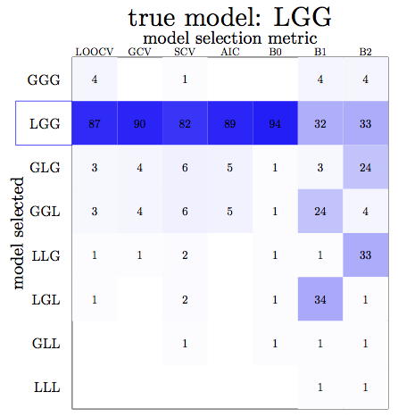

Slide 26
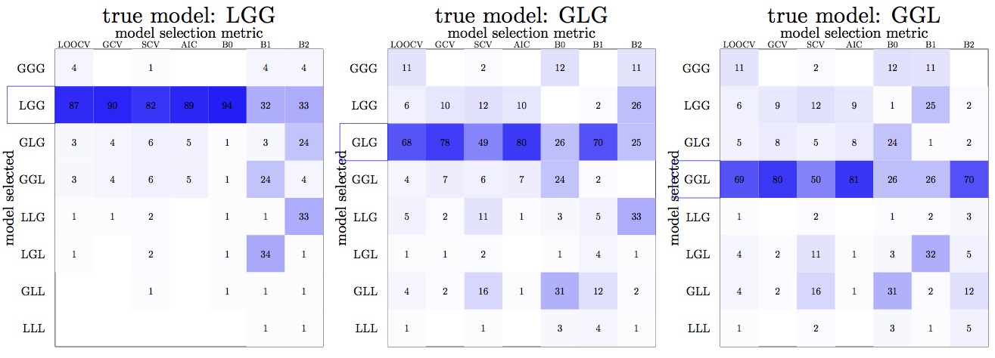

Slide 27
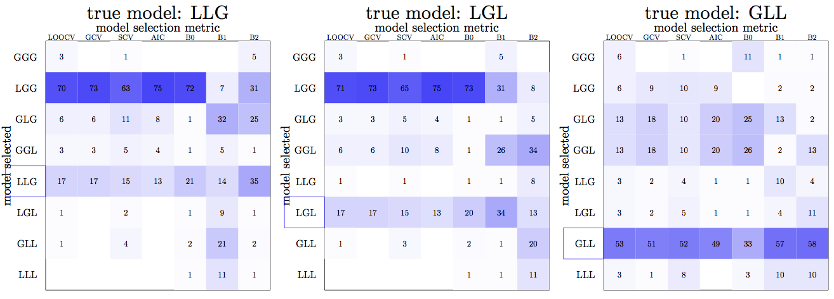

Slide 28
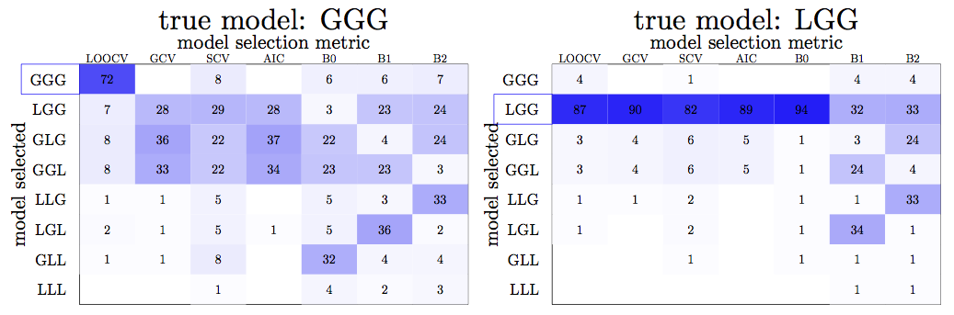

Slide 29
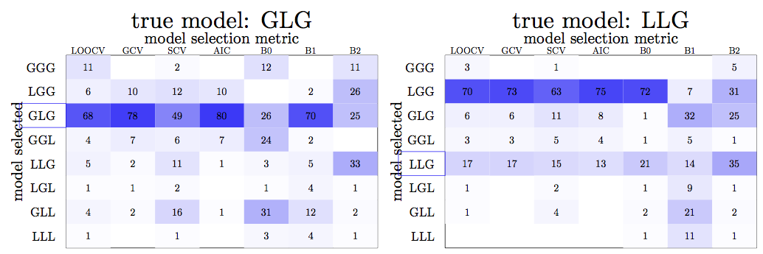

Slide 30
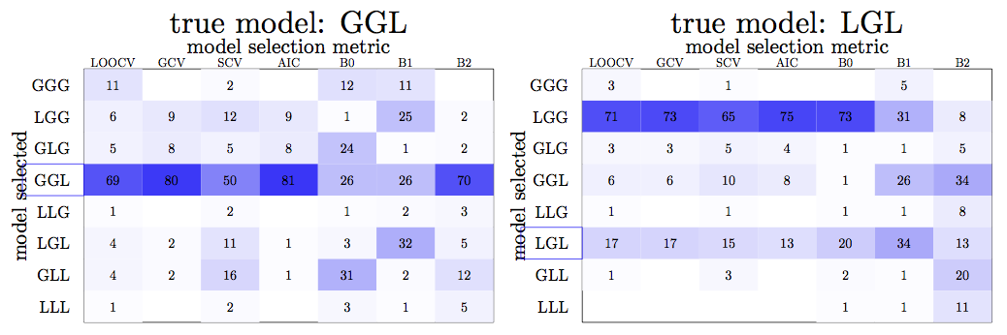

Slide 31
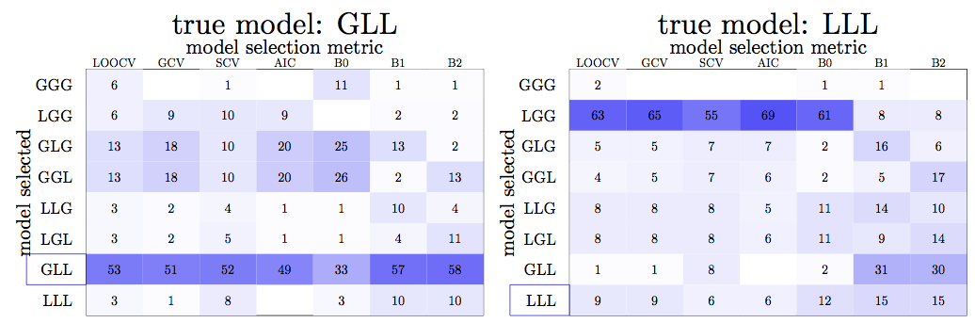

Slide 32
Some Conclusions and Questions
LOOCV is pretty good!

Slide 33
Some Conclusions and Questions
LOOCV is pretty good!
Most accurate coefficient estimates are
not necessarily from correct models.

Slide 34
Some Conclusions and Questions
LOOCV is pretty good!
Most accurate coefficient estimates are
not necessarily from correct models.
Are larger variances in some coefficients
driving the results?

Slide 35
Some Conclusions and Questions
LOOCV is pretty good!
Most accurate coefficient estimates are
not necessarily from correct models.
Are larger variances in some coefficients
driving the results?
Are coefficient estimates equally accurate
across metrics?

Slide 36
Some Conclusions and Questions
LOOCV is pretty good!
Most accurate coefficient estimates are
not necessarily from correct models.
Are larger variances in some coefficients
driving the results?
Are coefficient estimates equally accurate
across metrics?
What happens, ceteris paribus, with greater
error variance?

