Slide 1
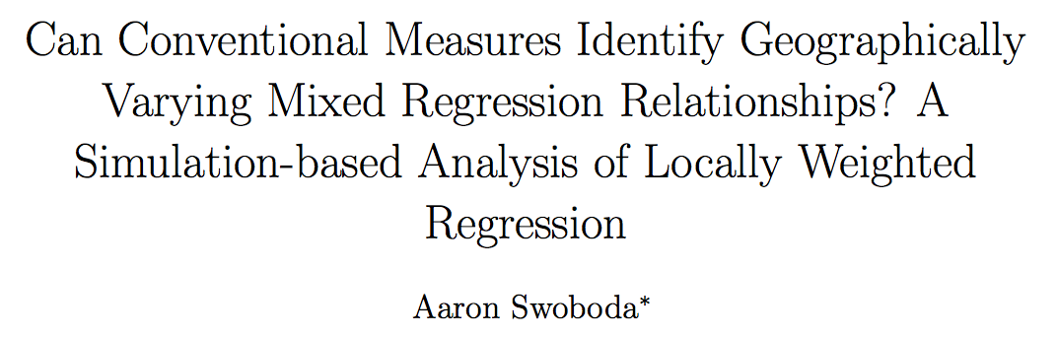



Slide 3
Locally Weighted Regression (LWR)
to the Rescue?

Slide 4

OLS
LWR

Slide 5
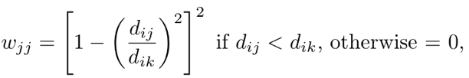
OLS
LWR

Slide 6
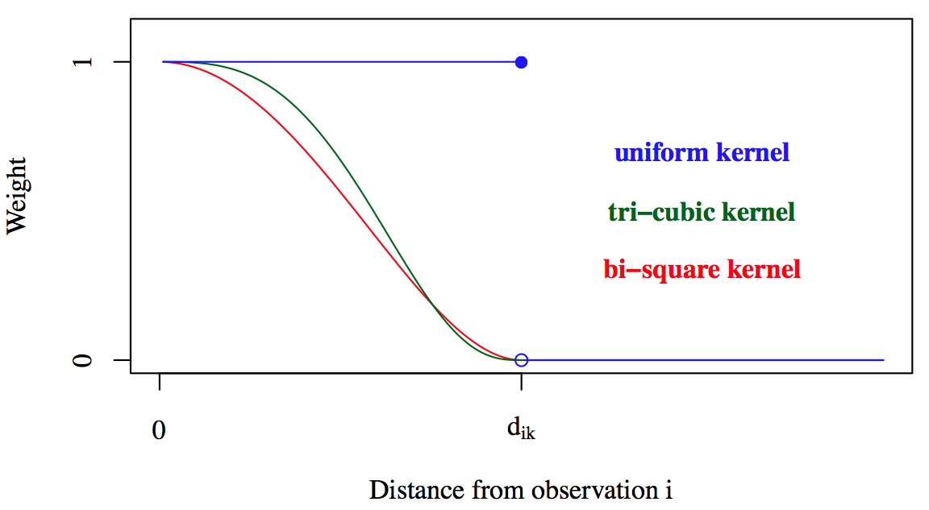

Slide 7
Bandwidths are commonly selected with…
Leave One Out Cross Validation
Akaike Information Criterion
Generalized Cross Validation
Standardized Cross Validation

Slide 8
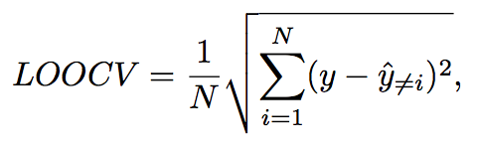

Slide 9
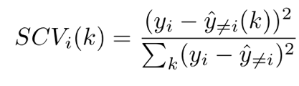



Slide 10
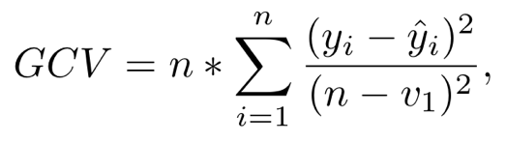

Slide 11
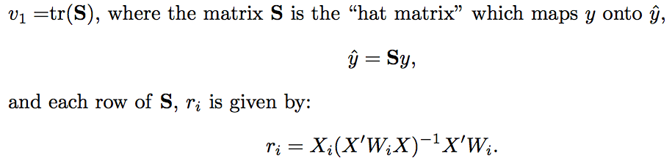

Slide 12


Slide 13

“Global” OLS
Mixed Models
“Local”Regression

Slide 14
“Global” OLS
Mixed Models
“Local”Regression

Slide 15
The Researcher’s Problem
Choose a bandwidth and a model

Slide 16
The Researcher’s Problem
Choose a bandwidth and a model
Can we do both with conventional metrics?

Slide 17
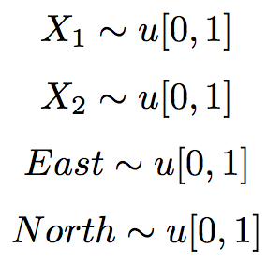

Experiment Data Generation Process

Slide 18

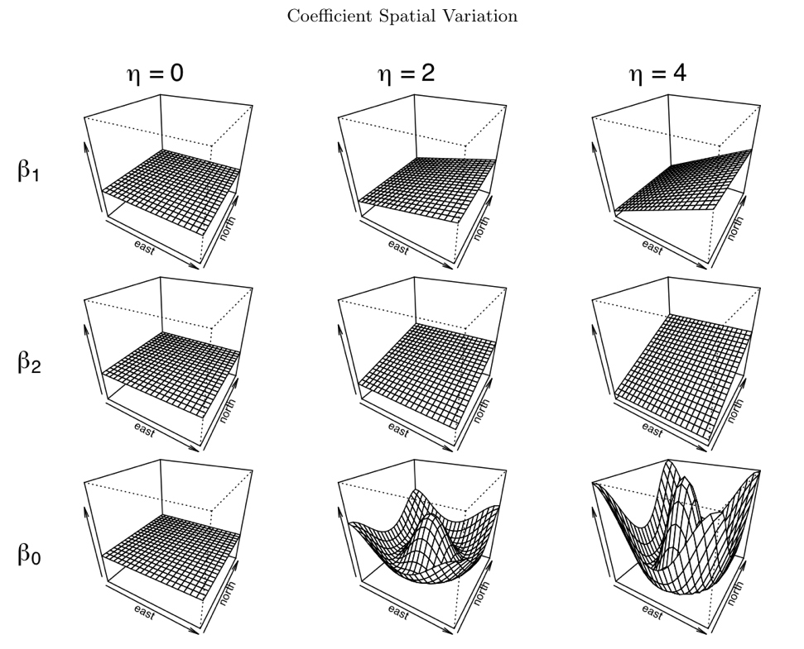
Global
Local
(more) Local

Slide 19


With Our Data…
Estimate all models
7 bandwidths each
50 combinations total

Slide 20
Calculate the values of the four metrics
(LOOCV, GCV, SCV, AIC)
Is the model with the optimized metric value the correct model?

Slide 21
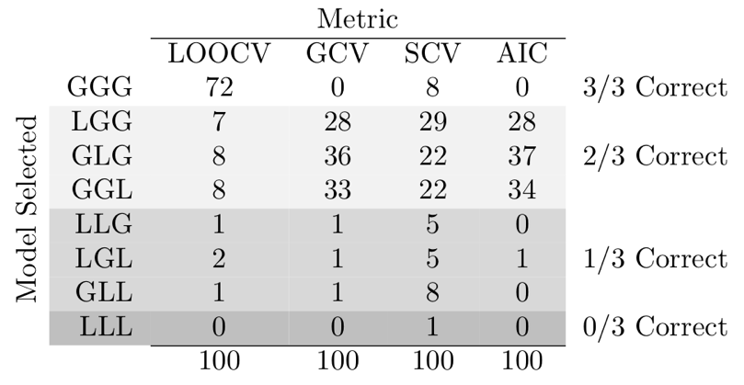
Start Simple… True Model: GGG

Slide 22
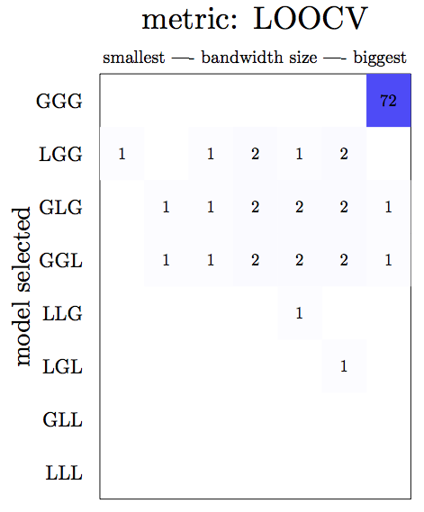
True Model: GGG

Slide 23
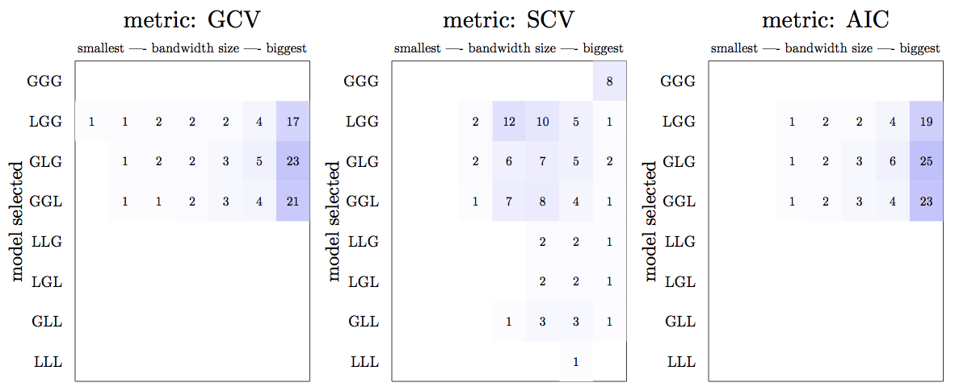
True Model: GGG

Slide 24
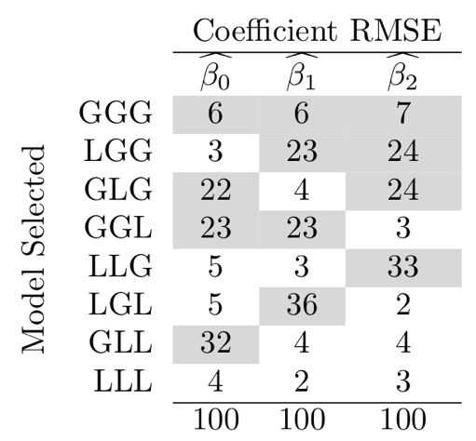
True Model: GGG

Slide 25
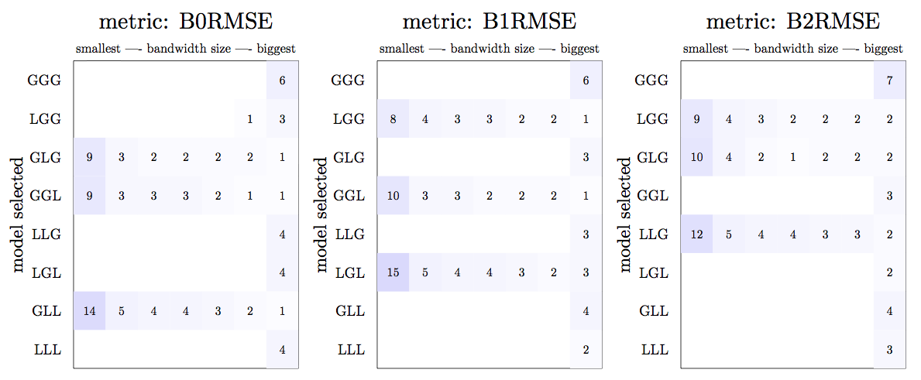
True Model: GGG

Slide 26
True Model: GGG
Most accurate coefficient estimates:
- Tend not to be the correct model
- Allow other coefficients to vary

Slide 27
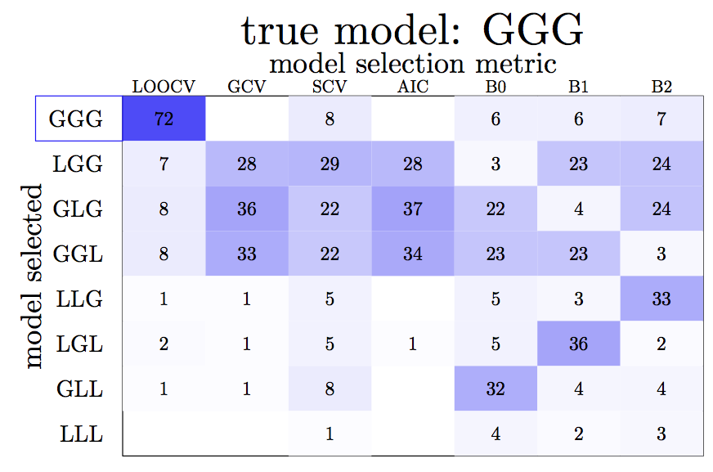

Slide 28
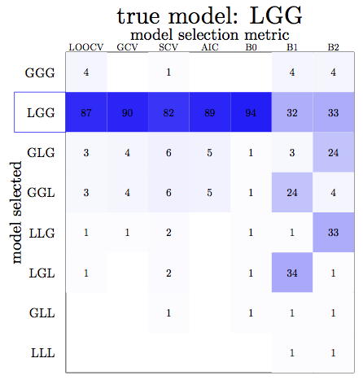

Slide 29
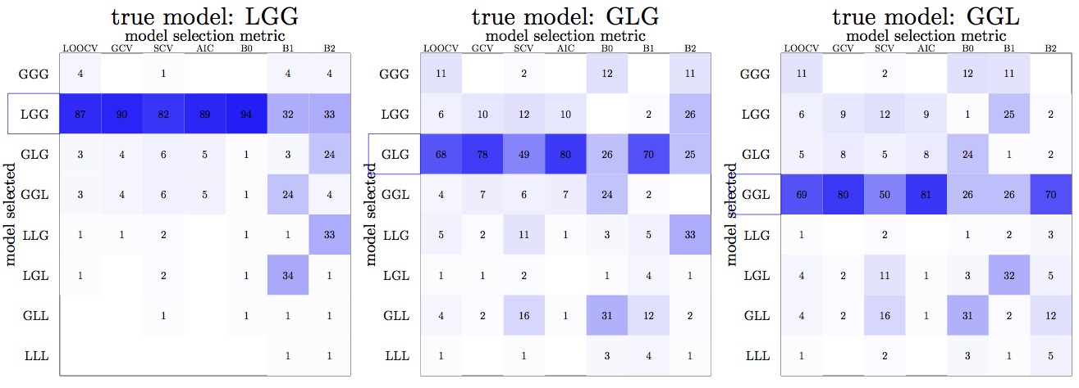

Slide 30
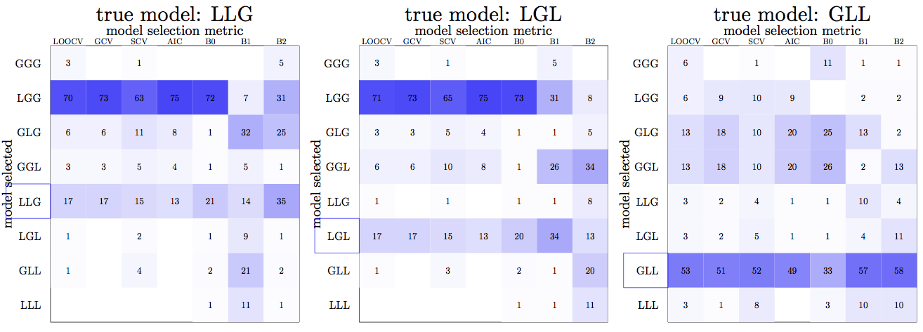

Slide 31
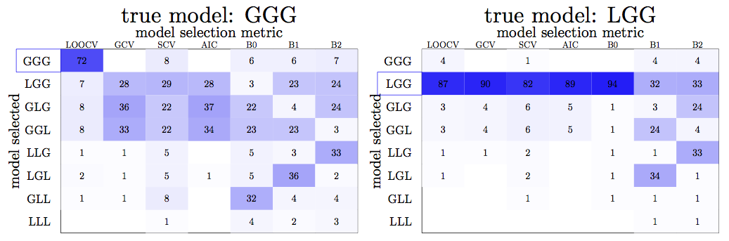

Slide 32
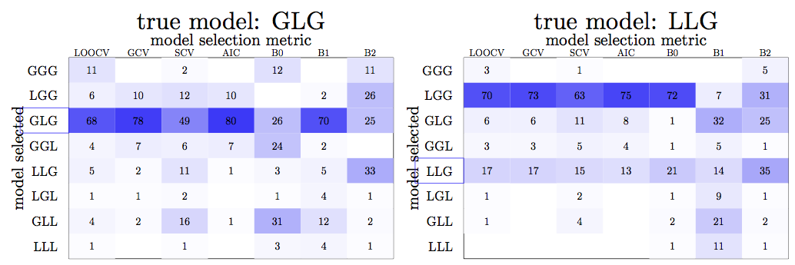

Slide 33
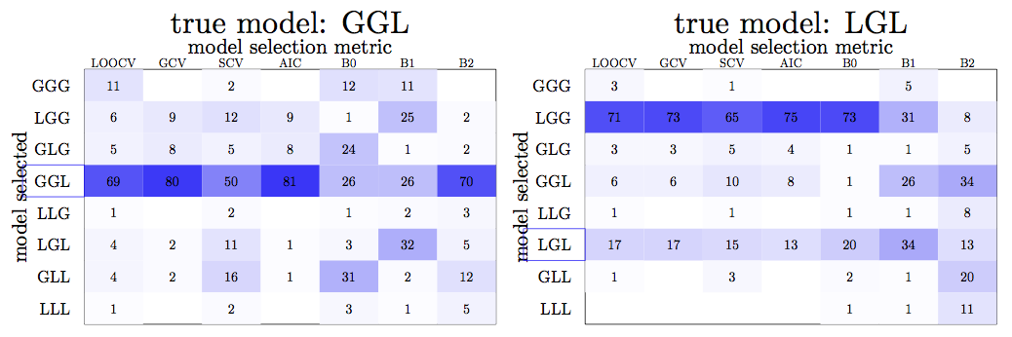

Slide 34
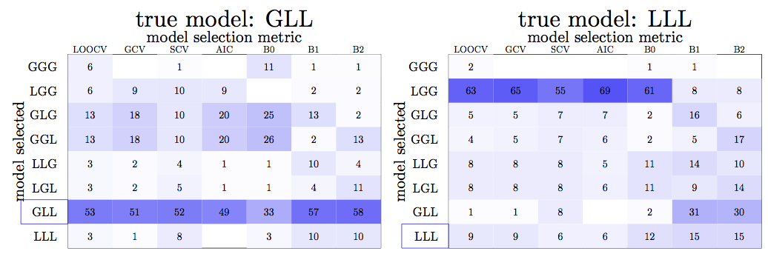

Slide 35
Some Conclusions and Questions
LOOCV is pretty good!

Slide 36
Some Conclusions and Questions
LOOCV is pretty good!
Most accurate coefficient estimates are
not necessarily from correct models.

Slide 37
Some Conclusions and Questions
LOOCV is pretty good!
Most accurate coefficient estimates are
not necessarily from correct models.
Are larger variances in some coefficients
driving the results?

Slide 38
Some Conclusions and Questions
LOOCV is pretty good!
Most accurate coefficient estimates are
not necessarily from correct models.
Are larger variances in some coefficients
driving the results?
Are coefficient estimates equally accurate
across metrics?

Slide 39
Some Conclusions and Questions
LOOCV is pretty good!
Most accurate coefficient estimates are
not necessarily from correct models.
Are larger variances in some coefficients
driving the results?
Are coefficient estimates equally accurate
across metrics?
What happens, ceteris paribus, with greater
error variance?

