Slide 1

Develop A SEO Tool to Analyze Live Web Pages

Slide 2
ABSTRACT
In this project I had designed a database to store user data by creating table in the database and a user-friendly account creation, password generation. And also a login program , by which the user can know about the code used in a website by using url and the user was also able to change his/her username and password with a OTP generator which sends the OTP to the user mail. In this database
I have used user-defined funtion to make it simple. This Function help divide a program into modules. This makes the code easier to manage, debug, and scale. It implements code reuse.

Slide 3
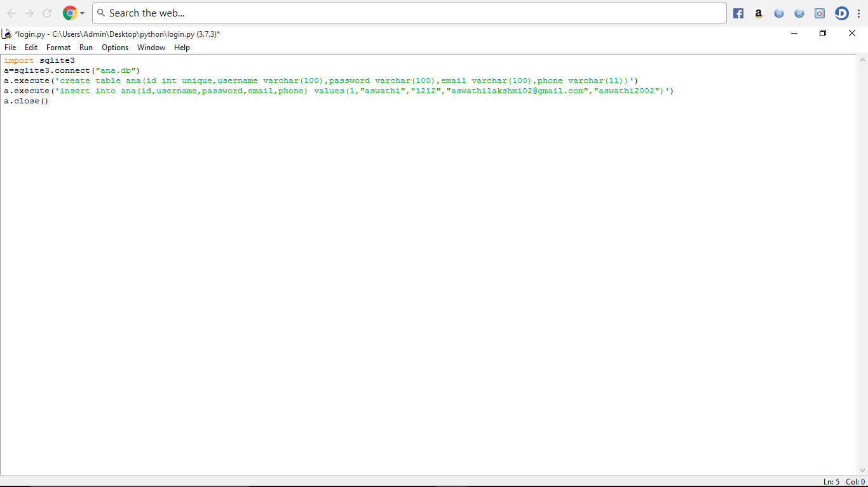
CREATING A TABLE
To create a table, first we have to connect the database to SQL . Then create a table in that database with unique (if necessary)numbers ,username , password.

Slide 4
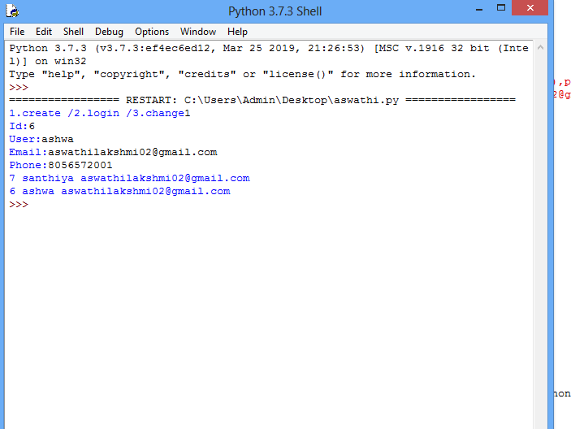
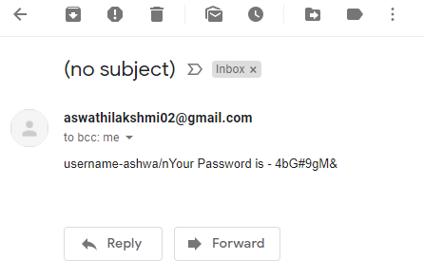
CREATING A ACCOUNT
In this part, the code gets the input for Id , Username , Email id and the Mobile number. Then the auto generated password is send to the user mail which is used to login the account.

Slide 5
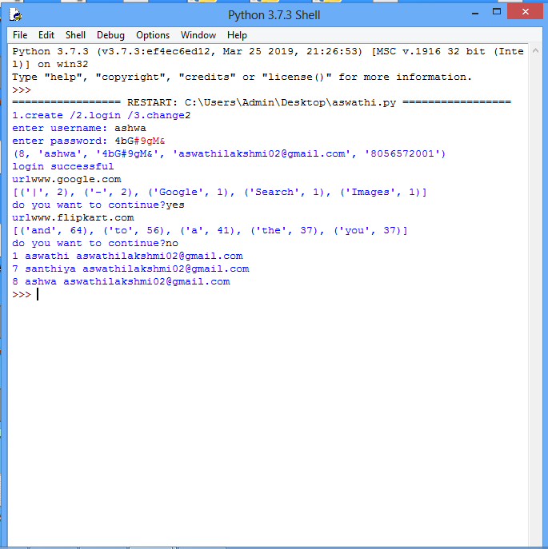
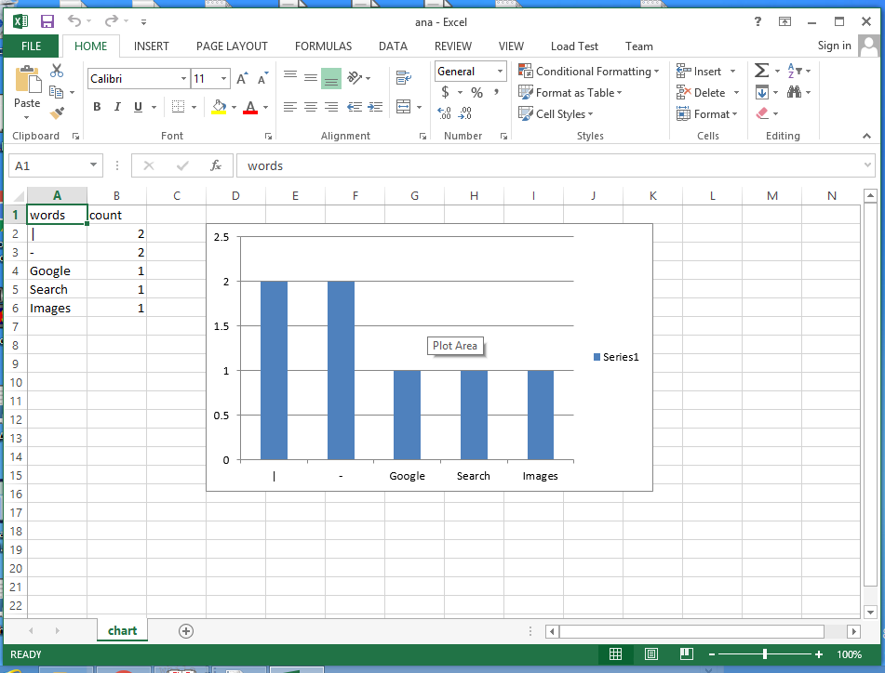
TO LOGIN A ACCOUNT
In this we get the input for username and password and check the user password . If the login is successful then an additional operation is done i.e. to get the URL from the website and the user can count and display the top five words in a excel sheet with chat . Also the user can say what are the words they doesn’t need to count by including that words in a file. If the user wants to continue this process there is option to continue upto to which the user want.

Slide 6
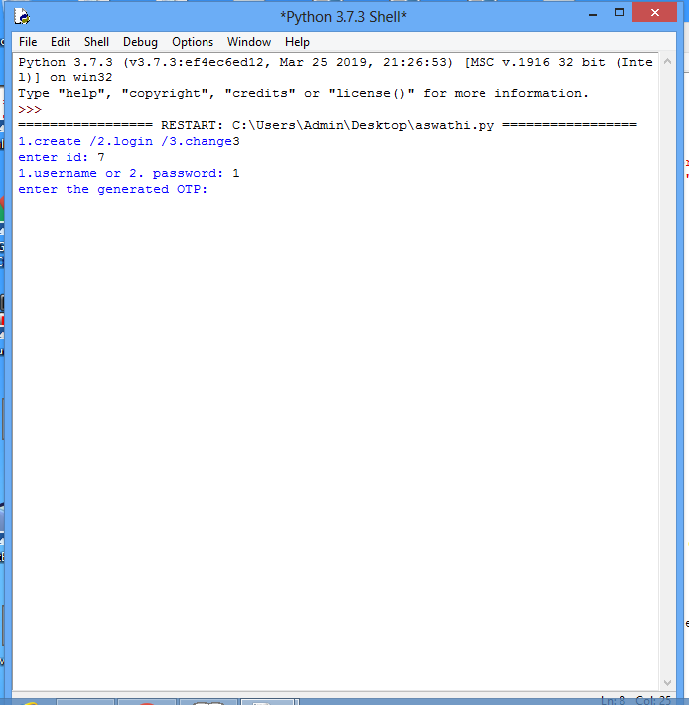
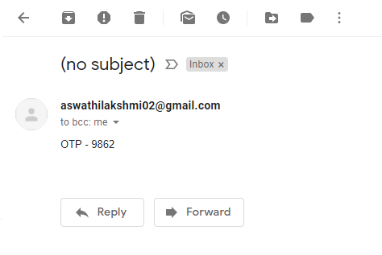
CHANGE OF PASSWORD OR USERNAME
In this we get the input for Id of the user then the request for change of username and password is given. The user can change either of the above by using the OTP sent to the user mail. (The id should be the same which has been used to create the account)

