Slide 1

Analysis and predictive modeling of hotel cancellation and price trends
Soyoung An
Jun 2021

Slide 2
Overview
Often, hotel cancellation can lead to the business loss. Having ability to accurately predict future customers’ cancellation rates is important. Predicting a hotel price rate is essential to evaluate demand for accommodation and pricing the room rates accordingly.
Predicting the actual demand and price can help to reduce the unexpected profit loss.
Goals
Identify the key factors that influence cancellation rate and price
Identify whether the average daily rates (ADR) between two groups (cancelled/not cancelled) are same
Develop a predictive models to estimate cancellation and price
Data
Hotel booking observations from a resort hotel and city hotel where the resort hotel located in Algarve and the city hotel in Lisbon.
40,060 rows 32 features

Slide 3

Data Wrangling
Processed date types data and stored them into year, month, day separately
Dropped any columns with more than 50% missing values
Implicated missing values with reasonable data
Dropped suspicious data with no additional information available
After Data Wrangling Process,
Final dataset left with
116,951 rows and 35 columns
(Original dataset: 119,390 rows and 32 columns)

Slide 4
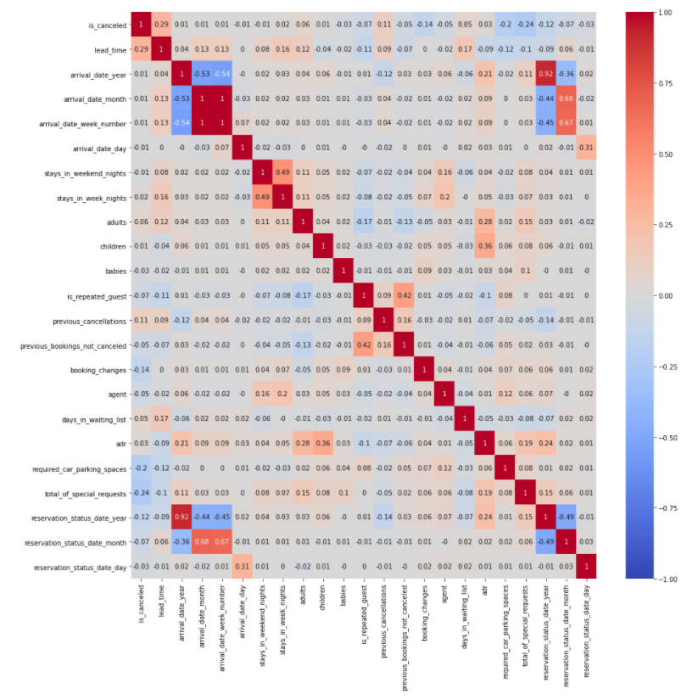
Important factors affecting cancellation and price
Cancellation
Lead_time
Previous_cancellation
Days_in_waiting_list
adr
Average Daily Rate (ADR)
Children
Adults
Reservation_status_date_year
Arrival_date_year
Total_of_special_requests
Heatmap of correlation coefficients between variables

Slide 5
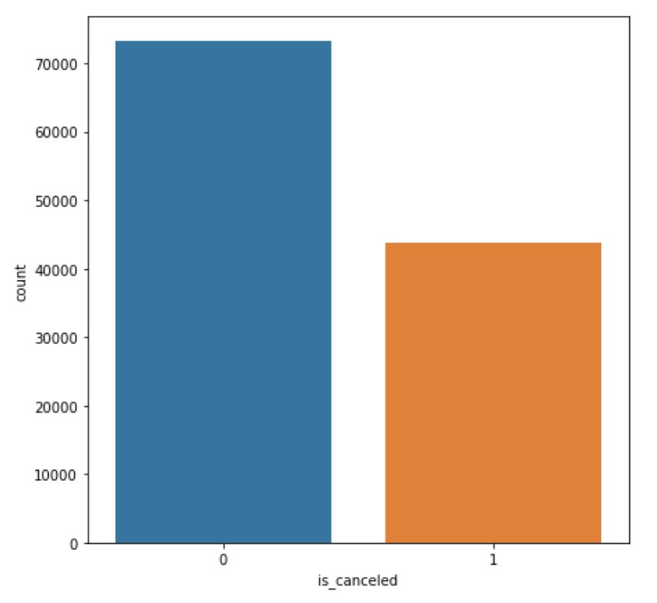
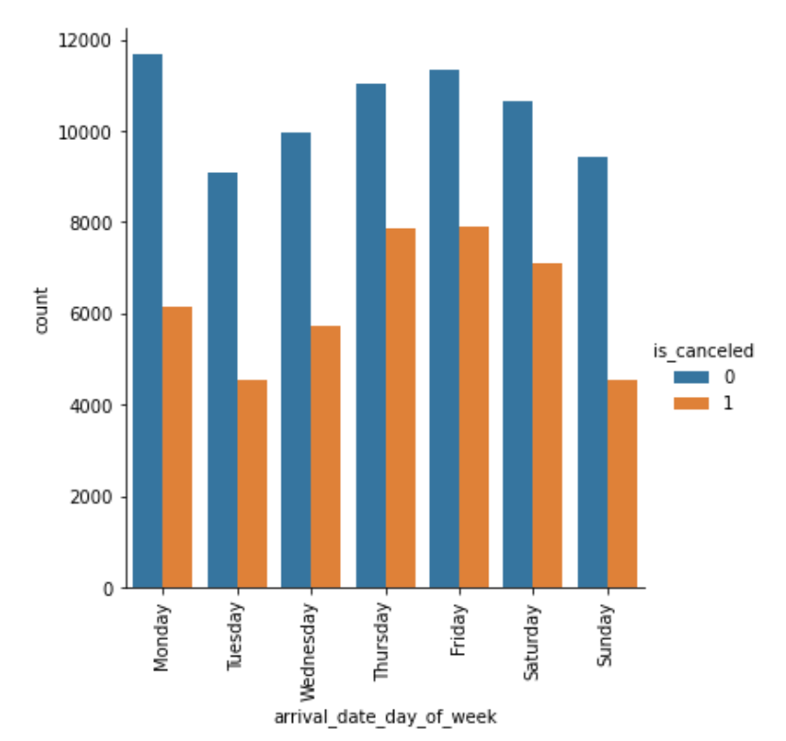
Canceled vs Non-canceled
Not Cancelled Reservations: 73,140
Cancelled reservations: 43,811
Count plot of different cancellation types
Count plot by day of week and cancellation type

Slide 6
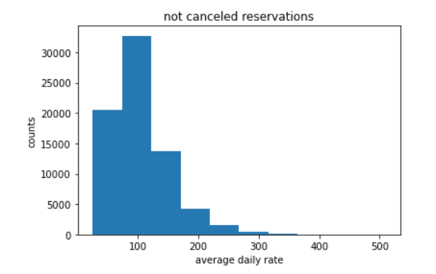
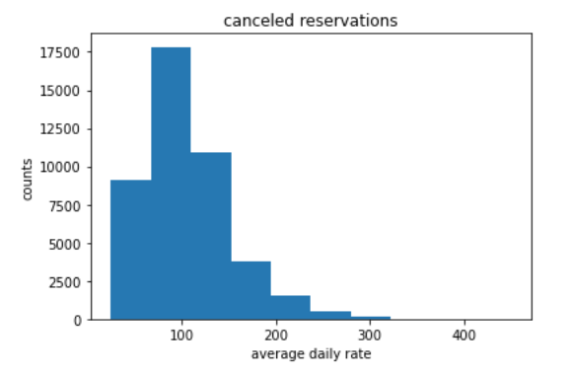
price rates are same in two cancellation type groups?
Null hypothesis: The average daily rate price (ADR) booked by who has cancelled the reservation has the same rate as people who is not cancelled.
Alternative hypothesis: The average daily rate price (ADR) booked by who has cancelled the reservation does NOT have the same rate as people who is not cancelled.
Method
Bootstrapping
t-test
Results : p-value < 0.05
Reject the null hypothesis and accept alternative hypothesis
Average daily rate (ADR) between
two groups are DIFFERENT!

Slide 7
Modeling Approach
Logistic Regression (Cancellation) / Linear Regression (Price)
KNN
SVM
Decision Tree
Gradient Boosting
Random Forest

Slide 8
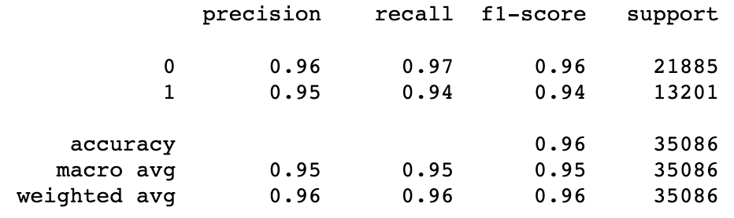
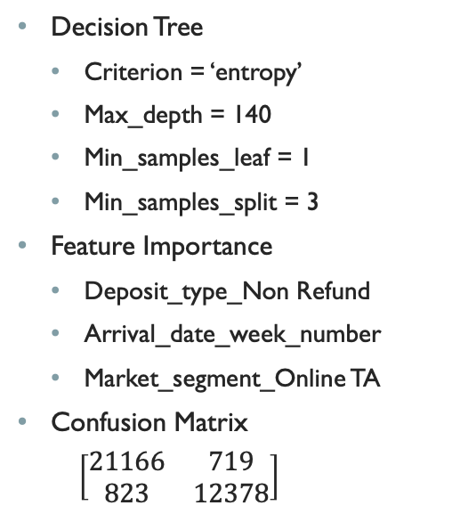
Best Hotel Cancellation Model
Decision Tree
Criterion = ‘entropy’
Max_depth = 140
Min_samples_leaf = 1
Min_samples_split = 3
Feature Importance
Deposit_type_Non Refund
Arrival_date_week_number
Market_segment_Online TA
Confusion Matrix
$\left[\begin{matrix}21166 & 719 \\ 823 & 12378\end{matrix}\right]$
Classification Report for Decision Tree with tuned parameters

Slide 9
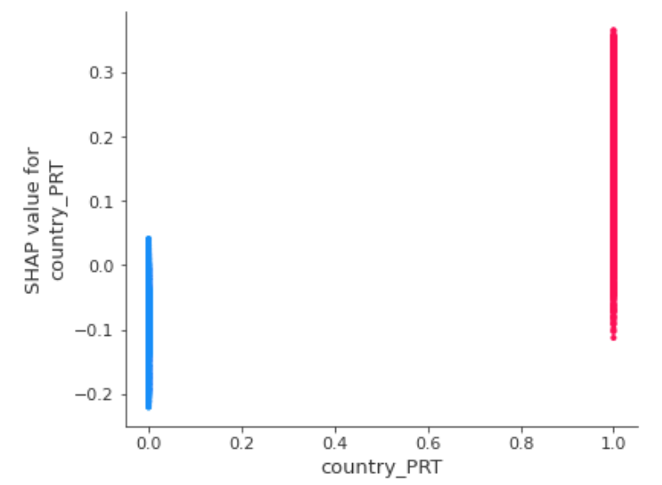
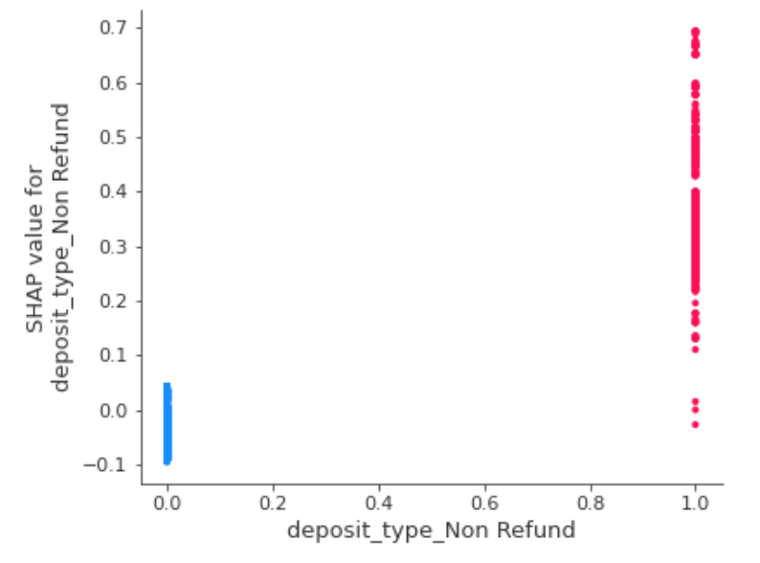
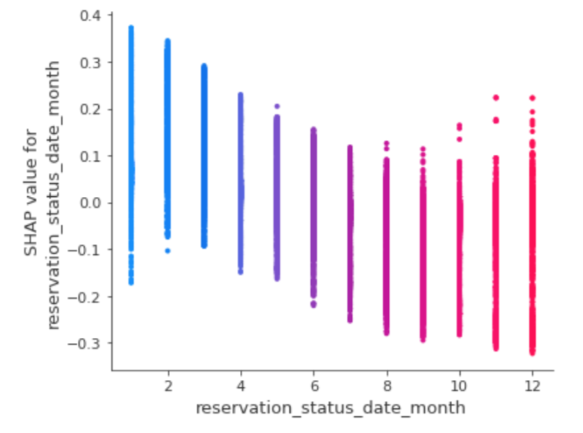
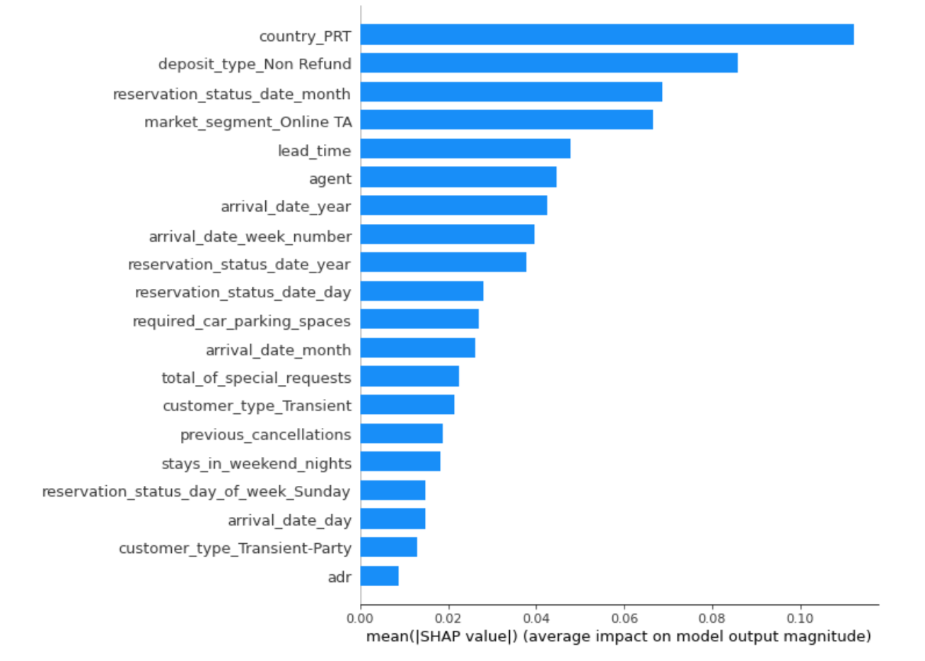
Comparative studies on cancellation predictive models
Top 3 Features affecting cancellation (1):
Country_PRT (Portugal)
Deposit_type_Non Refund
Reservation_status_date_month
Meaningful features
Lead_time

Slide 10
Best Hotel Price Model
Random Forest
n_estimator = 1000
max_depth = 50
max_features = ‘auto’
Errors
R squared: 0.926
Mean Squared Error: 12.675
Mean Absolute Error: 6.5474
Top 5 Important features
Arrival_date_month
Reserved_room_type_A
Arrival_date_week_number
Children
Agent

Slide 11
Conclusions
Provided hotels the analysis to reduce cancellation and set reasonable price points which helps to reduce unexpected profit loss
Developed classification and regression models for hotel using various machine learning algorithms with above 90% average accuracy in model performance
Performed comparative studies to analyze how feature importance impacts the results of the price and cancellation models for individual transactions for customers

