Slide 1
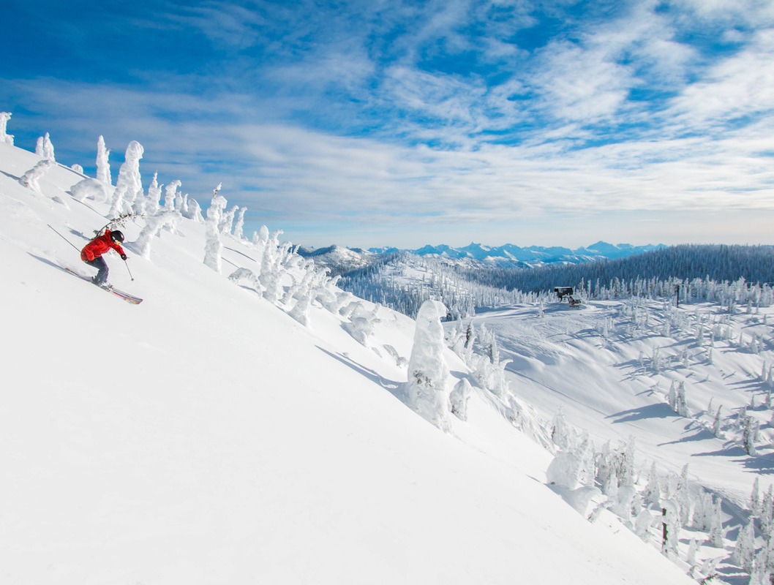
Business Analysis for Big Mountain Resorts
Soyoung An

Slide 2
Overview
Big Mountain Resort is a ski resort located in Montana, has recently installed additional chair lift to help increase the distribution of visitors across the mountain. This additional chair increases the operating costs by $1.54 M this season. Therefore, the resorts plan to charge a premium above the average price of resorts. However, they are not sure the optimal ticket price that can generate an additional $1.7 M revenue in next year.
Goal: To identify competitive ticket prices, and opportunity to improve the profit.
Data: Recent ski slope terrain & pricing data from other ski resorts in the U.S. market share.
330 rows 27 features

Slide 3
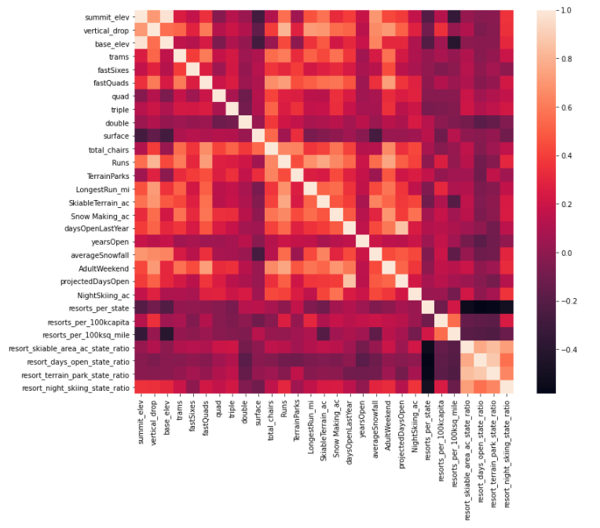
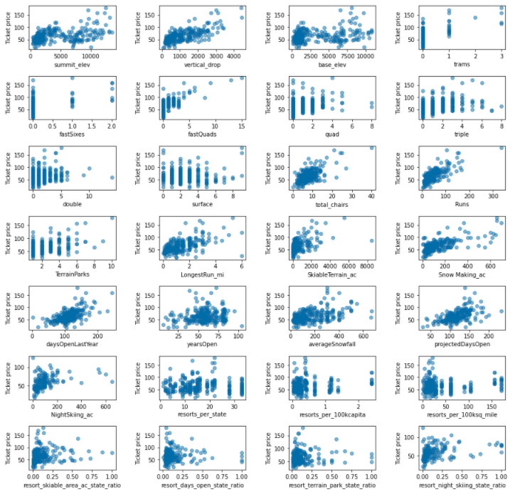
Important factors affecting the price
Top 4 features
vertical_drop
fastQuads
total_chairs
Runs
Heatmap
Scatter plots
The relationship between Ticket price vs. other features

Slide 4
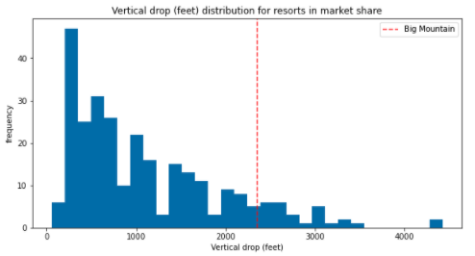
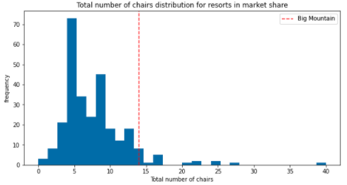
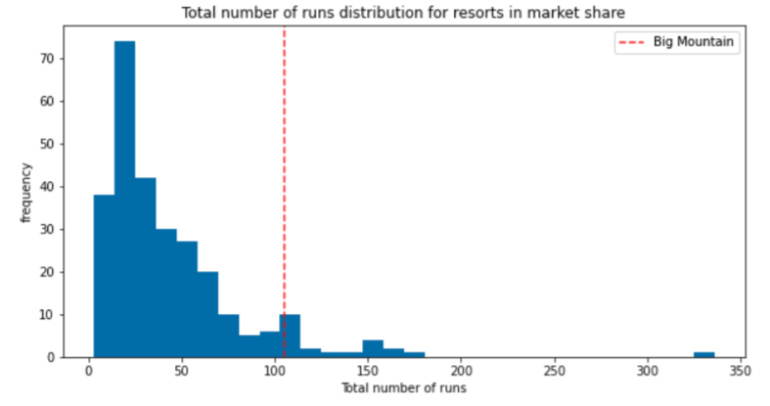
Top 4 features distributions comparing to the market
Vertical Drop (ft)
Fast quads
Total number of chair
Total number of runs

Slide 5
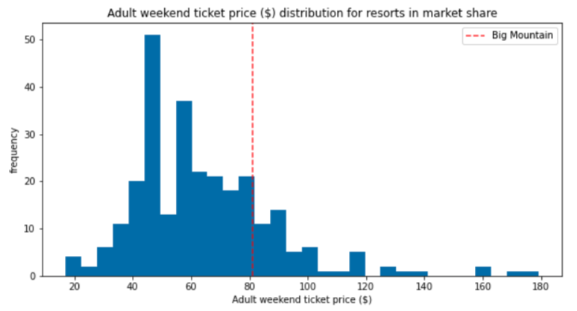
Model Results & Analysis
Big Mountain Current Ticket Price: $81.00
Modelled Ticket Price: $95.87
Mean absolute error: $10.39
85.97
Ticket Price distribution of Big Mountain comparing to market
Room for an Increase!!!
Big Mountain Current Ticket Price is already fairly high compare to the market.
WHY IS ITS MODELED PRICE SO MUCH HIGHER???

Slide 6
Recommendations
Two Model Scenarios can increase the ticket price to $2 more which increase the revenue to $3,464,638:
Adding a run, increase the vertical drop by 150 feets, and installing an additional chair lift (as planned)
OR/AND
Adding 2 acres of snow making area

Slide 7
Conclusions
Big Mountain resort can improve in the coming year, particularly with an extra lift chair. The business can raise the ticket price to a competitive value compared to the market rate and still generate large increase in revenue.

