Slide 1

Analysis and predictive modeling of hotel cancellation and price trends
Soyoung An
Jun 2021

Slide 2
Overview
Often, hotel cancellation can lead to the business loss. Having ability to accurately predict future customers’ cancellation rates is important. Predicting a hotel price rate is essential to evaluate demand for accommodation and pricing the room rates accordingly.
Predicting the actual demand and price can help to reduce the unexpected profit loss.
Goals
Identify the key factors that influence cancellation rate and price
Identify whether the average daily rates (ADR) between two groups (cancelled/not cancelled) are same
Develop a predictive models to estimate cancellation and price
Data
Hotel booking observations from a resort hotel and city hotel where the resort hotel located in Algarve and the city hotel in Lisbon.
40,060 rows 32 features

Slide 3
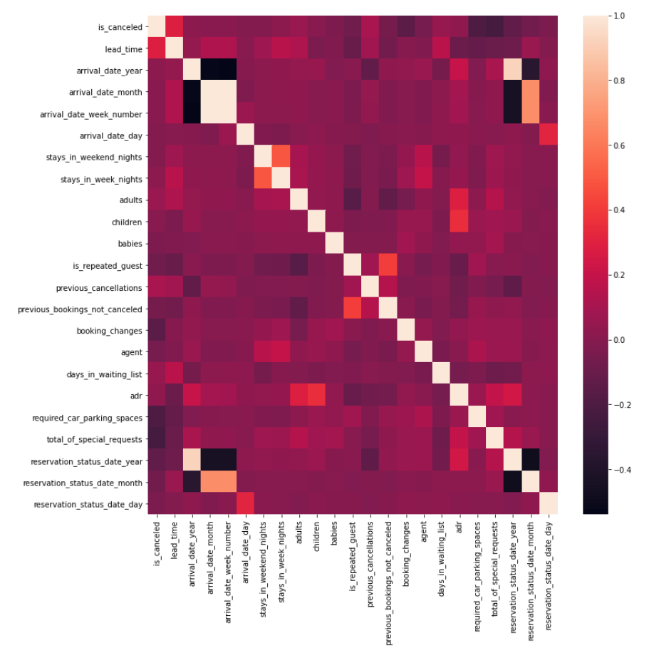
Important factors affecting cancellation and price
Cancellation
Lead_time
Previous_cancellation
Days_in_waiting_list
adr
Average Daily Rate (ADR)
Children
Adults
Reservation_status_date_year
Arrival_date_year
Total_of_special_requests
Heatmap

Slide 4
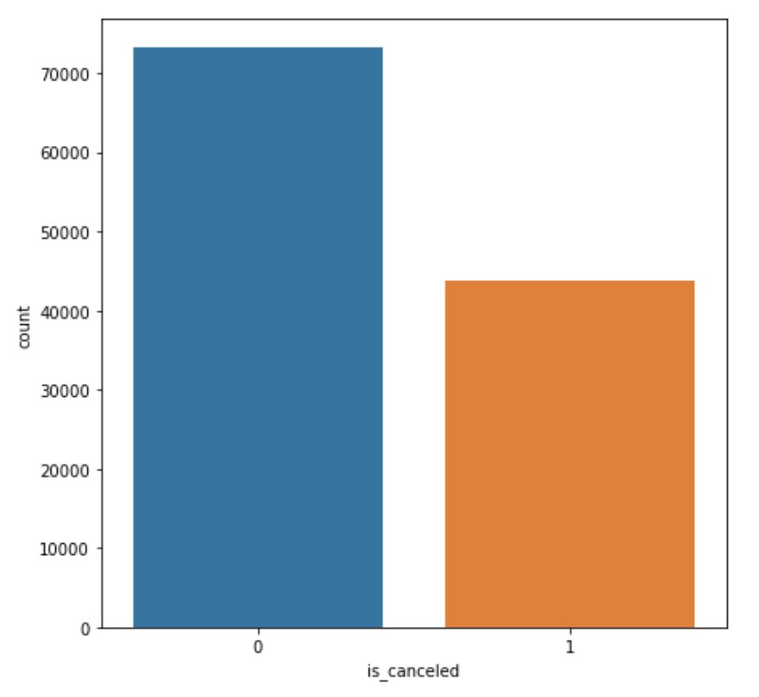
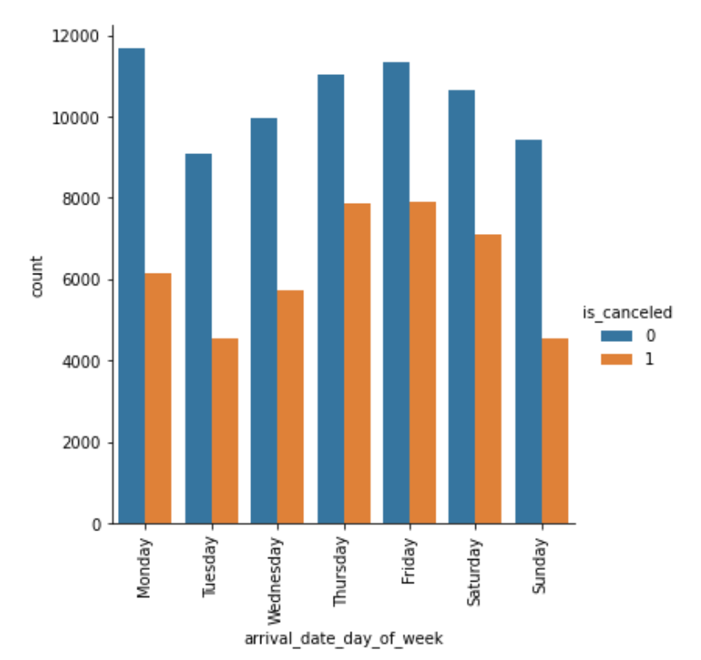
Canceled vs Non-canceled
Not Cancelled Reservations: 73,140
Cancelled reservations: 43,811
Count plot of different cancellation types
Count plot by day of week and cancellation type

Slide 5
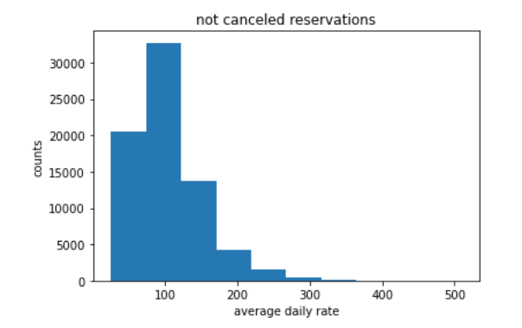
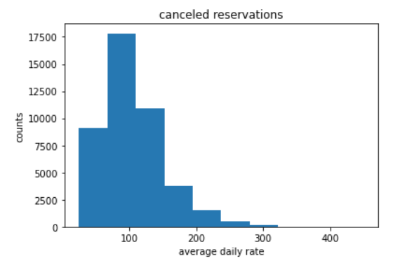
price rates are same in two cancellation type groups?
Null hypothesis: The average daily rate price (ADR) booked by who has cancelled the reservation has the same rate as people who is not cancelled.
Alternative hypothesis: The average daily rate price (ADR) booked by who has cancelled the reservation does NOT have the same rate as people who is not cancelled.
Method
Bootstrapping
t-test
Result: p-value < 0.05
Reject the null hypothesis and accept alternative hypothesis
Average daily rate (ADR) between
two groups are DIFFERENT!

Slide 6
Modeling Approach
Logistic Regression (Cancellation) / Linear Regression (Price)
KNN
SVM
Decision Tree
Gradient Boosting
Random Forest

Slide 7
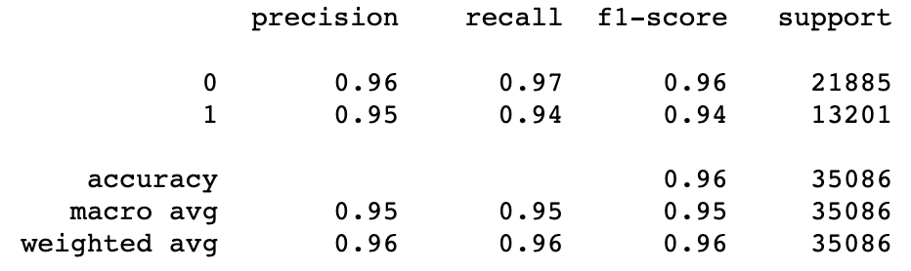
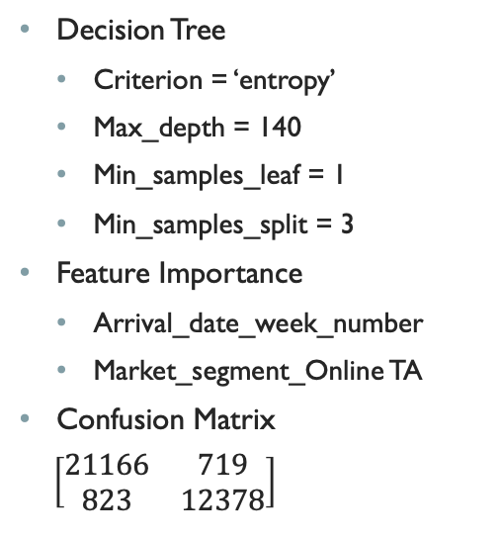
BesT Hotel Cancellation Model
Decision Tree
Criterion = ‘entropy’
Max_depth = 140
Min_samples_leaf = 1
Min_samples_split = 3
Feature Importance
Arrival_date_week_number
Market_segment_Online TA
Confusion Matrix
$\left[\begin{matrix}21166 & 719 \\ 823 & 12378\end{matrix}\right]$
Classification Report for Decision Tree with tuned parameters

Slide 8
Best Hotel Price Model
Random Forest
Max_depth
Errors
R squared: 0.925
Mean Squared Error: 12.739
Mean Absolute Error: 6.534
Top 3 Important features
Arrival_date_month

Slide 9
Conclusions
Big Mountain resort can improve in the coming year, particularly with an extra lift chair. The business can raise the ticket price to a competitive value compared to the market rate and still generate large increase in revenue.

