Slide 1
Adversarial neural network cryptography
Alexandra M. Borukhovetskaya
07.04.2020

Slide 2
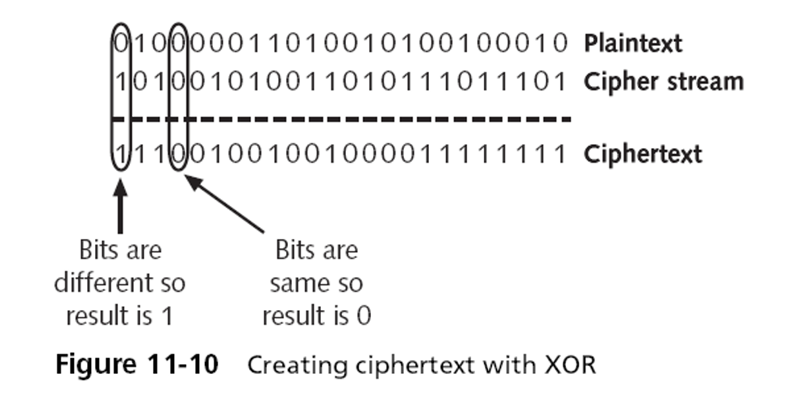
Motivation
“Learning to Protect Communications with Adversarial Neural Cryptography” (Abadi & Andersen 2016)
Can neural networks learn to use secret keys to protect information from other neural networks?
Neural networks are not great at cryptography
Why might you need neural networks to keep secrets?
ex. multi-component neural network, where we wish that one of the components does not rely on some input
https://crypto.stackexchange.com/questions/55708/xor-and-cipher-stream

Slide 3
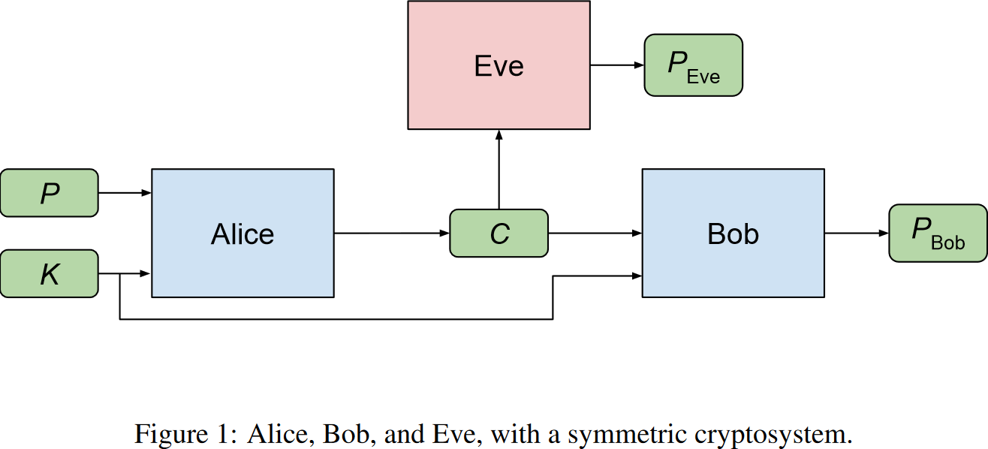
Premise
(Abadi & Andersen 2016)

Slide 4
Network Architecture
n-bit key
n-bit message
fully connected layer
1D convolutional layer (sigmoid)
1D convolutional layer (tanh)
Alice/Bob
Eve

Slide 5
Loss Functions & Training
Eve’s Loss:
Goal: minimize the error in difference of bits between Eve’s output and original plaintext message
Alice & Bob’s Loss:
Combine Bob’s reconstruction error and the optimal value of Eve’s loss
Goal: minimize Bob’s reconstruction error and maximize the reconstruction error of the “optimal Eve”
Training Specifications:
Optimizer: Adam
Alternate training: for each step train Alice & Bob once and Eve twice

Slide 6
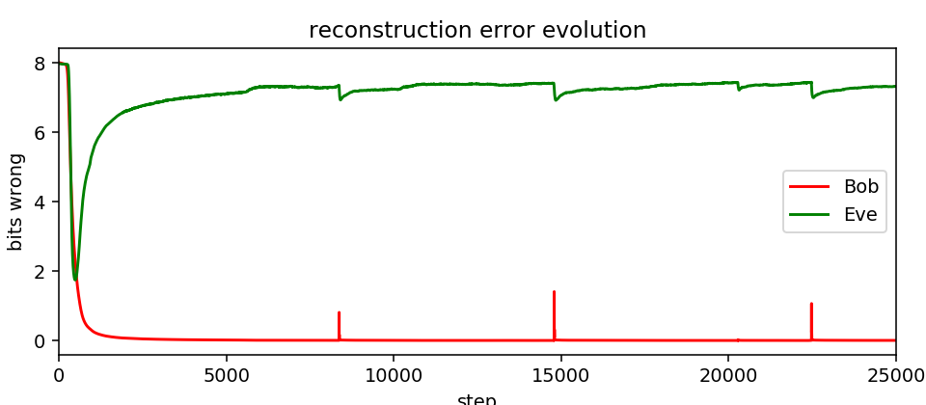
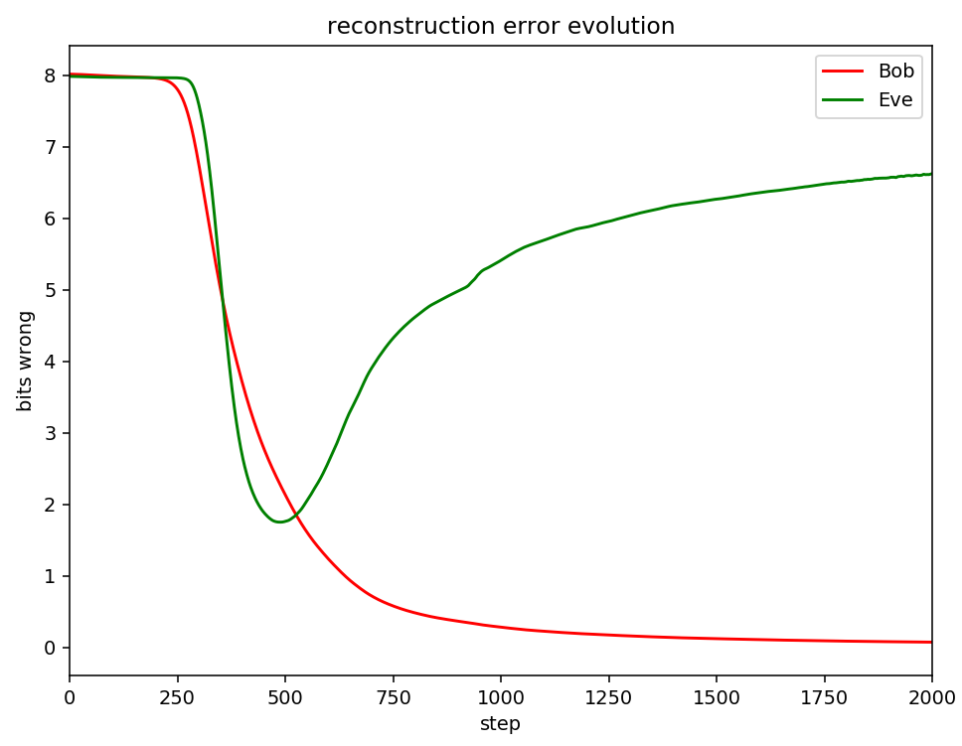
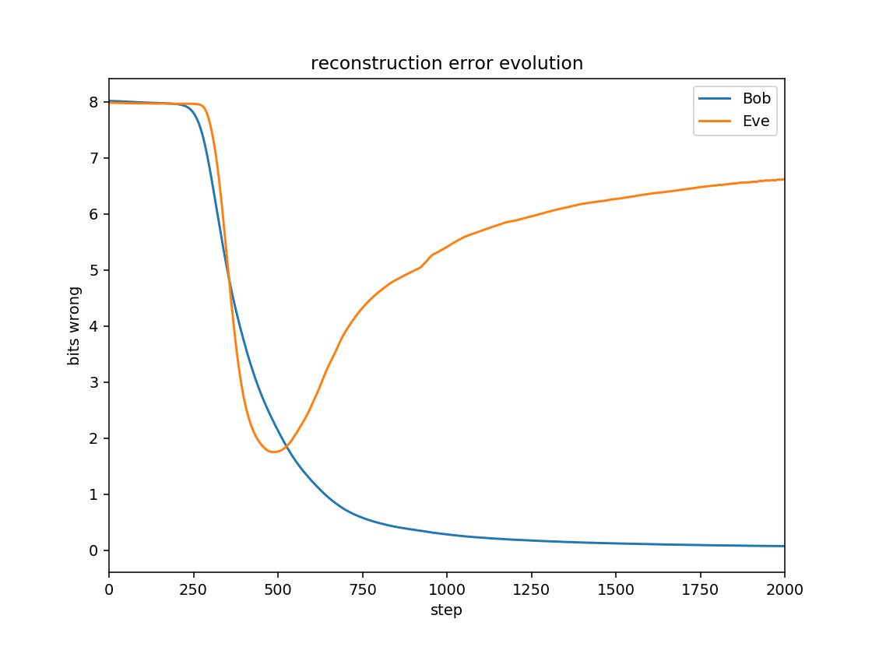
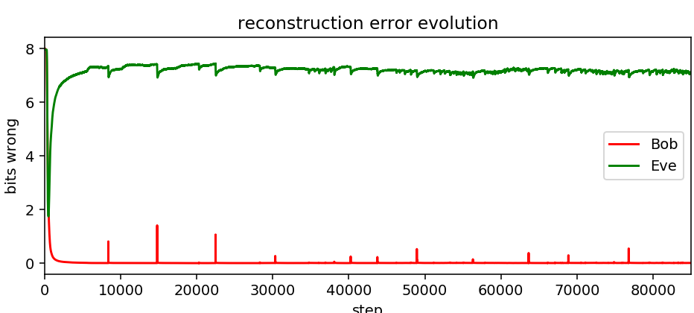
Results

Slide 7
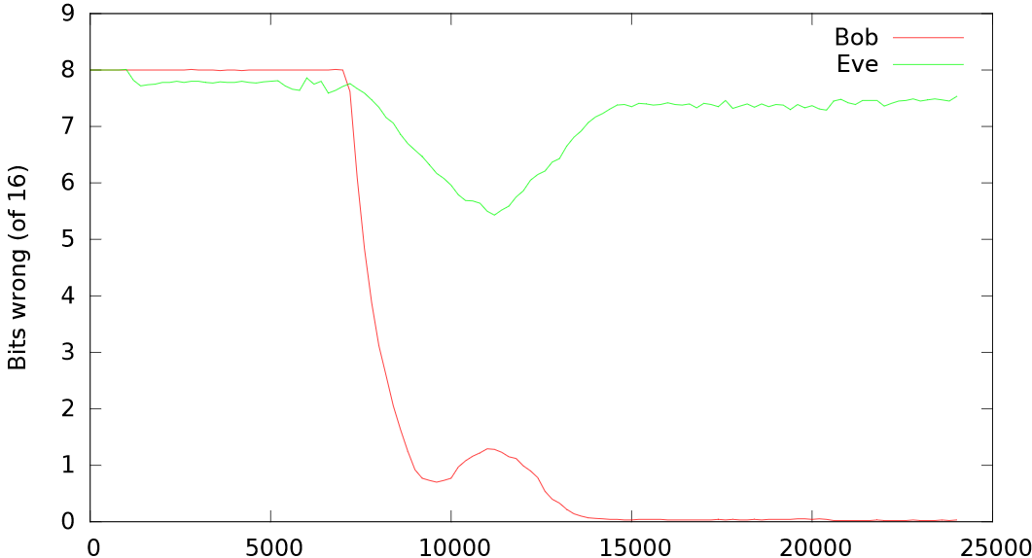
Results
(Abadi & Andersen 2016)

Slide 8
Conclusions
My error evolution for Bob & Eve generally followed a similar pattern to that of the original paper
Some differences between my methodology and that of the paper
In the paper ran experiment 20 times, for 850,000 training steps
Post-training evaluation of each run by resetting Eve and training her from scratch 5 times – if the retrained Eves obtain a substantial advantage, the solution is non-robust
Paper also goes on to show how neural networks can figure out which information to protect
References
“Learning to Protect Communications with Adversarial Neural Cryptography” (Abadi & Andersen 2016)

Slide 9
Questions?

