Slide 1
W6_Flights_data_17118999
File created on: 28/11/2021 10:27:07 PM

Slide 2
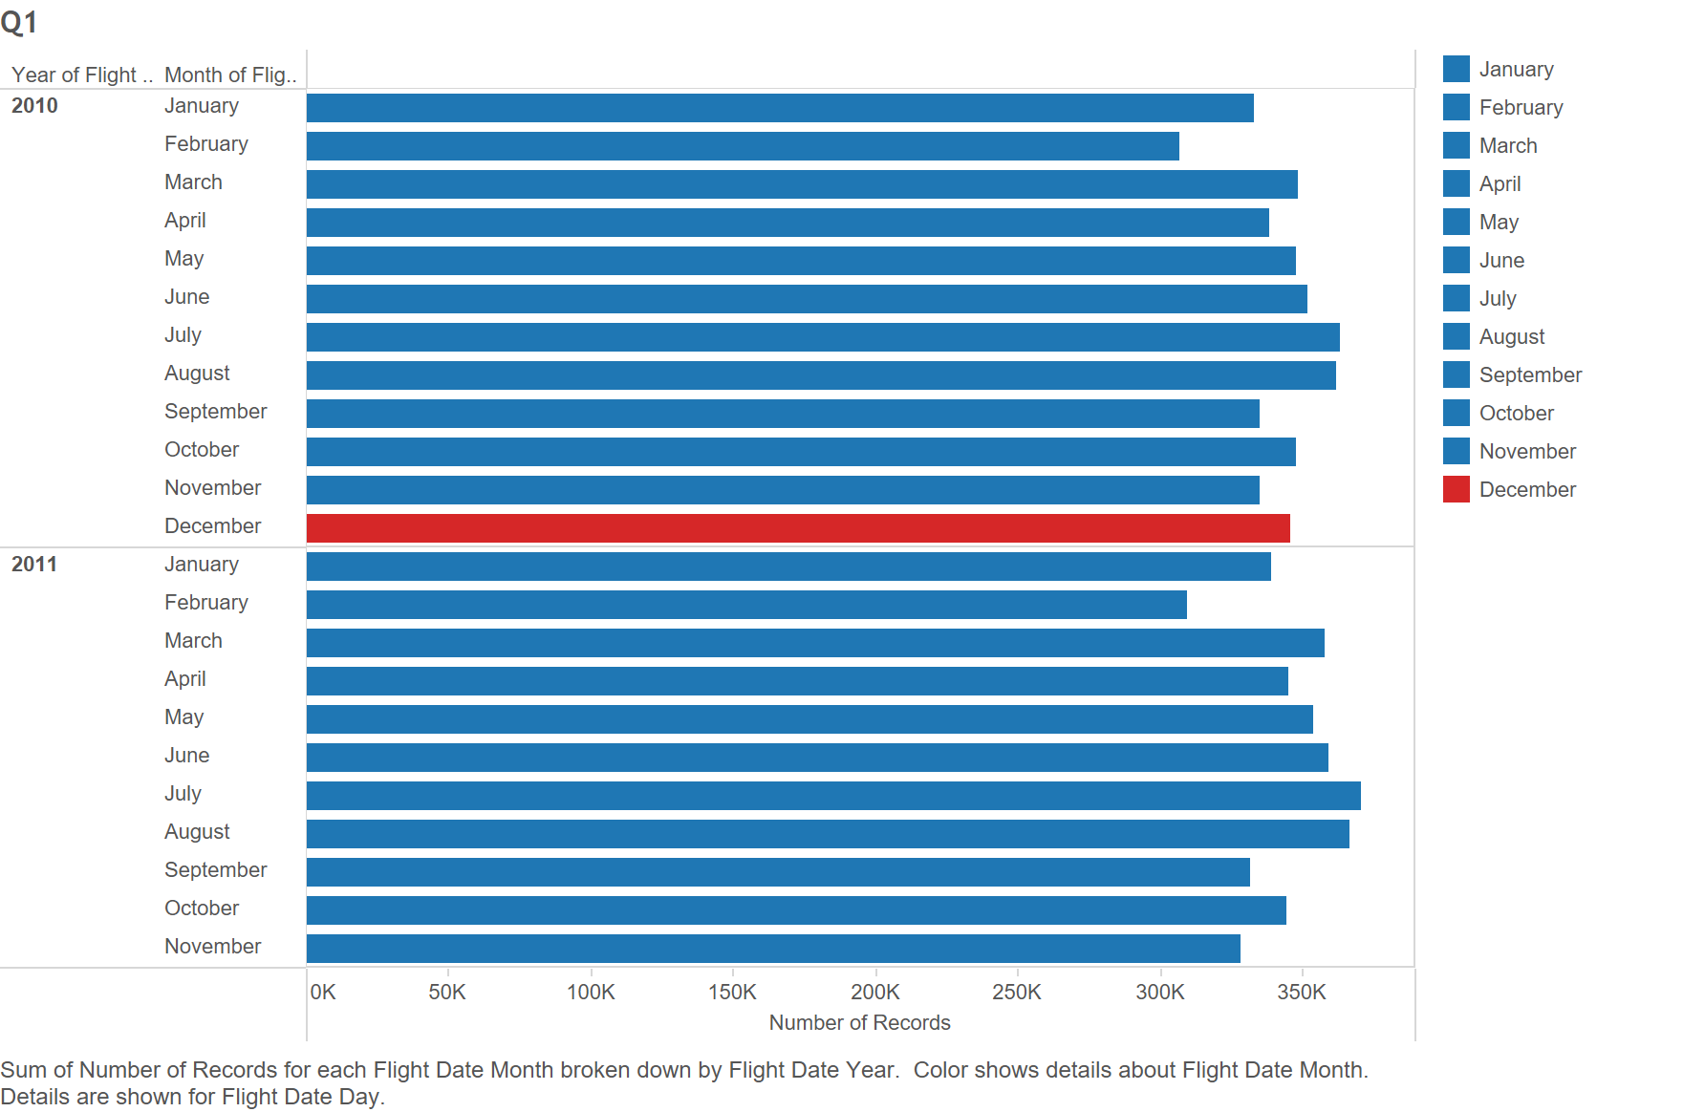

Slide 3
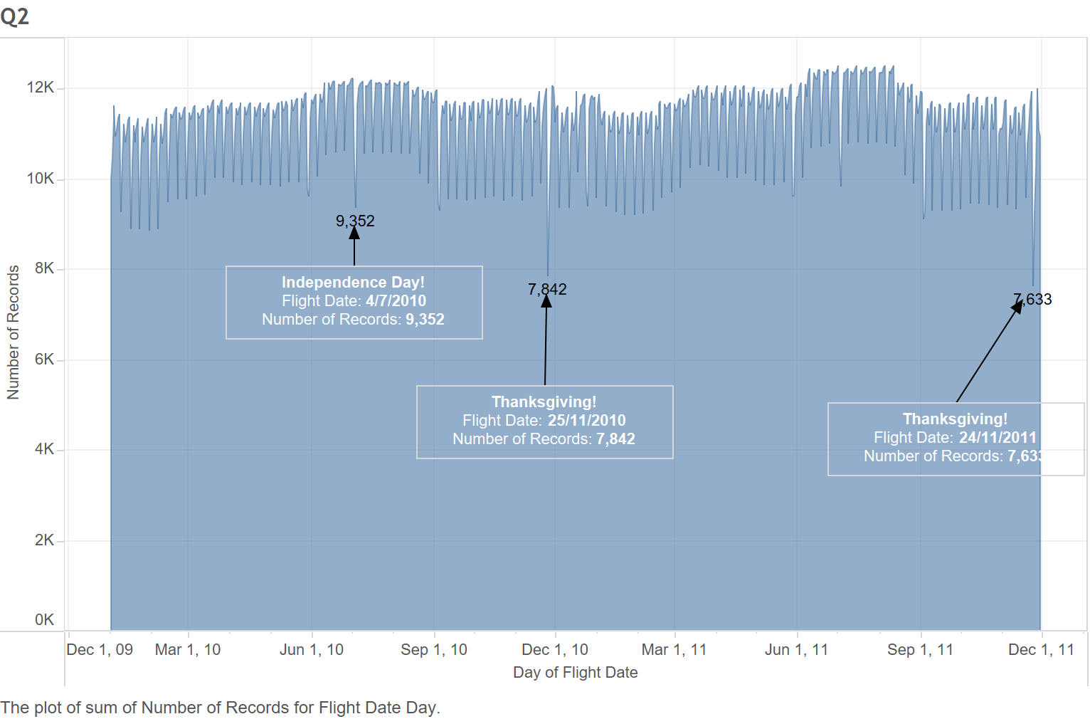

Slide 5
