Slide 1
DV_W6_Tableau_Flights_data
File created on: 29/11/2021 3:03:16 PM
Asyiqin Nasir

Slide 2
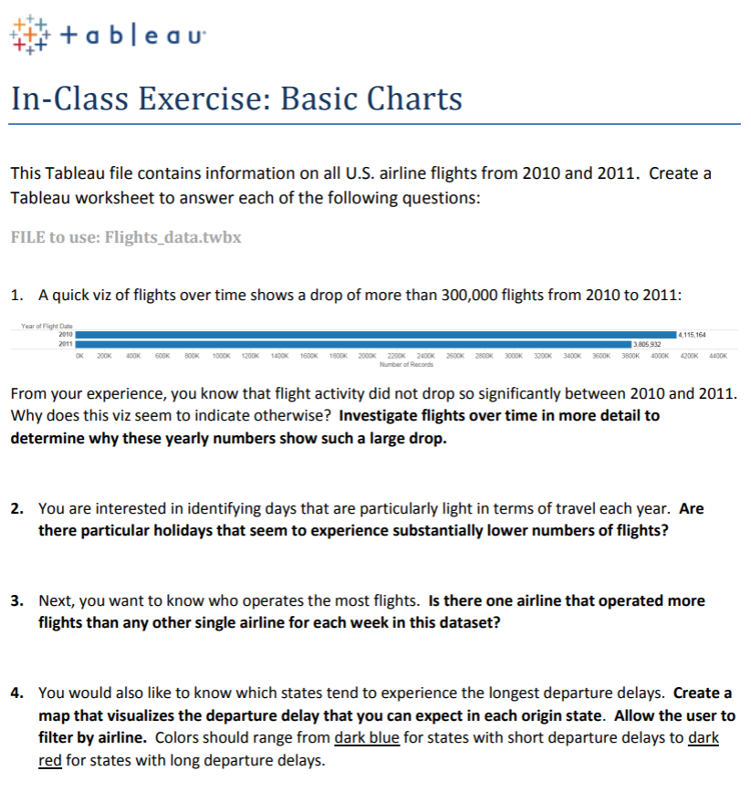

Slide 3
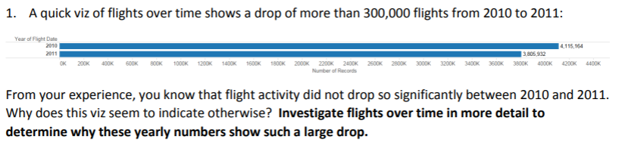
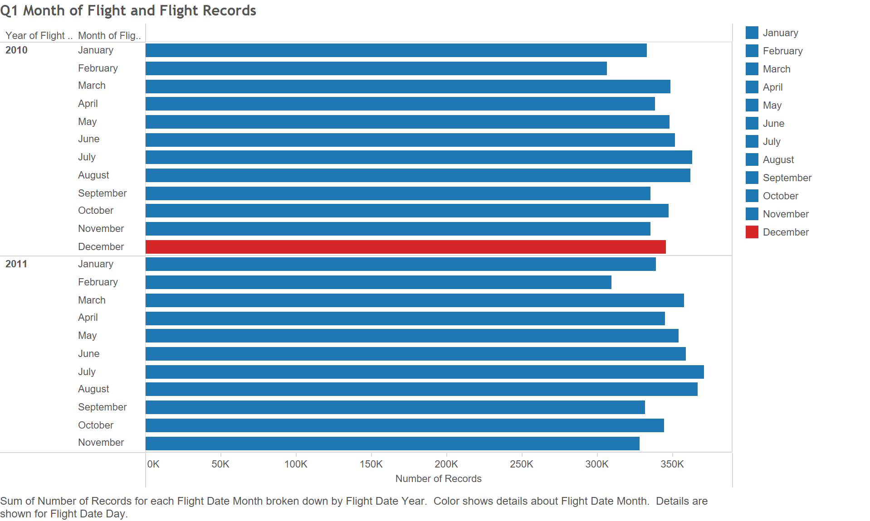
Answer: We can see that the flight activity dropped significantly from 2010 to 2011--- because in December 2010, the flight records are available. However, in December 2011, the flight records are not available yet.

Slide 4
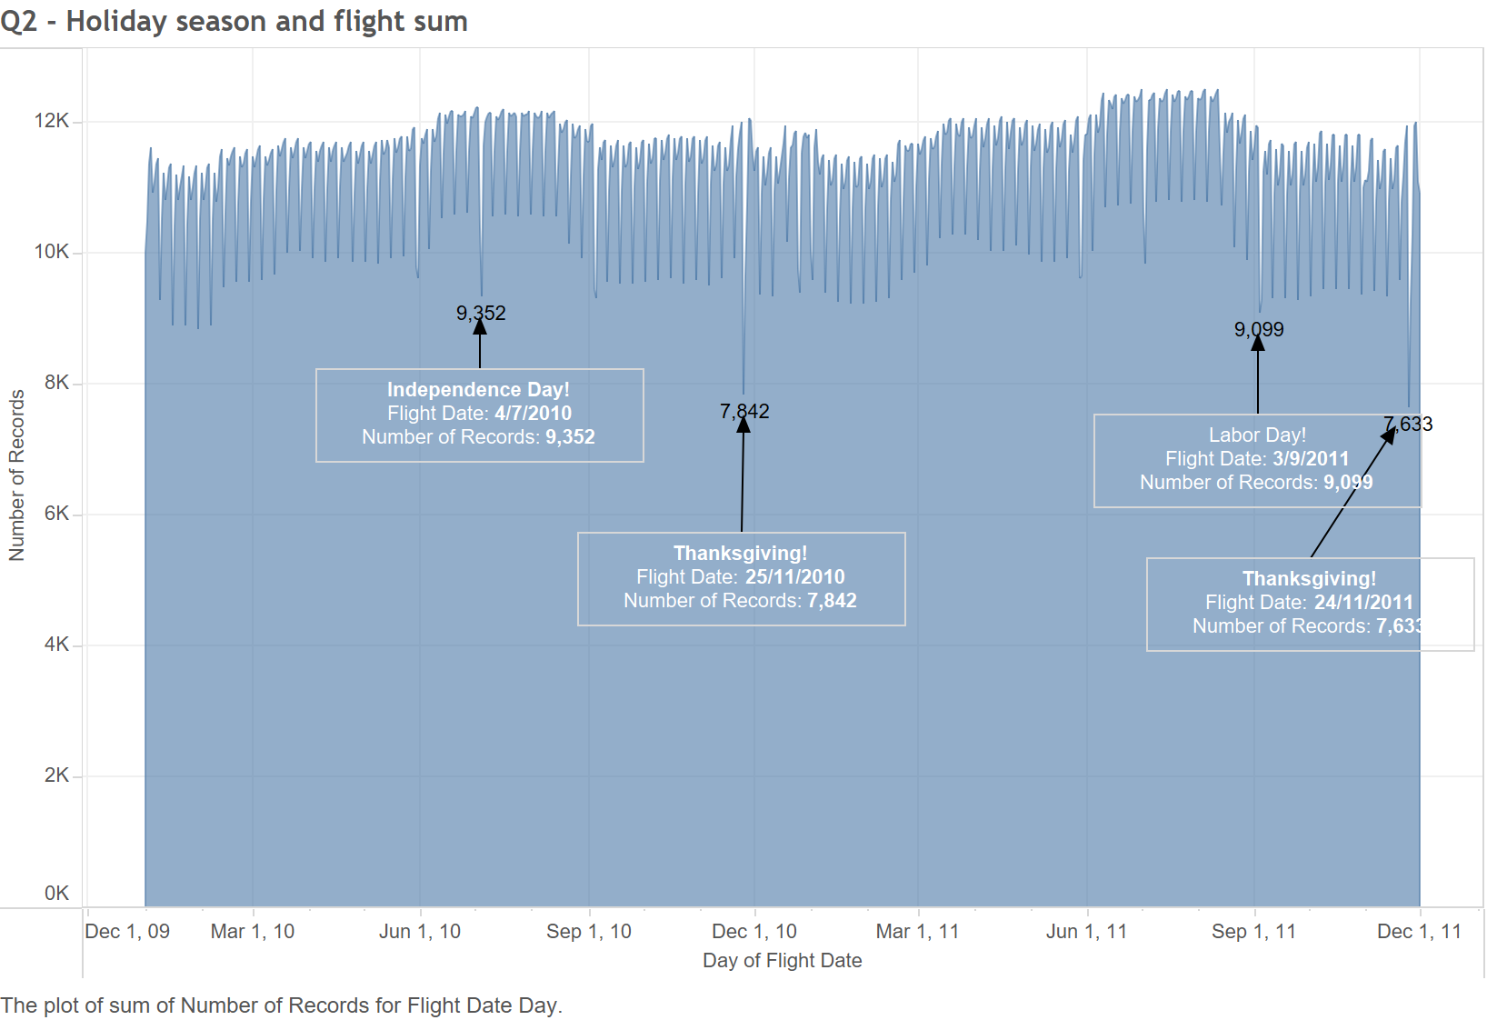
Answer: Holiday that experience substantially lower number of flights:
2010 1. Independence Day, 4/7/2010
2. Thanksgiving, 25/11/2010
2011
Labor Day, 3/9/2011
Thanksgiving, 24/11/2011

Slide 5
Answer:
Yes. Southwest Airline

Slide 6
