Slide 1
Bias Correction in Allele Specific Expression Analysis
Alyssa Ricketts, Joyce Zhou, Leo Brusa, Sam Wolfson, Steven Bishop
Notes:
- Explore the effect of SeqBias on ASE prediction. If deemed significant, develop a tool to automatically “correct” for it and apply this too a variety of data sets.

Slide 2
Overview: Allele Specific Expression
ASE analyzes the different expression levels of a heterozygous pair of alleles.
Use single nucleotide polymorphisms (SNP) sites to identify the allele
One allele is expressed more frequently than the other
Use RNA sequencing to determine expression levels
If DNA shows 2 alleles, but RNA only sees one, then there is ASE
Notes:
A quick review of ASE:
An allele is a variant of a gene.
For our project we identify alleles by the SNPs they have (so two alleles may differ by one/some bases at certain positions in the gene)
We have diploid cells, so two copies of each gene.
If these copies for some gene are different, then you are heterozygous for that gene.
However, this doesn’t mean that each allele is expressed equally often.
“Allele-specific expression” describes when each allele is expressed at a different level.
So one allele is “used”/transcribed more often than the other.
We identify allele-specific expression by using RNA sequencing data:
Counting the number of reads from each allele
We can identify which allele a read belongs to by mapping it to the genome and inspecting the SNP positions.

Slide 3
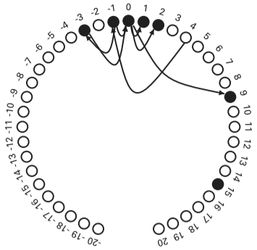
Overview: Problems with RNA Sequencing
DNA and RNA sequencing creates biased read counts.
Mapping Bias
Reads of the “reference allele” (matching the reference sequence) are more likely than reads of the “alternate allele” to be mapped correctly
Sequencing Bias
Some sequences are more likely to be sequenced more
often than others, depending on the sequencing method
Notes:
First: briefly explain reference and alternate
But there are some big issues with calculating ASE based on tallying up the RNA reads directly.
Two main sources of bias:
Mapping bias
The reference genome that we map to contains only one “canonical” version of each gene.
So reads containing the “alternate” allele are less likely to map to the correct position - we end up undercounting the number of alternate reads perhaps.
This has been shown before that mapping reads to the “alternate” allele version of the genome produces lots of different mappings sometimes, so this is probably a significant source of bias.
Sequencing bias
Different methods of RNA sequencing will overcount or undercount different sequences.
This affects the “counts” from each reads. For example some reads containing version A of the allele may end up being overrepresented in the sequencing data, while version B is underrepresented.

Slide 4
Overview: Approaches to Bias Correction
Map reads to 4 different sequences
Forward reference
Reverse reference
Forward alternate
Reverse alternate
seqbias
Package implementing a model of per-position sequencing bias
Simple Bayesian network trained on a set of aligned reads and reference sequence
readcounter
Uses biased count vectors to adjust counts of each read
Notes:
This is how we’re attempting to correct for the two big sources of bias.
To correct for mapping bias:
We map the reads to 4 different sequences (fwref, revref, fwalt, rvalt), instead of just the one reference.
To correct for sequencing bias:
We run the RNA reads through seqbias (the tool that Daniel wrote to correct for sequence bias)
We use the output from seqbias in the process of tallying up SNPs, so overrepresented sequences count for less, while underrepresented sequences count for more.
Readcounter is the program that we wrote to calculate bias-adjusted reference/alternate SNPs.
This will be described in more detail later, in terms of how we adjust for bias.

Slide 5
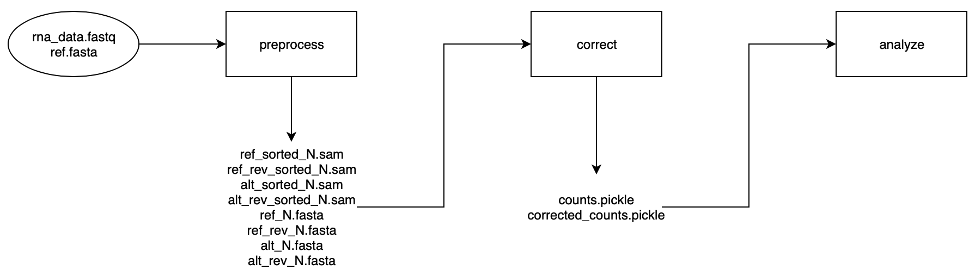
Overview: Pipeline
Notes:
Flowchart time~

Slide 6
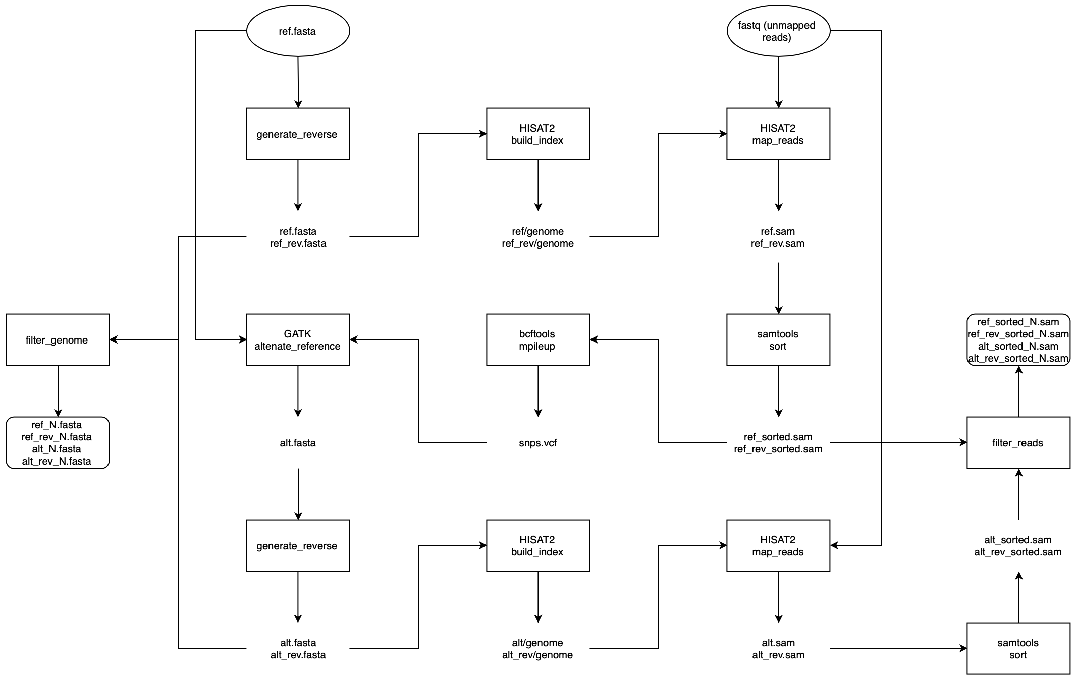
Preprocessing Data

Slide 7
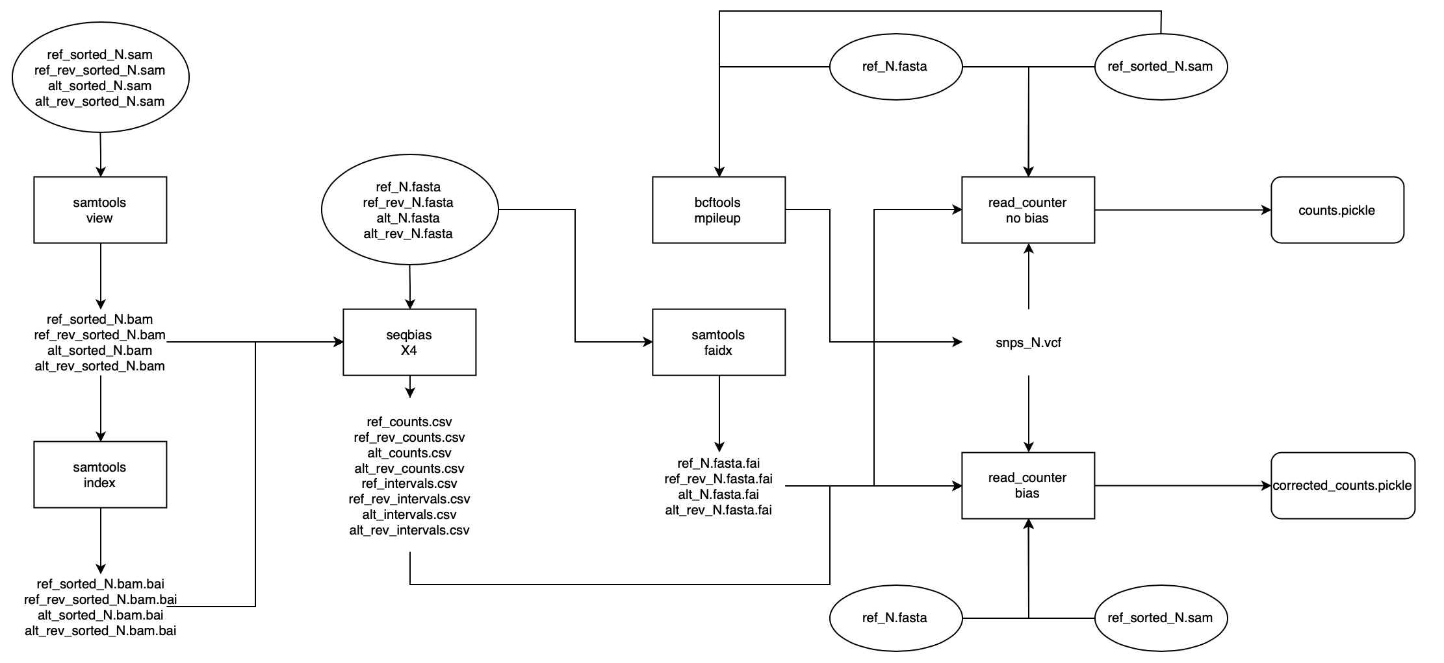
Correcting Bias

Slide 8
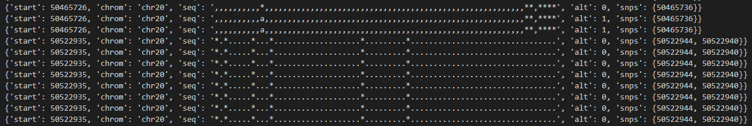
readcounter: Parsing RNASeq Reads
Reference SAM
Reference FASTA
SNPs
VCF
readcounter.parse_sam
Notes:
→ Start of bulk of correction phase
Inputs:
FASTA: represents the forward reference sequence and will be compared with the SAM reads
SAM: contains the forward reference reads which will be parsed
VCF: extracts SNP positions and alternate bases (for SNPs)
Output:
Parses reads in pseudo PILEUP format: fullstops = forward match, comma = reverse match, {ACGT|acgt} = alternate match, and star = no match (likely an error)
Start position and chromosome name taken from SAM file
alt stores whether there is any match to the alternate sequence within that read, i.e. 1 if there is at least a single match and 0 otherwise
snps stores the SNP positions that are crossed by this read. It doesn’t mean that this read actually has any SNP alternates!
will be used later in the pipeline

Slide 9
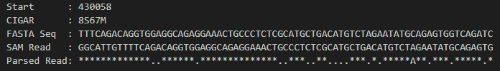
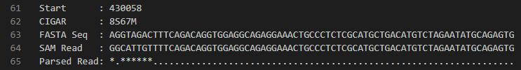
readcounter: Alignment Errors in Parsing
Before
After
Notes:
1.
We had hella stars!
Notice them.
This is bad.
2.
We noticed that CIGAR strings stored information regarding match and alignment info.
Integer that comes before S indicates soft-clipping at start (8-base misalignment) → followed by 67-base match
3.
Used soft-clipping value to shift where we match to the FASTA sequence
FASTA and SAM read now have a 67-base perfect match
4.
We ignore stars so the first 7/8 stars do not pose an issue.
NB: how without alignment the parser says we have a match to the alternate but with alignment we can see that it is actually was a match to the reference.
This would have given us erroneous results later on.
5.
Alternate matches can only happen on SNP positions so that means this is actually an SNP position!
However!!! There was NOT supposed to be a match so this would result in much higher ALT counts than REF counts and throw our counts off.

Slide 10

seqbias: Bias Correction
Reference FASTA
Intervals
seqnames | start | end | width | strand
chr20 | 1 | 10001 | 10001 | +
chr20 | 64434167 | 64444167 | 10001 | +
...
...
...
...
...
seqbias
Bias Values
RNA Seq BAM
X1 | X2 | ...
0 | 0.72 | ...
1.5 | 0 | ...
 |  | ...
0.6 | 0 | ...
...
...
Notes:
After parsing the files Leo just described, the next step in the read counter script involves parsing the outputs of the seqbias package.
So as an overview, seqbias takes in a reference FASTA and an RNA Sequenced BAM file and attempts to correct for sequencing bias
It considers user-input intervals, which can be modified to cover various positions in the genome, or in the chromosome of interest.
A model is then trained using the reads in the provided BAM file to predict the probability of a read beginning at a certain position given the surrounding sequence. It then outputs a csv of the intervals that were covered, and a csv of sequencing bias values for read start positions in the corresponding intervals.
For our purposes, we used one interval with a length of the chromosome to ensure coverage of each position.

Slide 11
readcounter: Parse Bias Values and Intervals
Intervals
seqnames | start | end | width | strand
chr20 | 1 | 10001 | 10001 | +
chr20 | 64434167 | 64444167 | 10001 | +
...
...
...
...
...
Bias Values
X1 | X2 | ...
0 | 0.72 | ...
1.5 | 0 | ...
 |  | ...
0.6 | 0 | ...
10001
...
...
Notes:
From these, we align each bias value to the corresponding position, determined from the interval start and end positions.

Slide 12
readcounter: Parse Bias Values and Intervals
Intervals
x4
Chr 20
seqnames | start | end | width | strand
chr20 | 1 | 10001 | 10001 | +
chr20 | 64434167 | 64444167 | 10001 | +
Start Pos | Bias
1 | 0
2 | 1.5
10001 | 0.6
64434167 | 0.72
64434168 | 0
64444167 | 0.6
...
...
...
Forward reference
Reverse reference
Forward alternate
Reverse alternate
...
...
...
...
Bias Values
...
...
X1 | X2 | ...
0 | 0.72 | ...
1.5 | 0 | ...
 |  | ...
0.6 | 0 | ...
...
...
10001
...
...
Notes:
Here, the column X1 correlates with the interval 1-10001 on chromosome 20.
Thus we map the positions 1-10001 to the corresponding bias values.
This is then done for every interval provided, resulting in coverage of the chromosome.
The final product of this step is then a map of positions to bias values.
This package is run four times

Slide 13
readcounter: Calculating Total Counts
20
25
1
100
chr20
{‘start’:20, ‘chrom’:‘chrom20’, ‘seq’:‘.....‘}
Notes:
So now that we’ve obtained the bias values for each read start position, we can finally count the number of occurrences of each allele seen in the reads. We use the pseudo pileup-format created by parsing the SAM, VCF, and FASTA files as Leo described.
In this example, the parsed read indicates to us there is a read on chromosome 20, starting at position 20, with each nucleotide matching the forward reference sequence, indicated by the ‘periods’.
Suppose the strand chr20 is our forward reference sequence, with a length of 100.
From the provided information, we know a read begins at position 20, and ends at position 25.

Slide 14
readcounter: Calculating Total Counts W/O Bias
20
25
1
100
chr20
Position 20 Count += 1
Position 21 Count += 1
Position 22 Count += 1
Position 23 Count += 1
Position 24 Count += 1
Position 25 Count += 1
Notes:
When calculating the total count each nucleotide is seen in the reads without correcting for sequencing bias, we simply increment each positions count by 1 each time a read covers it

Slide 15
readcounter: Calculating Total Counts With Bias
20
25
1
100
chr20
Start Pos | Bias
1 | 1.2
20 | 0.175
100 | 0
...
...
...
...
Notes:
In contrast, when calculating the total count each nucleotide is seen in the reads WITH correcting for bias, we use the bias values we obtained from seqbias and mapped to read start positions. Here, the read starts at position 20, so we index into that start position and obtain the bias value for it.

Slide 16

readcounter: Calculating Total Counts With Bias
20
25
1
100
chr20
Start Pos | Bias
1 | 1.2
20 | 0.175
100 | 0
Normalized Count:
...
...
...
...
Notes:
The abundance of region can be more accurately assessed by normalizing (dividing) each position by its predicted bias.
Thus, we calculate the normalized count value by dividing 1 by the bias value.

Slide 17
readcounter: Calculating Total Counts With Bias
20
25
1
100
chr20
Start Pos | Bias
1 | 1.2
20 | 0.175
100 | 0
Position 20 Count += 5.71
Position 21 Count += 5.71
Position 22 Count += 5.71
Position 23 Count += 5.71
Position 24 Count += 5.71
Position 25 Count += 5.71
Normalized Count:
...
...
...
...
Notes:
Each position in that read is then incremented by that amount.
So here, positions 20-25 are all incremented by 5.71. Note that all positions in the read use the bias value corresponding to the read START position (which is 20 here).
After we have iterated over all reads and obtained the total counts, for bias corrected and non-corrected, we ONLY export the counts for SNP positions

Slide 18
Analysis Methodology
Ensembl database to identify gene corresponding to position.
pos | ref | alt
42 | 3 | 8
752 | 22 | 9
...
pos | ref | alt
42 | 3 | 8
48 | 5 | 12
...
chr1
chr2
...
gene
NA62
..
chr1
chr2
...
http://www.ensembl.org/
Notes:
when transcribing, generally the entire gene should be transcribed
abundance of SNPs should be preserved along the entire gene

Slide 19
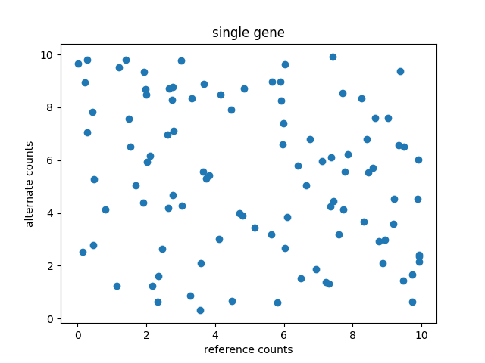
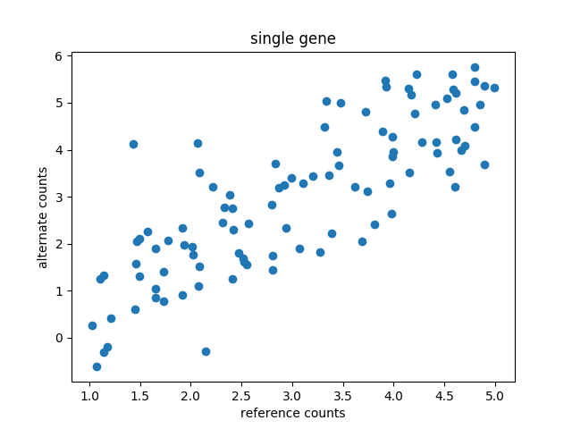
Analysis Methodology
before correction
after correction
* this is not real data
Notes:
Each dot represents a SNP
Assume that an entire gene is transcribed at once
With a random sample of transcribed gene data, we should find that the ratio between reference SNPs and alternate SNPs is more or less consistent within a gene
On its own, this doesn’t really say anything about ASE. But it does imply that our data “makes sense”, i.e., we captured an accurate sample of transcription
If counts skew towards reference or towards alternate, then that can suggest ASE.

Slide 20
Results: Data Sources
Reference Sequence: Homo sapiens 38 assembly
Standard human reference genome
https://software.broadinstitute.org/gatk/download/bundle
RNA Seq: GSM484895: GM12878_RNA-SEQ_Rep1(SRR038448)
Looks at variation in the binding sites of RNA Polymerase II
https://trace.ncbi.nlm.nih.gov/Traces/sra/?run=SRR038448

Slide 21
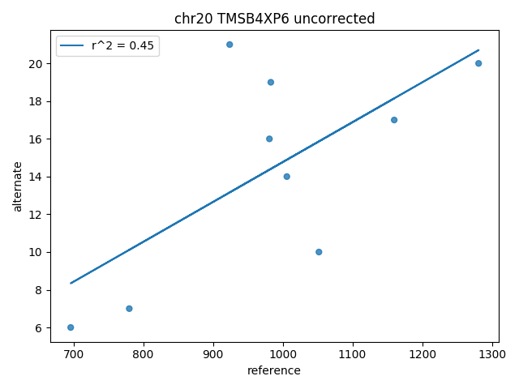
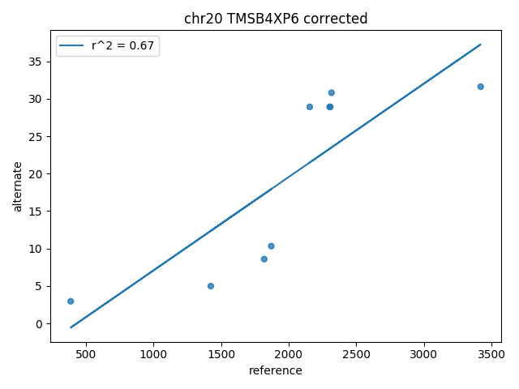
Results: chr20, gene TMSB4XP6
Notes:
This is the first chromosome we managed to get it through the entire pipeline
We chose this chromosome to debug because it was the smallest well-sequenced chromosome
Chose the gene with the most SNPs according to the VCF file
Bias correction actually made best fit line fit better (higher r^2)
Corrected data skews heavily towards reference, suggesting ASE

Slide 22
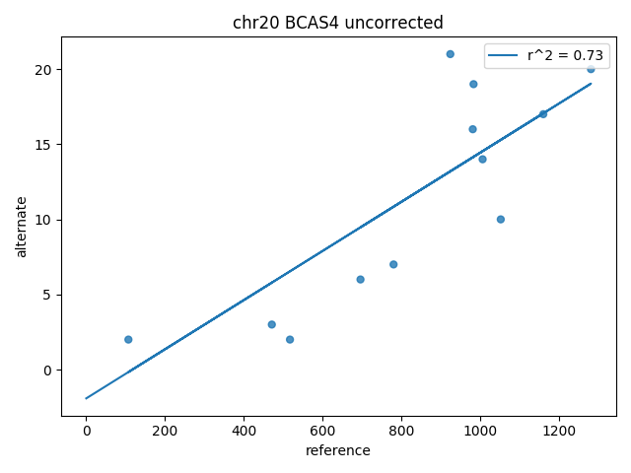
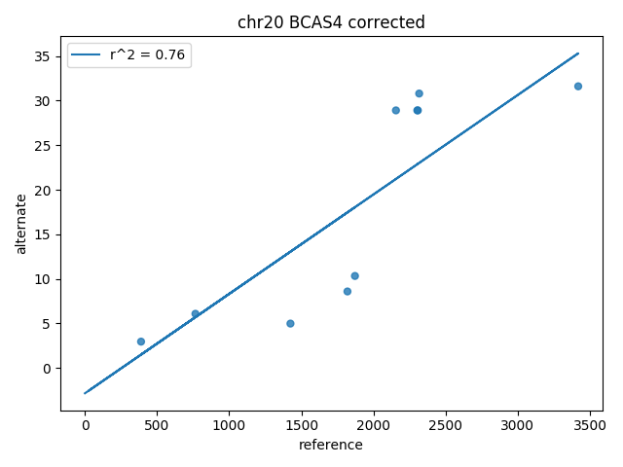
Results: chr20, gene BCAS4
Notes:
Also improved best fit line
Skews heavily towards reference -- ASE?

Slide 23
Results: chr1

Slide 24
Summary & Discussion: What We’ve Learnt
Technical skills required to work with RNASeq data
File formats (FASTA, SAM, VCF)
Tools (HISAT2.0, GATK, samtools)
Understand sources of bias
Mapping bias
Sequencing bias
Challenges with Big Data
Python memory errors
Optimizing code
Notes:
NOT SURE ABOUT OTHER OUTSTANDING PROBLEMS THAT AREN’T ALREADY MENTIONED IN FUTURE STEPS!
We learned the technical skills required to handle RNASeq data as well as a brief intro to bias correction.
We also learned about the files and formats required to work with compbio + HISAT + GATK, which are easily translatable to other compbio projects.
+ Soft Skills : Management, Organization, etc.

Slide 25
Summary & Discussion: Future Steps
Optimize code
Run on entire genome
Implement an "other" count for reads
Reads that don't match ('*' reads) should still be accounted for
Further reduce mapping bias
Run readcounter on reverse and alternate SAM files
Create SAM file that is concatenation of reference and alternate SAMs
Filter reads based on quality scores
Current data doesn't include quality scores
Analyze interesting genes (e.g. eye color, hair color)

Slide 26


Thanks Larry and Daniel!

