Slide 1
Finding & Evaluating RNA Motifs
Joyce Zhou
advised by Pf. Larry Ruzzo
Notes:
Hello everyone!
For the last while
- I’ve been working on ways to augment methods of detecting functional RNA.
There’s algorithms that already take in some set of DNA sequences and produce results
- but I wanted to focus on the “outside” of that box
- The input and the output itself.
First I’m going to go through some of the background on functional RNA and what already exists
Then describe my own work.

Slide 2
Background
Functional RNA:
“Central Dogma”: DNA …> RNA …> Protein
Extra RNA transcribed that does not make protein: ncRNA (fRNA?)
RNA can base pair with itself
Notes:
First, what’s functional RNA?
In some cell
- there is DNA in the nucleus
- When the cell needs to make proteins
- it will transcribe some sections of that DNA into RNA
- which is then translated into a protein.
-This is the “canonical” example, pretty much one of the first things the bio classes I’ve taken have taught.
However, the cell also transcribes lots of DNA->RNA that isn’t used to make proteins.
Some of the ways this can happen:
- transcription happens outside of the known start position
- this happens a lot especially in regions that generally surround a gene
- RNA splicing
- parts of the RNA that was transcribed are cut out of the sequence to produce the final messenger RNA
- the messenger RNA itself can have a lot of bases before and after the actual section that gets translated.
An observation to make about RNA now.
DNA is double-stranded. That means one strand bonds to the other, making a sort of ladder.
RNA is single-stranded, and it is capable of bonding to itself and making shapes a lot more complicated than a ladder – can fold similar to how a protein folds.
There’s a lot of space for functionality!

Slide 3
Background
Functional RNA:
Well-known examples: tRNA, ribosomes
More recently discovered: riboswitches, miRNA
(this is definitely not an exhaustive list)
Rfam has over 2600 families logged
Notes:
That means that a lot of that “extra” transcription can probably be (and is!) being put to good use.
Well, some of it’s still junk probably, but that’s fine too.
The transcribed but not-protein RNA is usually referred to as “noncoding RNA” i.e. transcribed RNA that does not code for proteins, alternatively “functional RNA”.
This class of genes isn’t super new:
- older (well-known) examples of ncRNA include
- transfer RNA
- ribosomes
- these have been known about for protein translation for a really long time.
- a lot of new examples of different RNA genes have appeared recently, I think tending since the 2000s ish.
- More recently discovered examples of ncRNA include
- riboswitches (functional segments of the mRNA itself that can control if it is transcribed or not)
- miRNA (…really small ncRNA pieces that can cut up a mRNA).
- There’s a database of a lot of them called rfam, parallel to a protein database called pfam. It’s got a lot of entries, somewhere above 2600 *families* of motifs.

Slide 4
ncRNA-finding algorithms
Generally work based on compensating base changes
Algorithms (also definitely not exhaustive, but covers main approaches)
EvoFold: multiple sequence alignment …> motifs
CMfinder: unaligned sequences get folded …> motifs
Notes:
Okay, so how have these functional RNA-finding algorithms worked
Qualities of a functional RNA:
- the structure pretty much stays the same
- the sequence is free to change
Mutations happen a lot over time, but they will preserve the base pairing: mutations happen in pairs.
Since we only have the DNA of animals that are alive today, we need to look for compensating base changes.
Here’s two algorithms that attack the challenge from basically different approaches:
- EvoFold
- starts with an alignment of sequences from multiple species and works based off that.
- (These alignments are based on the bases themselves.)
- Cmfinder
- starts with a set of any sequences, assuming that at least some fraction of that set of sequences contains the motif
- proceeds to conduct E-M on a CM model / a representation of the motif.
- Both of these need you to give it a set of sequence inputs and spit out a CM or equivalent…
- I haven’t actually *used* EvoFold.

Slide 5
Previous Work
Studies using CMfinder:
Verified in original paper [1]
Scan on prokaryotic bacteria [2]
Scan on more bacteria [3]
Scan on vertebrates [4]
Notes:
Previous Work
Because I’m working with Cmfinder, let’s go over some of the studies that have already been done using it.
There have been 2 and a half (the half was verifying results against a known set) studies using Cmfinder on bacteria.
- All of these focus on the 5’ UTR regions of homologous genes in bacteria
- the entire upstream sequences of a single gene from multiple species of bacteria were fed to Cmfinder as a set of input, and then repeated for some number of genes.
There has been 1 big study of vertebrates using Cmfinder across the entire genome
- (human specifically, and then including other animals where they happen to align).
- Because of the scale of this study (and because the big-O of Cmfinder and similar algorithms is at least polynomial if not exponential iirc) the individual inputs were actually each alignment block.

Slide 6
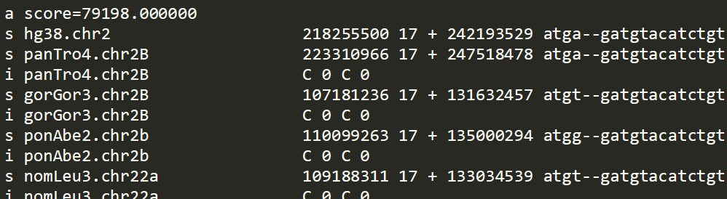
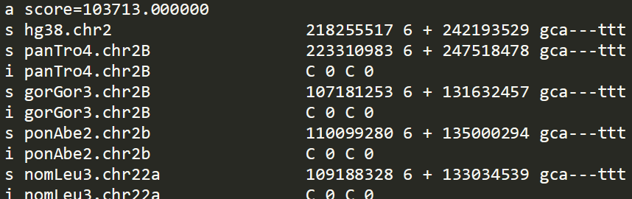
Alignment Blocks
Alignment block:
Notes:
What is an alignment block? :
- one chunk of DNA where it happens to more or less match up across multiple species. (Here’s) what it looks like.
- For the species that I show they’re really similar in sequence
- But there’s 95 more species that get really different or have gaps in between those chunks
- That’s why they’re separated
However, this really runs the possibility of cutting apart ncRNA that crosses block boundaries!
Some blocks are long enough that they might contain a significant portion of the motif to show up
- Especially since the vertebrate scan was run on hg17, MULTIZ17 which has longer blocks
- but some might still be too short and end up slicing a motif apart!
Also, because motifs are not necessarily structurally conserved but are still near conserved areas
- Possibility of them being skewed across nearby blocks

Slide 7
Blockmerger
Rules for mergeability:
Must be in same chromosome
Must be on same strand
Must be in-order (not disordered)
Must not have an insert that is too long
Notes:
Blockmerge explanation
Describe “syntenic blocks”
- Blocks that can be merged
Describe the motivations for how I’m merging them and the rules.
- Rules apply per-species
- Sequences that don’t fit all of these rules are excluded from the output

Slide 8
Blockmerger
Merge approaches:
N-block: merge N blocks at a time
Fillblock: merge as many blocks as possible within length range
Notes:
Blockmerge explanation
Outline different attempts at behavior (n-block, fillblock).
Nblock:
- group n blocks at a time
- window shift down 1 block at a time
- simple, less redundant
- Short block error
Fillblock:
- within a length range for the REF sequence
- doesn’t have “short block error”
- VERY redundant

Slide 9
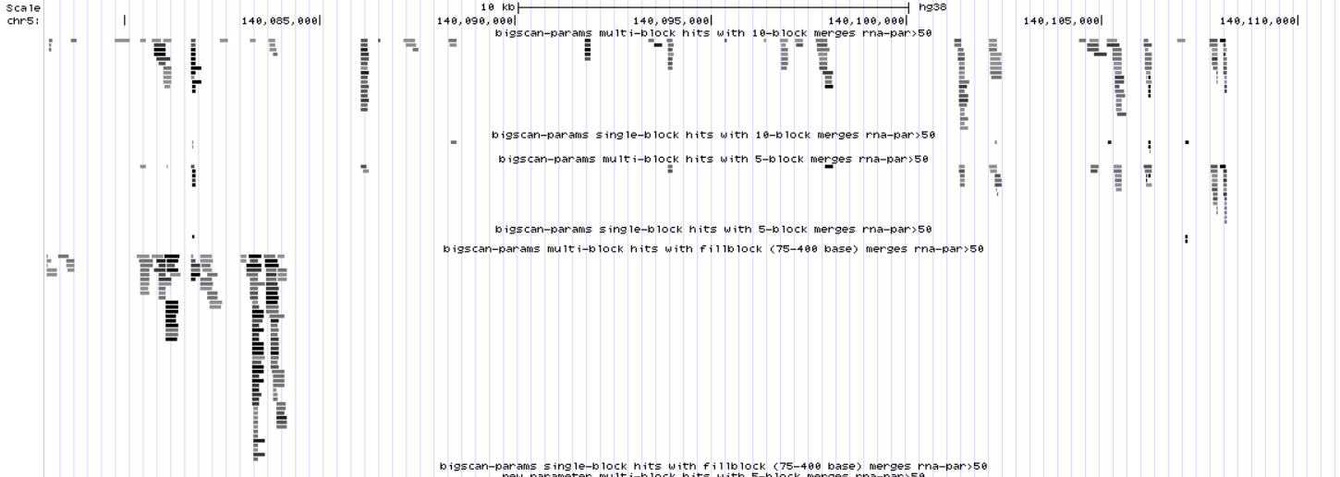
Notes:
Screenshot of the browser for chr5

Slide 10
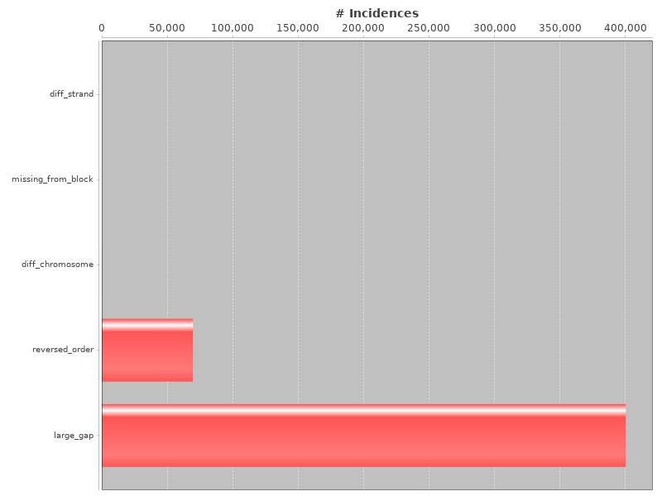
Notes:
Chr5 bigscan5

Slide 11
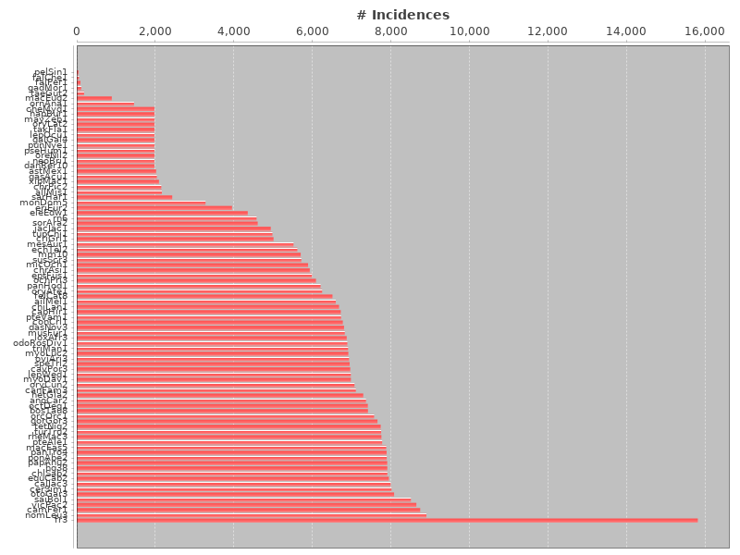
Notes:
Chr5 bigscan5

Slide 12
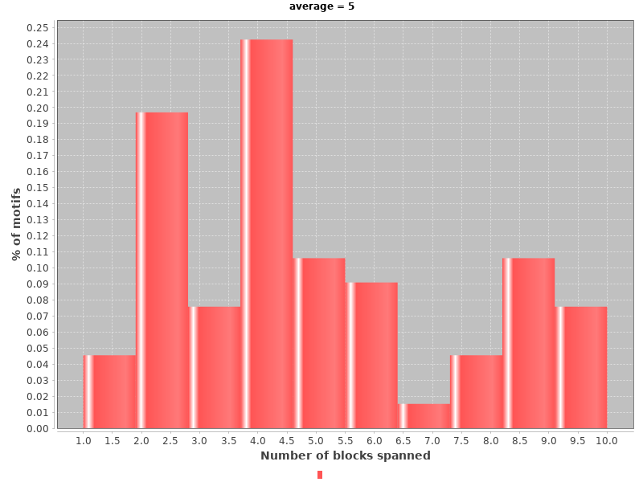
Notes:
Chr5 bigscan10

Slide 13
Covariance Models
Representation of ncRNA motif
Tree of nodes:
each node = one unpaired base / two paired bases
each node also contains insert / delete probabilities
Can be considered a probability distribution over RNA sequences
Notes:
CMs background
Let’s go back to CMs. What are they exactly?

Slide 14


K-L Divergence
A method of evaluating distance between probability distributions
Usually not symmetric: can add Dkl(P||Q)+Dkl(Q||P) to get symmetric score
Continuous distributions:
Discrete distributions:
Notes:
K-L divergence background
Describe K-L divergence as a thing that exists

Slide 15
K-L Divergence between CMs?
Hard to estimate divergence for all discrete distributions [1]
Infernal bitscore = log2(P/null)
6 estimation methods tested:
Sampling: sample from P only, sample from both P and Q
Correction: direct avg, corrected 2^Pbitscore, corrected 2^Pbitscore/null
Notes:
Scoring explanation
have a lot of potential CMs above a score threshold
- that more than likely exist as patterns
- but we also have a lot of overlapping between them
- Some of the overlaps might be sensibly exact repeats
- some overlaps suggest an alternative folding
- Almost all of them are different in some small regard
- How do we collapse those overlaps?
Rfam?
Here’s the six ways we tried.
- PQ had really high variance generally. PN also.
- PQ2P I went with using

Slide 16
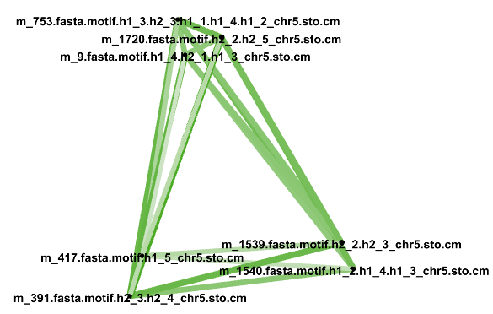
Clustering CMs
Distance matrix between CMs
Can be converted to affinity matrix
Use spectral clustering to group (graph interpretation)
For visualization: use Force Atlas (Gephi) >
Notes:
Scoring result exploration
Here’s how clustering them turned out. Probably some of those ways weren’t very good..

Slide 17
Clustering CMs
This was done for a much larger set of CMs!
The visualization software wasn’t cooperating…
Notes:
Scoring result exploration

Slide 18
Review
Done:
Merge alignment blocks
Scoring method for comparing CMs
Future work?:
Evaluate score threshold quality
Compare against Rfam
Notes:
Summary
Review of the things that I did.
Should I mention the things that I didn’t do?

Slide 19
Thank you!

