Slide 1

Week 1
Beginner Python
Course Introduction, Setup and the Command Line Basics

Slide 2
Brief Course Overview
10-Week Crash Course
Introduction, Setup and Command Line Basics
Git Basics and Setup
Variables, Data Types, Casting, Arrays, Comments
Conditional Statements and Input/Output
Loops
Functions and Recursions
Classes, Objects and Dictionaries
Course Project : Choose, Setup and Code Along
Course Project (Continued)
Course Completion and Project Demo

Slide 3
Each class we have
Lectures
2-3 sub topics
Q&A before move on to next topic
Quizzes between subtopics - https://quizizz.com/
End of Class Exercise
Finish before you go
Take Home Challenge (only starts on week 3 onwards)
Recommended to finish
Ask me anytime
Will be discussed on the week after
Between classes
Video support as needed – every Monday and Tuesdays

Slide 4
Resources
A computer
Windows 10
MacOS
Python & Anaconda (includes Jupyter Notebook)
Git & Github account
Quizziz: https://quizizz.com/
Message through: Telegram
Announcements: Google Classroom
Classes: Google Meet

Slide 5
Course Aim
Understand the fundamental concepts of programming
Obtain familiarity with Python
Equip students with skills to enable them to take their own projects independently
Equip students with tools to showcase their skills to future employers
Allow students to ”think like a programmer”
Notes:
Think like a programmer – able to break complex problem intro smaller, solvable units – divide and conquer

Slide 6
Today’s Class
Introduction to Programming and Python
Installing Python and Code Editor
The Command Line Basics

Slide 7
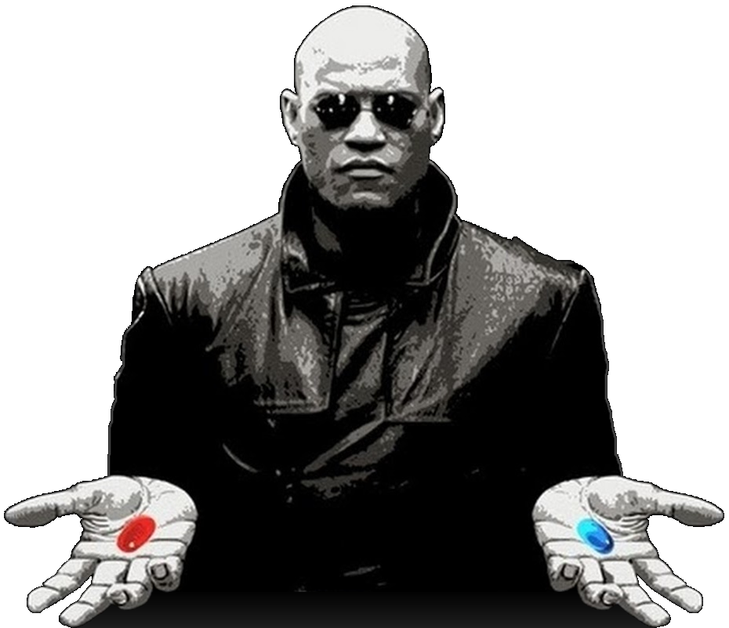
Enter Programming
Today begins your journey

Slide 8


What is Programming?
Simply to give instructions to a computer to execute specific tasks
Hey, calculate for me the square root of 9
Programming a.k.a to code
3

Slide 9

But what is a Computer?
Just a machine with many components
Circuit boards
Transistors
Processors
Hard Drives
Screen
Don’t understand human language
Only understand Binary

Slide 10
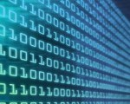
Binary?
Binary is simply a series of 0’s and 1’s
0010010101000101010100101010…..

Slide 11
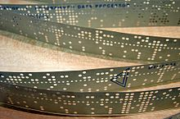
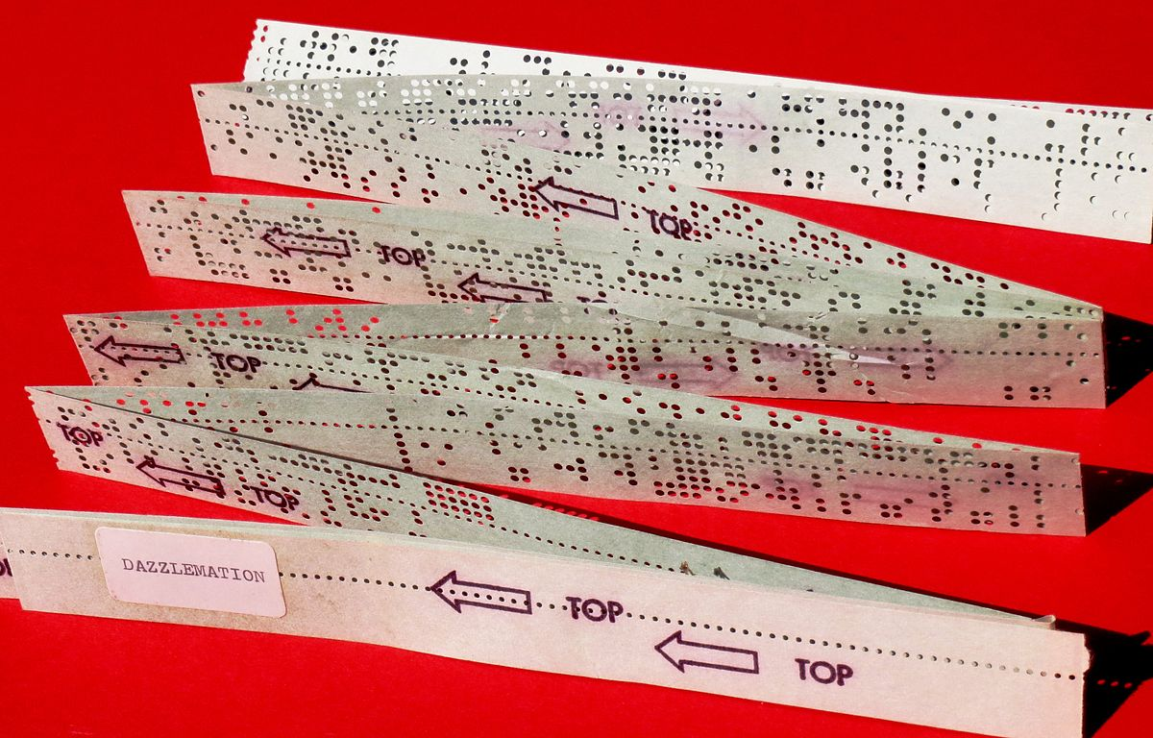
Back in the day…
Hey, calculate for me the square root of 9
0010010101000101010100101010…..
3
This Photo by Unknown Author is licensed under CC BY-SA
This Photo by Unknown Author is licensed under CC BY-SA

Slide 12

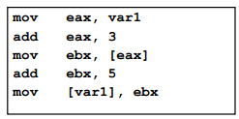

As we progressed through the years…
This new language
Compiler
Assembly
Language
Translate
0010010101000101010100101010…..
Why not I create something more “human readable”
and have a compiler translate that to binary?
This Photo by Unknown Author is licensed under CC BY-SA

Slide 13
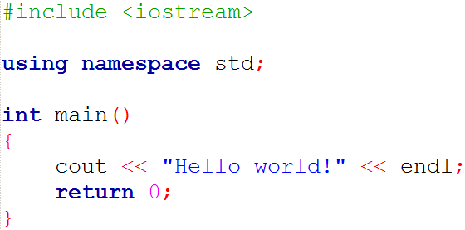
Still not close to human readable…
This new language
Compiler
Translate
Assembly
C/C++
Why not I create something new, more “human readable”
and have a compiler translate that to Assembly?
This Photo by Unknown Author is licensed under CC BY-SA

Slide 14
In the effort to make “code” more human readable…
So was born…
Python
Translate
C/C++
High Level i.e. close to English
Easy to Learn, Fast to Develop
Supports a tremendously wide range of libraries

Slide 15
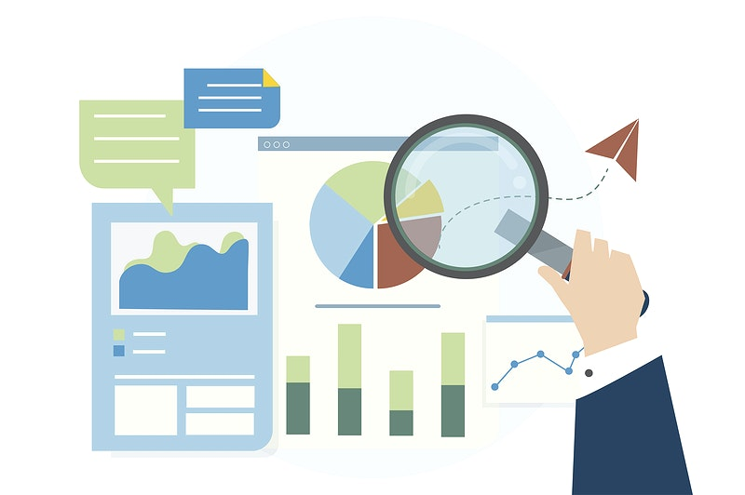
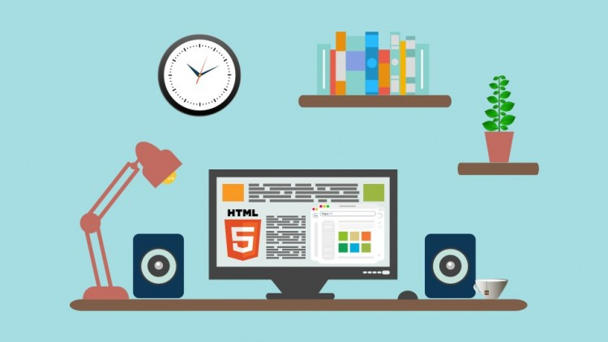
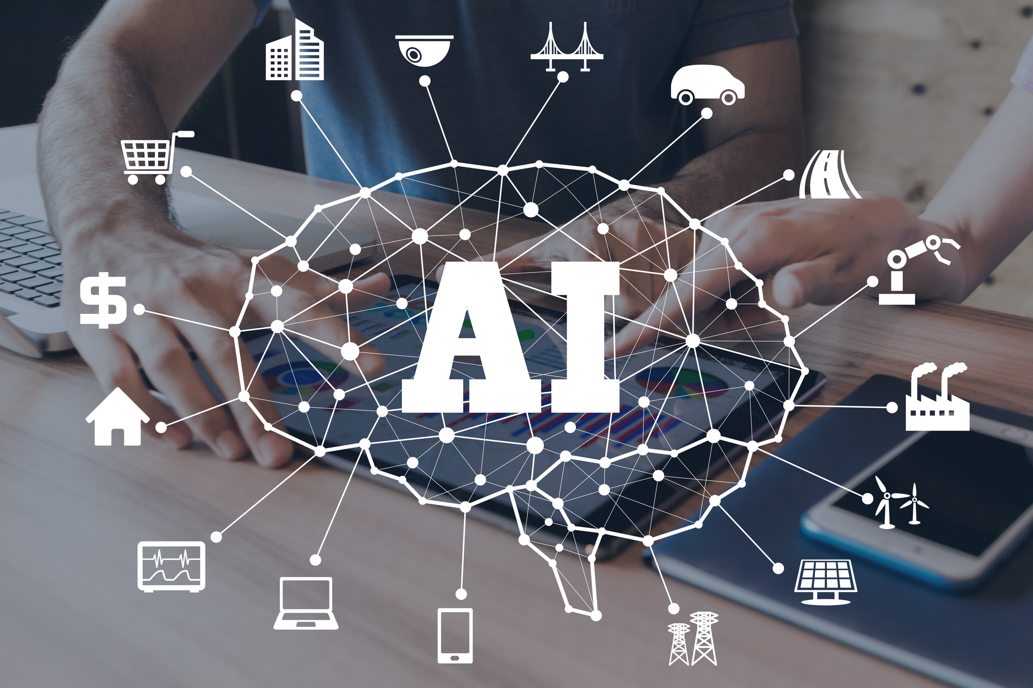
Python Use Cases
Data Analysis & Visualizations
Web Scraping
Web Development
Software Testing
Automation
Data Science
Machine Learning
AI – NLP, Computer Vision
This Photo by Unknown Author is licensed under CC BY-SA
This Photo by Unknown Author is licensed under CC BY-NC

Slide 16
Let’s Install Python!

Slide 17
And a Code Editor!

Slide 18
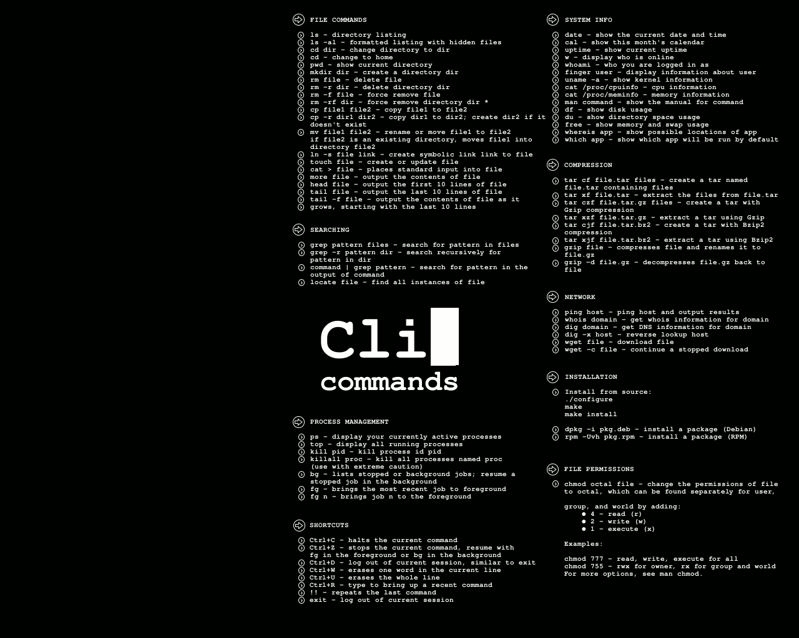
The Command Line Basics
Meet your new best friend
This Photo by Unknown Author is licensed under CC BY-SA

Slide 19
References
https://www.botreetechnologies.com/blog/top-10-python-use-cases-and-applications/

