Slide 1

Week 1
Beginner Python
Course Introduction, Setup and the Command Line Basics

Slide 2
Brief Course Overview
10-Week Crash Course
Introduction, Setup and Command Line Basics
Git Basics and Setup
Variables, Data Types, Casting, Arrays, Comments
Conditional Statements and Input/Output
Loops
Functions and Recursions
Classes, Objects and Dictionaries
Course Project : Choose, Setup and Code Along
Course Project (Continued)
Course Completion

Slide 3
Each class we have
Lectures
2-3 sub topics
Q&A before move on to next topic
Quizzes between subtopics - https://quizizz.com/
End of Class Exercise
Finish before you go
Take Home Challenge (only starts on week 3 onwards)
Recommended to finish
Ask me anytime
Will be discussed on the week after
Between classes
Video support as needed – every Monday and Tuesdays

Slide 4
Resources
A computer
Windows 10
MacOS
Python & Anaconda (includes Jupyter Notebook)
Git & Github account
Quizziz: https://quizizz.com/
Message through: Telegram
Announcements: Google Classroom
Classes: Google Meet

Slide 5

Enter Programming
Today begins your journey

Slide 6


What is Programming?
Simply to give instructions to a computer to execute specific tasks
Hey, calculate for me the square root of 9
Programming a.k.a to code
3

Slide 7

But what is a Computer?
Just a machine with many components
Circuit boards
Transistors
Processors
Hard Drives
Screen
Don’t understand human language
Only understand Binary

Slide 8

Binary?
Binary is simply a series of 0’s and 1’s
0010010101000101010100101010…..

Slide 9
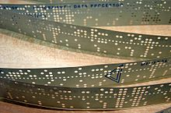
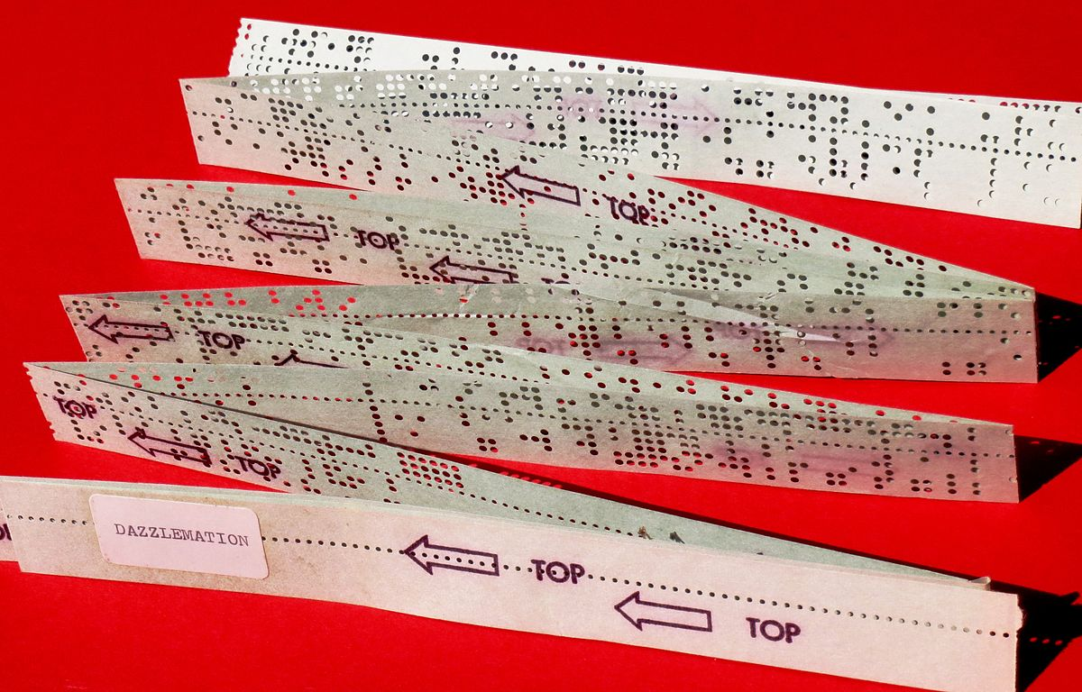
Back in the day…
Hey, calculate for me the square root of 9
0010010101000101010100101010…..
3
This Photo by Unknown Author is licensed under CC BY-SA
This Photo by Unknown Author is licensed under CC BY-SA

Slide 10

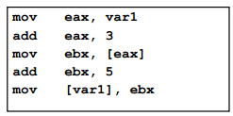

As we progressed through the years…
This new language
Compiler
Assembly
Language
Translate
0010010101000101010100101010…..
Why not I create something more “human readable”
and have a compiler translate that to binary?
This Photo by Unknown Author is licensed under CC BY-SA

Slide 11
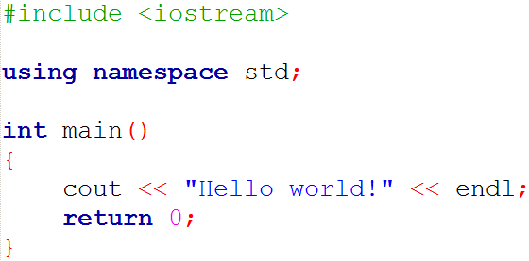
Still not close to human readable…
This new language
Compiler
Translate
Assembly
C/C++
Why not I create something new, more “human readable”
and have a compiler translate that to Assembly?
This Photo by Unknown Author is licensed under CC BY-SA

Slide 12
In the effort to make “code” more human readable…
So was born…
Python
Translate
C/C++
High Level i.e. close to English
Easy to Learn, Fast to Develop
Supports a tremendously wide range of libraries

Slide 13

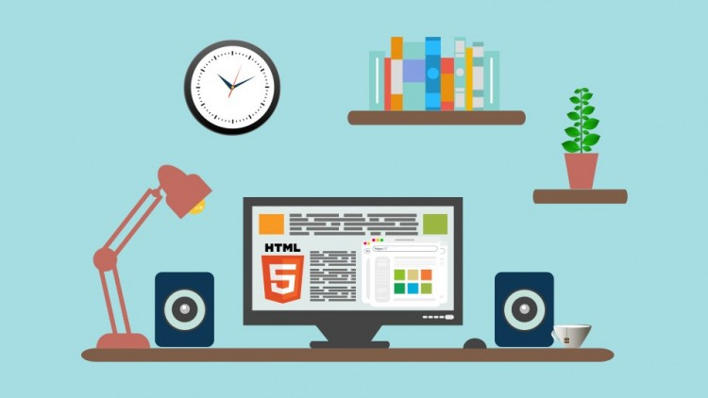

Python Use Cases
Data Analysis & Visualizations
Web Scraping
Web Development
Software Testing
Automation
Data Science
Machine Learning
AI – NLP, Computer Vision
This Photo by Unknown Author is licensed under CC BY-SA
This Photo by Unknown Author is licensed under CC BY-NC

Slide 14
Let’s Install Python!

Slide 15
And a Code Editor!

Slide 16
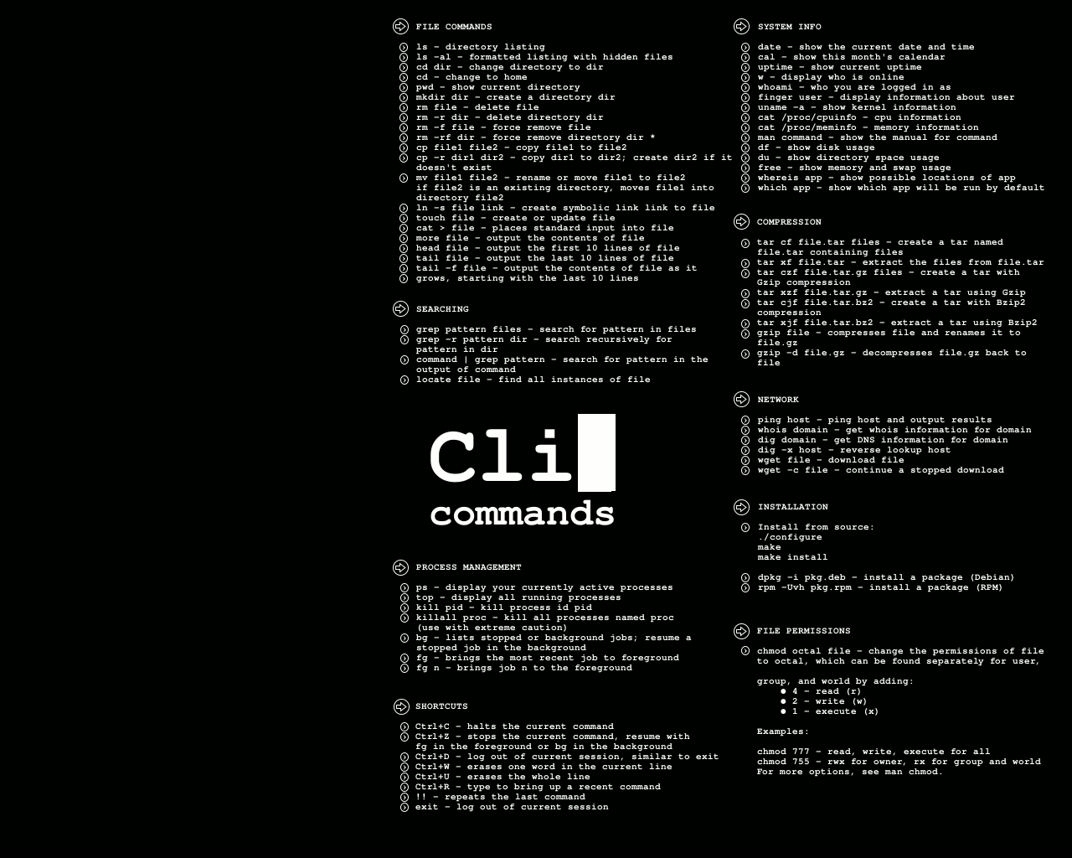
The Command Line Basics
Meet your new best friend
This Photo by Unknown Author is licensed under CC BY-SA

Slide 17
References
https://www.botreetechnologies.com/blog/top-10-python-use-cases-and-applications/

