Slide 1

Path Tracing Denoising
Pascal Cornu
Bachelorthesis

Slide 2
Inhalt
Project 2 Hintergrund
Projektziele
Projektablauf
SLProject4 Path Tracer
Path Tracing Rauschen
Dataset Generierung
Modell Erstellung

Slide 3
Project 2 Hintergrund
Path Tracing Global Illumination
Ray & Path Tracing
Indirekte Beleuchtung
Physically Based rendering

Slide 4
Projektziele
Path Tracing und Denoising erforschen
Implementierung eines einfachen Path Tracers
Implementierung eines Denoisers
Denoiser Vergleich

Slide 5
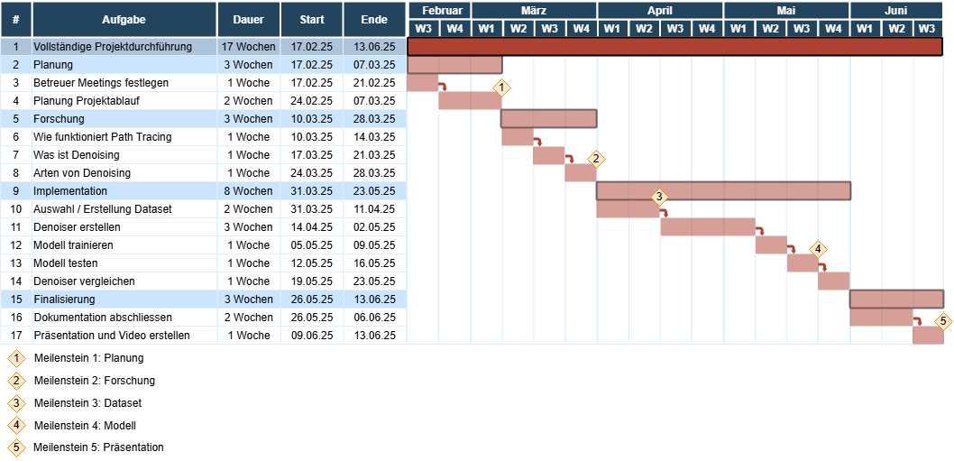
Projektablauf

Slide 6
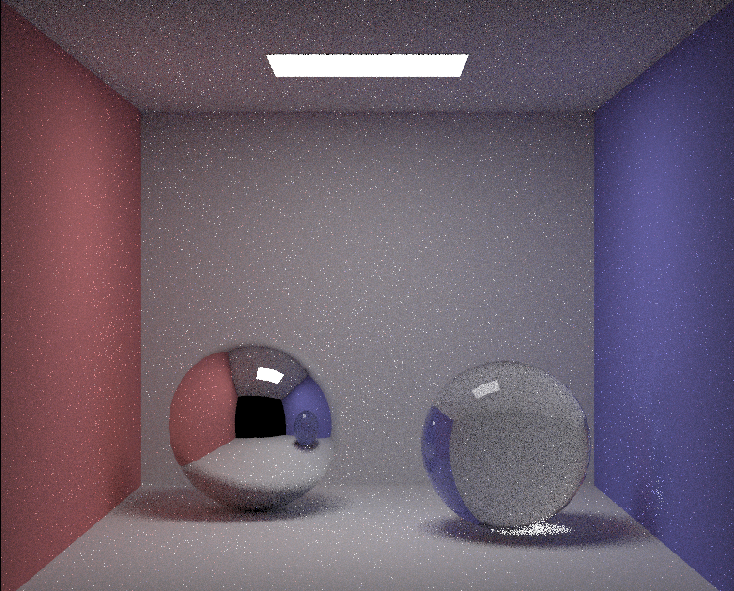
SLProject4 Path Tracer
Untersuchung der Fireflies
Vergleich mit SmallPT

Slide 7
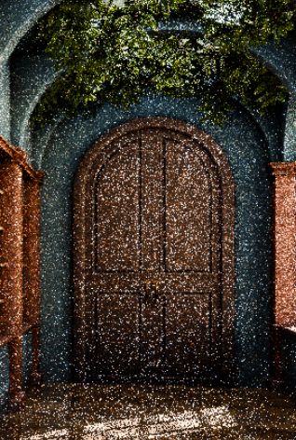
Path Tracing Rauschen
Entsteht durch Monte-Carlo-Approximation
Anders als natürliches Rauschen
Abhängig von Struktur und Lichtverhältnis der Szene

Slide 8
Dataset Generierung
Kein perfektes öffentliches Dataset vorhanden
Python Skript mit Blender
Speichert Bilder nach vordefinierten Frames
Noisy / Ground Truth pairs

Slide 9
Modell Erstellen
Auto Encoder vs CNN
Beides erstellen und vergleichen
Notes:
🔹 Autoencoder – Pros and Cons
✅ Pros:
Global context awareness: Learns a compressed latent representation, which helps capture larger-scale structures and patterns in the image.
Structured noise removal: Well-suited for removing structured or scene-dependent noise common in path tracing.
Dimensionality reduction: Bottleneck forces the model to focus on the most relevant features, potentially reducing overfitting.
Flexible loss combinations: Can incorporate perceptual, structural, or latent-space losses to enhance reconstruction quality.
❌ Cons:
Detail loss risk: Bottleneck can cause loss of fine details or texture, especially if it’s too small or the decoder is weak.
Complex architecture: More parameters and layers (especially in the decoder) can make it slower to train and harder to tune.
Reconstruction artifacts: Poorly designed decoders can introduce blurring or checkerboard artifacts during upsampling.
Less interpretable layers: Intermediate representations are more abstract and harder to understand or debug.
🔹 CNN – Pros and Cons
✅ Pros:
Preserves spatial resolution: Typically operates at full image resolution without compression, helping retain fine details.
Simpler architecture: Easier to implement and faster to train due to fewer layers and no explicit bottleneck.
Effective local filtering: Excels at removing localized noise using learned convolutional kernels.
Scalable: Can be easily extended into more complex architectures (e.g., U-Nets, residual networks).
❌ Cons:
Limited context range: Without downsampling or dilation, CNNs mainly see local neighborhoods and may miss global structure.
Harder to denoise complex scenes: May struggle with scenes where noise patterns are influenced by large-scale scene geometry or lighting.
Can overfit: Without appropriate regularization, CNNs can overfit to the training data and generalize poorly.
No explicit compression: Doesn't learn a compact representation of the scene, which could be useful for certain denoising insights.

