Slide 1
github
ikt
ikt
Local Repository
Internet
Staged Changes:
szoveg1.txt
git commit –m „uzenet”
git push origin master
Unstaged changes:
szoveg1.txt
git add fájlnév
git remote add origin https://github.com/...

Slide 2
Local repository
Github
git clone https://github...
ikt_feladat
ikt_feladat
git push origin master

Slide 3
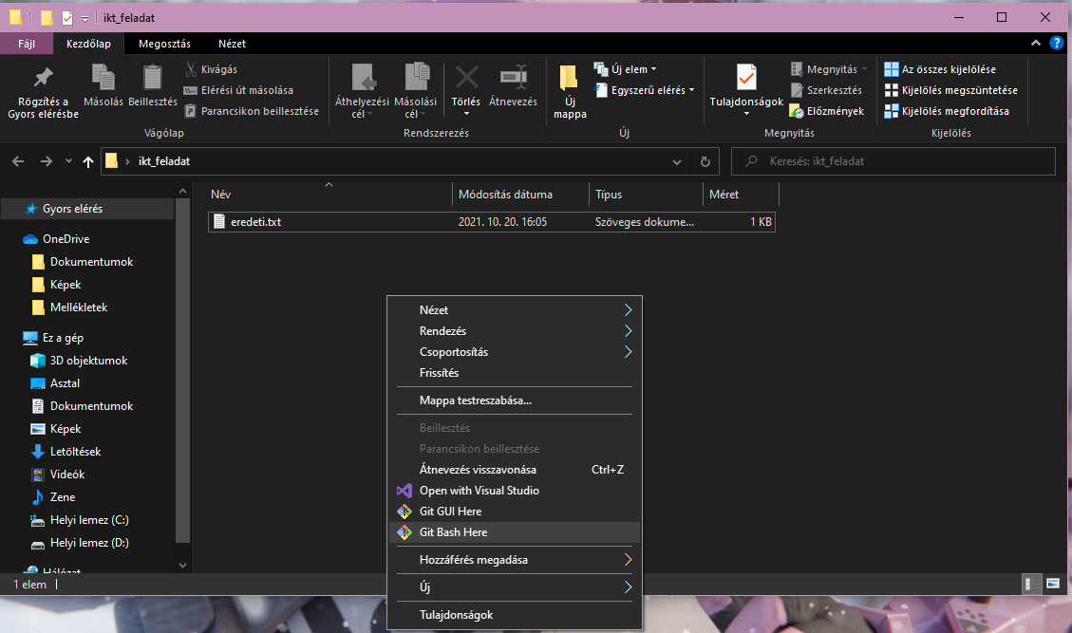

Slide 4
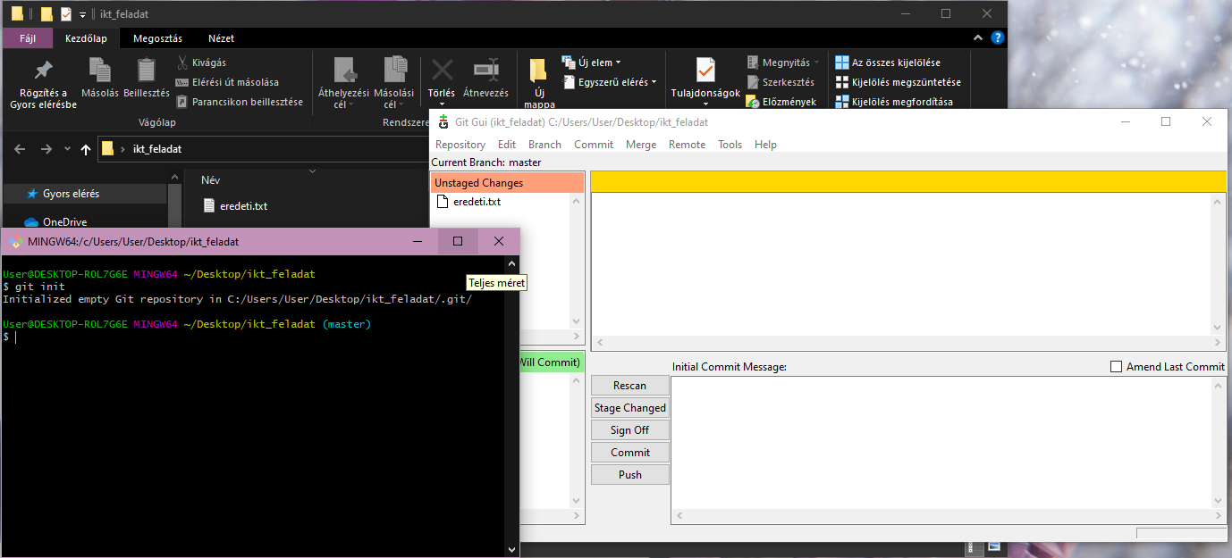

Slide 5
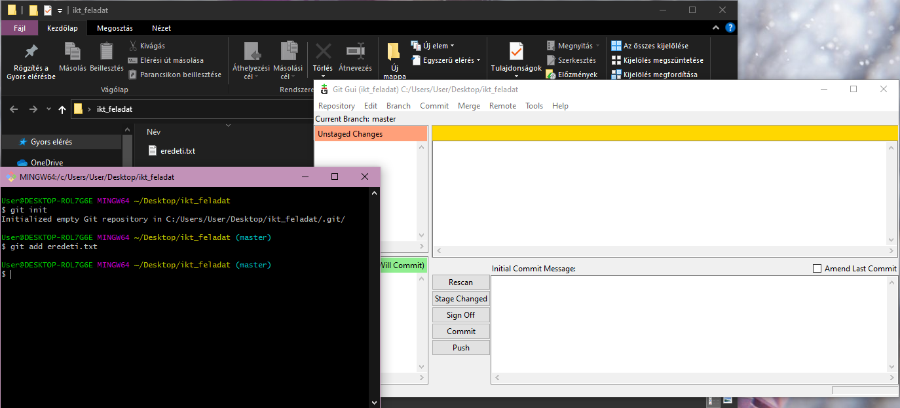

Slide 6
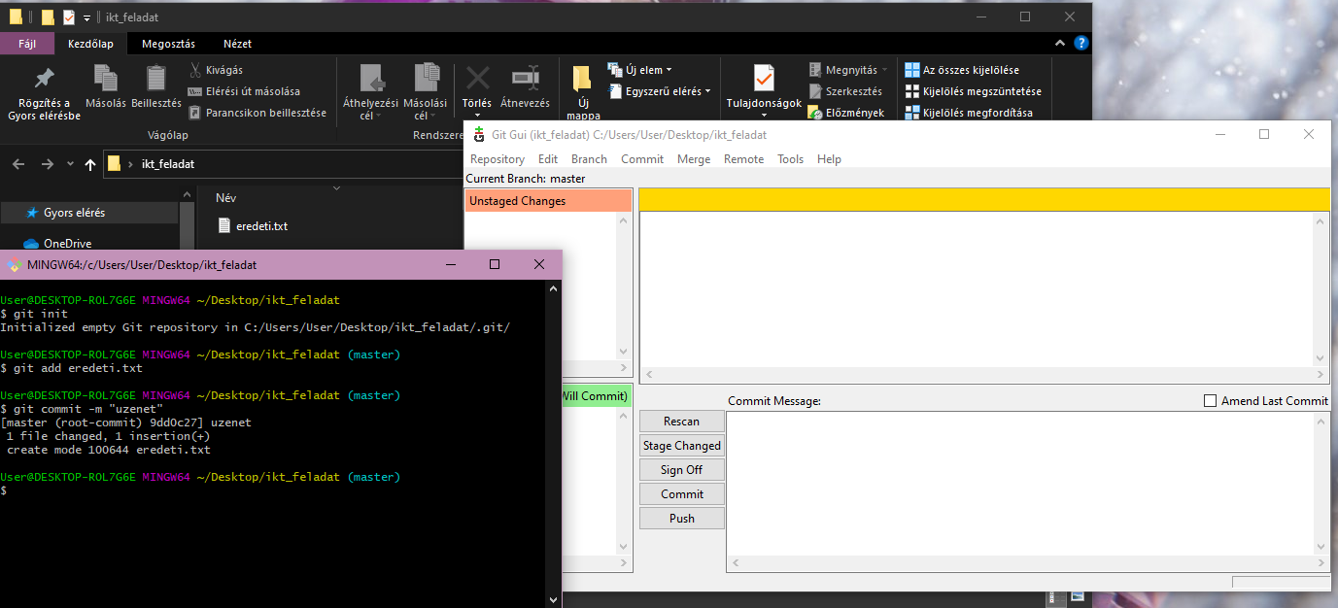

Slide 7
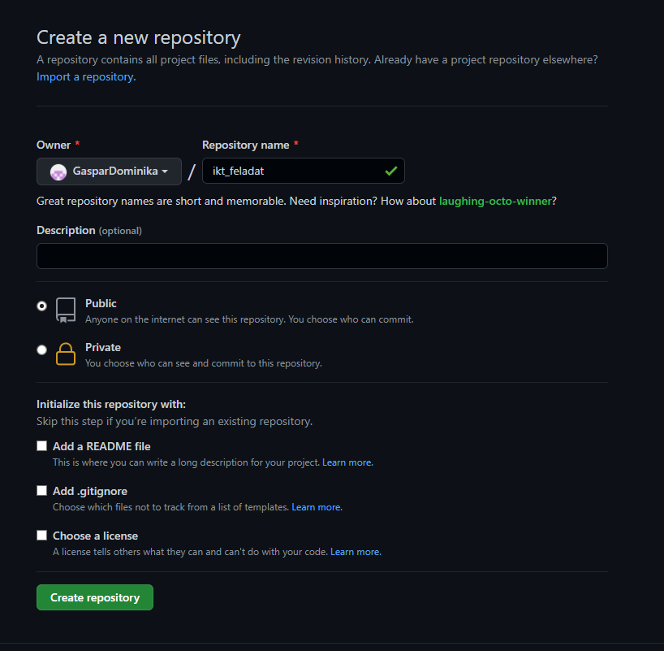

Slide 8
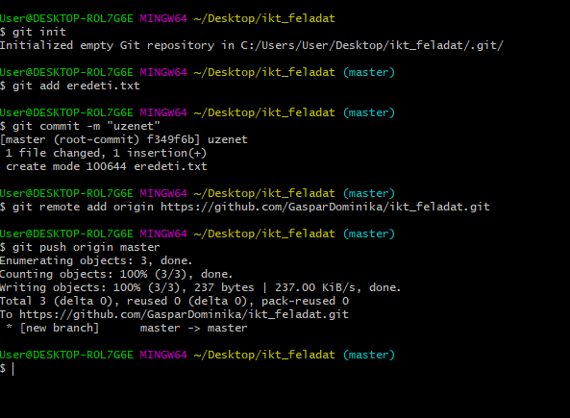

Slide 9
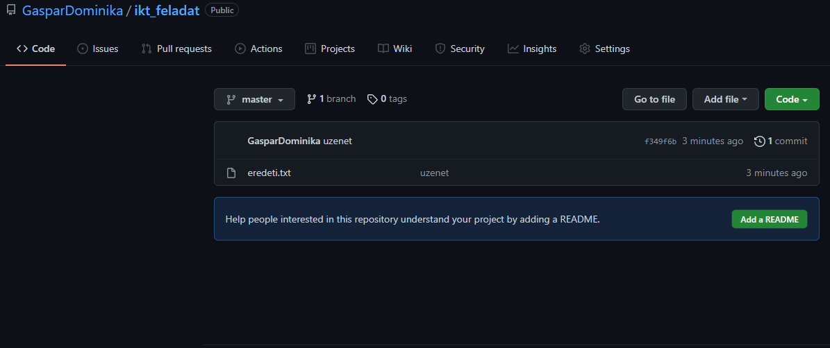

Slide 10
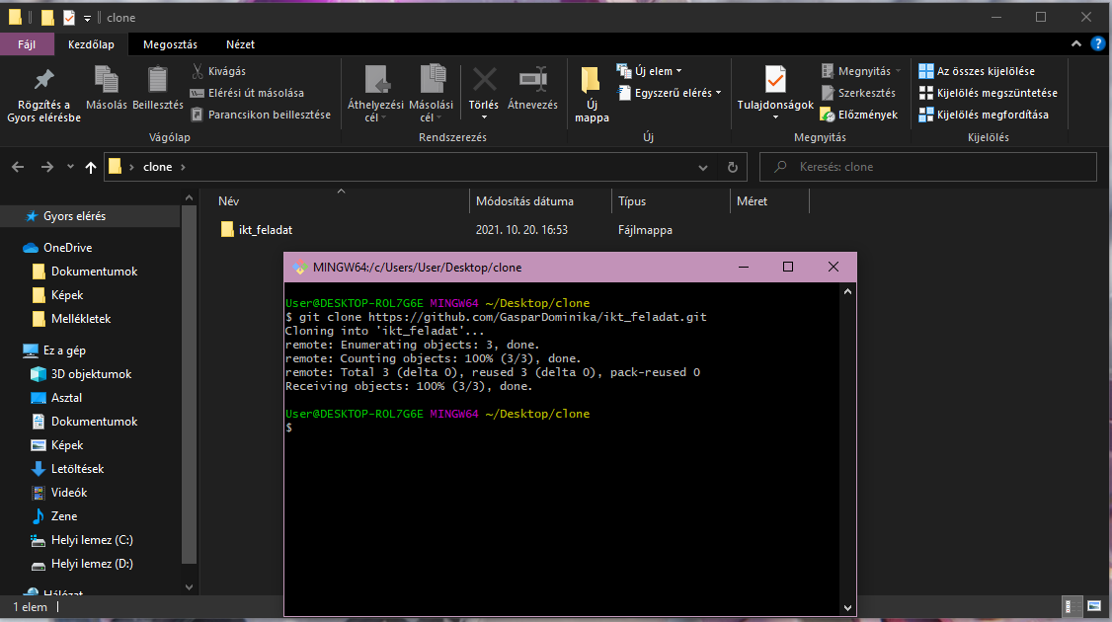

Slide 11
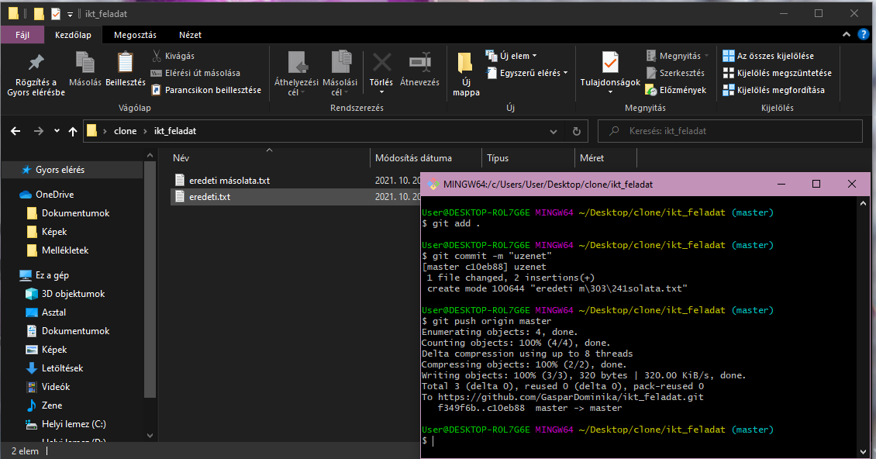

Slide 12
