Slide 1
MORTGAGE CREDIT · MODEL SUMMARY
Maximum loan amount
model.
Predicting the bank's responsible lending limit from applicant data — validated against the actual decisions it has held out.
ÁS
EXECUTIVE BRIEFING · 2026
CONFIDENTIAL

Slide 2
CONTENTS
What's in this deck
01
Executive summary
APPENDIX
The ask, the answer, the headline result
A
Why interest rate was excluded
02
Can we trust the model?
Accuracy against the held-out actual decisions
B
Four factors & fair lending
03
What drives the loan
The four factors that set the limit
C
Data & method background
04
Recommendation & next steps
How to put it to work
MAXIMUM LOAN AMOUNT MODEL
CONTENTS

Slide 3
01 — EXECUTIVE SUMMARY
A model that reproduces lending
decisions to within ~4%
0.990
±$22.0k
94.9%
VARIANCE EXPLAINED (R²)
TYPICAL ERROR (MAE)
WITHIN ±10% OF ACTUAL
The ask: estimate the maximum loan the bank should responsibly offer each applicant, from their financial profile alone.
The answer: a gradient-boosting model predicts that limit with high accuracy — and we validated it against the real decisions, which were never shown to the model.
Why it matters: consistent, explainable loan sizing — a fast first-pass limit for ~95% of applicants, with the rare large miss easy to flag for review.
MAXIMUM LOAN AMOUNT MODEL
01 · EXECUTIVE SUMMARY

Slide 4
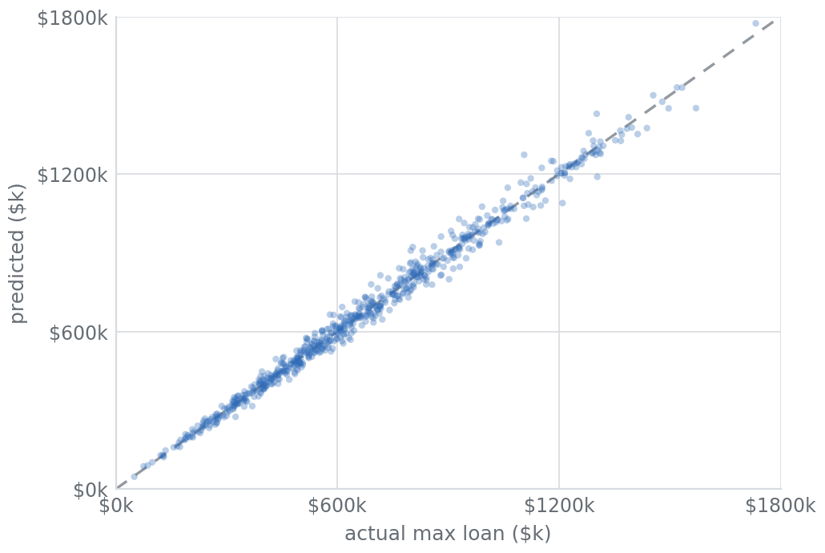
02 — CAN WE TRUST THE MODEL?
Predictions land on the bank's
actual decisions
PREDICTED VS ACTUAL — HELD-OUT APPLICANTS
Tested honestly. Measured on 9,998 applicants the model never saw in training.
On the line. Each point is one applicant; the closer to the dashed line, the closer the prediction to the real limit.
No size blind spot. Accuracy holds from the smallest to the largest loans.
MAXIMUM LOAN AMOUNT MODEL
02 · VALIDATION

Slide 5
03 — WHAT DRIVES THE LOAN
Four factors set the limit
Income leads — the single biggest driver of how much the bank will lend.
Credit score next — creditworthiness scales the limit up or down.
Debt pulls down, down payment nudges up — capacity and commitment.
Everything else is noise: age, job, education, area add nothing once income and credit are known.
RELATIVE INFLUENCE ON THE PREDICTED LIMIT
MAXIMUM LOAN AMOUNT MODEL
03 · DRIVERS

Slide 6
04 — RECOMMENDATION & NEXT STEPS
Adopt it as a first-pass limit engine
Pilot in shadow mode — run alongside underwriters; compare before going live.
RECOMMENDATION
Use the model to propose a maximum loan instantly for every applicant, auto-approving the ~95% it sizes within ±10% and routing the rest to a human reviewer.
Set a review band — flag predictions that disagree with policy by > 10%.
Govern the inputs — uses no demographics; document and monitor for drift.
Refresh on real data — retrain when a book of genuine decisions is available.
MAXIMUM LOAN AMOUNT MODEL
04 · RECOMMENDATION

Slide 7
Appendix
Key decisions & background
ÁS
APPENDIX

Slide 8
APPENDIX A — FEATURE DECISION
Interest rate was excluded — it's a
price the bank sets, not an input
Near-perfectly tied to credit score (correlation −0.95): better credit → lower rate, almost mechanically.
INTEREST RATE VS CREDIT SCORE
−0.95 correlation with credit score
Predictable from other inputs with 91–94% accuracy — it carries almost no new information.
Using it would be circular — feeding one bank decision in to predict another, and double-counting credit score.
0.91–0.94 predictable from applicant inputs (R²)
MAXIMUM LOAN AMOUNT MODEL
APPENDIX A

Slide 9
APPENDIX B — MODEL DESIGN
Four factors beat twelve — leaner
and more defensible
 | R² | Typical error
12 features | 0.9894 | $22,428
4 features | 0.9897 | $21,966
WHY IT'S MORE DEFENSIBLE
No demographics. Uses no gender, marital status or age — supports fair-lending (ECOA) defensibility.
Job & education added nothing — they were just stand-ins for income.
Same model on just income, credit score, existing debt and down payment is marginally more accurate.
Simpler to explain and to govern: four inputs, all financial.
MAXIMUM LOAN AMOUNT MODEL
APPENDIX B

Slide 10
APPENDIX C — BACKGROUND
Data & method, in brief
Dataset: 49,990 mortgage applicants, 13 attributes. Clean — no missing values or duplicates; 41 minor anomalies kept and flagged.
MODEL COMPARISON — TYPICAL ERROR
Held-out target: the actual maximum loan was never used in training — only to score the model at the end.
Models compared: linear, random forest and gradient boosting, on raw and log scales — six combinations under one test.
Chosen: gradient boosting (raw) — clearly the most accurate and stable.
MAXIMUM LOAN AMOUNT MODEL
APPENDIX C

