Slide 1
CREDIT RISK · MODEL METHODOLOGY & VALIDATION
Maximum loan amount
model — technical review
Data, feature decisions, model selection and held-out validation — for credit and modelling reviewers.
ÁS
INTERNAL · CREDIT & MODELLING
METHODOLOGY V1 · 2026

Slide 2
CONTENTS
Storyline
01
Data & exploration
Shape, quality, distributions, what correlates
02
Feature decisions
Interest rate, down payment, cleaning & audit
03
Model & evaluation
Benchmark, parsimony, validation, governance
PLUS — OBJECTIVE & APPROACH, AND APPENDIX (FULL BENCHMARK + DATA DICTIONARY)
MAX LOAN MODEL · METHODOLOGY
CONTENTS

Slide 3
OBJECTIVE & APPROACH
Predict the bank's loan limit — without
ever seeing it during modelling
Goal: estimate Max Loan Amount (USD) from applicant attributes, as a regression problem.
THE LEAKAGE RULE
Interest rate and the target are kept out of the feature set. The model sees only what an applicant brings to the table.
Held-out target: the actual maximum loan is excluded from every training/selection step and used only for final evaluation.
Discipline: staged & gated — discovery → cleaning (audited) → method selection → validation, each surfaced for decision.
Reproducible: numbered standalone scripts regenerate every figure and number in this deck.
MAX LOAN MODEL · METHODOLOGY
OBJECTIVE

Slide 4
01
Data & exploration
49,990 applicants — what's there, how clean, and what moves the loan.
ÁS
01

Slide 5
01 — DATASET & QUALITY
Clean to begin with
49,990
14
0
41
APPLICANTS (ROWS)
COLUMNS
NULLS / DUPLICATES
ANOMALIES FLAGGED
Grain: one row per mortgage applicant; no duplicates.
Types: 8 numeric (income, credit score, down payment, debt, age, employment, loans repaid, rate), 5 categorical, 1 target.
Quality: no missing values; all integrity checks pass except 41 rows implying a working start age of 14–15 (off by 1–2 yrs).
Decision: keep all rows; the 41 are kept and flagged in the cleaning audit, not removed.
MAX LOAN MODEL · METHODOLOGY
01 · DATA QUALITY

Slide 6
01 — DISTRIBUTION & DRIVERS
Right-skewed target; income & credit lead
MAX LOAN AMOUNT — DISTRIBUTION
CORRELATION WITH THE TARGET
MAX LOAN MODEL · METHODOLOGY
01 · DISTRIBUTIONS

Slide 7
01 — CATEGORICAL SIGNAL
Education and job look strong — but echo income
AVG LOAN BY EDUCATION ($K)
AVG LOAN BY JOB ($K)
Three job tiers (≈$575k / $690k / $810k) mirror income tiers exactly — a hint that these categoricals are proxies, confirmed later by feature importance.
MAX LOAN MODEL · METHODOLOGY
01 · CATEGORICALS

Slide 8
02
Feature decisions
What goes into the model — and the evidence behind each call.
ÁS
02

Slide 9
02 — FEATURE DECISION
Interest rate excluded: it's risk-based
pricing, not an applicant input
Correlation −0.95 with credit score — the rate is essentially a deterministic function of creditworthiness.
IS THE RATE AN INPUT OR AN OUTPUT?
−0.95
Predicted from the other inputs at R² 0.91–0.94 (linear / random forest) — almost no independent information.
correlation with credit score
Circular if used: a bank-set output predicting another bank output, double-counting credit score.
0.91–0.94
rate predictable from applicant inputs (R²)
Down payment, by contrast, is a genuine input — kept (next slide).
MAX LOAN MODEL · METHODOLOGY
02 · INTEREST RATE

Slide 10
02 — FEATURE DECISION
Down payment kept — it carries real signal
Conceptually an input: reflects household purchasing power and commitment to the purchase.
TYPICAL ERROR (MAE) IMPACT
$21,966 with down payment
Empirically load-bearing: dropping it raises the 4-feature model's typical error from $21,966 to $35,648.
$35,648 without it
Correlation 0.47 with the target, and 3rd–4th in model importance — not redundant with income or credit.
+62% error if removed
MAX LOAN MODEL · METHODOLOGY
02 · DOWN PAYMENT

Slide 11
02 — CLEANING & AUDIT
Nothing removed — everything reconciled
Integrity checks: nulls, duplicates, non-positive values, credit-score range, down-payment > loan, debt > income, categorical whitespace — all pass.
RECONCILIATION
49,990 raw 49,990 kept + 0 removed
Only anomaly: 41 rows with implied working start age < 16; kept and individually logged (step C9).
Audit trail: cleaning_audit.csv records every check and flagged row with a reason.
kept + removed = raw ✓
MAX LOAN MODEL · METHODOLOGY
02 · CLEANING

Slide 12
03
Model & evaluation
Choosing the model on evidence, then testing it against the held-out actual.
ÁS
03

Slide 13
03 — METHOD SELECTION
Six combinations, one protocol
Model | Target | R² | MAE | RMSE | MAPE
HistGradientBoosting | raw | 0.9894 | $22,428 | $31,937 | 3.74%
HistGradientBoosting | log | 0.9894 | $22,463 | $31,915 | 3.70%
Random Forest | raw | 0.9876 | $24,312 | $34,498 | 4.14%
Random Forest | log | 0.9876 | $24,427 | $34,551 | 4.12%
Ridge (linear) | raw | 0.9502 | $51,858 | $69,239 | 12.1%
Ridge (linear) | log | 0.8830 | $62,625 | $106,103 | 9.97%
CHOSEN
Gradient boosting, raw target
Trees beat linear by ~$30k MAE; log scale adds nothing for the winner.
CV R² std ≤ 0.0004 across folds → stable, no overfitting.
MAX LOAN MODEL · METHODOLOGY
03 · BENCHMARK

Slide 14
03 — PARSIMONY
Four features beat twelve
Feature set | R² | MAE
12 features (all) | 0.9894 | $22,428
4 features (primary) | 0.9897 | $21,966
3 features (no down pmt) | 0.9768 | $35,648
Job ≈ income tiers: Doctor/Lawyer/Owner ≈$146k, Banker/SWE/Sales ≈$125k, rest ≈$105k.
Education tracks income; Age & Employment are 0.97 correlated; Loans Repaid tracks credit score.
So 8 features are downstream correlates — zero permutation importance once income & credit are in.
MAX LOAN MODEL · METHODOLOGY
03 · PARSIMONY

Slide 15
03 — FINAL MODEL & PROTOCOL
Specification
Estimator: HistGradientBoostingRegressor — max_iter 400, learning_rate 0.06, default depth.
ARTIFACTS
model_final.joblib — the fitted 4-feature pipeline.
Features (4): annual income, credit score, existing monthly debt, down payment (raw target).
model_full.joblib — 12-feature model, kept for the record.
Split: 80 / 20 train-test, fixed seed; 5-fold CV on train for stability.
evaluation_metrics.json + predictions_test.csv.
Metrics: R², MAE, RMSE, MAPE on the held-out 20% — all in native USD.
MAX LOAN MODEL · METHODOLOGY
03 · SPECIFICATION

Slide 16
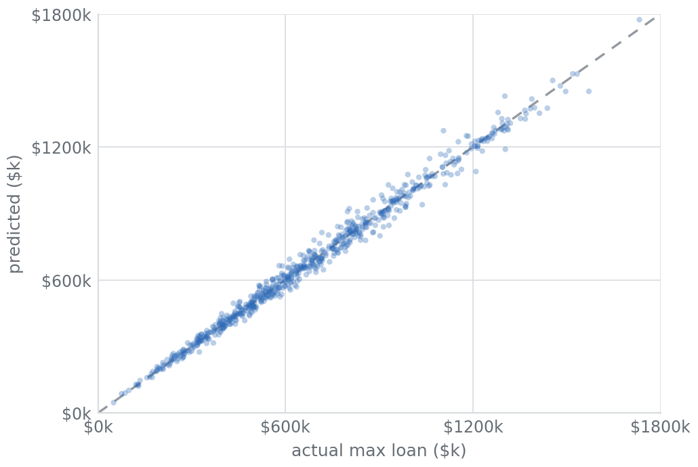
03 — VALIDATION VS HELD-OUT ACTUAL
It reproduces real decisions
0.990
$21,966
3.65%
94.9%
R²
MAE
MAPE
WITHIN ±10%
PREDICTED VS ACTUAL — 9,998 HELD-OUT APPLICANTS
MAX LOAN MODEL · METHODOLOGY
03 · VALIDATION

Slide 17
03 — ERROR STRUCTURE
Unbiased, and accurate across loan sizes
RESIDUALS (ACTUAL − PREDICTED), $K
MAPE BY LOAN-SIZE BAND
Residuals center on zero (no systematic over/under-lending). Absolute error grows with loan size but percentage error shrinks — most accurate on the largest loans.
MAX LOAN MODEL · METHODOLOGY
03 · ERROR STRUCTURE

Slide 18
03 — FEATURE IMPORTANCE
Permutation importance confirms the four
Income dominates (1.44), then credit score (0.65).
Existing debt (0.34) is a genuine third factor — capacity to repay.
Down payment (0.03) small but load-bearing.
All other features ≈ 0 — measured directly, not assumed.
DROP IN TEST R² WHEN THE FEATURE IS SHUFFLED
MAX LOAN MODEL · METHODOLOGY
03 · IMPORTANCE

Slide 19
03 — GOVERNANCE
Fair-lending posture
No protected attributes: the primary model uses no gender, marital status or age — supporting ECOA / fair-lending defensibility.
No obvious proxies: job and education (income proxies) were dropped; inputs are all direct financial measures.
Explainable: four inputs with monotonic, intuitive effects — straightforward to document for model risk and audit.
Monitor: track input drift and disparate-impact metrics once live on real decisions.
MAX LOAN MODEL · METHODOLOGY
03 · GOVERNANCE

Slide 20
03 — LIMITATIONS & ASSUMPTIONS
What to keep in mind
Synthetic-style data: relationships are cleaner and more deterministic than a real lending book — expect lower R² on production data.
Counter-intuitive debt sign: existing debt correlates positively with the limit here (likely an artifact); revisit on real data.
Mimics existing decisions: the model learns the bank's historical limit policy — it does not judge whether that policy is optimal or fair.
No macro / collateral context: property value, LTV, rates environment and affordability stress are out of scope here.
MAX LOAN MODEL · METHODOLOGY
03 · LIMITATIONS

Slide 21
03 — REPRODUCIBILITY
One command per stage
01
scripts/01_clean_data.py
Validate + audit → data/mortgage_clean.csv, metrics/cleaning_audit.csv
02
scripts/02_model_benchmark.py
Six model × scale combos → metrics/model_benchmark.csv
03
scripts/03_train_evaluate.py
Fit both models, validate → metrics + artifacts
04
scripts/04_build_presentations.js
These PPTX decks
05
scripts/05_build_html_decks.py
The HTML twins
Every figure in this deck traces back to the raw CSV through these scripts.
MAX LOAN MODEL · METHODOLOGY
03 · REPRODUCIBILITY

Slide 22
CONCLUSION
A compact, leakage-free model that reproduces the bank's loan limits to ~3.6% error — using just four financial inputs.
Next: shadow-mode pilot, review band at ±10%, retrain on a real decision book.
Then: add collateral / LTV context and affordability stress for production underwriting.
MAX LOAN MODEL · METHODOLOGY
CONCLUSION

Slide 23
APPENDIX
Data dictionary
Field | Type | Role in the model
Annual Income (USD) | num | Applicant income — top driver
Credit Score | num | 300–850; second driver
Existing Monthly Debt | num | Current monthly obligations
Down Payment (USD) | num | Cash toward purchase — kept
Interest Rate | num | Risk-based price — EXCLUDED
Age / Employment Years | num | Correlated; not used
Loans Repaid | num | Tracks credit score; not used
Gender / Married / Area | cat | No signal; not used
Education / Job | cat | Income proxies; not used
Max Loan Amount (USD) | num | TARGET — held out
MAX LOAN MODEL · METHODOLOGY
APPENDIX · DATA DICTIONARY

