Slide 1
Phenotype Covariance Ongoing Slides
Austin Szatrowski | 2026-02-27

Slide 2
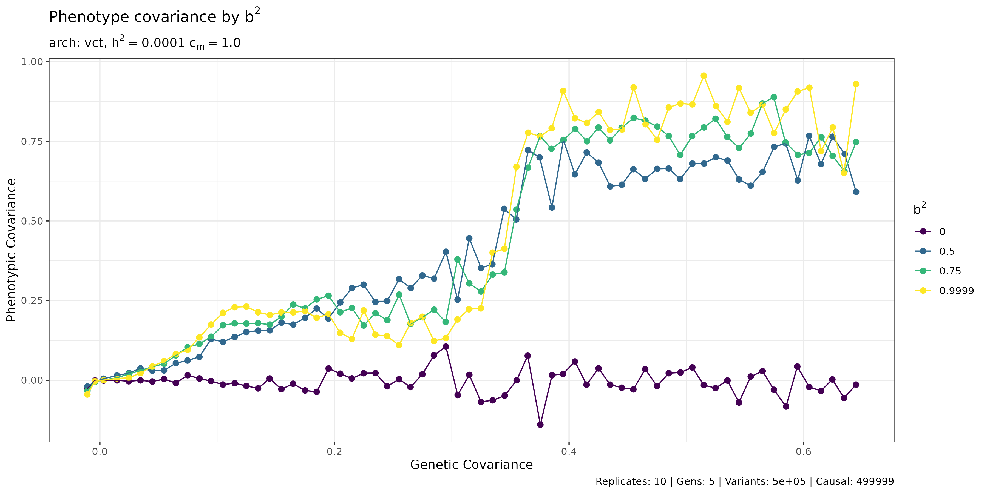
Curves don't separate at 5 generations

Slide 3
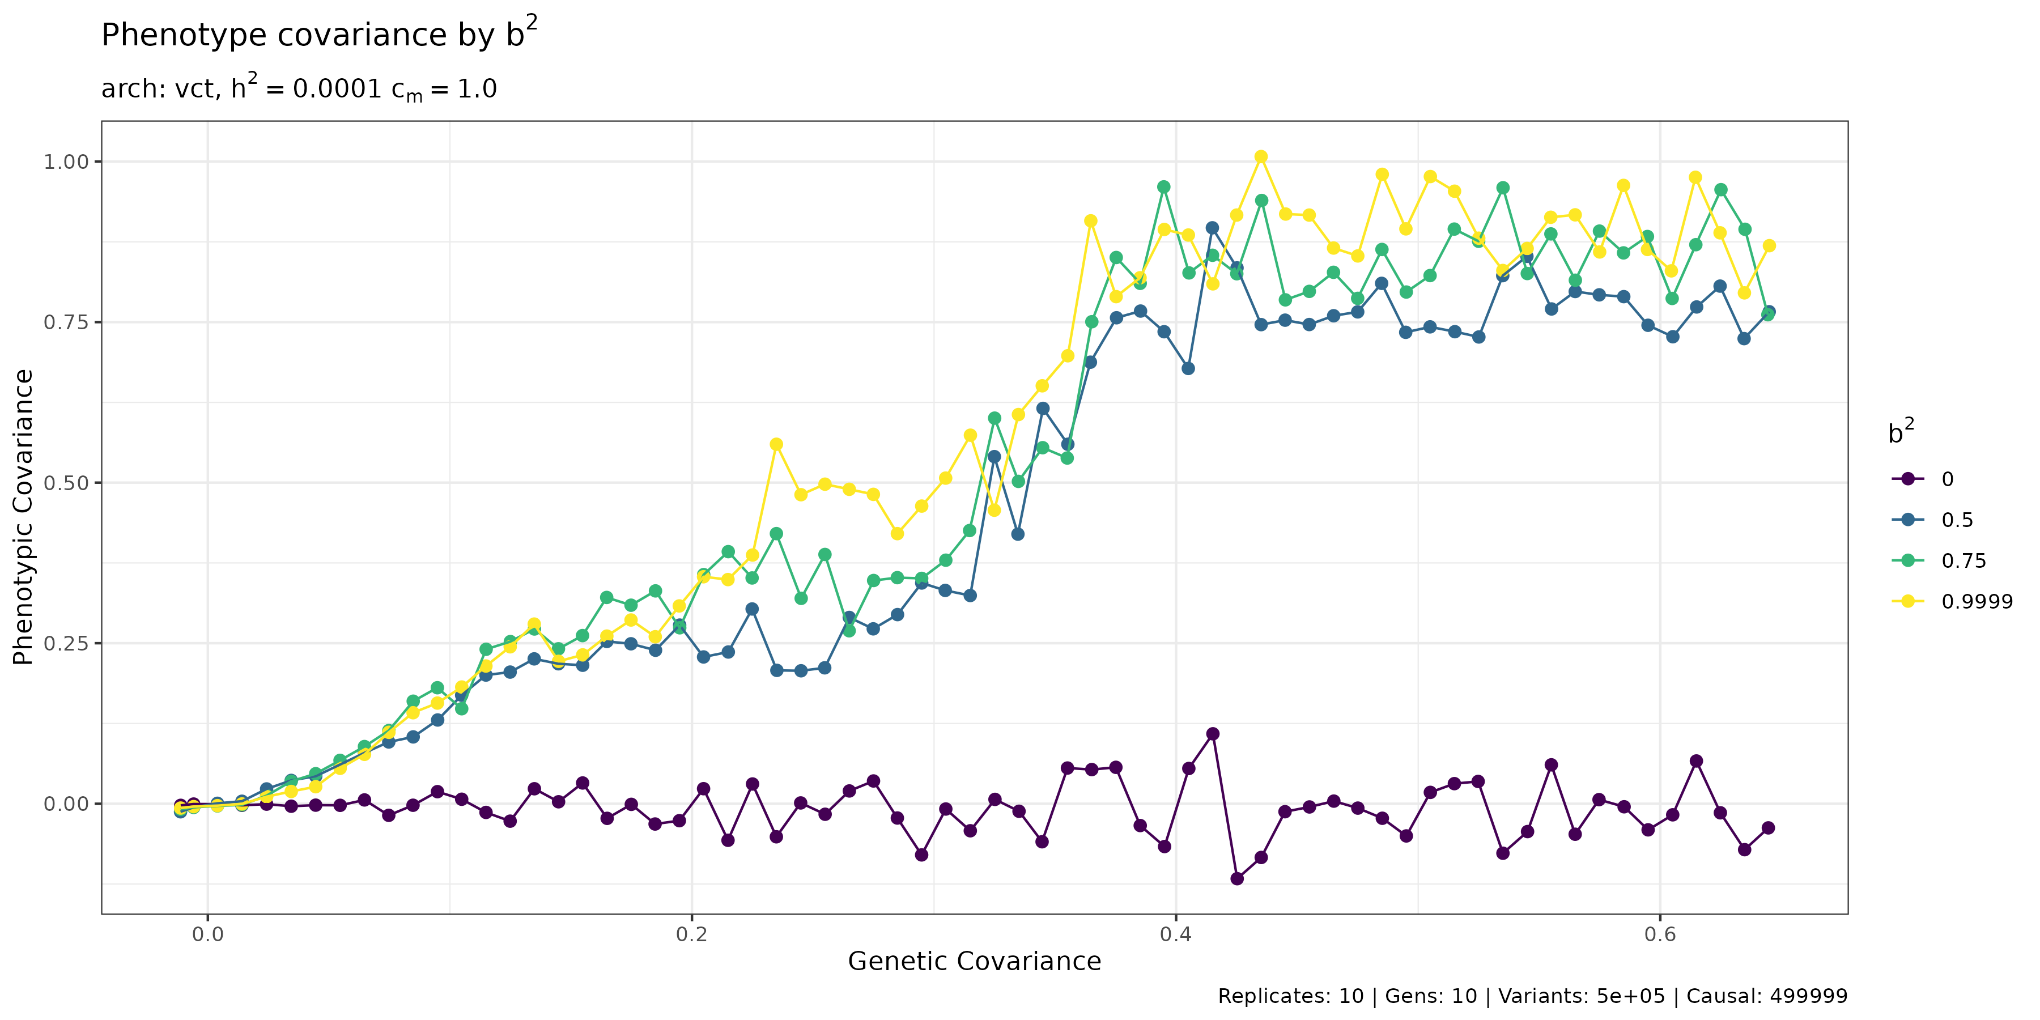

Slide 4
